Slide 1
CPS 210
Introduction to Operating Systems
Spring 2013
Jeff Chase
Duke University

Slide 2
Resources to know about
Course Web
http://www.cs.duke.edu/~chase/cps210
Or other links through CS department
All powerpoints, policies, reading, schedule, lab (project) instructions are posted there.
Piazza
Chatter. “Maybe even anonymous posting.”
Sakai
Minimal use, e.g., mainly for disseminating grades

Slide 3
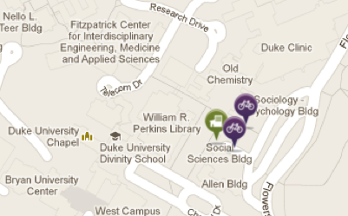
Meetings
“Lectures”:
MF 3:05 – 4:20
25 lectures total
Recitations
Monday in class slot, but Soc Sci 139
TA: Vamsi Thummala
Two midterms: 2/18 (recit) and 4/5 (in class)
“Light” final exam (1.5x): 5/2 7-10 PM

Slide 4
Monday
Recitations
Monday: 3:05-4:20 PM
Soc Sci 139: see maps.duke.edu
TA: Vamsi Thummala
This week: important info for P1: heap manager

Slide 5
What is this course about?
Platforms
Sharing
Concurrency
Storage
Protection and trust
Resource management
Virtualization
Scale and performance
Abstractions
User Applications
Operating System
Substrate / Architecture

Slide 6
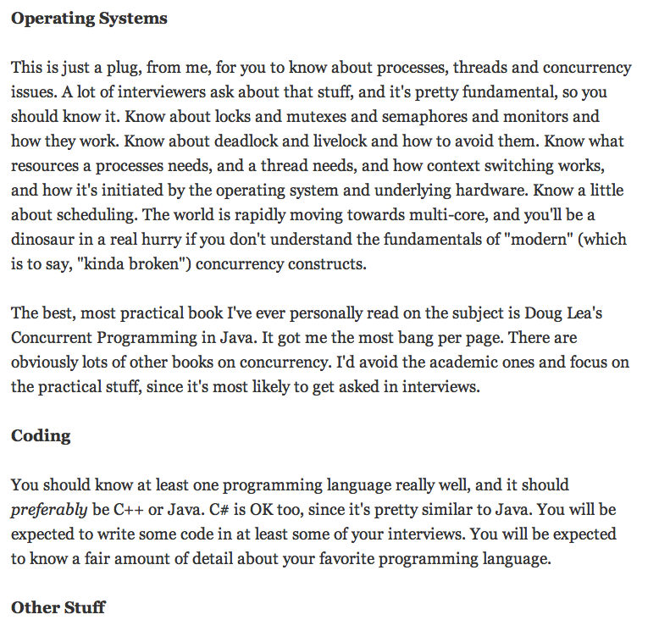
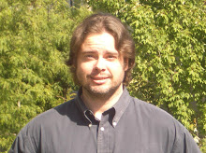
http://steve-yegge.blogspot.com/2008/03/get-that-job-at-google.html

Slide 7
What is this course about?
“Greater Unix”
Classical OS abstractions and structure
Systems programming with C and Unix
Networked systems
Sockets and servers, smartphones to clouds
Elementary cryptosystems
Distributed systems topics
Managing concurrency
Threads, multi-threaded Java
Managing storage and data
Files, caches, disks, recovery, content delivery

Slide 8
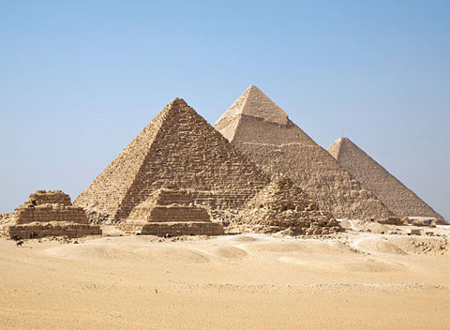
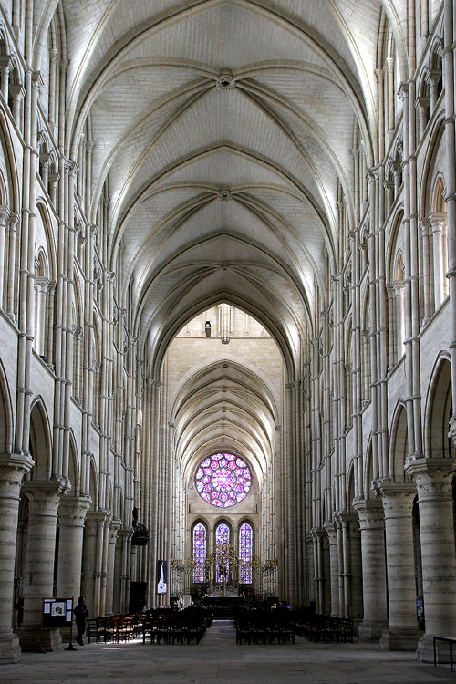
“Software Architecture”
User Applications
Software
architecture
Physics stops here.
Operating System(s)
Computer
architecture
Substrate / Architecture
Comparative architecture: what works
Reusable / recurring design patterns
Used in OS
Supported by OS

Slide 9
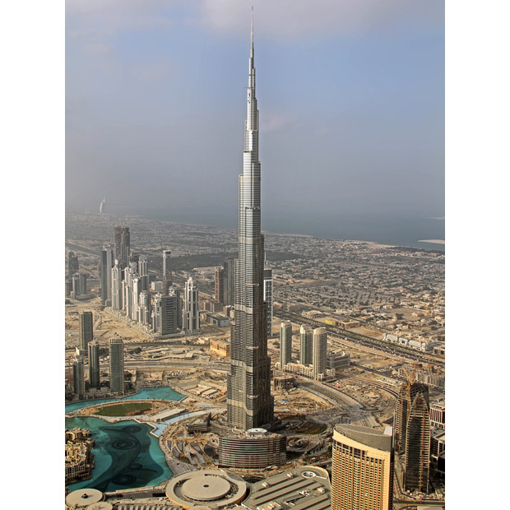
Systems as Architecture
Large, long-lived software systems are like buildings.
They are built by workers using standard design patterns.
They depend on some underlying infrastructure.
But they can evolve and are not limited by the laws of physics.

Slide 10
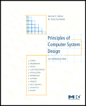
Managing Complexity
System
Systems are built from components.
Operating systems define styles of software components and how they interact.
OS maps components onto the underlying machine.
…and makes it all work together.
Component
Component
Component
Component
System
Environment

Slide 11
Abstraction
Separate:
Interface from internals
Specification from implementation
Abstraction is a double-edged sword.
“Don’t hide power.”
More than an interface…
This course is (partly) about the use of abstraction(s) in complex software systems.
We want abstractions that are simple, rich, efficient to implement, and long-lasting.

Slide 12
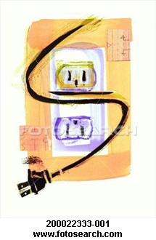
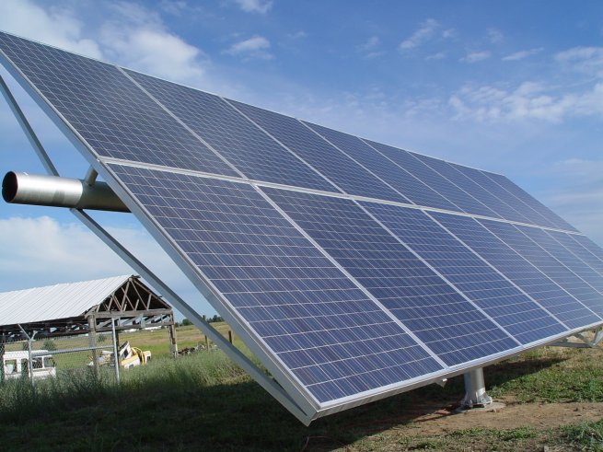
Interface and abstraction
Notes:
“Wasp waist” / hourglass

Slide 13
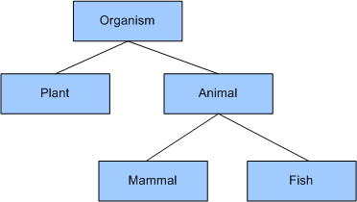
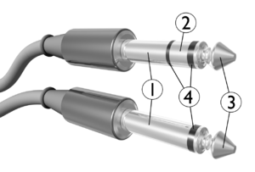
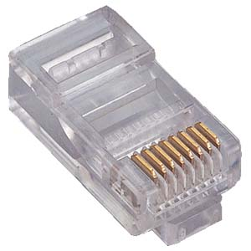
Abstraction(s)
A means to organize knowledge
Capture what is common and essential
Generalize and abstract away the details
Specialize as needed
Concept hierarchy
A design pattern or element
Templates for building blocks
Instantiate as needed
E.g.: class, subclass, and instance

Slide 14
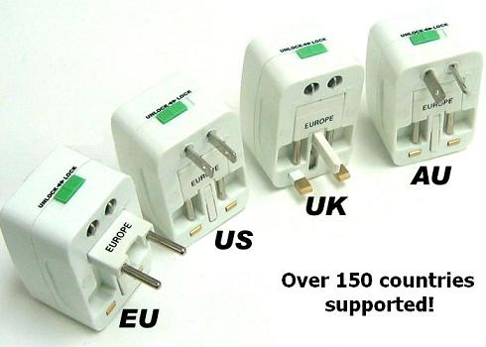
Standards, wrappers, adapters
“Plug-ins”
“Plug-compatible”
Another layer of software can overcome superficial or syntactic differences if the fundamental are right.

Slide 15
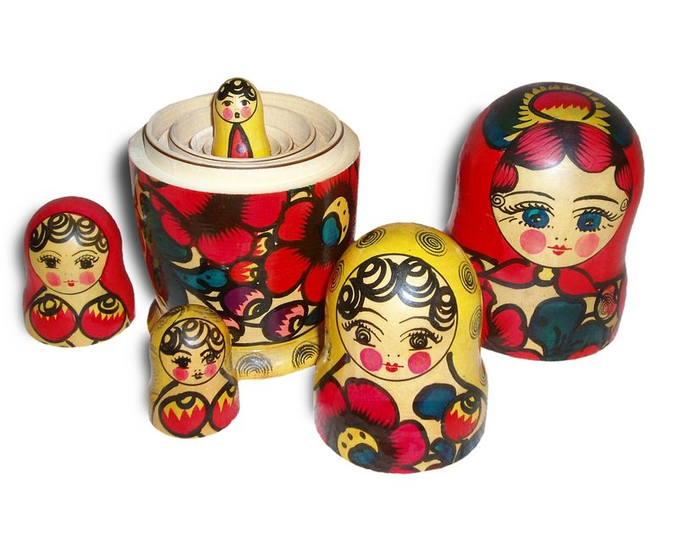
Platforms are layered/nested

Slide 16
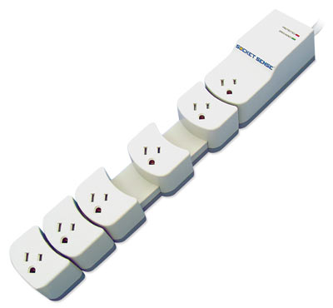
Virtualization?

Slide 17
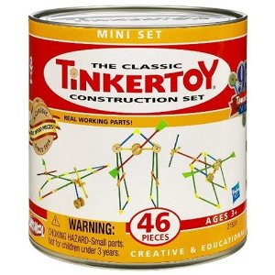
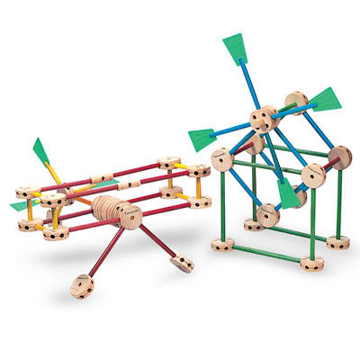
Platform abstractions
Platforms provide “building blocks”…
…and APIs to use them.
Instantiate/create/allocate
Manipulate/configure
Attach/detach
Combine in uniform ways
Release/destroy
Abstractions are layered.
What to expose? What to hide?
The choice of abstractions reflects a philosophy of how to build and organize software systems.

Slide 18
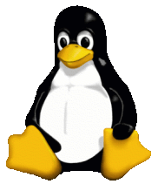
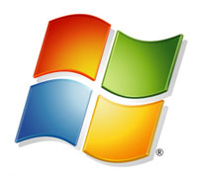
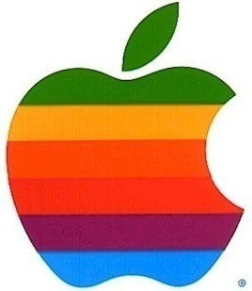
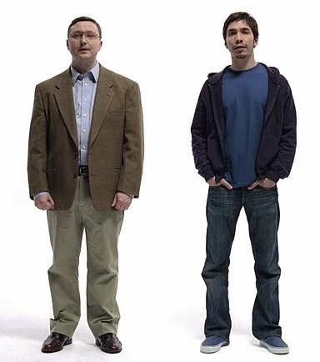
Canonical OS Example: “Classical OS”
Unix/Linux, Windows, OS-X
Research systems
Multics
Mach
Minix
…

Slide 19
Some lessons of history
At the time it was created, Unix was the “simplest multi-user OS people could imagine.”
It’s in the name: Unix vs. Multics
Simple abstractions can deliver a lot of power.
Many people have been inspired by the power of Unix.
The community spent four decades making Unix complex again....but the essence is unchanged.
Unix is a simple context to study core issues for classical OS design. “It’s in there.”
Unix variants continue to be in wide use.
They serve as a foundation for advances.

Slide 20
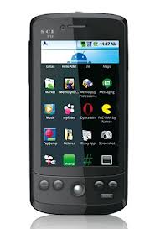
End-to-end application delivery
Where is your application?
Where is your data?
Where is your OS?
Cloud and Software-as-a-Service (SaaS)
Rapid evolution, no user upgrade, no user data management.
Agile/elastic deployment on virtual infrastructure.

Slide 21
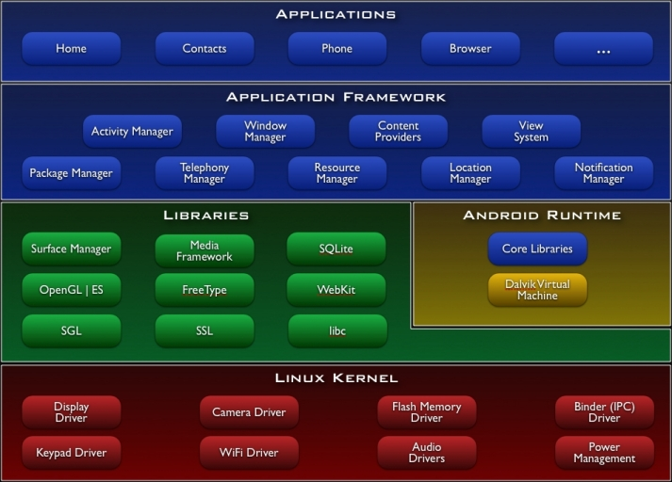
Virtual Machine
(JVM)
“Classical OS”
Reloaded.
[http://www.android.com]

Slide 22
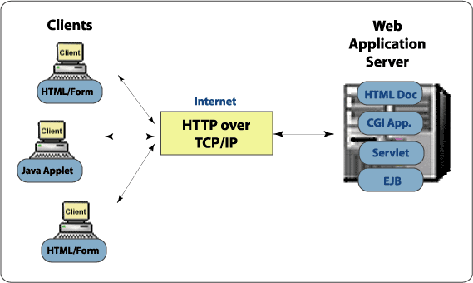
SaaS platform elements
container
browser
“Classical OS”
[wiki.eeng.dcu.ie]

Slide 23
Course prerequisites
Basic data structures and programming
Graphs, queues, trees, heap
Abstract data types (ADTs), classes, objects
Dynamic data structures, garbage collection
Basic discrete math and probability
Basic architecture
CPU context: registers
Execution: stacks and frames
Memory, storage, and caches
Virtual addressing and data layout

Slide 24
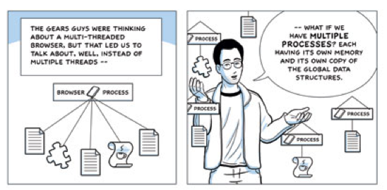
Reading
Course notes and slides
External sources on every topic
OS in Three Easy Pieces
A few academic papers and web readings
Yes, even a “comic book”
We’ll look at these with varying levels of scrutiny.

Slide 25
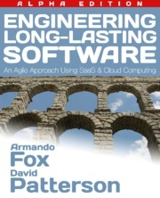
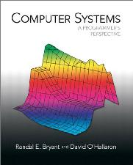
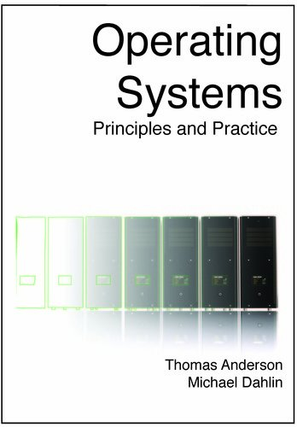
New!
$10!
Web/SaaS/cloud
http://saasbook.info
New! $75!
http://csapp.cs.cmu.edu
a classic
No text, but these may be useful.
Saltzer/Kaashoek
Very MIT
Do not buy kindle edition.

Slide 26
Workload: projects
Dynamic heap memory (malloc/free)
Unix shell (“Devil Shell”)
Java concurrency: multi-threaded programming (“Elevator”)
Key/value storage server (“Devil Filer”)
Performance evaluation of storage server

Slide 27
Collaboration
OK among groups:
General discussion of course concepts and programming environment.
“What does this part of the handout mean?”
Not OK among groups
Design/writing of another’s program
“How do I do this part of the handout?”
If in doubt, ask me.

Slide 28
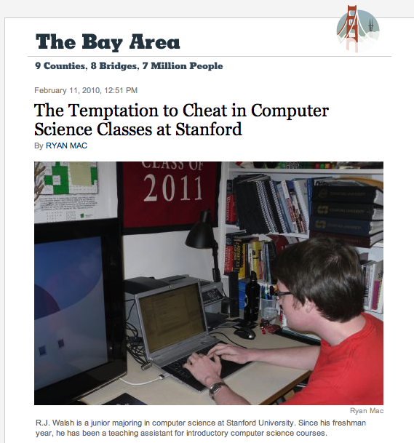
Thoughts on cheating
Cheating is a form of laziness.
Cheating happens at those other schools.
Duke students work hard and don’t cut corners.
Your work is your own: if in doubt, ask.
Listen to what shame tells you.

Slide 29
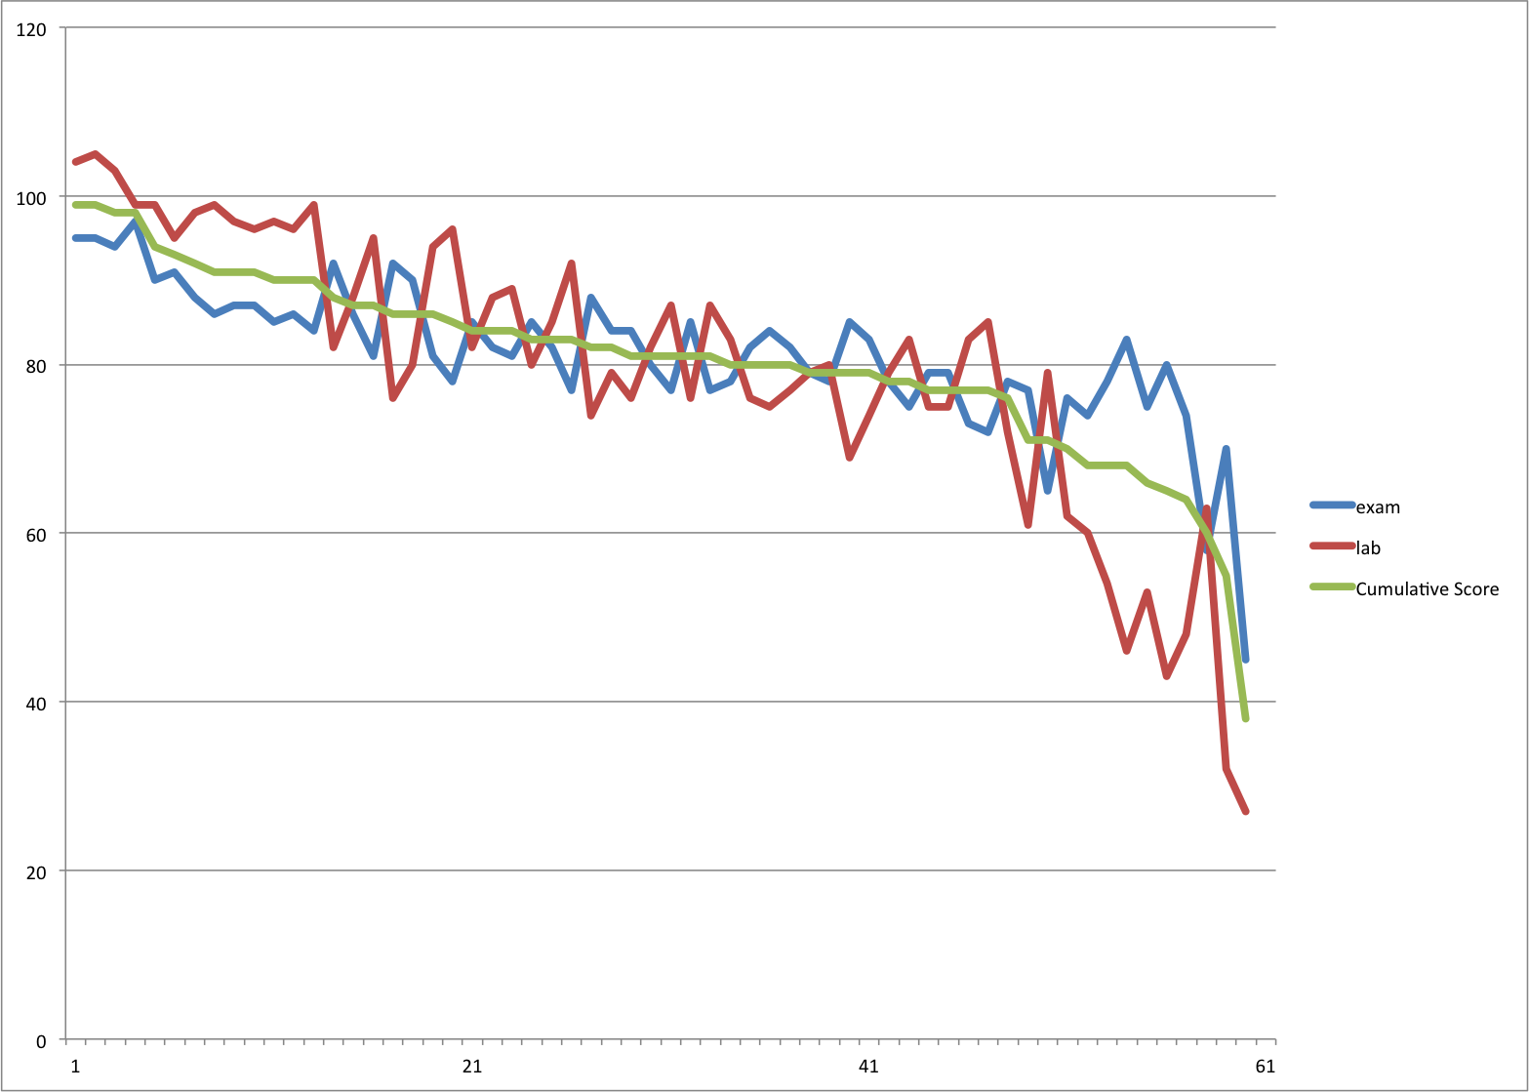
Grades: CPS 210 Fall 2012
4 A+
8 A
11 A-
13 B+
8 B
7 B-
9 C* or lower

Slide 30
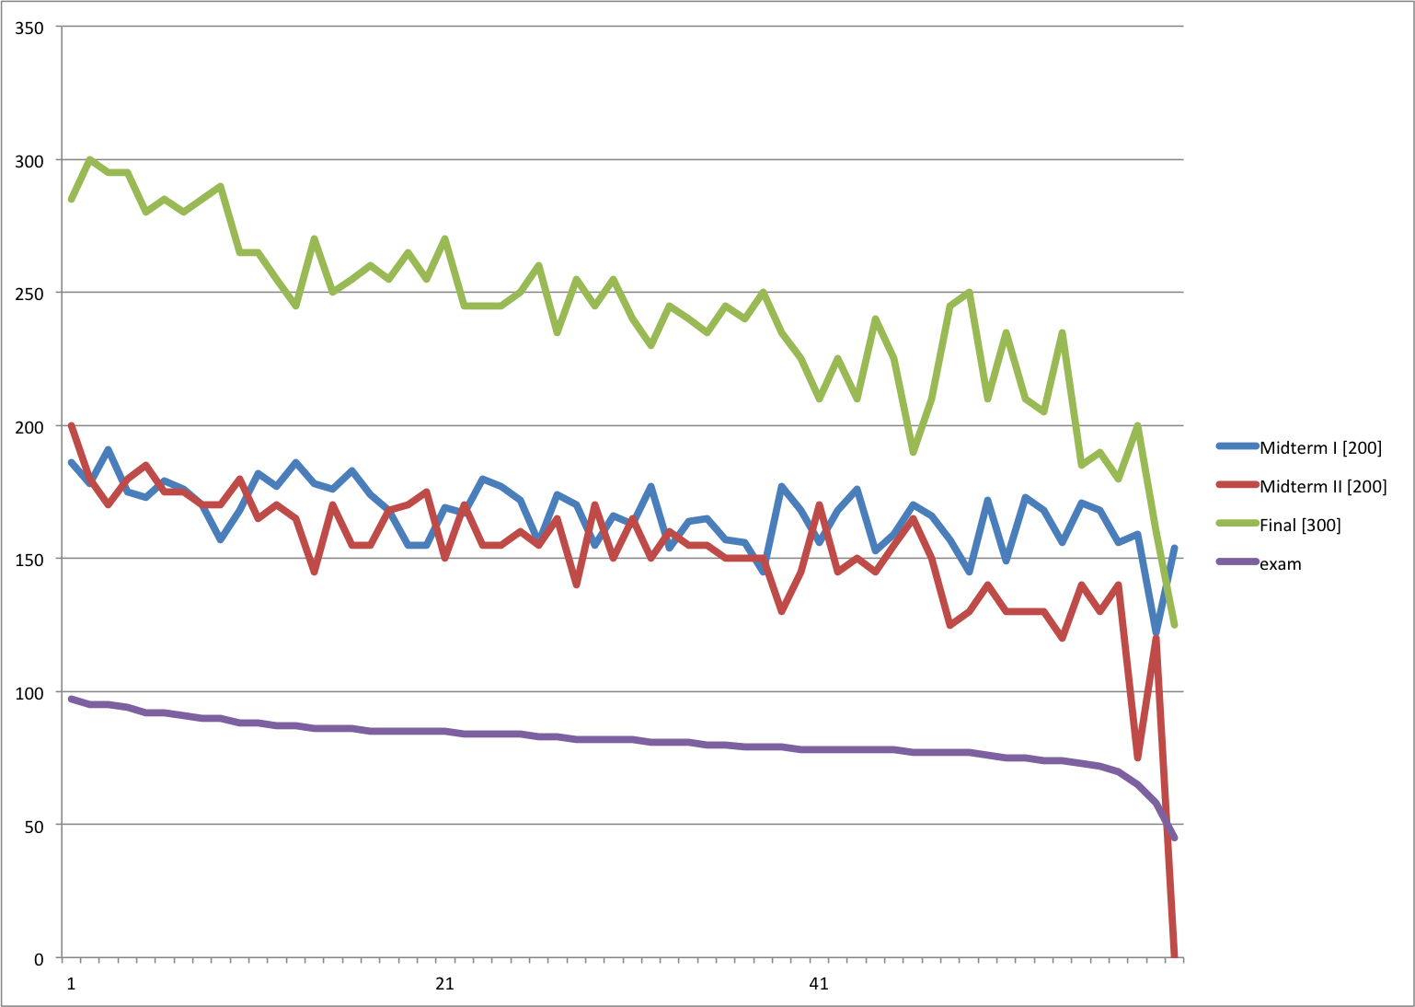

Slide 31
What’s in a program?

Slide 32
What’s in a program?
code
instructions (“text”)
procedures
data
global variables (“static”)
constants (“immutable”)
symbols (import/export)
names
interfaces
signatures
references
data

Slide 33
The Birth of a Program (C/Ux)
myprogram.c
myprogram.o
int j;
char* s = “hello\n”;
int p() {
j = write(1, s, 6);
return(j);
}
object file
assembler
data
data
data
data
…..
p:
store this
store that
push
jsr _write
ret
etc.
linker
libraries and other objects
compiler
myprogram.s
data
program
myprogram
(executable file)
Notes:
Executable images are also built from separately developed components (modules)...
separate compilation
symbol tables
...linked together by system utilities.
cross-module procedure calls and data references
relocation records and linkage sections
static link-and-load in “traditional” Unix
DLLs and shared libraries
importance of calling conventions

Slide 34
Running a program
data
Program
When a program launches, the platform allocates memory to store its code and data.

Slide 35
Running a program
code
constants
initialized data
imports/exports
symbols
types/interfaces
data
Program
“Unix Classic” simplifications
Context == process == (1 VAS + 1 thread + ...)
Each process runs exactly one program/component instance (at a time).
IPC channels are pipes.
All I/O is based on a simple common abstraction: file / stream.

Slide 36
VAS example (32-bit)
0x7fffffff
Reserved
An addressable array of bytes…
Containing every instruction the process thread can execute…
And every piece of data those instructions can read/write…
i.e., read/write == load/store
Partitioned into logical segments with distinct purpose and use.
Every memory reference by a thread is interpreted in its VAS context.
Resolve to a location in machine memory
A given address in different VAS may resolve to different locations.
Stack
Dynamic data
(heap/BSS)
Static data
Text
(code)
0x0

Slide 37
Protection / isolation
On most platforms, contexts are isolated.
They cannot interfere with one another, even if they are running the same program.
I.e., each context is its own “sandbox”.
The programs may fail independently.
In classical OS, a context is called a process.
Each has a private virtual address space.
Butler Lampson’s definition: “I am isolated if anything that goes wrong is my fault (or my program’s fault).”
Isolation might not be absolute.
E.g., the program instances may choose to interact, or may access shared data.

Slide 38
The Operating System
An operating system:
sets up the contexts
enforces isolation
mediates interactions
Applications trust the OS to do these things.
Any software platform for running application programs can be called an OS.

Slide 39
Running a program
Can a program launch multiple running instances on the same platform?
Program

Slide 40
Running a program
Can a program launch multiple running instances on the same platform?
Program
It depends.
On some platforms (e.g., Android) an app is either active or it is not.

Slide 41
Drivers of Change
Increasing diversity
Exponential growth
User Applications
Operating System
Substrate / Architecture
Aggregation
Composition
Orchestration
Backward compatibility
Broad view: smartphones to servers, web, and cloud.

Slide 42
Moore’s Law and CPU Performance
3X
From Hennessy and Patterson, Computer Architecture: A Quantitative Approach, 4th edition, 2006
⇒ Sea change in chip design: multiple “cores” or processors per chip
Uniprocessor Performance (SPECint)
Notes:
Note: Moore’s lLaw can be a driver of simplicity, since it may be less important to use resources efficiently.
But now the growth is slowing, which shifts more of a scaling burden onto software (cf blog post on Myhrvold).

Slide 43
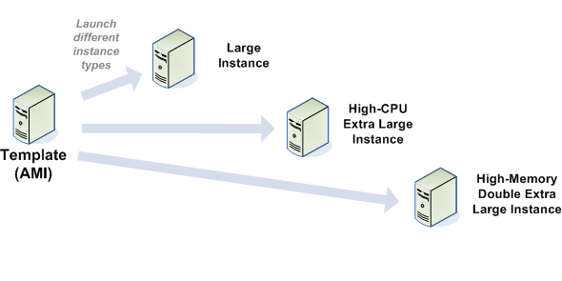
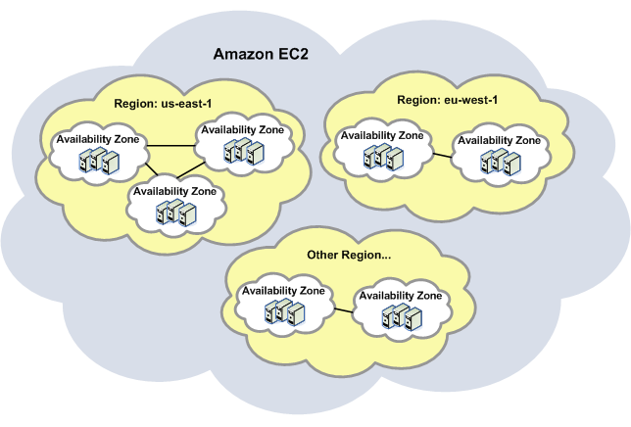
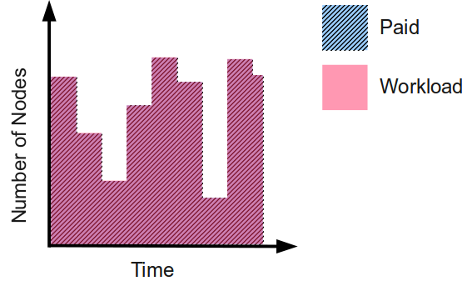
EC2 The canonical public cloud
Virtual Appliance Image

Slide 44
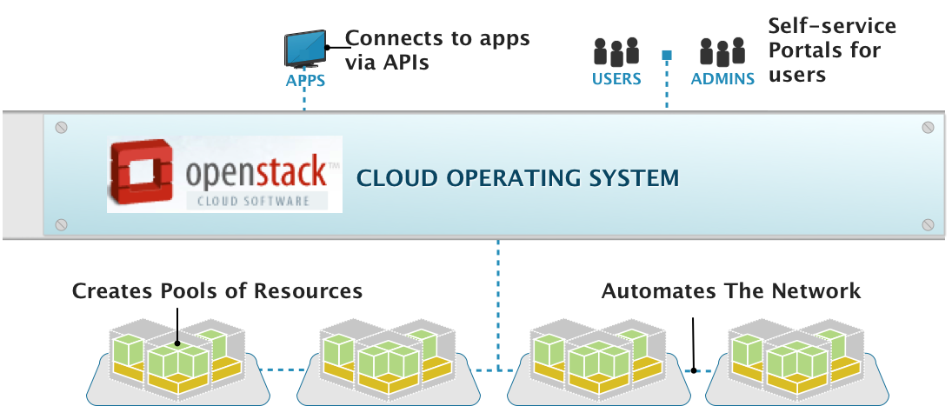
OpenStack, the Cloud Operating System
Management Layer That Adds Automation & Control
[Anthony Young @ Rackspace]

