Slide 1
Data Scaling
and Key-Value Stores
Jeff Chase
Duke University

Slide 2

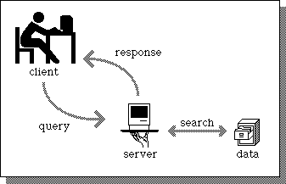
A service
Client
request
Web Server
client
reply
server
App Server
DB Server
Store

Slide 3
Scaling a service
Dispatcher
Work
Support substrate
Server cluster/farm/cloud/grid
Data center
Add servers or “bricks” for scale and robustness.
Issues: state storage, server selection, request routing, etc.

Slide 4

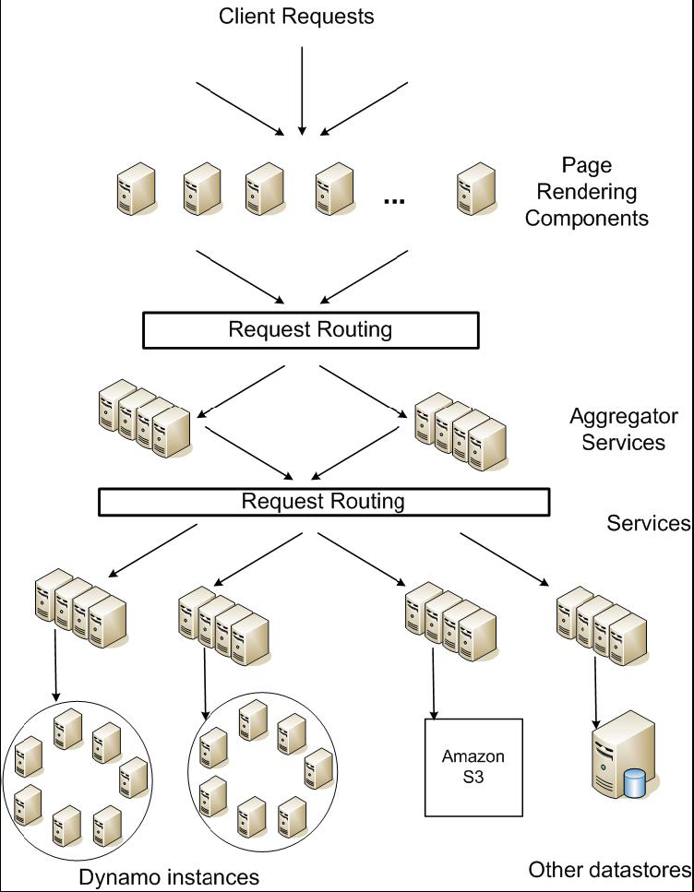
Service-oriented architecture of
Amazon’s platform

Slide 5

The Steve Yegge rant, part 1
Products vs. Platforms
Selectively quoted/clarified from http://steverant.pen.io/, emphasis added. This is an internal google memorandum that ”escaped”. Yegge had moved to Google from Amazon. His goal was to promote service-oriented software structures within Google.
So one day Jeff Bezos [CEO of Amazon] issued a mandate....[to the developers in his company]:
His Big Mandate went something along these lines:
1) All teams will henceforth expose their data and functionality through service interfaces.
2) Teams must communicate with each other through these interfaces.
3) There will be no other form of interprocess communication allowed: no direct linking, no direct reads of another team's data store, no shared-memory model, no back-doors whatsoever. The only communication allowed is via service interface calls over the network.

Slide 6
The Steve Yegge rant, part 2
Products vs. Platforms
4) It doesn't matter what technology they use. HTTP, Corba, PubSub, custom protocols -- doesn't matter. Bezos doesn't care.
5) All service interfaces, without exception, must be designed from the ground up to be externalizable. That is to say, the team must plan and design to be able to expose the interface to developers in the outside world. No exceptions.
6) Anyone who doesn't do this will be fired.
7) Thank you; have a nice day!

Slide 7
Challenge: data management
Data volumes are growing enormously.
Mega-services are “grounded” in data.
How to scale the data tier?
  Scaling requires dynamic placement of data items across data servers, so we can grow the number of servers.
  Caching helps to reduce load on the data tier.
  Replication helps to survive failures and balance read/write load.
  E.g., alleviate hot-spots by spreading read load across multiple data servers.
  Caching and replication require careful update protocols to ensure that servers see a consistent view of the data.
  What is consistent? Is it a property or a matter of degrees?

Slide 8
Scaling database access
Many services are data-driven.
  Multi-tier services: the “lowest” layer is a data tier with authoritative copy of service data.
Data is stored in various stores or databases, some with advanced query API.
  e.g., SQL
Databases are hard to scale.
  Complex data: atomic, consistent, recoverable, durable. (“ACID”)
web
servers
SQL query API
database servers
SQL: Structured Query Language
Caches can help if much of the workload is simple reads.

Slide 9
Memcached
memcached servers
“Memory caching daemon”
It’s just a key/value store
Scalable cluster service
  array of server nodes
  distribute requests among nodes
  how? distribute the key space
  scalable: just add nodes
Memory-based
LRU object replacement
Many technical issues:
get/put API
etc…
web
servers
SQL query API
database servers
Multi-core server scaling, MxN communication, replacement, consistency

Slide 10
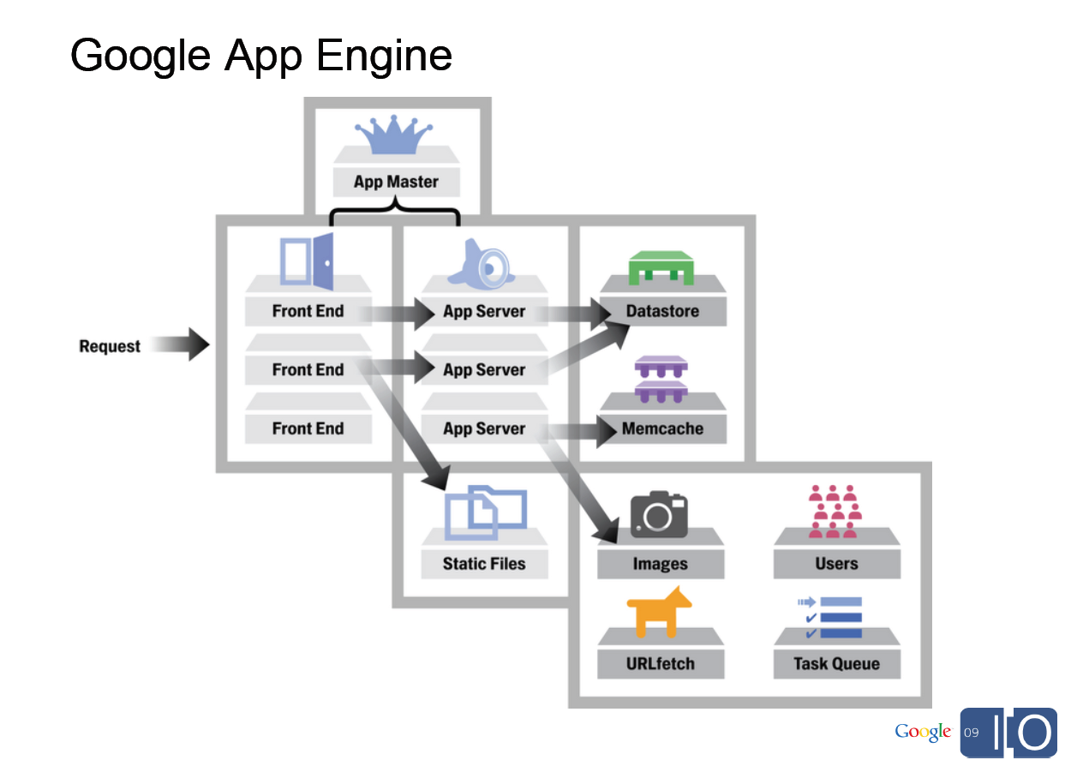
[From Spark Plug to Drive Train: The Life of an App Engine Request, Along Levi, 5/27/09]

Slide 11

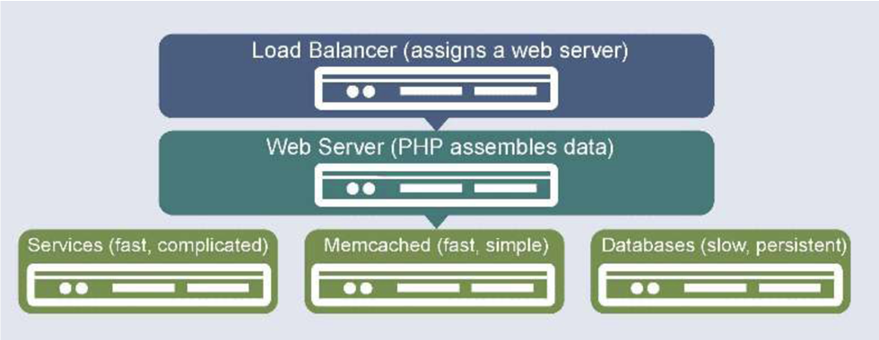

Slide 12
“Soft” state vs. “hard” state
State is “soft” if the service can continue to function even if the state is lost.
  Rebuild it
  Restart it
  Limp along without it
“Hard” state is necessary for correct function
  User data
  Billing records
  Durable!
“But it’s a spectrum.”
Internet routers: soft state or hard?

Slide 13
ACID vs. BASE
A short cultural history lesson.
“ACID” data is hard state with strong consistency and durability requirements.
  Atomicity, Consistency, Isolation, Durability
  Serialized compound updates (transactions)
Fox&Brewer SOSP 1997 defined a “new” model for state in Internet services: BASE.
  Basically Available, Soft State, Eventually Consistent

Slide 14
“ACID” Transactions
Transactions group a sequence of operations, often on different objects.
BEGIN T1
read X
read Y
…
write X
COMMIT
BEGIN T2
read X
write Y
…
write X
COMMIT

Slide 15
Serial schedule
T1
T2
Tn
S0
S1
S2
Sn
Consistent States
A consistent state is one that does not violate any internal invariant relationships in the data.
Transaction bodies must be coded correctly!

Slide 16
ACID properties of transactions
Transactions are Atomic
  Each transaction either commits or aborts: it either executes entirely or not at all.
  Transactions don’t interfere with one another (I).
Transactions appear to commit in some serial order (serializable schedule).
    Each transaction is coded to transition the store from one Consistent state to another.
    One-copy serializability (1SR): Transactions observe the effects of their predecessors, and not of their successors.
Transactions are Durable.
  Committed effects survive failure.

Slide 17
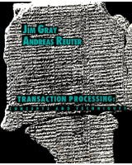
Transactions: References
Gold standard
Jim Gray and Andreas Reuter
Transaction Processing:
Concepts and Techniques
Comprehensive Tutorial
Michael J. Franklin
Concurrency Control and Recovery
1997
Industrial Strength
C. Mohan, D. Haderle, B. Lindsay, H. Pirahesh
ARIES: a transaction recovery method supporting fine-granularity locking and partial rollbacks using write-ahead logging
ACM Transactions on Database Systems, March 1992

Slide 18
Limits of Transactions?
Why not use ACID transactions for everything?
How much work is it to serialize and commit transactions?
E.g., what if I want to add more servers?
What if my servers are in data centers all over the world?
“How much consistency do we really need?”
What kind of question is that?

Slide 19
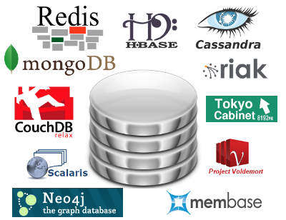

Do we need DB tables and transactions?
Can built rich-functioned services on a scalable data tier that is “less” than an ACID database or even a consistent file system?
People talk about the “NoSQL Movement”.
But there’s a long history, even before BASE ….

Slide 20


Key-value stores
Over the next couple of years, Amazon transformed internally into a service-oriented architecture. They learned a tremendous amount…
- pager escalation gets way harder….build a lot of scaffolding and metrics and reporting.
- every single one of your peer teams suddenly becomes a potential DOS attacker. Nobody can make any real forward progress until very serious quotas and throttling are put in place in every single service.
- monitoring and QA are the same thing. You'd never think so until you try doing a big SOA. But when your service says "oh yes, I'm fine", it may well be the case that the only thing still functioning in the server is the little component that knows how to say "I'm fine, roger roger, over and out" in a cheery droid voice. In order to tell whether the service is actually responding, you have to make individual calls. The problem continues recursively until your monitoring is doing comprehensive semantics checking of your entire range of services and data, at which point it's indistinguishable from automated QA. So they're a continuum.
- if you have hundreds of services, and your code MUST communicate with other groups' code via these services, then you won't be able to find any of them without a service-discovery mechanism. And you can't have that without a service registration mechanism, which itself is another service. So Amazon has a universal service registry where you can find out reflectively (programmatically) about every service, what its APIs are, and also whether it is currently up, and where.
- debugging problems with someone else's code gets a LOT harder, and is basically impossible unless there is a universal standard way to run every service in a debuggable sandbox.
That's just a very small sample. There are dozens, maybe hundreds of individual learnings like these that Amazon had to discover organically. There were a lot of wacky ones around externalizing services, but not as many as you might think. Organizing into services taught teams not to trust each other in most of the same ways they're not supposed to trust external developers.
This effort was still underway when I left to join Google in mid-2005, but it was pretty far advanced. From the time Bezos issued his edict through the time I left, Amazon had transformed culturally into a company that thinks about everything in a services-first fashion. It is now fundamental to how they approach all designs, including internal designs for stuff that might never see the light of day externally.
Many mega-services are built on key-value stores.
  Store variable-length content objects: think “tiny files” (value)
  Each object is named by a “key”, usually fixed-size.
  Key is also called a token: not to be confused with a crypto key! Although it may be a content hash (SHAx or MD5).
  Simple put/get interface with no offsets or transactions (yet).
  Goes back to literature on Distributed Data Structures [Gribble 1998] and Distributed Hash Tables (DHTs).
[image from Sean Rhea, opendht.org]

Slide 21
Key-value stores
Data objects named in a “flat” key space (e.g., “serial numbers”)
K-V is a simple and clean abstraction that admits a scalable, reliable implementation: a major focus of R&D.
Is put/get sufficient to implement non-trivial apps?
Distributed application
put(key, data)
get (key)
data
Distributed hash table
lookup(key)
node IP address
Lookup service
node
node
….
node
[image from Morris, Stoica, Shenker, etc.]

Slide 22

Scalable key-value stores
Can we build massively scalable key/value stores?
  Balance the load.
  Find the “right” server(s) for a given key.
  Adapt to change (growth and “churn”) efficiently and reliably.
  Bound the spread of each object.
Warning: it’s a consensus problem!
What is the consistency model for massive stores?
  Can we relax consistency for better scaling? Do we have to?

Slide 23
Service-oriented architecture of
Amazon’s platform

Slide 24
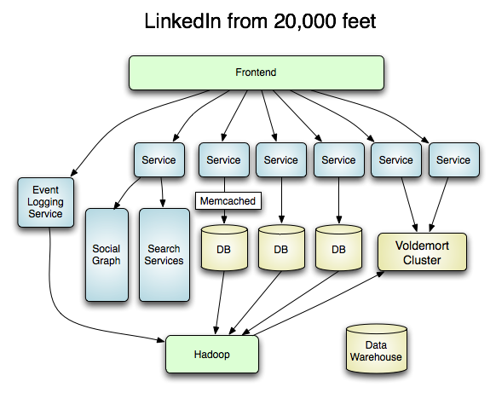
Voldemort: an open-source K-V store based on Amazon’s Dynamo.

Slide 25


ACID vs. BASE
Jim Gray
ACM Turing Award 1998
Eric Brewer
ACM SIGOPS
Mark Weiser Award
2009

Slide 26
ACID vs. BASE
BASE
Weak consistency
  stale data OK
Availability first
Best effort
Approximate answers OK
Aggressive (optimistic)
“Simpler” and faster
Easier evolution (XML)
“wide” Invariant Boundary
Outside consistency boundary
ACID
Strong consistency
Isolation
Focus on “commit”
Nested transactions
Availability?
Conservative (pessimistic)
Difficult evolution
(e.g. schema)
“small” Invariant Boundary
The “inside”
but it’s a spectrum

Slide 27


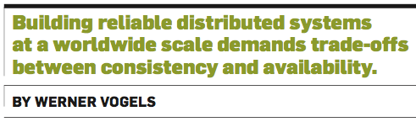
Dr. Werner Vogels is Vice President & Chief Technology Officer at Amazon.com.
Prior to joining Amazon, he was on the faculty at Cornell University.

Slide 28

Vogels on consistency
The scenario
A updates a “data object” in a “storage system”.
Consistency “has to do with how observers see these updates”.
Strong consistency: “After the update completes, any subsequent access will return the updated value.”
Eventual consistency: “If no new updates are made to the object, eventually all accesses will return the last updated value.”

Slide 29

Concurrency and time
A
B
C
C
What do these words mean?
after?
last?
subsequent?
eventually?

Slide 30
Same world, different timelines
Which happened first?
Message send
W(x)=v
e3a
A
e1a
e2
“Event e1a wrote W(x)=v”
e1b
e3b
e4
B
R(x)
Message receive
R(x)
Events in a distributed system have a partial order. There is no common linear time!
Can we be precise about when order matters?
Time, Clocks, and the Ordering of Events in Distributed Systems, by Leslie Lamport, CACM 21(7), July 1978

Slide 31
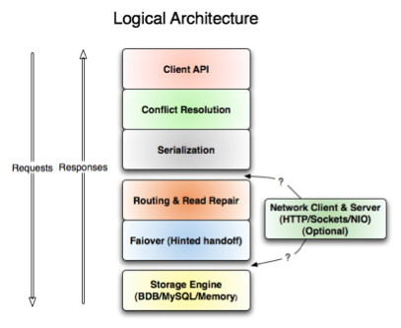
Inside Voldemort
Read from multiple replicas: what if they return different versions?
How is the key space partitioned among the servers?
put/get API at every layer
How to change the partitioning if nodes stutter or fail?
How does each server manage its underlying storage?

Slide 32


Slide 33
Post-note
We didn’t cover these last slides.
They won’t be tested.
They are left here for completeness.

Slide 34

Tricks: consistent hashing
Consistent hashing is a technique to assign data objects (or functions) to servers
Key benefit: adjusts efficiently to churn.
  Adjust as servers leave (fail) and join (recover)
Used in Internet server clusters and also in distributed hash tables (DHTs) for peer-to-peer services.
Developed at MIT for Akamai CDN
Consistent hashing and random trees: distributed caching protocols for relieving hot spots on the WWW. Karger, Lehman, Leighton, Panigrahy, Levine, Lewin. ACM STOC, 1997. 1000+ citations

Slide 35
Partition the Key Space
Each node will store some k,v pairs
Given a key space K, e.g. [0, 2¹⁶⁰):
  Choose an identifier for each node, id_{i} ∈ K, uniformly at random
  A pair k,v is stored at the node whose identifier is closest to k
0
2¹⁶⁰
[Sean Rhea]

Slide 36

Consistent Hashing
Bruce Maggs
Idea: Map both objects and buckets to unit circle.
object
bucket
new bucket
Assign object to next bucket on circle in clockwise order.
[Bruce Maggs]

Slide 37
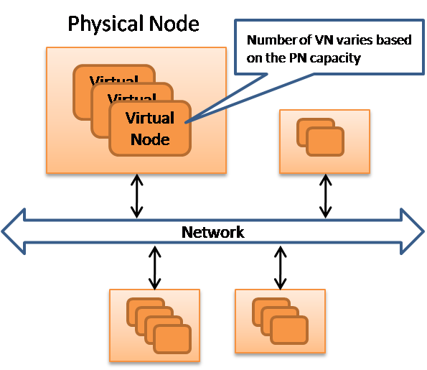
Tricks: virtual nodes
Trick #1: virtual nodes
  Assign multiple buckets to each physical node.
  Can fine-tune load balancing by adjusting the assignment of buckets to nodes.
  bucket == “virtual node”
Not to be confused with file headers called “virtual nodes” or vnodes in many file systems!

Slide 38
Tricks: leaf sets
Trick #2: leaf sets
  Replicate each object in a sequence of D buckets: target bucket and immediate successors.
How to find the successor of a node?
N5
N110
N10
K19
N20
N99
K19
Wide-area cooperative storage with CFS. Frank Dabek, M. Frans Kaashoek, David Karger, Robert Morris, Ion Stoica. SOSP 2001.
1600+ cites. DHash
N32
N40
K19
N80
N60
[image from Morris, Stoica, Shenker, etc.]

Slide 39
Tricks: content hashing
Trick #3: content hashing
  For storage applications, the hash key for an object or block can be the hash of its contents.
  The key acts as an authenticated pointer.
    If a node produces a value matching the hash, it “must be” the right value.
  An entire tree of such objects is authenticated by the hash of its root object.
Wide-area cooperative storage with CFS. Frank Dabek, M. Frans Kaashoek, David Karger, Robert Morris, Ion Stoica. SOSP 2001.
1600+ cites. DHash

Slide 40


Replicated Servers
X
Servers
Clients
[Barbara Liskov]
Notes:
40

Slide 41
Quorums
State:
…
State:
…
State:
…
Servers
X
write A
write A
write A
Clients
[Barbara Liskov]
Notes:
41

Slide 42
Quorums
State:
…
State:
…
State:
…
A
A
X
Servers
Clients
[Barbara Liskov]
Notes:
42

Slide 43
Quorums
State:
…
State:
…
State:
…
A
A
X
Servers
X
write B
write B
write B
Clients
[Barbara Liskov]
Notes:
43

Slide 44
Quorum Consensus
Each data item has a version number
  A sequence of values
write(d, val, v#)
  Waits for f+1 oks
read(d) returns (val, v#)
  Waits for f+1 matching v#’s
  Else does a write-back of latest received version to the stale replicas
[Barbara Liskov]

Slide 45
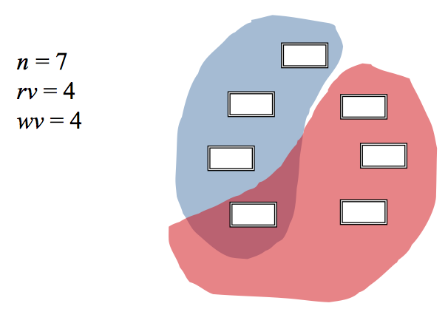
Quorum consistency
n = 7 nodes
Example
rv=wv=f
where n=2f+1
Read from at least rv servers (read quorum).
Write to at least wv servers (write quorum).
[Keith Marzullo]

Slide 46
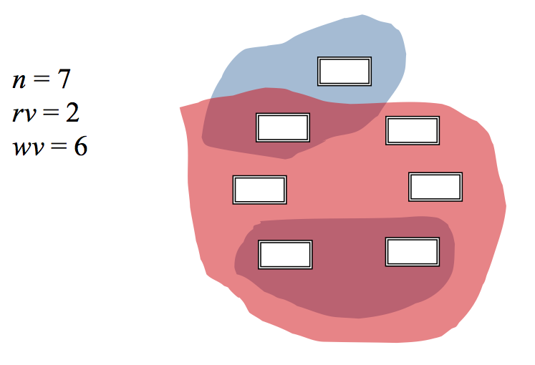
Weighted quorum voting
Choose rv and wv
so that rv+wv=n+1
Any write quorum intersects every other quorum.
“Guaranteed” that a read will see the last write.
[Keith Marzullo]

Slide 47
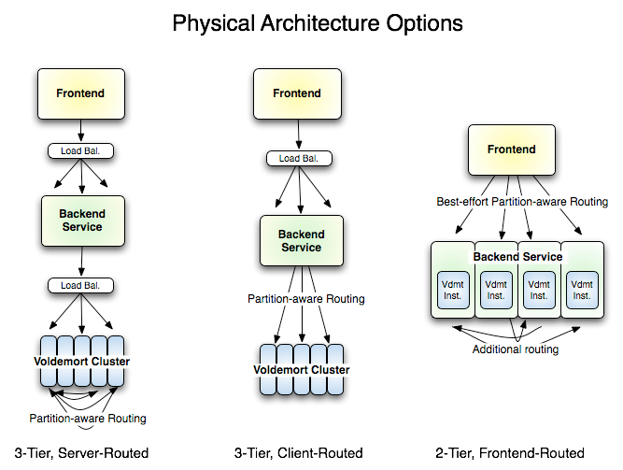

Slide 48
Caches are everywhere
Inode caches, directory entries (name lookups), IP address mappings (ARP table), …
All large-scale Web systems use caching extensively to reduce I/O cost.
Memory cache may be a separate shared network service.
Web content delivery networks (CDNs) cache content objects in web proxy servers around the Internet.

Slide 49
Issues
How to be sure that the cached data is consistent with the “authoritative” copy of the data?
Can we predict the hit ratio in the cache? What factors does it depend on?
  “popularity”: distribution of access frequency
  update rate: must update/invalidate cache on a write
What is the impact of variable-length objects/values?
  Metrics must distinguish byte hit ratio vs. object hit ratio.
  Replacement policy may consider object size.
What if the miss cost is variable? Should the cache design consider that?

Slide 50
Caching in the Web
Web “proxy” caches are servers that cache Web content.
Reduce traffic to the origin server.
Deployed by enterprises to reduce external network traffic to serve Web requests of their members.
Also deployed by third-party companies that sell caching service to Web providers.
  Content Delivery/Distribution Network (CDN)
  Help Web providers serve their clients better.
  Help absorb unexpected load from “flash crowds”.
  Reduce Web server infrastructure costs.

Slide 51
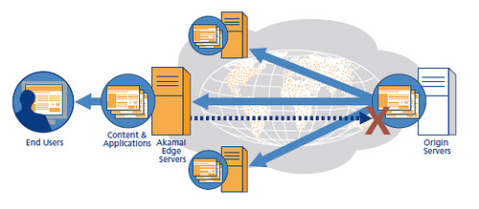

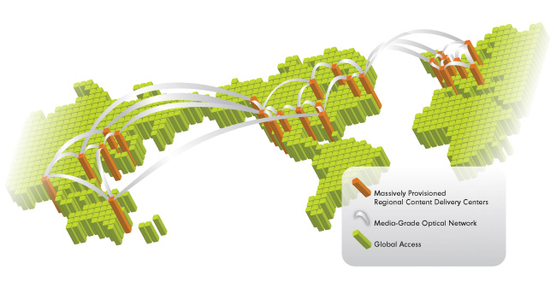

Content Delivery Network (CDN)

Slide 52
Zipf popularity
Web accesses can be modeled using Zipf-like probability distributions.
  Rank objects by popularity: lower rank i ==> more popular.
  The probability that any given reference is to the ith most popular object is given by p_{i}
Zipf says: p_{i} is proportional to 1/i^{α}
  “frequency is inversely proportional to rank”
  α parameter with 0 < α < 1
  Higher α gives more skew: popular objects are way popular.
  Lower α gives a more heavy-tailed distribution.
  In the Web, α ranges from 0.6 to 0.8 [Breslau/Cao99].
  With α=0.8, 0.3% of the objects get 40% of requests.

Slide 53
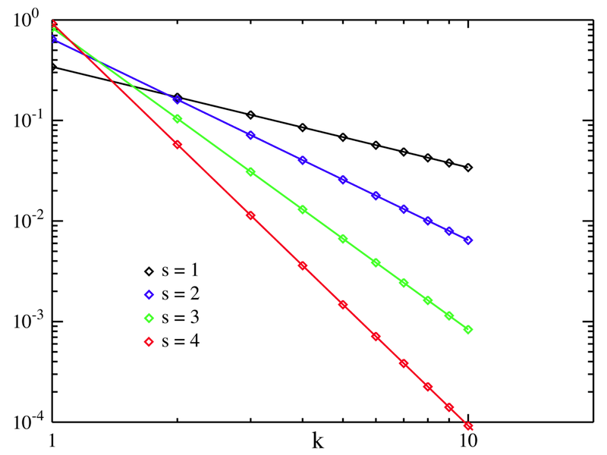
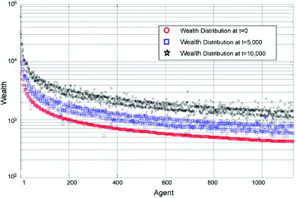
Zipf
log-log scale
x: log rank
y: log share of accesses
“head”
x: rank
y: log $$$
“tail”

Slide 54
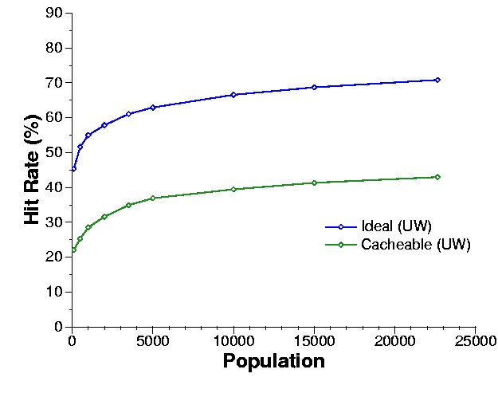
Hit rates of Internet caches
It turns out this matters.
With Zipf power-law popularity distributions, the best possible (ideal) hit rate of a cache is logarithmic in its size.
…and logarithmic in the population served.
The hit rate also depends on how frequently objects are updated at their source.
Wolman/Voelker/Levy 1997
Intuition. The “head” (most popular objects) is cached easily. After that: diminishing benefits. The “tail” is effectively random.

Slide 55
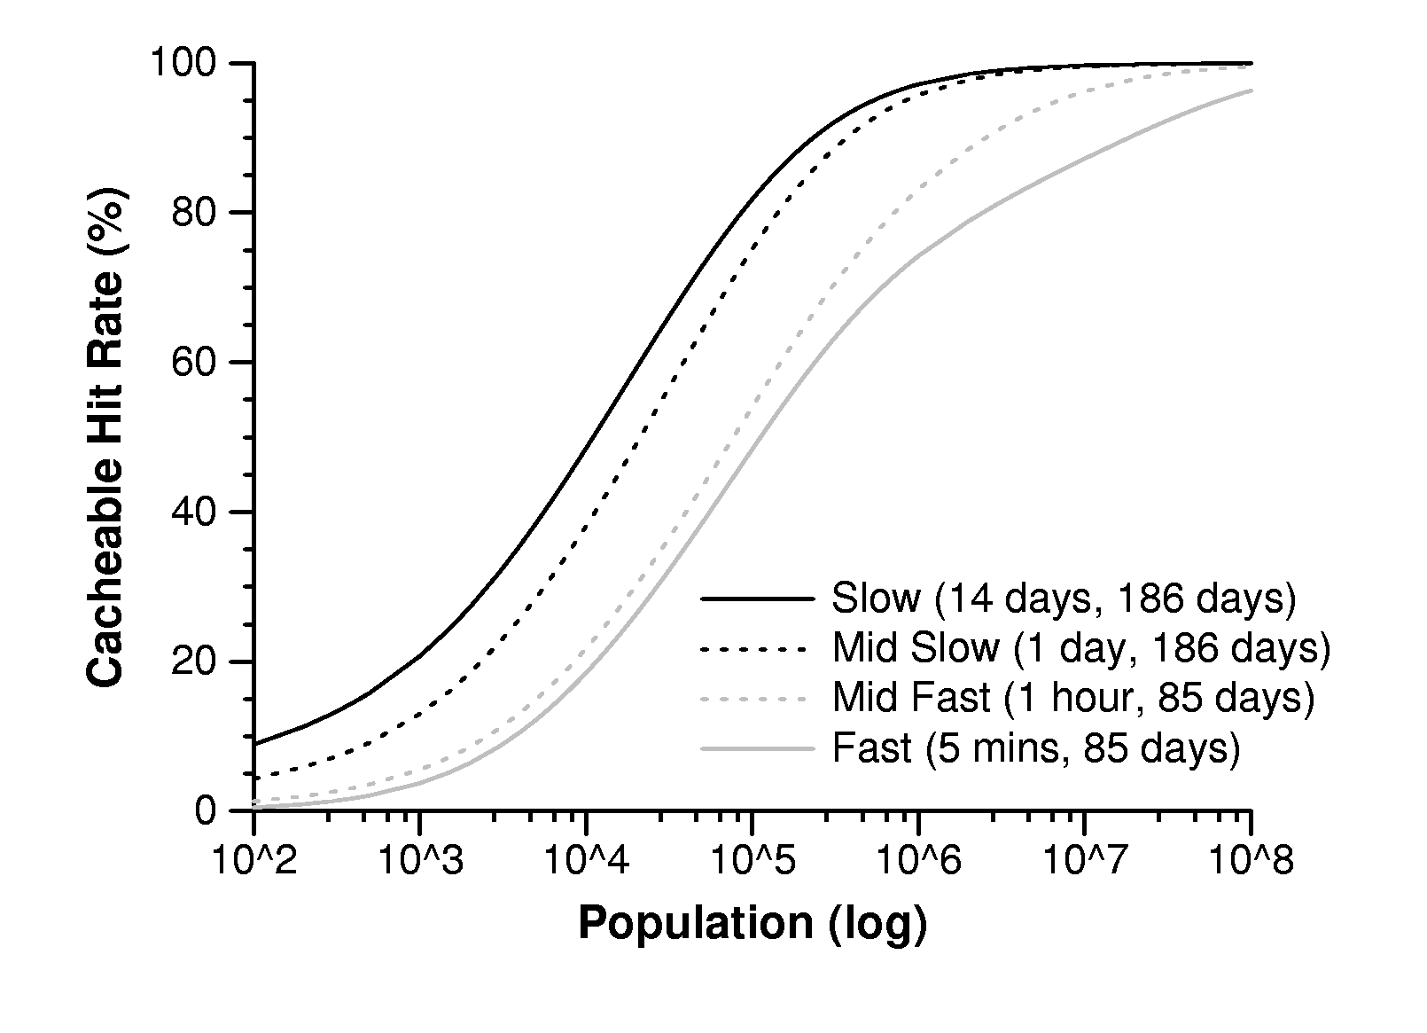
Hit ratio by population size, with different update rates
Wolman/Voelker/Levy 1997

Slide 56
For people who want the math
Approximates a sum over a universe of n objects...
...of the probability of access to each object x...
…times the probability x was accessed since its last change.
C is just a normalizing constant for the Zipf-like popularity distribution, which must sum to 1. C is not to be confused with C_{N}.
λ N
C = 1/α
0 < α < 1

Slide 57
You don’t need to know this
But you should know what it is and where to look for it.
Zipf and power law distributions seem to be axiomatic for human population behavior.
  Popularity, interests, traffic, wealth, market share, population, word frequency in natural language.
Heavy-tailed distributions like these are amenable to closed-form analysis.
They lead to lots of counterintuitive behaviors.
  E.g., multi-level caching has limited value: L1 absorbs the head, L2 has the detritus on the tail: “your cache ain’t nuthin but trash”.
  How to balance load in cache arrays (e.g., memcached)?

Slide 58
It’s all about reads
The last few slides (memcached, web) focus on caches for read accesses: no-write caches.
In CDNs the object is modified only at the origin server.
  Updates propagate out to the caches “eventually”.
  Web caches may deliver stale data
  Web objects have a “freshness date” or “time-to-live” (TTL).
In memcached database cache, writes occur only at the database servers.
  Writer must invalidate and/or update the cache on write.
In contrast, file caches and VM systems are write-back.
  We might lose data in a crash: introduces problems of recovery and failure-atomicity.

