Slide 1
Cloud Services and Scaling
Part 2: Coordination
Jeff Chase
Duke University

Slide 2
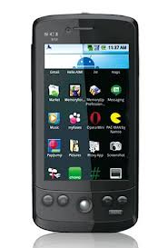
End-to-end application delivery
Where is your application?
Where is your data?
Where is your OS?
Cloud and Software-as-a-Service (SaaS)
Rapid evolution, no user upgrade, no user data management.
Agile/elastic deployment on virtual infrastructure. Seamless integration with apps on personal devices.

Slide 3

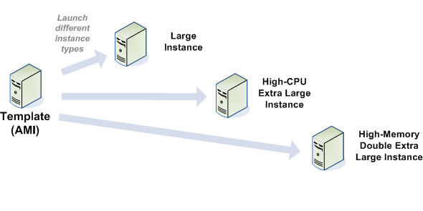
EC2 Elastic Compute Cloud
The canonical public cloud
Virtual Appliance Image
Client
Cloud Provider(s)
Service
Guest
Host

Slide 4



IaaS: Infrastructure as a Service
Client
Service
EC2 is a public IaaS cloud (fee-for-service).
Deployment of private clouds is growing rapidly w/ open IaaS cloud software.
Platform
Hosting performance and isolation is determined by virtualization layer
Virtual Machines (VM): VMware, KVM, etc.
OS
VMM
Physical
Notes:
The EC2 APIs come from Amazon but these clouds can be deployed anywhere.

Slide 5



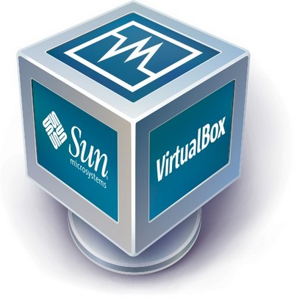


guest VM1
guest VM2
guest VM3
guest or tenant
VM contexts
P1A
P2B
P3C
OS kernel 1
OS kernel 2
OS kernel 3
hypervisor/VMM
host

Slide 6
Native virtual machines (VMs)
Slide a hypervisor underneath the kernel.
  New OS/TCB layer: virtual machine monitor (VMM).
Kernel and processes run in a virtual machine (VM).
  The VM “looks the same” to the OS as a physical machine.
  The VM is a sandboxed/isolated context for an entire OS.
A VMM can run multiple VMs on a shared computer.

Slide 7



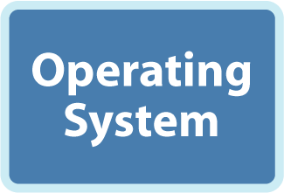


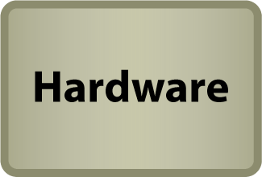
Thank you, VMware

Slide 8
More on VMs
Recent CPUs support additional protected mode(s) for hypervisors. When the hypervisor initializes, it selects some set of event types to intercept, and registers handlers for them.
Selected machine events occuring in user mode or kernel mode transfer control to a hypervisor handler. For example, a guest OS kernel accessing device registers may cause the physical machine to invoke the hypervisor to intervene.
In addition, the VM architecture has another level of indirection in the MMU page tables: the hypervisor can specify and restrict what parts of physical memory are visible to each guest VM.
A guest VM kernel can map to or address a physical memory frame or command device DMA I/O to/from a physical frame if and only if the hypervisor permits it.
If any guest VM tries to do anything weird, then the hypervisor regains control and can see or do anything to any part of the physical or virtual machine state before (optionally) restarting the guest VM.

Slide 9
If you are interested…
2.1 The Intel VT-x Extension
In order to improve virtualization performance and simplify VMM implementation, Intel has developed VT-x [37], a virtualization extension to the x86 ISA. AMD also provides a similar extension with a different hardware interface called SVM [3].
The simplest method of adapting hardware to support virtualization is to introduce a mechanism for trapping each instruction that accesses privileged state so that emulation can be performed by a VMM. VT-x embraces a more sophisticated approach, inspired by IBM’s interpre tive execution architecture [31], where as many instructions as possible, including most that access privileged state, are executed directly in hardware without any intervention from the VMM. …The motivation for this approach is to increase performance, as traps can be a significant source of overhead.
VT-x adopts a design where the CPU is split into two operating modes: VMX root and VMX non-root mode. VMX root mode is generally used to run the VMM and does not change CPU behavior, except to enable access to new instructions for managing VT-x. VMX non-root mode, on the other hand, restricts CPU behavior and is intended for running virtualized guest OSes.
Transitions between VMX modes are managed by hardware. When the VMM executes the VMLAUNCH or VMRESUME instruction, hardware performs a VM entry; placing the CPU in VMX non-root mode and executing the guest. Then, when action is required from the VMM, hardware performs a VM exit, placing the CPU back in VMX root mode and jumping to a VMM entry point. Hardware automatically saves and restores most architectural state during both types of transitions. This is accomplished by using buffers in a memory resident data structure called the VM control structure (VMCS).
In addition to storing architectural state, the VMCS contains a myriad of configuration parameters that allow the VMM to control execution and specify which type of events should generate VM exits. This gives the VMM considerable flexibility in determining which hardware is exposed to the guest. For example, a VMM could configure the VMCS so that the HLT instruction causes a VM exit or it could allow the guest to halt the CPU. However, some hardware interfaces, such as the interrupt descriptor table (IDT) and privilege modes, are exposed implicitly in VMX non-root mode and never generate VM exits when accessed. Moreover, a guest can manually request a VM exit by using the VMCALL instruction.
Virtual memory is perhaps the most difficult hardware feature for a VMM to expose safely. A straw man solution would be to configure the VMCS so that the guest has access to the page table root register, %CR3. However, this would place complete trust in the guest because it would be possible for it to configure the page table to access any physical memory address, including memory that belongs to the VMM. Fortunately, VT-x includes a dedicated hardware mechanism, called the extended page table (EPT), that can enforce memory isolation on guests with direct access to virtual memory. It works by applying a second, underlying, layer of address translation that can only be configured by the VMM. AMD’s SVM includes a similar mechanism to the EPT, referred to as a nested page table (NPT).
From Dune: Safe User-level Access to Privileged CPU Features, Belay e.t al., (Stanford), OSDI, October, 2012

Slide 10
VT in a Nutshell
New VM mode bit
  Orthogonal to kernel/user mode
If VM mode is off
  Machine “looks just like it always did”
If VM bit is on
  Machine is running a guest VM: “VMX non-root operation”
  Machine “looks just like it always did” to the guest, BUT:
  Various events cause gated entry into hypervisor
  “virtualization intercept”
  Hypervisor can control which events cause intercepts
  Hypervisor can examine/manipulate guest VM state

Slide 11
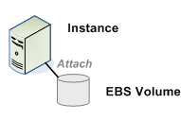
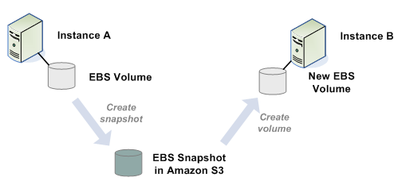
Adding storage

Slide 12
IaaS Cloud APIs (OpenStack, EC2)
Register SSH/HTTPS public keys for your site
  add, list, delete
Bundle and register virtual machine (VM) images
  Kernel image and root filesystem
Instantiate VMs of selected sizes from images
  start, list, stop, reboot, get console output
  control network connectivity / IP addresses / firewalls
Create/attach storage volumes
  Create snapshots of VM state
  Create raw/empty volumes of various sizes

Slide 13

PaaS: platform services
Client
Service
Hadoop, grids,
batch job services, etc. can also be viewed as PaaS category.
Platform
PaaS cloud services define the high-level programming models, e.g., for clusters or specific application classes.
OS
VMM (optional)
Note: can deploy them over IaaS.
Physical

Slide 14

Competing Cloud Models: PaaS vs. IaaS
• Cloud Platform as a Service (PaaS). The capability provided to the consumer is to deploy onto the cloud infrastructure consumer-created or acquired applications created using programming languages and tools supported by the provider. The consumer does not manage or control the underlying cloud infrastructure including network, servers, operating systems, or storage, but has control over the deployed applications and possibly application hosting environment configurations.
• Cloud Infrastructure as a Service (IaaS). The capability provided to the consumer is to provision processing, storage, networks, and other fundamental computing resources where the consumer is able to deploy and run arbitrary software, which can include operating systems and applications. The consumer does not manage or control the underlying cloud infrastructure but has control over operating systems, storage, deployed applications, and possibly limited control of select networking components (e.g., host firewalls).
Amazon Elastic Compute Cloud (EC2)
Eucalyptus
OpenNebula
OpenStack

Slide 15
Service components
RPC
(binder/AIDL)
service
content provider
GET (HTTP)
etc.
Clients
initiate connection and send requests.
Server
listens for and accepts clients, handles requests, sends replies

Slide 16

Scaling a service
Dispatcher
Work
Support substrate
Server cluster/farm/cloud/grid
Data center
Add servers or “bricks” for scale and robustness.
Issues: state storage, server selection, request routing, etc.

Slide 17
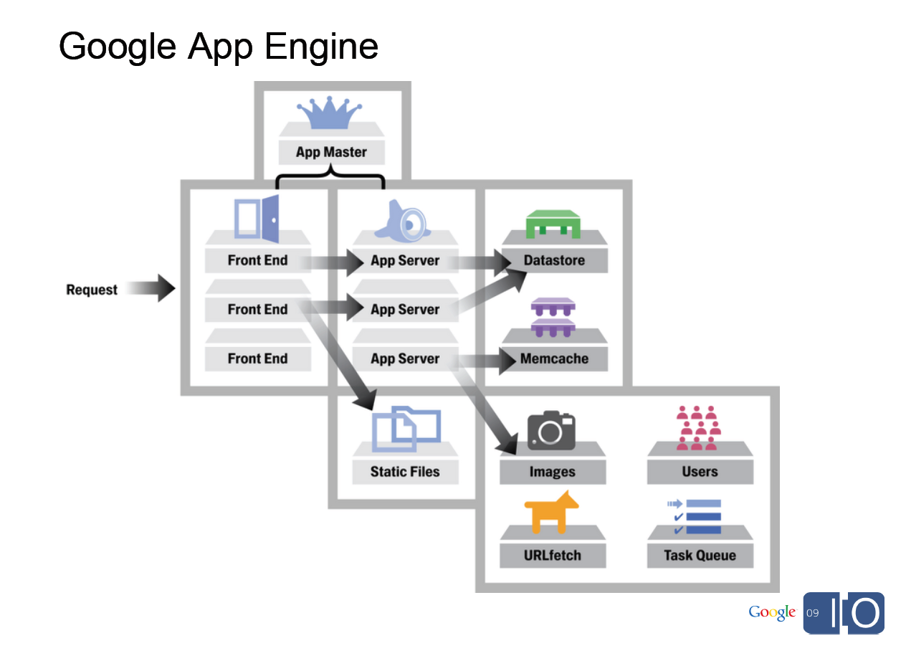
[From Spark Plug to Drive Train: The Life of an App Engine Request, Along Levi, 5/27/09]

Slide 18

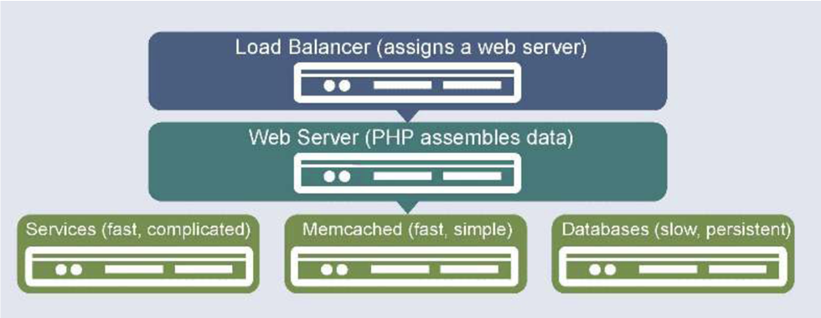

Slide 19
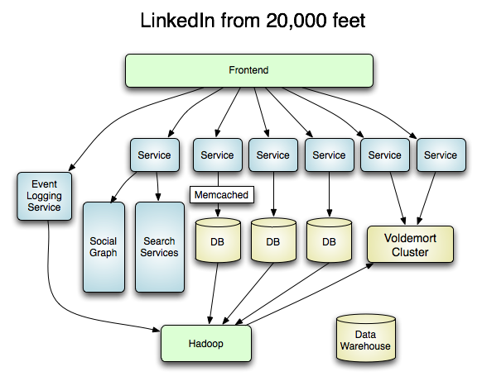

Slide 20
What about failures?
Systems fail. Here’s a reasonable set of assumptions about failure properties:
Nodes/servers/replicas/bricks
  Fail-stop or fail-fast fault model
  Nodes either function correctly or remain silent
  A failed node may restart, or not
  A restarted node loses its memory state, and recovers its secondary (disk) state
  Note: nodes can also fail by behaving in unexpected ways, like sending false messages. These are called Byzantine failures.
Network messages
  “delivered quickly most of the time”
  Message source and content are safely known (e.g., crypto).

Slide 21

Coordination and Consensus
If the key to availability and scalability is to decentralize and replicate functions and data, how do we coordinate the nodes?
  data consistency
  update propagation
  mutual exclusion
  consistent global states
  failure notification
  group membership (views)
  group communication
  event delivery and ordering
All of these reduce to the problem of consensus: can the nodes agree on the current state?

Slide 22
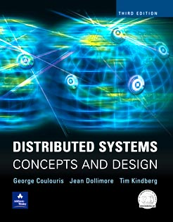
Consensus
P₁
P₁
v₁
d₁
Unreliable multicast
Consensus algorithm
P₂
P₃
P₂
P₃
v₂
v₃
d₂
d₃
Step 1
Propose.
Step 2
Decide.
Each P proposes a value to the others.
All nonfaulty P agree on a value in a bounded time.
Coulouris and Dollimore

Slide 23
A network partition
A network partition is any event that blocks all message traffic between subsets of nodes.

Slide 24
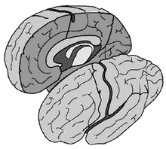
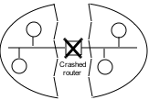
Fischer-Lynch-Patterson (1985)
No consensus can be guaranteed in an asynchronous system in the presence of failures.
Intuition: a “failed” process may just be slow, and can rise from the dead at exactly the wrong time.
Consensus may occur recognizably, rarely or often.
Network partition
Split brain

Slide 25

consistency
C
C-A-P choose two
CA: available, and consistent, unless there is a partition.
CP: always consistent, even in a partition, but a reachable replica may deny service if it is unable to agree with the others (e.g., quorum).
A
P
AP: a reachable replica provides service even in a partition, but may be inconsistent.
Availability
Partition-resilience

Slide 26
Properties for Correct Consensus
Termination: All correct processes eventually decide.
Agreement: All correct processes select the same d_{i}.
  Or…(stronger) all processes that do decide select the same d_{i}, even if they later fail.
Consensus “must be” both safe and live.
FLP and CAP say that a consensus algorithm can be safe or live, but not both.

Slide 27
Now what?
We have to build practical, scalable, efficient distributed systems that really work in the real world.
But the theory says it is impossible to build reliable computer systems from unreliable components.
So what are we to do?

Slide 28


Example: mutual exclusion
It is often necessary to grant some node/process the “right” to “own” some given data or function.
Ownership rights often must be mutually exclusive.
  At most one owner at any given time.
How to coordinate ownership?
Warning: it’s a consensus problem!

Slide 29


[From Spark Plug to Drive Train: The Life of an App Engine Request, Along Levi, 5/27/09]

Slide 30

One solution: lock service
acquire
acquire
grant
x=x+1
wait
release
A
grant
x=x+1
release
B
lock service

Slide 31

A lock service in the real world
acquire
acquire
grant
X
???
???
x=x+1
A
B
B

Slide 32
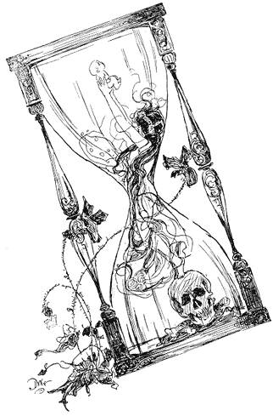

Solution: leases (leased locks)
A lease is a grant of ownership or control for a limited time.
The owner/holder can renew or extend the lease.
If the owner fails, the lease expires and is free again.
The lease might end early.
  lock service may recall or evict
  holder may release or relinquish

Slide 33

A lease service in the real world
acquire
acquire
grant
X
???
x=x+1
A
grant
x=x+1
release
B

Slide 34
Leases and time
The lease holder and lease service must agree when a lease has expired.
  i.e., that its expiration time is in the past
  Even if they can’t communicate!
We all have our clocks, but do they agree?
  synchronized clocks
For leases, it is sufficient for the clocks to have a known bound on clock drift.
  |T(C_{i}) – T(C_{j})| < ε
  Build in slack time > ε into the lease protocols as a safety margin.

Slide 35
OK, fine, but…
What if the A does not fail, but is instead isolated by a network partition?

Slide 36
Never two kings at once
acquire
acquire
grant
x=x+1
???
A
grant
x=x+1
release
B

Slide 37
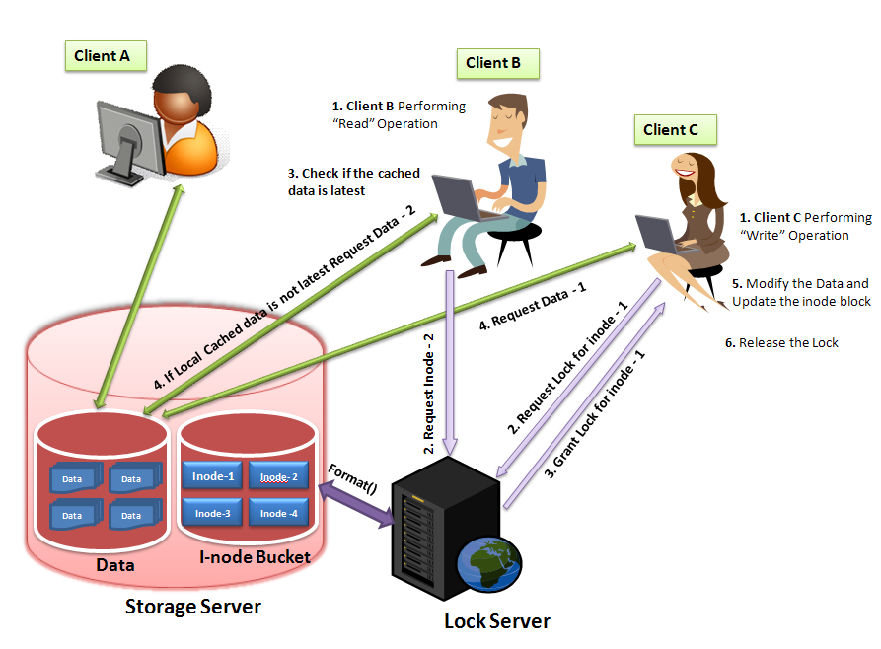
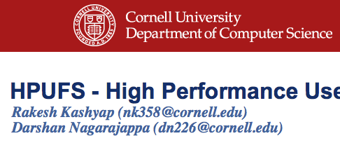
Lease example network file cache consistency

Slide 38

Example: network file cache
Clients cache file data in local memory.
File protocols incorporate implicit leased locks.
  e.g., locks per file or per “chunk”, not visible to applications
Not always exclusive: permit sharing when safe.
  Client may read+write to cache if it holds a write lease.
  Client may read from cache if it holds a read lease.
  Standard reader/writer lock semantics (SharedLock)
Leases have version numbers that tell clients when their cached data may be stale.
Examples: AFS, NQ-NFS, NFS v4.x

Slide 39
Example: network file cache
A read lease ensures that no other client is writing the data.
A write lease ensures that no other client is reading or writing the data.
Writer must push modified cached data to the server before relinquishing lease.
If some client requests a conflicting lock, server may recall or evict on existing leases.
  Writers get a grace period to push cached writes.

Slide 40
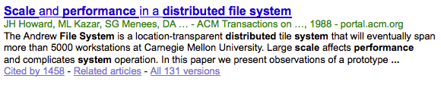
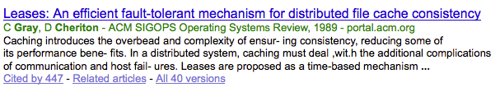
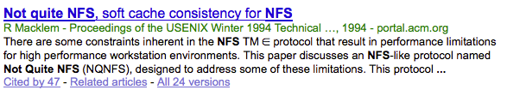
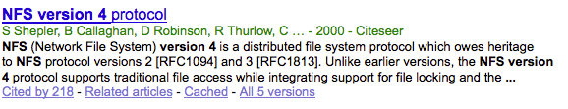
History

Slide 41
Google File System
Similar: Hadoop HDFS

Slide 42
OK, fine, but…
What if the lock manager itself fails?
X

Slide 43
The Answer
Replicate the functions of the lock manager.
  Or other coordination service…
Designate one of the replicas as a primary.
  Or master
The other replicas are backup servers.
  Or standby or secondary
If the primary fails, use a high-powered consensus algorithm to designate and initialize a new primary.

Slide 44
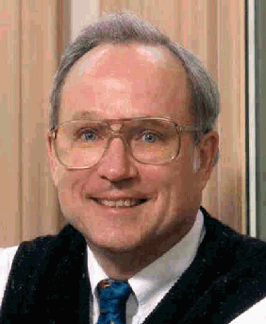
Butler W. Lampson
http://research.microsoft.com/en-us/um/people/blampson/
Butler Lampson is a Technical Fellow at Microsoft Corporation and an Adjunct Professor at MIT…..He was one of the designers of the SDS 940 time-sharing system, the Alto personal distributed computing system, the Xerox 9700 laser printer, two-phase commit protocols, the Autonet LAN, the SPKI system for network security, the Microsoft Tablet PC software, the Microsoft Palladium high-assurance stack, and several programming languages. He received the ACM Software Systems Award in 1984 for his work on the Alto, the IEEE Computer Pioneer award in 1996 and von Neumann Medal in 2001, the Turing Award in 1992, and the NAE’s Draper Prize in 2004.

Slide 45
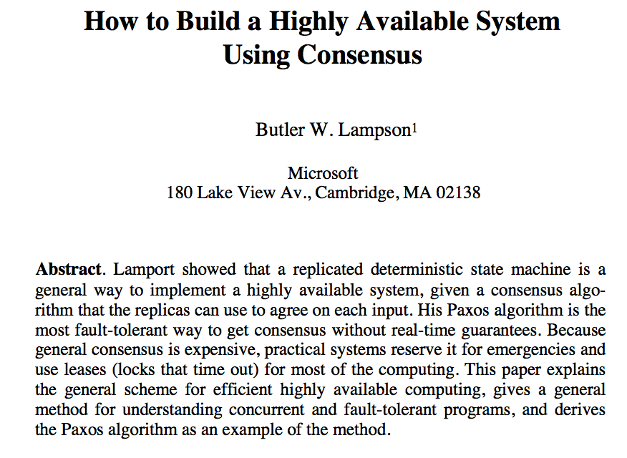
[Lampson 1995]

Slide 46
Summary/preview
Master coordinates, dictates consensus
  e.g., lock service
  Also called “primary”
Remaining consensus problem: who is the master?
  Master itself might fail or be isolated by a network partition.
  Requires a high-powered distributed consensus algorithm (Paxos).

Slide 47
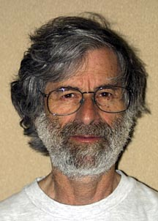

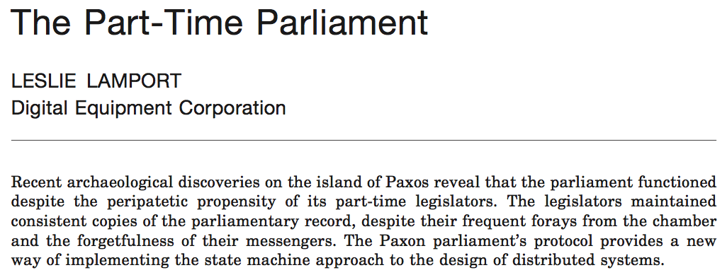
A Classic Paper
ACM TOCS:
  Transactions on Computer Systems
Submitted: 1990. Accepted: 1998
Introduced:

Slide 48
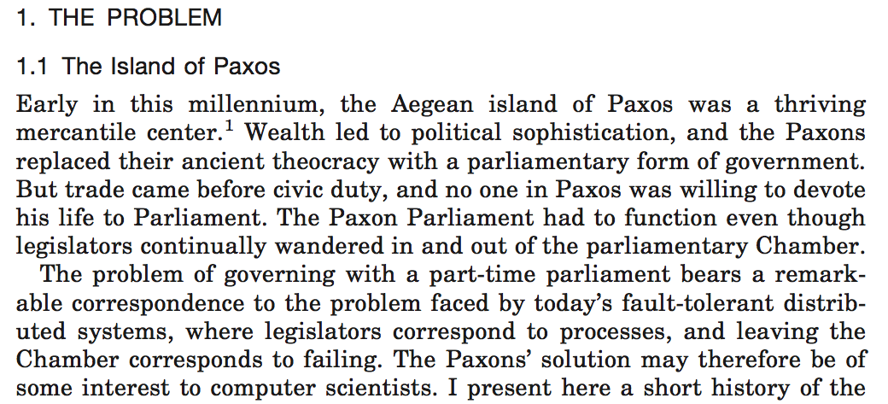



Slide 49
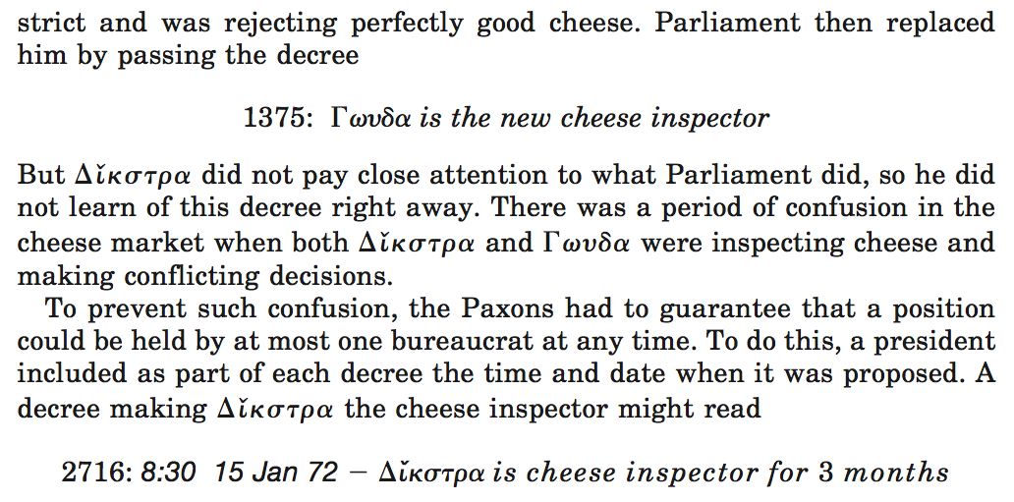
???

Slide 50
A Paxos Round
Self-appoint
Wait for majority
Wait for majority
“Can I lead b?”
“OK, but”
“v?”
“OK”
“v!”
L
N
1a
1b
2a
2b
3
log
log
safe
Propose
Promise
Accept
Ack
Commit
Nodes may compete to serve as leader, and may interrupt one another’s rounds. It can take many rounds to reach consensus.
Notes:
Consensus point of no return occurs when a majority of agents accept v and log it. At that point it’s done, the round has succeeded and consensus has been reached, and nobody can ever be permitted to choose a new/different value. However, it may take more rounds to recognize the success.

Slide 51
Consensus in Practice
Lampson: “Since general consensus is expensive, practical systems reserve it for emergencies.”
  e.g., to select a primary/master, e.g., a lock server.
    Centrifuge, GFS master, Frangipani, etc.
    Google Chubby service (“Paxos Made Live”)
Pick a primary with Paxos. Do it rarely; do it right.
  Primary holds a “master lease” with a timeout.
    Renew by consensus with primary as leader.
  Primary is “czar” as long as it holds the lease.
  Master lease expires? Fall back to Paxos.
  (Or BFT.)

Slide 52
[From Spark Plug to Drive Train: The Life of an App Engine Request, Along Levi, 5/27/09]

Slide 53
Coordination services
Build your cloud apps around a coordination service with consensus at its core.
This service is a fundamental building block for consistent scalable services.
  Chubby (Google)
  Zookeeper (Yahoo!)
  Centrifuge (Microsoft)

Slide 54
Chubby in a nutshell
Chubby generalizes leased locks
  easy to use: hierarchical name space (like file system)
  more efficient: session-grained leases/timeout
  more robust
    Replication (cells) with master failover and primary election through Paxos consensus algorithm
  more general
    general notion of “jeopardy” if primary goes quiet
  more features
    atomic access, ephemeral files, event notifications
    It’s a swiss army knife!

