Slide 1
Services: Scale and Performance
A Lightning Tour
Now with Elastic Scaling!
Jeff Chase
Duke University

Slide 2

Growth and scale
The Internet
How to handle all those client requests raining on your server?

Slide 3
Scaling a service
Dispatcher
Work
Support substrate
Server cluster/farm/cloud/grid
Data center
Add servers or “bricks” for scale and robustness.
Issues: state storage, server selection, request routing, etc.

Slide 4

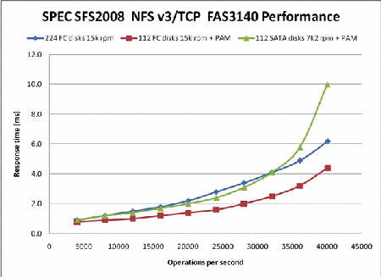

Slide 5
Queuing Theory for Busy People
wait here in queue
offered load
request stream @
arrival rate λ
Process for mean service demand D
“M/M/1” Service Center
Big Assumptions (at least for this summary)
  Single service center (e.g., one core)
  Queue is First-Come-First-Served (FIFO, FCFS).
  Independent request arrivals at mean rate λ (poisson arrivals).
  Requests have independent service demands at the center.
  i.e., arrival interval (1/λ) and service demand (D) are exponentially distributed (noted as “M”) around some mean.
  These assumptions are rarely true for real systems, but they give a good “back of napkin” understanding of queue behavior.

Slide 6
Servers Under Stress
saturation
Ideal
Response rate (throughput)
Response time
Overload
Thrashing
Collapse
Request arrival rate (offered load)
Load (concurrent requests, or arrival rate)
[Von Behren]

Slide 7
Ideal throughput: cartoon version
throughput == arrival rate
The server is not saturated: it completes requests at the rate requests are submitted.
throughput == peak rate
The server is saturated. It can’t go any faster, no matter how many requests are submitted.
Ideal throughput
Response rate (throughput)
i.e., request completion rate
This graph shows throughput (e.g., of a server) as a function of offered load. It is idealized: your mileage may vary.
saturation
peak rate
Request arrival rate (offered load)

Slide 8
Utilization: cartoon version
U = XD
X = throughput
D = service demand, i.e., how much time/work to complete each request.
U = 1 = 100%
The server is saturated. It has no spare capacity. It is busy all the time.
saturated
1 == 100%
This graph shows utilization (e.g., of a server) as a function of offered load. It is idealized: each request works for D time units on a single service center (e.g., a single CPU core).
Utilization
(also called load factor)
saturation
peak rate
Request arrival rate (offered load)

Slide 9
Utilization
What is the probability that the center is busy?
  Answer: some number between 0 and 1.
What percentage of the time is the center busy?
  Answer: some number between 0 and 100
These are interchangeable: called utilization U
The probability that the service center is idle is 1-U.

Slide 10
The Utilization Law
If the center is not saturated then:
  U = λD = (arrivals/T) * service demand
Reminder: that’s a rough average estimate for a mix of independent request arrivals with average service demand D.
If you actually measure utilization at the device, it may vary from this estimate.
  But not by much.

Slide 11
Throughput: reality
Thrashing, also called congestion collapse
Real servers/devices often have some pathological behaviors at saturation. E.g., they abort requests after investing work in them (thrashing), which wastes work, reducing throughput.
delivered throughput
(“goodput”)
Response rate (throughput)
i.e., request completion rate
saturation
Illustration only
Saturation behavior is highly sensitive to implementation choices and quality.
peak rate
Request arrival rate (offered load)

Slide 12
Improving throughput
Make the service center faster. (“scale up”)
  Upgrade the hardware, spend more $$$
Reduce the work required per request (D).
  More/smarter caching, code path optimizations, use smarter disk layout.
Add service centers, expand capacity. (“scale out”)
  RAIDs, blades, clusters, elastic provisioning
  N centers improves throughput by a factor of N: iff we can partition the workload evenly across the centers!
  Note: the math is different for multiple service centers, and there are various ways to distribute work among them, but we can “squint” and model a balanced aggregate roughly as a single service center: the cartoon graphs still work.

Slide 13
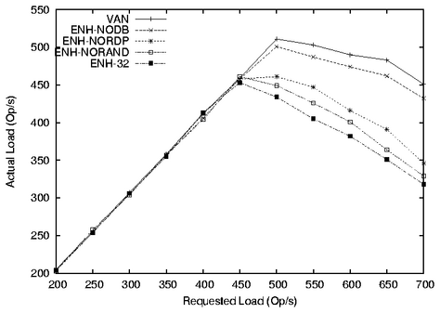
This graph shows how certain design alternatives under study impact a server’s throughput. The alternatives reduce per-request work (overhead) and/or improve load balancing. (This is a graph from a random research paper: the design alternatives themselves are not important to us.)
saturation
Measured
throughput
(“goodput”)
Higher numbers are better.
Note how throughput degrades in overload on this system.
Offered load (request/sec)

Slide 14
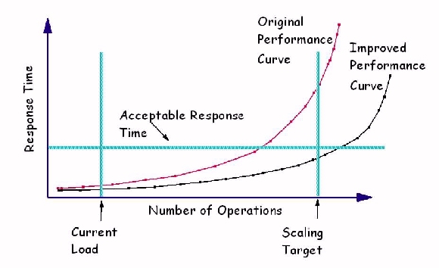
Scaling and response time
In the real world we don’t want to saturate our systems.
We want systems to be responsive, and saturated systems aren’t responsive.
Instead, characterize max request rate λ_{max} this way:
Define a response time objective: maximum acceptable response time (R_{max}): a simple form of Service Level Objective (SLO).
Increase λ until system response time surpasses R_{max} : that is λ_{max}.
λ_{max}
R_{max}
λ
[graphic from IBM.com]

Slide 15
Response time (R)
R == D
The server is idle. The response time of a request is just the time to service the request (do requested work).
R = D + queuing delay
As the server approaches saturation, the queue of waiting request grows without bound.
(We will see why in a moment.)
R_{max}
saturation (U = 1)
Average response time R
Illustration only
Saturation behavior is highly sensitive to implementation choices and quality.
U
R
saturation
D
λ_{max}
Request arrival rate (offered load)

Slide 16

The same picture, only different
Queuing delay is proportional to:
Response time,
determined by:
rho is “load factor”
= r/rmax
= utilization
λ/λ_{max}
“stretch factor”
R/D
(normalized
response time)
(Max request load)
“saturation”
Offered load
(request/sec)
also called lambda
Principles of Computer System Design ♥ Saltzer & Kaashoek 2009

Slide 17
Little’s Law
For an unsaturated queue in steady state, mean response time R and mean queue length N are governed by:
      Little’s Law: N = λR
Why?
Suppose a task T is in the system for R time units.
During that time:
  λR new tasks arrive (on average)
  N tasks depart (all the tasks ahead of T, on average).
But in steady state, the flow in balances flow out.
  Note: this means that throughput X = λ in steady state.

Slide 18
Inverse Idle Time “Law”
Service center saturates as 1/ λ approaches D: small increases in λ cause large increases in the expected response time R.
R
U
1(100%)
Little’s Law gives response time R = D/(1 - U).
  Intuitively, each task T’s response time R = D + DN.
  Substituting λR for N: R = D + D λR
  Substituting U for λD: R = D + UR
  R - UR = D → R(1 - U) = D → R = D/(1 - U)

Slide 19
Why Little’s Law is important
1. Intuitive understanding of FCFS queue behavior.
    Compute response time from demand parameters (λ, D).
    Compute N: how much storage is needed for the queue.
2. Notion of a saturated service center.
  Response times rise rapidly with load and are unbounded.
    At 50% utilization, a 10% increase in load increases R by 10%.
    At 90% utilization, a 10% increase in load increases R by 10x.
3. Basis for predicting performance of queuing networks.
    Cheap and easy “back of napkin” estimates of system performance based on observed behavior and proposed changes, e.g., capacity planning, “what if” questions.
  Guides intuition even in scenarios where the assumptions of the theory are not met.

Slide 20
Managing overload
What should we do when a service is in overload?
  Overload: service is close to saturation, leading to unacceptable response time.
  Work queues grow without bound, increasing memory consumption.
λ > λ_{max}
Throughput
X
λ
λ_{max}
offered load

Slide 21
Options for overload
Thrash.
  Keep trying and hope things get better. Accept each request and inject it into the system. Then drop requests at random if some queue overflows its memory bound. Note: leads to dropping requests after work has been invested, wasting work and reducing throughput (e.g., congestion collapse).
Admission control or load conditioning.
  Reject requests as needed to keep system healthy. Reject them early, before they incur processing costs. Choose your victims carefully, e.g., prefer “gold” customers, or reject the most expensive requests.
Elastic provisioning.
  E.g., acquire new capacity on the fly from a cloud provider, and shift load over to the new capacity.

Slide 22

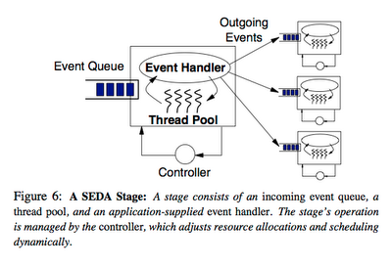
SEDA: An architecture for well-conditioned scalable internet services
A 2001 paper, mentioned here because it offers basic insight into server structure and performance.
Internally, server software is “like” server hardware: requests “flow through” a set of processing stages.
SEDA is a software architecture to manage this flow explicitly.
We can control how much processing power to give to each stage by changing the number of threads dedicated to it.
We can identify bottlenecks by observing queue lengths. If we must drop a request, we can pick which queue to drop it from.
Connector
Component
Component

Slide 23
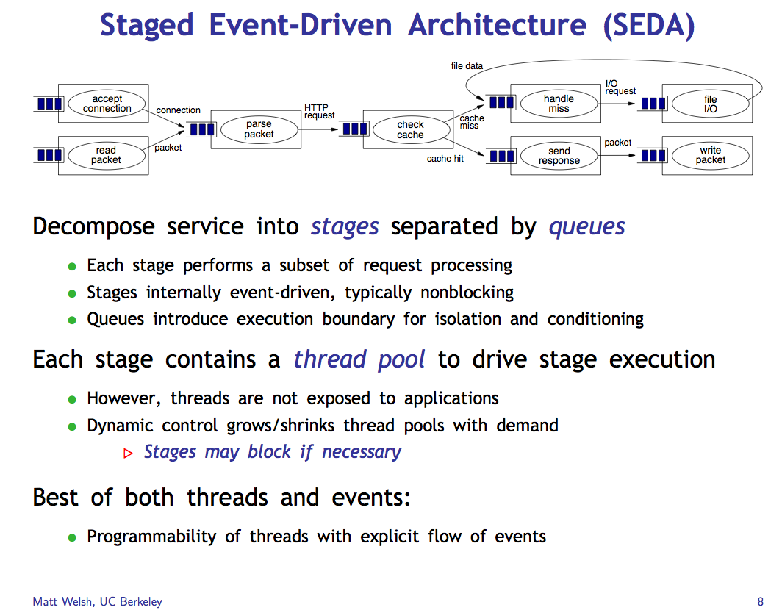

Slide 24
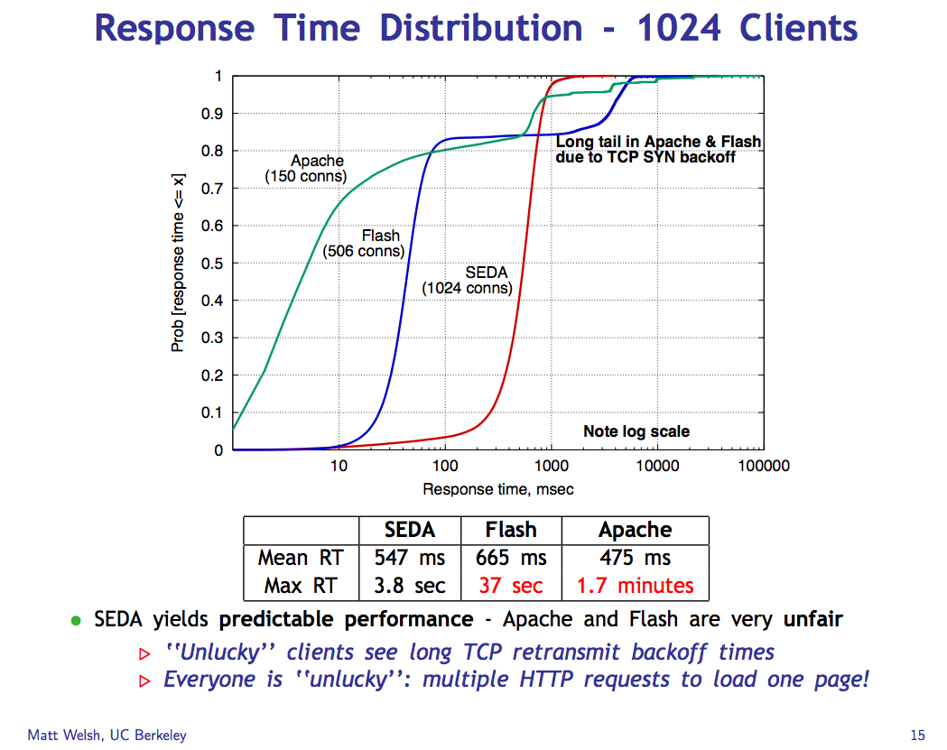

Slide 25
Cumulative Distribution Function (CDF)
80% of the requests have response time R with x1 < R < x2.
“Tail” of 10% of requests with response time R > x2.
90%
quantile
A few requests have very long response times.
What’s the mean R?
50%
median
10%
quantile
x1
x2
Understand how the mean (average) response time can be misleading.

Slide 26
SEDA Lessons
Means/averages are almost never useful: you have to look at the distribution.
Pay attention to quantile response time.
All servers must manage overload.
Long response time tails can occur under overload, and that is bad.
A staged structure with multiple components separated by queues can help manage performance.
Note: a staged structure can also help to manage concurrency and and simplify locking.

Slide 27
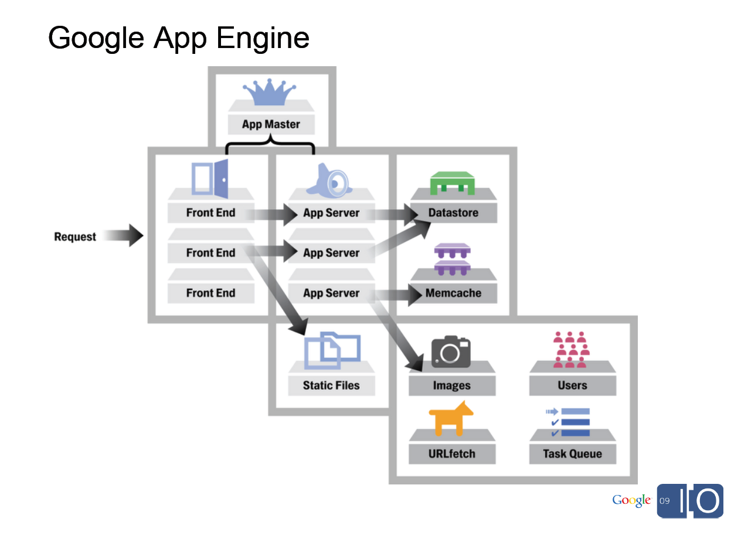
[From Spark Plug to Drive Train: The Life of an App Engine Request, Along Levi, 5/27/09]

Slide 28

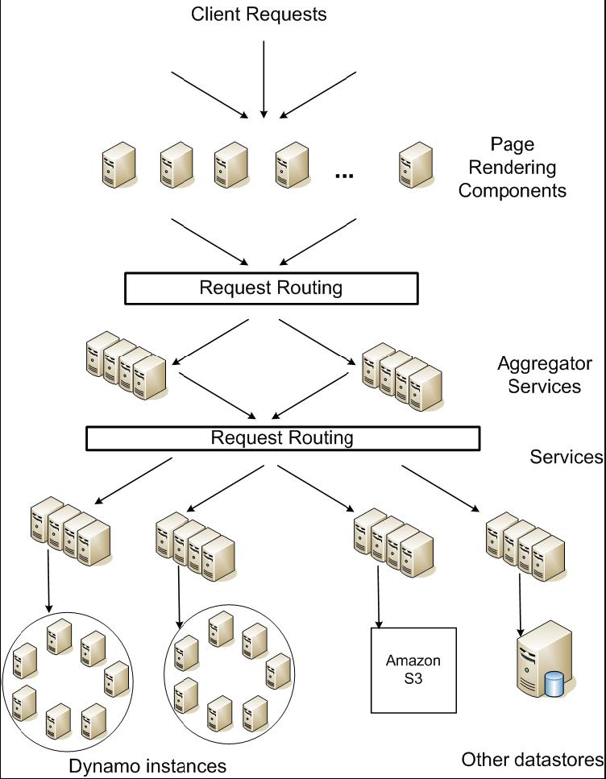
Service-oriented architecture of
Amazon’s platform

Slide 29

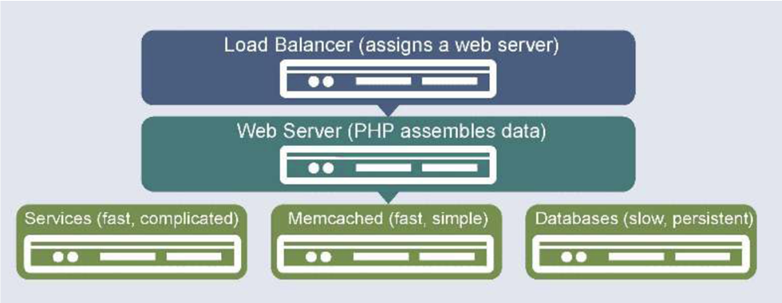

Slide 30
Incremental Scalability
Scalability is part of the “enhanced standard litany” [Armando Fox]. What does it really mean?
How do we measure or validate claims of scalability?
not
scalable
scalable
cost
marginal
cost of capacity
No hockey sticks!
capacity

Slide 31
Scaling and bottlenecks
Scale up by adding capacity incrementally?
“Just add bricks/blades/units/elements/cores”...but that presumes we can parallelize the workload.
Vertically: identify functional stages, and execute different stages on different units (or “tiers”).
Horizontally: spread requests/work across multiple units.
  Or partition the data and spread the chunks across the elements, e.g., for parallel storage or parallel computing.
Load must be evenly distributed, or else some element or stage saturates first (bottleneck).
A bottleneck limits throughput and/or may increase response time for some class of requests.
Work

Slide 32
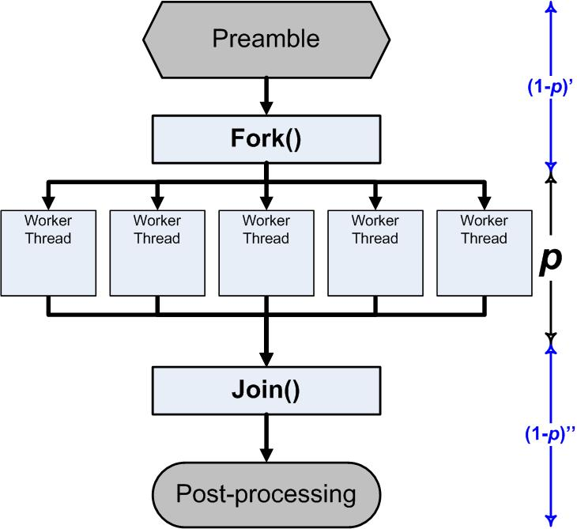
Parallelization
A simple treatment
A program has some work to do. We want to do it fast. How?
Do it on multiple computers/cores in parallel.
But we won’t be able to do all of the work in parallel.
Suppose some portion p of the work can be done in parallel.
Then a portion 1-p is serial.
How much does that help?
Some portion will be serialized.
E.g.:
startup,
locking
combining results
access to a specific disk
http://blogs.msdn.com/b/ddperf/archive/2009/04/29/parallel-scalability-isn-t-child-s-play-part-2-amdahl-s-law-vs-gunther-s-law.aspx

Slide 33
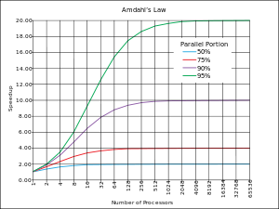
Amdahl’s Law
Normalize runtime = 1
(On a single core.)
Now parallelize:
Parallel portion: P (0 ≤ P ≤1)
Serial portion: 1-P
N-way parallelism (N cores)
Runtime is now:
P/N + (1-P)
Even if “infinite parallelism”, runtime is 1-P in the limit. It is determined by the serial portion.
Bottleneck: limits performance.
Speedup: bounded by 1/(1-P)
1/(1 - 0.95)
P
1/(1 - 0.90)
1/(1 - 0.75)
speedup
1/(1 – 0.50)
N
Law of Diminishing Returns
“Optimize for the primary bottleneck.”

Slide 34
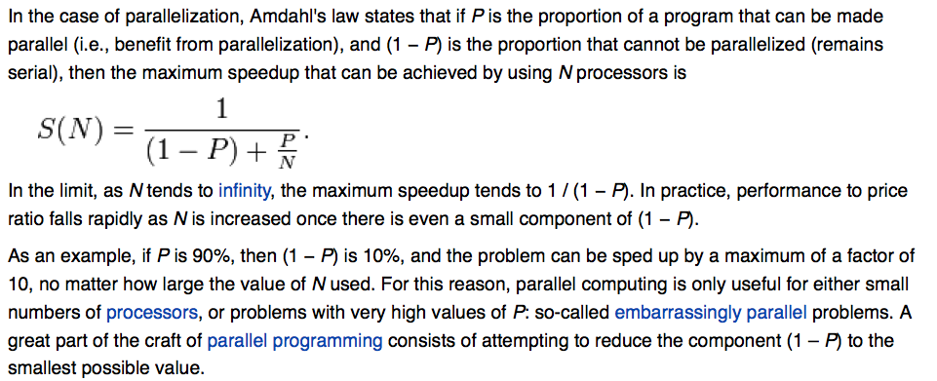
Amdahl’s Law
What is the “serial portion” that “cannot be parallelized”?
- Mutexes/critical sections
- Combining results from parallel portions (e.g., “reducers”)
- …

Slide 35

Virtual Cloud hosting
“Cloud computing is a model for enabling convenient, on-demand network access to a shared pool of configurable computing resources (e.g., networks, servers, storage, applications, and services) that can be rapidly provisioned and released with minimal management effort or service provider interaction.”
US National Institute for Standards and Technology
Part 2
http://www.csrc.nist.gov/groups/SNS/cloud-computing/

Slide 36
Cloud > server-based computing
Client
Server(s)
Client/server model (1980s - )
Now called Software-as-a-Service (SaaS)

Slide 37
Host/guest model
Client
Cloud Provider(s)
Service
Guest
Host
Service is hosted by a third party.
  flexible programming model
  cloud APIs for service to allocate/link resources
  on-demand: pay as you grow

Slide 38

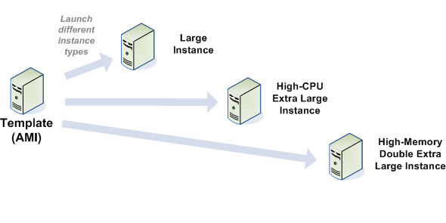
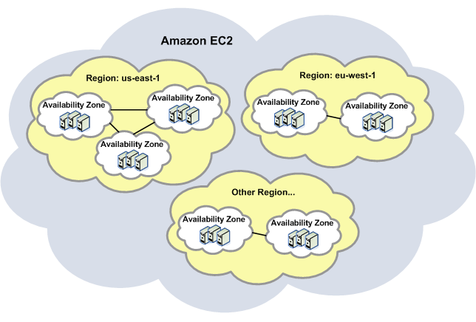
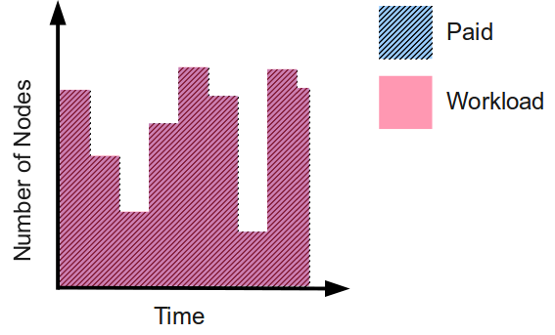
EC2
The canonical public cloud
Virtual Appliance Image

Slide 39
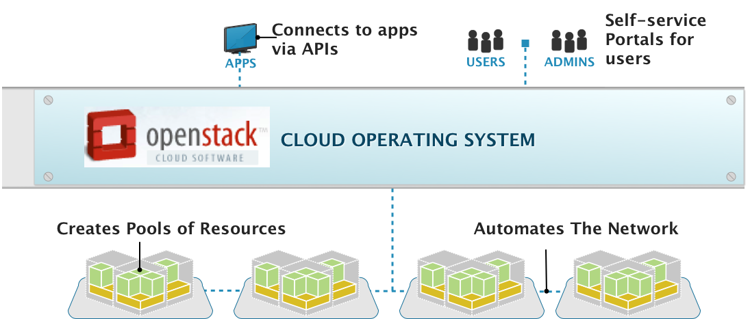
OpenStack, the Cloud Operating System
Management Layer That Adds Automation & Control
[Anthony Young @ Rackspace]

Slide 40
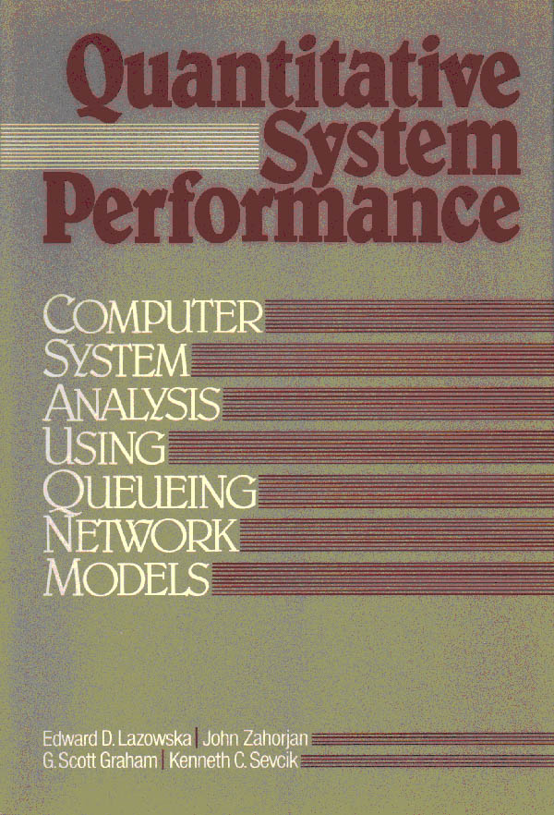
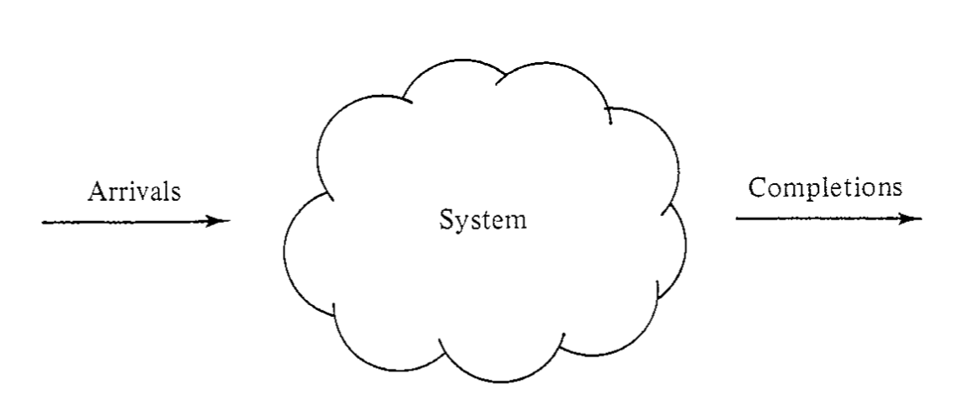
Varying workload
Fixed system
Varying performance

Slide 41
Varying workload
Varying system
Fixed performance

Slide 42
“Elastic Cloud”
Resource Control
Varying workload
Varying system
Target performance

Slide 43
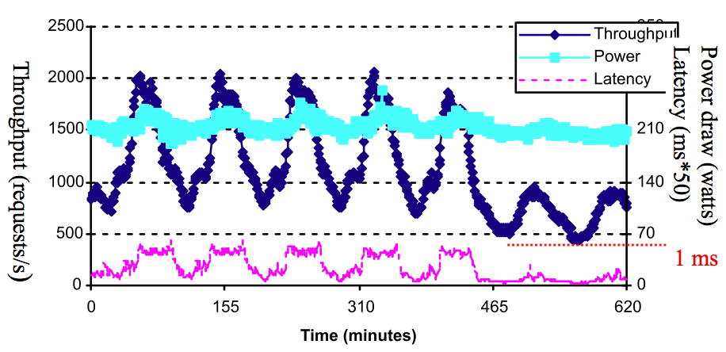
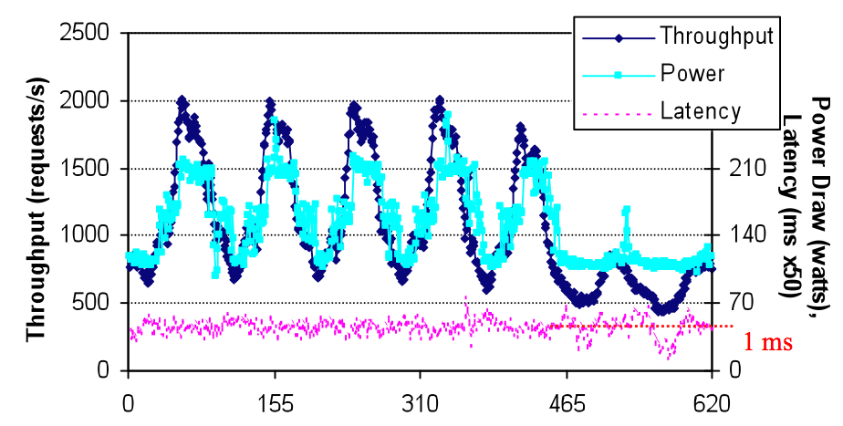
Elastic provisioning
Managing Energy and Server Resources in Hosting Centers, SOSP, October 2001.

Slide 44
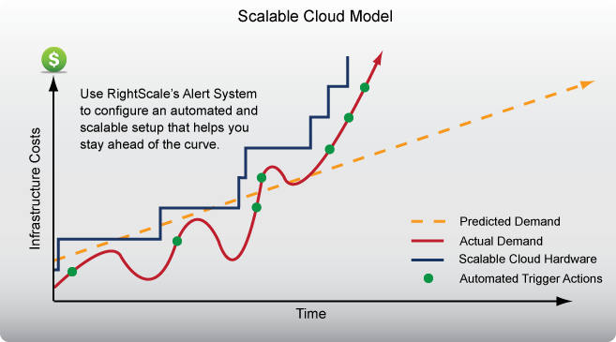
Elastic scaling

Slide 45
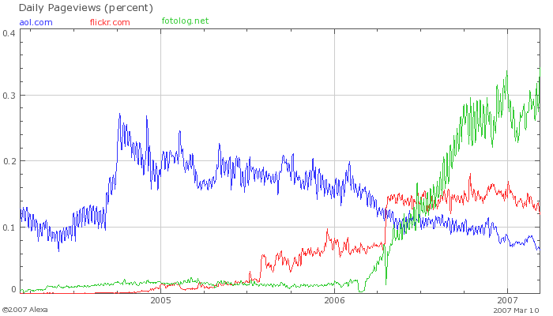
Motivation: “Success disaster”
[Graphic from Amazon: Mike Culver, Web Scale Computing]

Slide 46
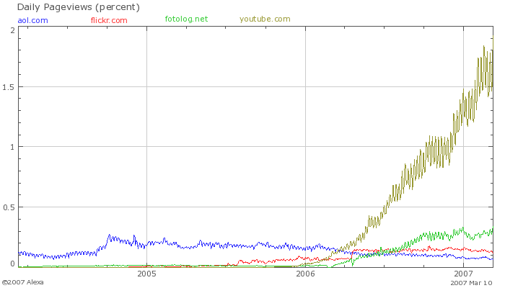
Motivation: “Success disaster”
[Graphic from Amazon: Mike Culver, Web Scale Computing]

