Slide 1

Introduction to MapReduce Programming
&
Local Hadoop Cluster Accesses Instructions
Rozemary Scarlat
August 31, 2011

Slide 2
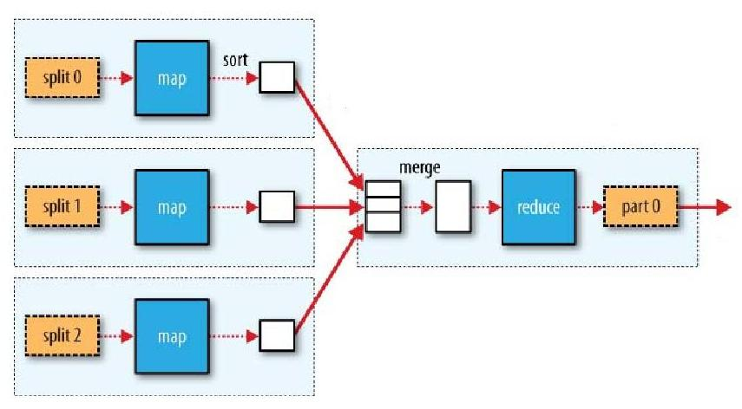
Dataflow in a MR Program
(K1, V1)
(K2, V2)
(K2, List<V2>)
(K3, V3)
Notes:
MapReduce works by breaking the processing into two phases: the map phase and the reduce phase. Each phase has key-value pairs as input and output, the types of which may be chosen by the programmer. The programmer also specifies two functions: the map function and the reduce function.

Slide 3
We have temperature readings for the years 1901 – 2001 and we want to compute the maximum for each year
In our temperature data set, each line looks like this:
0067011990999991950051507004...9999999N9+00001+99999999999... 0043011990999991950051512004...9999999N9+00221+99999999999...
We know that characters 16 – 19 represent the year, characters 88 – 92 represent the temperature and character 93 represents the quality code
(0, 0067011990999991950051507004...9999999N9+00001+99999999999...)
(106, 0043011990999991950051512004...9999999N9+00221+99999999999...)

Slide 4
Implementation in MapReduce
Selection+
Projection
Aggregation
(MAX)
(0, 0067011... )
(1950, 22)
0
1950, 22
-11
(1950, 22)
Notes:
K1 are the line offsets and K2 are the lines from the files
The map function extracts the year and the temperature from each line and outputs them as the (K2, V2) pairs: (1950, 0) (1950, 22) (1950, −11) (1949, 111) (1949, 78)
All the (K2, V2) pairs get sorted and grouped by the key, resulting in the (K2, list<V2>) pairs: (1949, [111, 78]) (1950, [0, 22, −11])
These are the inputs to the reducer. The reduce function will now go through the list and determine the maximum. The output will be the (K3, V3) pairs of year, max temperature for that year (1949, 111) (1950, 22)

Slide 5
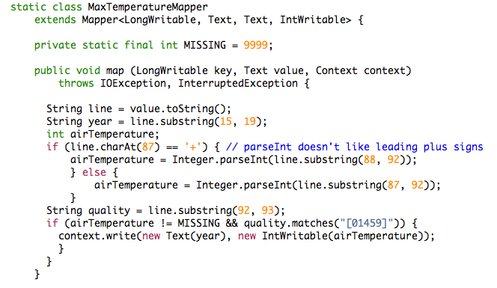
Mapper

Slide 6
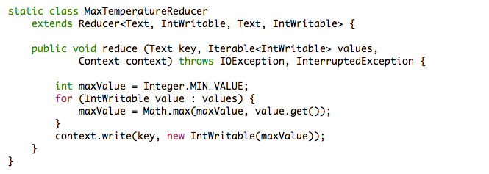
Reducer

Slide 7
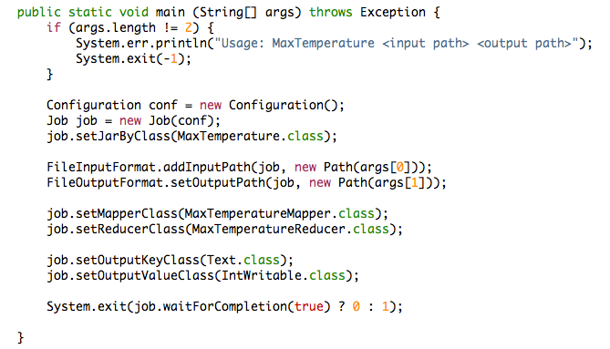
Main

Slide 8
Beyond MaxTemperature
What if we want to get the average temperature for a year?
What if you are only interested in the temperature in Durham? (Assume the station ID at Durham is 212)
Notes:
You may want to change the code a little bit and fulfill a different query

Slide 9
Local Hadoop Cluster
The master node is hadoop21.cs.duke.edu
The slave nodes are hadoop[22,24-36].cs.duke.edu
Online jobtracker address*:
http://hadoop21.cs.duke.edu:50030/jobtracker.jsp
Online HDFS health*:
http://hadoop21.cs.duke.edu:50070/dfshealth.jsp
* Accesible only from within the CS trusted network. Solution:
ssh to any node and then use lynx.
build “ssh -D port” connection to any node, set proxy in your browser
Notes:
You may want to change the code a little bit and fulfill a different query

Slide 10
Now, let’s see how to compile and run a MapReduce job on the local cluster
You can find the detailed instructions at the course website:
http://www.cs.duke.edu/courses/fall10/cps216/TA_material/cluster_instructions

Slide 11
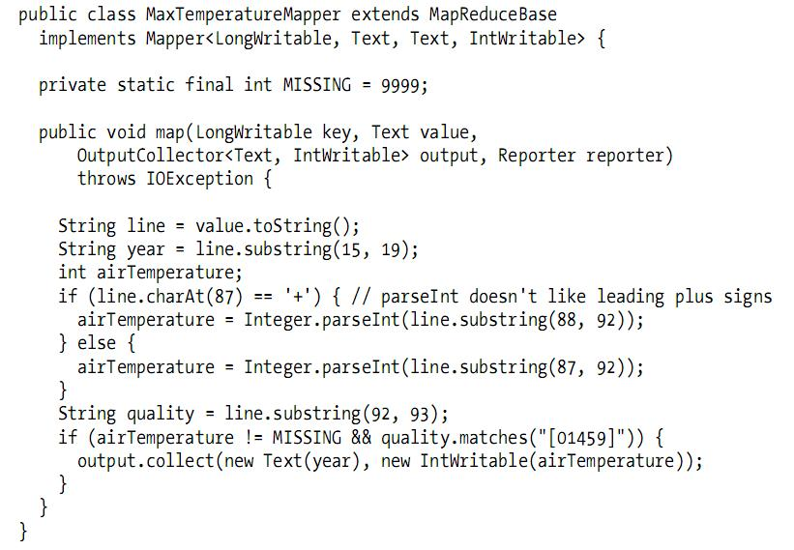
Mapper (old API)

Slide 12
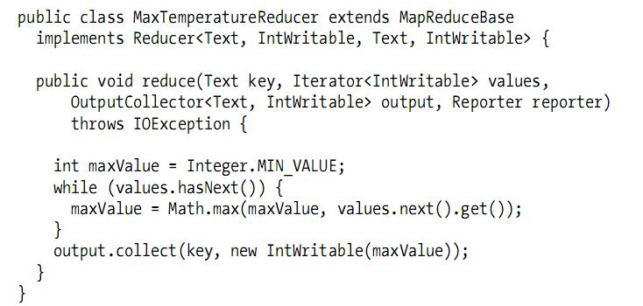
Reducer (old API)

Slide 13
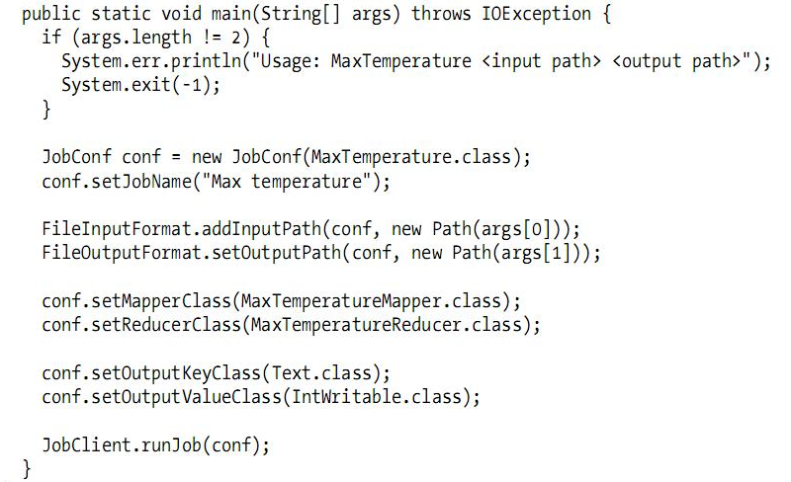
Main (old API)

