Slide 1
Beyond Mapper and Reducer
Partitioner, Combiner,
Hadoop Parameters and more
Rozemary Scarlat
September 13, 2011

Slide 2
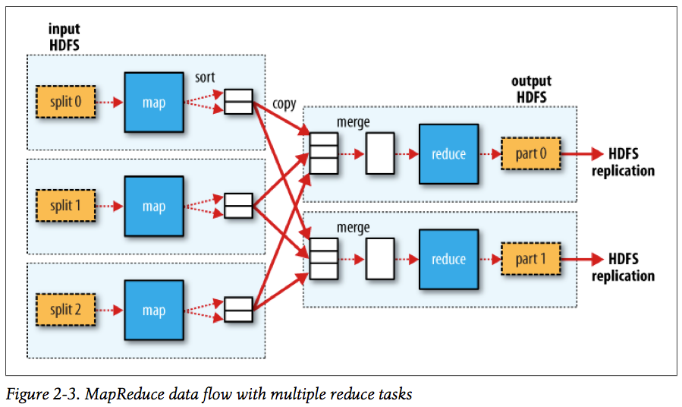
Data flow with multiple reducers

Slide 3
Partitioner
the map tasks partition their output, each creating one partition for each reduce task
many keys per partition, but all records for a key are in a single partition
default partitioner: HashPartitioner - hashes a record’s key to determine which partition the record belongs in
another partitioner: TotalOrderPartitioner – creates a total order by reading split points from an externally generated source

Slide 4
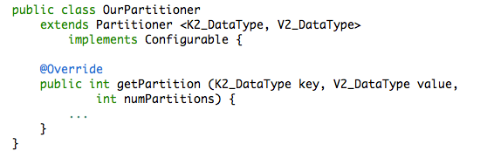
The partitioning can be controlled by a user-defined partitioning function:
Don’t forget to set the partitioner class:
job.setPartitionerClass(OurPartitioner.class);
Useful information about partitioners:
Hadoop book –Total Sort (pg. 237); Multiple Outputs (pg. 244);
http://chasebradford.wordpress.com/2010/12/12/reusable-total-order-sorting-in-hadoop/
http://philippeadjiman.com/blog/2009/12/20/hadoop-tutorial-series-issue-2-getting-started-with-customized-partitioning/ (Note: uses the old API!)

Slide 5
Partitioner example

Slide 6
Combiner
The combiner receives as input all data emitted by the mapper instances on a given node
Its output is sent to the Reducers (instead of the mappers’ output).
Hadoop does not guarantee how many times it will call the combiner for a particular map output record => calling the combiner for 0, 1 or many times should result in the same output of the reducer
Generally, the combiner is called as the sort/merge result is written to disk. The combiner must:
be side-effect free
have the same input and output key types and the same input and output value types
Notes:
You may want to change the code a little bit and fulfill a different query

Slide 7
Combiner example

Slide 8
Parameters and more
Cluster-level parameters (e.g. HDFS block size)
Job-specific parameters (e.g. number of reducers, map output buffer size)
Configurable
Important for job performance
Map-side/Reduce-side/Task-environment – Tables 6-1, 6-2, 6-5 from the book
Full list of mapreduce paramteres with their default values: http://hadoop.apache.org/common/docs/current/mapred-default.html
User-defined parameters
Used to pass information from driver (main) to mapper/reducer.
Help to make your mapper/reducer more generic

Slide 9
Also, built-in parameters managed by Hadoop that cannot be changed, but can be read
For example, the path to the current input that can be used in joining datasets will be read with:
FileSplit split = (FileSplit)context.getInputSplit();
String inputFile = split.getPath().toString();
Counters – built-in (Table 8.1 from the book) and user-defined (e.g. count the number of missing records and the distribution of temperature quality codes in the NCDC weather data set)
MapReduceTypes – you already know some (eg. setMapOutputKeyClass()), but there are more – Table 7-1 from the book
Identity Mapper/Reducer
no processing of the data (output == input)

Slide 10
Why do we need map/reduce function without any logic in them?
Most often for sorting
More generally, when you only want to use the basic functionality provided by Hadoop (e.g. sorting/grouping)
More on sorting at page 237 from the book
MapReduce Library Classes - for commonly used functions (e.g. InverseMapper used to swap keys and values) (Table 8-2 in the book)
implementing Tool interface - support of generic command-line options
the handling of standard command-line options will be done using ToolRunner.run(Tool, String[]) and the application will only handle its custom arguments
most used generic command-line options:
-conf <configuration file> -D <property=value>

Slide 11
How to determine the number of splits?
If a file is large enough and splitable, it will be splited into multiple pieces (split size = block size)
If a file is non-splitable, only one split.
If a file is small (smaller than a block), one split for file, unless...
CombineFileInputFormat
Merge multiple small files into one split, which will be processed by one mapper
Save mapper slots. Reduce the overhead
Other options to handle small files?
hadoop fs -getmerge src dest
~

