Slide 1
Performance Anomalies Within The Cloud
This slide includes content from slides by Venkatanathan Varadarajan and Benjamin Farley

Slide 2


Public Clouds (EC2, Azure, Rackspace, …)
Multi-tenancy
Different customers’ virtual machines (VMs) share same server
VM
VM
VM
VM
VM
VM
VM
Tenant: Why Cloud?
Pay-as-you-go
Infinite Resources
Cheaper Resources
Provider: Why multi-tenancy?
Improved resource utilization
Benefits of economies of scale
Notes:
Particularly, we are looking at IAAS style cloud setting where providers like Amazon EC2, Microsoft Azure sets up a data center and provides an interface to their customers through which customers can dynamically rent out virtual machine instances and pay per hour of the usage. An interesting aspect of such public cloud setting is the provider’s practice of multi-tenancy, where customers share the same physical machine with other VM instances of other customers. The main reason for such practice is for improving resource utilization since a single virtual machine will not be using all the resources all the time.

Slide 3
Available Cloud Resources
Virtual Machine
Cloud Storage
Cloud Services
  Load balancers
  Private Networks
  CDNs

Slide 4
Cloud Use Cases
Deploying enterprise applications
Deploying start-up ideas

Slide 5
Benefits of Cloud
Easily adjust to load (no upfront costs)
  Auto-scaling
  Deal with flash crowds.

Slide 6
Why would performance every be unpredictable?

Slide 7
Implications of Multi-tenancy
VMs share many resources
  CPU, cache, memory, disk, network, etc.
Virtual Machine Managers (VMM)
  Goal: Provide Isolation
Deployed VMMs don’t
perfectly isolate VMs
  Side-channels [Ristenpart et al. ’09, Zhang et al. ’12]
VM
VMM
VM
Notes:
Apart from this advantages of multi-tenancy there are also some security implications when VMs share resources like CPU, Cache, Disk with other VMs. The state of the art VMMs make this possible by providing isolation guarantees. Unfortunately, these VMMs do not provide perfect isolation. One major security implication prior work had explored is the possibility of side-channel attacks due to lack of performance isolation which may leak confidential information. In this work, we are going to look at a much more direct implication of lack of performance isolation where the performance degradation due to the presence of other VMs could incentivize malicious behavior.
Toward that we will look at the extent of this performance degradation.

Slide 8
Assumption Made by Cloud Tenant
Infinite resources
All VMs are created equally
Perfect isolation

Slide 9
This Talk
Taking control of where your instances run
Are all VMs created equally?
How much variation exists and why?
Can we take advantage of the variation to improve performance?
Gaining performance at any cost
Can users impact each other’s performance?
Is there a way to maliciously steal another user’s resource?
Is tehre

Slide 10
Heterogeneity in EC2
Cause of heterogeneity:
  Contention for resources: you are sharing!
  CPU Variation:
    Upgrades over time
    Replacement of failed machined
  Network Variation:
    Different path lengths
    Different levels of oversubscription

Slide 11
Are All VMs Created Equally?
Inter-architecture:
  Is there differences between architectures
  Can this be used to predict perform aprior?
Intra-architecture:
  Within an architecture
  If large, then you can’t predict performance
Temporal
  On the same VM over time?
  There is no hope!

Slide 12
Benchmark Suite & Methodology
Methodology:
  6 Workloads
  20 VMs (small instances) for 1 week
  Each run micro-benchmarks every hour

Slide 13
Inter-Architecture

Slide 14
Intra-Architecture
CPU is predictable – les than 15%
Storage is unpredictable --- as high as 250%

Slide 15
Temporal

Slide 16
Overall
CPU type can only be used to predict CPU performance
For Mem/IO bound jobs need to empirically learn how good an instance is

Slide 17
What Can We Do about it?
Goal: Run VM on best instances
Constraints:
  Can control placement – can’t control which instance the cloud gives us
  Can’t migrate
Placement gaming:
  Try and find the best instances simply by starting and stopping VMs

Slide 18
Measurement Methodology
Deploy on Amazon EC2
  A=10 instances
  12 hours
Compare against no strategy:
  Run initial machines with no strategy
    Baseline varies for each run
  Re-use machines for strategy

Slide 19
EC2 results
16 migrations
Records/sec
MB/sec
NER Runs
Apache Runs

Slide 20
Placement Gaming
Approach:
  Start a bunch of extra instances
  Rank them based on performance
  Kill the under performing instances
    Performing poorer than average
  Start new instances.
Interesting Questions:
  How many instances should be killed in each round?
  How frequently should you evaluate performance of instances.

Slide 21
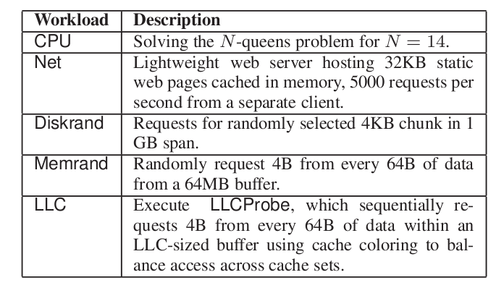
Contention in Xen
Same Core
  Same core & same L1 Cache & Same memory
Same Package
  Diff core but share L1 Cache and memory
Different Package
  Diff core & diff Cache but share Memory

Slide 22
I/O contends with self
VMs contend for the same resource
  Network with Network:
    More VMs → Fair share is smaller
  Disk I/O with Disk I/O:
    More disk access → longer seek times
Xen does N/W batching to give better performances
  BUT: this adds jitter and delay
  ALSO: you can get more than your fairshare because of the batch

Slide 23
I/O contends with self
VMs contend for the same resource
  Network with Network:
    More VMs → Fair share is smaller
  Disk I/O with Disk I/O:
    More disk access → longer seek times
Xen does N/W batching to give better performances
  BUT: this adds jitter and delay
  ALSO: you can get more than your fairshare because of the batch

Slide 24
Everyone Contends with Cache
No contention on same core
  VMs run in serial so access to cache is serial
No contention on diff package
  VMs use different cache
Lots of contention when same package
  VMs run in parallel but share same cache

Slide 25
Contention in Xen
  3x-6x Performance loss → Higher cost
VM
Work-conserving
scheduling
VM
Local Xen Testbed
Machine | Intel Xeon E5430, 2.66 Ghz
CPU | 2 packages each with 2 cores
Cache Size | 6MB per package
Non-work-conserving
CPU scheduling
Notes:
To understand the resource contention, we set up a local testbed close to what we see on Amazon EC2 which also uses the Xen VMM. We ran a bunch of synthetic benchmarks that stresses each physical resource on two VMs and measured the performance degradation due to sharing of these resources. As you can see there is a huge performance degradation for some resources and for some don’t. Eg. CPU which is managed by a non-work-conserving scheduler is very well isolated compared to other resources like Net, Disk, which are managed by a work-conserving scheduler. This is because under a work-conserving scheduler a VM gets full access to that resources when it is not shared with other VMs and hence perceives perf degrad when sharing. The major take away from this is that this huge performance degradation of 3-6x may directly lead to high cost..

Slide 26



What can a tenant do?
Ask provider for better isolation
… requires overhaul of the cloud
VM
Pack up VM and move
(See our SOCC 2012 paper)
… but, not all workloads cheap
to move
VM
This work: Greedy customer can recover performance by interfering with other tenants
Resource-Freeing Attack
Notes:
Tenant can go and ask the provider for better isolation guarantees
This may require changes to the hardware and/or software infrastructure of the cloud
Though this may very well happen in the future, the current state-of-the-art cloud infrastructure does not have any immediate solution to this problem.
Another approach to this problem that we explored in our recent SOCC 2012 paper is that the tenant can pack up his VM and move to another machine by stopping and restarting the VM hoping to land on a better machine, though this is possible and in fact beneficial for some workloads, it is not economical to move workloads which may have large state on their local disk.
In this work, we took a different approach, where the tenant becomes a vigilante and interferes with the workload of other VMs on the same physical machine in order to free up resources. We call this as resource freeing attack

Slide 27
Questions

