Slide 1
Intro to Map-Reduce
Feb 4, 2015

Slide 2
map-reduce?
A programming model or abstraction.
A novel way of thinking about designing a solution to certain problems…
[Image] http://goo.gl/5Dszro

Slide 3
Why?
Process and analyze huge volumes of data.
Facebook posts and photos, twitter streams, …
Facebook
220 million new photos per week
25TB of storage per week
This was in 2009!
Needle in a haystack, Facebook, http://goo.gl/zvAmc

Slide 4
Easy…
Computational resources are cheap.
Amazon EC2, Microsoft Azure, …
[Image] http://goo.gl/clqohd
Notes:
[The Hewlett-Piggard Hamminator] http://goo.gl/clqohd

Slide 5
Not really!
Code running on one CPU is simple, two is a headache, four is a nightmare, …
You get the picture.

Slide 6
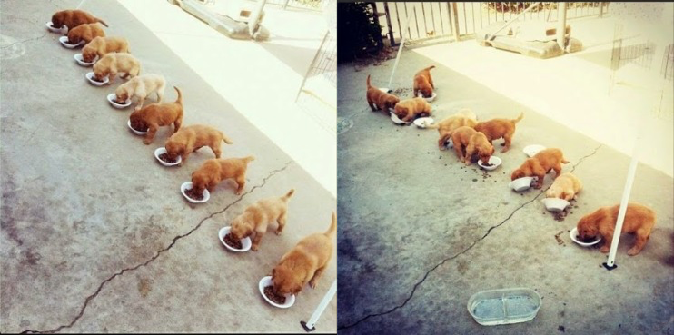
Multithreaded Programming
Theory
Practice
[Image] http://goo.gl/CCAENt

Slide 7
Pipe Dream
Forget multiple machines.
Write code imagining only one thread.
Someone else takes care of running the code on thousands of machines.
Free the programmer from the unnecessary details.

Slide 8
Map-Reduce
map-reduce programming model to the rescue

Slide 9
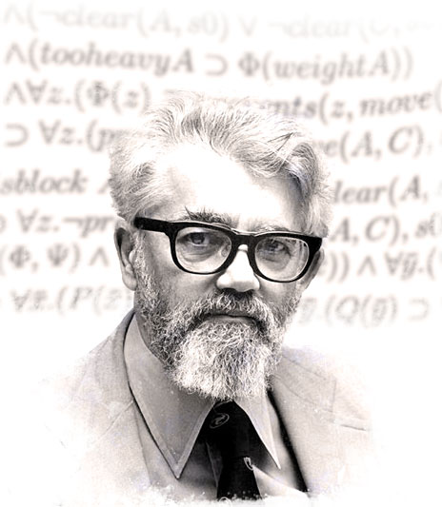
Long, long ago…
Lisp, 1958
A programming language that introduced several innovative ideas
Recursive Functions of Symbolic Expression and Their Computation by Machine, Part I
John McCarthy, MIT, April 1960
[Image] http://goo.gl/qhnBKB
Notes:
SICP - the famous introductory computer science course at MIT, taught by Hal Abelson and Gerald Sussman, uses ‘Scheme’, which is a dialect of LISP.

Slide 10
LISP
Introduced map and reduce.
Notes:
SICP - the famous introductory computer science course at MIT, taught by Hal Abelson and Gerald Sussman, uses ‘Scheme’, which is a dialect of LISP.

Slide 11
Map
map(m_{f}, [a₁, a₂, …a_{n}])
-> [b₁, b₂, …, b_{n}]
Accepts two arguments: a function and a list of values.
Generates output by repeatedly applying the function on the list of values.

Slide 12
Reduce
reduce(r_{f}, [b₁, b₂, …b_{n}])
-> c
Accepts two arguments: a function and a list of values.
Generates output by reducing the list of input values using the function.

Slide 13
Simple composition
reduce(r_{f}, map(m_{f}, [a₁, a₂, …a_{n}]))
-> c
Map’s output is a list of values, which reduce can accept as one of its argument.

Slide 14
Simple composition
reduce(sum, map(square, [1, 2, …, 10]))
-> 1²+2²+…+10²
Sum of squares
Ignore map/reduce; observe the functions

Slide 15
Analogy
Map
Break large problem into small pieces
Code m_{f} to solve one piece
Run map to apply m_{f} on the small pieces and generate nuggets of solutions

Slide 16
Analogy
Reduce
Code r_{f} to combine the nuggets
Run reduce to apply r_{f} on the nuggets to output the complete solution

Slide 17
Example — Word Count
Input: 1TB file
wc = {‘hello’: 0}
for line in file {
for word in line {
wc[word]++
}
}
print(wc)
You don’t want to write a multi-threaded version!
At least, not the night before the deadline.

Slide 18
Example — Word Count
1TB file split into 100,000 pieces (chunks)
With each piece
Split each line into words
For each unique word, maintain a counter
Output the word-count mappings
Merge word-count mappings together

Slide 19
Example — Word Count
1TB file split into 100,000 pieces (chunks)
With each piece
Split each line into words
For each unique word, maintain a counter
Output the word-count mappings
Merge word-count mappings together

Slide 20
Word Count: Split and count
‘There are three types of lies – lies, damn lies, and statistics’

Slide 21
Word Count: Split and count
‘There are three types of lies – lies, damn lies, and statistics’
{‘There’ : 1, ‘are’ : 1, ‘lies’ : 3, …}

Slide 22
Word Count: Merge
{‘There’ : 1, ‘lies’ : 1, …}
{ ‘lies’ : 2, …}
{ ‘There’ : 1, ‘lies’ : 3, …}
{‘are’ : 1}
{‘types’ : 1}
{ ‘are’ : 1, ‘types’ : 1, …}

Slide 23
Word Count: Merge
{‘There’ : 1, ‘lies’ : 1, …}
{ ‘lies’ : 2, …}
{ ‘There’ : 1, ‘lies’ : 3, …}
{‘are’ : 1}
{‘types’ : 1}
{ ‘are’ : 1, ‘types’ : 1, …}

Slide 24
A slightly different map-reduce
Map
Copies a function on a number of machines and applies each copy on different pieces of the input

Slide 25
A slightly different map-reduce
Reduce
Combine the map outputs from different machines into a final solution

Slide 26
Map-reduce reintroduced…
Google created the awareness
Hadoop made it into a sensation
Hadoop is an open-source map-reduce implementation based on Google’s paper.
MapReduce: Simplified Data Processing on Large Clusters
Jeffrey Dean and Sanjay Ghemawat
OSDI'04: Sixth Symposium on Operating System Design and Implementation. December, 2004.

Slide 27
Hadoop: Simplified

Slide 28
Example

Slide 29
Mapper
An instance of the map function

Slide 30
Reducer
An instance of the reduce function

Slide 31
Job
*User’s implementation of map and reduce functions.
Notes:
Mapper and reducer implementation are the key parts. Job can also include a custom scheduler or input formatter or components that can define or dictate the behavior of the computations.

Slide 32
Input Splits?
How is input data split into equal parts and provided to mappers?

Slide 33
Input Splits
Distributed Filesystem viz., HDFS, splits large files into smaller chunks.
Chunks are distributed and replicated over many machines.
Notes:
Who fixes the chunk size? Are chunks of varying size? What if input is a large collection of small files?

Slide 34
Trackers
JobTracker
Manage cluster resources
Schedule all user jobs
TaskTracker
Run map or reduce task on a machine

Slide 35
Trackers
There is one TaskTracker for each machine.
JobTracker monitors and controls the TaskTrackers.

Slide 36
Hadoop: Job

Slide 37
Parallel Mappers
Mappers run in parallel.
Simple & straightforward — operate on a set of chunks; inputs to mappers are disjoint

Slide 38
Data Locality
How to schedule mappers to machines?
As close to data as possible: data-local, rack-local

Slide 39
Map Output
Mappers output to local disk
expensive to write to DFS; if maps fail, output (and its copies) are useless

Slide 40
Fault Tolerance
Mapper Failures
Easiest to handle! Re-run failed mappers.
Assuming idempotence

Slide 41
Fault Tolerance
Reducer Failures
Re-run failed reducers
Complicated to re-run reducers!

Slide 42
Fault Tolerance
Speculative executions
Do we have to wait to see a failure?
Check for stragglers

Slide 43
Hadoop: Overview

Slide 44
Input to reducers
#reducers (n) known a priori.
#partitions equals #reducers.
Hash on the keys of mapper outputs.
partition = hash(key) mod n
Load balancing by randomization.

Slide 45
Wait before reducing…
Cannot start reducers before mappers complete.
Synchronization barrier between map and reduce phases. Is it necessary?

Slide 46
Embarrassing Parallelism

Slide 47
Not a panacea!
If your workload exhibits embarrassing parallelism, Hadoop might be the ideal framework.
If not, look for other parallel programming paradigms.

Slide 48
Word Count using Hadoop

Slide 49
Mapper
public static class MyMapper implements Mapper<LongWritable, Text, Text, IntWritable> {
private final static IntWritable one = new IntWritable(1);
private Text word = new Text();
public void map(LongWritable key, Text value,
OutputCollector<Text, IntWritable> output,
Reporter reporter) throws IOException {
// Split the given line (in value) into words and emit for each word the tuple <word, 1>
String line = value.toString();
StringTokenizer itr = new StringTokenizer(line);
while (itr.hasMoreTokens()) {
word.set(itr.nextToken());
output.collect(word, one);
}
}
}
https://developer.yahoo.com/hadoop/tutorial/module4.html
Notes:
Code written by the user is in blue (with comments in green).

Slide 50
Reducer
public static class MyReducer implements Reducer<Text, IntWritable, Text, IntWritable> {
public void reduce(Text key, Iterator<IntWritable> values,
OutputCollector<Text, IntWritable> output,
Reporter reporter) throws IOException {
int sum = 0;
while (values.hasNext()) {
sum += values.next().get();
}
output.collect(key, new IntWritable(sum));
}
}
https://developer.yahoo.com/hadoop/tutorial/module4.html
Notes:
Code written by the user is in blue (with comments in green).

Slide 51
Next steps?
CPS 516: Data-Intensive Computing Systems
Shivnath Babu
There are lots of folks in our department working on cool projects involving distributed systems!

