Slide 1
Failure, replication, replicated state machines (RSM), and consensus
Jeff Chase
Duke University

Slide 2


What is a distributed system?
"A distributed system is one in which the failure of a computer you didn't even know existed can render your own computer unusable." -- Leslie Lamport
Leslie Lamport

Slide 3
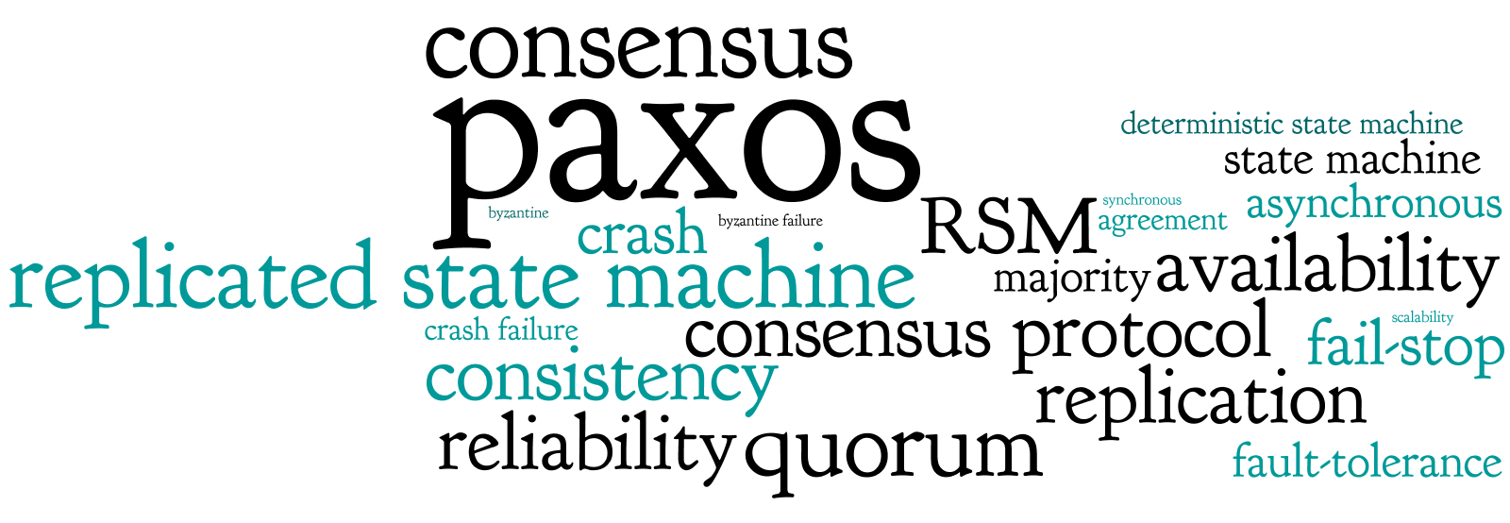
Just a peek, and a project (p3)
From http://paxos.systems

Slide 4

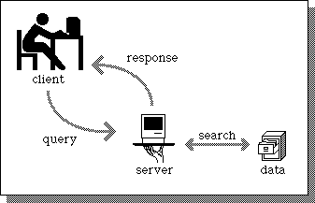
A service
Client
request
Web Server
client
reply
server
App Server
DB Server
Store

Slide 5
Scaling a service
Dispatcher
many
many
clients
Requests
Support substrate
Server cluster/farm/cloud/grid
Data center
Add interchangeable server “bricks” to partition (“shard”) and/or replicate service functionality for scale and robustness. Issues: state storage, server selection, request routing, etc.

Slide 6

What about failures?
X
Systems fail. Here’s a reasonable set of assumptions about failure properties for servers/bricks (or disks)
Fail-stop or fail-fast fault model
Nodes either function correctly or remain silent
A failed node may restart, or not
A restarted node loses its memory state, and recovers its secondary (disk) state
If failures are random/independent, the probability of some failure is linear with the number of units.
Higher scale → less reliable!

Slide 7
Nine
9. “Failures are independent.” - Chase

Slide 8
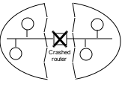
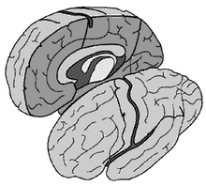

The problem of network partitions
Partitions cause “split brain syndrome”: part of the system can’t know what the other is doing.
A network partition is any event that blocks all message traffic between some subsets of nodes.

Slide 9


Distributed mutual exclusion
It is often necessary to grant some node/process the “right” to “own” some given data or function.
Ownership rights often must be mutually exclusive.
At most one owner at any given time.
How to coordinate ownership?

Slide 10


One solution: lock service
acquire
acquire
grant
x=x+1
release
A
grant
x=x+1
release
B
lock service

Slide 11
A lock service in the real world
acquire
acquire
grant
X
???
???
x=x+1
A
B
B

Slide 12


Solution: leases (leased locks)
A lease is a grant of ownership or control for a limited time.
The owner/holder can renew or extend the lease.
If the owner fails, the lease expires and is free again.
The lease might end early.
lock service may recall or evict
holder may release or relinquish

Slide 13

A lease service in the real world
acquire
acquire
grant
X
x=x+1
A
grant
x=x+1
release
B

Slide 14
Leases and time
The lease holder and lease service must agree when a lease has expired.
i.e., that its expiration time is in the past
Even if they can’t communicate!
We all have our clocks, but do they agree?
synchronized clocks
For leases, it is sufficient for the clocks to have a known bound on clock drift.
|T(C_{i}) – T(C_{j})| < ε
Build in slack time > ε into the lease protocols as a safety margin.

Slide 15
OK, fine, but…
What if the A does not fail, but is instead isolated by a network partition?
This condition is often called a “split brain” problem: literally, one part of the system cannot know what the other part is doing, or even if it’s up.

Slide 16
Never two kings at once
acquire
acquire
grant
x=x+1
???
A
grant
x=x+1
release
B

Slide 17
OK, fine, but…
What if the manager/master itself fails?
X
We can replace it, but the nodes must agree on who the new master is: requires consensus.

Slide 18
The Answer
Replicate the functions of the manager/master.
Or other coordination service…
Designate one of the replicas as a primary.
Or master
The other replicas are backup servers.
Or standby or secondary
If the primary fails, use a high-powered consensus algorithm to designate and initialize a new primary.

Slide 19
Consensus: abstraction
P₁
P₁
v₁
d₁
Unreliable multicast
Consensus algorithm
P₂
P₃
P₂
P₃
v₂
v₃
d₂
d₃
Step 1
Propose.
Step 2
Decide.
Each P proposes a value to the others.
All nonfaulty P agree on a value in a bounded time.
Coulouris and Dollimore

Slide 20

Coordination and Consensus
The key to availability and scalability is to decentralize and replicate functions and data.
But how to coordinate the nodes?
data consistency
update propagation
mutual exclusion
consistent global states
failure notification
group membership (views)
group communication
event delivery and ordering
All of these are consensus problems.

Slide 21
Fischer-Lynch-Patterson (1985)
No consensus can be guaranteed in an asynchronous system in the presence of failures.
Intuition: a “failed” process may just be slow, and can rise from the dead at exactly the wrong time.
Consensus may occur recognizably, rarely or often.
Network partition
Split brain

Slide 22
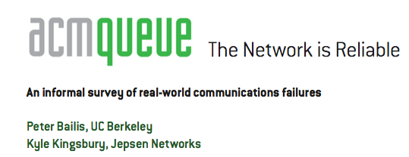
The celebrated FLP impossibility result demonstrates the inability to guarantee consensus in an asynchronous network (i.e., one facing indefinite communication partitions between processes) with one faulty process. This means that, in the presence of unreliable (untimely) message delivery, basic operations such as modifying the set of machines in a cluster (i.e., maintaining group membership, as systems such as Zookeeper are tasked with today) are not guaranteed to complete in the event of both network asynchrony and individual server failures.
…
Therefore, the degree of reliability in deployment environments is critical in robust systems design and directly determines the kinds of operations that systems can reliably perform without waiting. Unfortunately, the degree to which networks are actually reliable in the real world is the subject
of considerable and evolving debate.
…
CONCLUSIONS: WHERE DO WE GO FROM HERE?
This article is meant as a reference point—to illustrate that, according to a wide range of (often informal) accounts, communication failures occur in many real-world environments. Processes, servers, NICs, switches, and local and wide area networks can all fail, with real economic consequences. Network outages can suddenly occur in systems that have been stable for months at a time, during routine upgrades, or as a result of emergency maintenance. The consequences of these outages range from increased latency and temporary unavailability to inconsistency, corruption, and data loss. Split-brain is not an academic concern: it happens to all kinds of systems—sometimes for days on end. Partitions deserve serious consideration.

Slide 23

“CAP theorem”
consistency
C
C-A-P “choose two”
Dr. Eric Brewer
CA: available, and consistent, unless there is a partition.
CP: always consistent, even in a partition, but a reachable replica may deny service if it is unable to agree with the others (e.g., quorum).
A
P
AP: a reachable replica provides service even in a partition, but may be inconsistent.
Availability
Partition-resilience

Slide 24
Paxos: voting among groups of nodes
Self-appoint
Wait for majority
Wait for majority
“Can I lead b?”
“OK, but”
“v?”
“OK”
“v!”
L
N
1a
1b
2a
2b
3
log
log
safe
Propose
Promise
Accept
Ack
Commit
You will see references to Paxos state machine: it refers to a group of nodes that cooperate using the Paxos algorithm to keep a system with replicated state safe and available (to the extent possible under prevailing conditions). We will discuss it later.
Notes:
Consensus point of no return occurs when a majority of agents accept v and log it. At that point it’s done, the round has succeeded and consensus has been reached, and nobody can ever be permitted to choose a new/different value. However, it may take more rounds to recognize the success.

Slide 25
“CAP theorem”
consistency
C
C-A-P “choose two”
Dr. Eric Brewer
CA: available, and consistent, unless there is a partition.
CP: always consistent, even in a partition, but a reachable replica may deny service if it is unable to agree with the others (e.g., quorum).
A
P
AP: a reachable replica provides service even in a partition, but may be inconsistent.
Availability
Partition-resilience

Slide 26
Properties for Correct Consensus
Termination: All correct processes eventually decide.
Agreement: All correct processes select the same d_{i}.
Or…(stronger) all processes that do decide select the same d_{i}, even if they later fail.
Consensus “must be” both safe and live.
FLP and CAP say that a consensus algorithm can be safe or live, but not both.

Slide 27
Now what?
We must build practical, scalable, efficient distributed systems that really work in the real world.
But the theory says it is impossible to build reliable computer systems from unreliable components.
So what are we to do?

Slide 28
Recap: replicated lock service
acquire
acquire
grant
x=x+1
release
A
grant
X
x=x+1
release
B
How to handle failure of the lock server? Replicate it.

Slide 29
Coordination services and consensus
It is common to build cloud service apps around a coordination service.
Locking, failure detection, atomic/consistent update to small file-like objects in a consistent global name space.
Fundamental building block for scalable services.
Chubby (Google)
Zookeeper (Yahoo! / Apache)
Centrifuge (Microsoft)
They have the same consensus algorithm at their core (with minor variations): Paxos/VR/Raft
For p3 we use Raft for State Machine Replication.

Slide 30
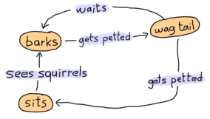



Finite State Machine (FSM) Dogs and Cats
http://learnyousomeerlang.com/finite-state-machines

Slide 31
FSM Basics
It’s a useful formal model for thinking about programs.
Finite set of states and actions (inputs)
Deterministic transition function: F(state, input) → state
State determines behavior (e.g., also emit an output).
We can think of servers as FSMs.
States: all possible combinations of internal data values.
Inputs: client requests change data + generate output.
F(state, input) → (state, output)

Slide 32
Lock server as an FSM
acquire()
Free
Busy
release()
It’s an FSM, but we also have to represent waiters, and actions like waking up a waiter on a state transition.

Slide 33
An FSM for two locks
A(1)
1F2F
1B2F
R(1)
A(2)
R(2)
A(1)
A(2)
R(2)
1F2B
1B2B
R(1)
It gets complicated fast. But the point is that, formally, a lock server with N locks may be viewed as an FSM.

Slide 34
Why bother with FSMs?
We can represent any server as an FSM – theoretically.
The point is that if we are going to replicate servers, we want all the replicas to give the same responses.
And that just means that they must be in the same state.
And that will happen if they receive exactly the same inputs (requests) in exactly the same order.
That is what we mean when we say we view a set of server replicas as a replicated state machine (RSM).

Slide 35
State machines
At any moment, machine exists in a “state”
What is a state?
Should think of as a set of named variables and their values

Slide 36
State machines
Clients can ask a machine about its current state.
What is your state?
1
2
Client
4
3
6
5
My state is “2”

Slide 37
State machines
“actions” change the machine’s state
What is an action?
Command that updates named variables’ values

Slide 38
State machines
“actions” change the machine’s state
Is an action’s effect deterministic?
For our purposes, yes. Given a state and an action,
we can determine next state w/ 100% certainty.

Slide 39
State machines
“actions” change the machine’s state
Is the effect of a sequence of actions deterministic?
Yes, given a state and a sequence of actions, can be 100% certain of end state

Slide 40
Replicated state machines
Each state machine should compute same state, even if some fail.
Client
What is the state?
What is the state?
Client
What is the state?
Client

Slide 41
Replicated state machines
What has to be true of the actions that clients submit?
Applied in same order
Client
Apply action a.
Apply action c.
Client
Apply action b.
Client

Slide 42
State machines
How should a machine make sure it applies action in same order across reboots?
Store them in a log!
Action
Action
Action
…

Slide 43
Replicated state machines
Can reduce problem of consistent, replicated states to consistent, replicated logs
…
…
…
…

Slide 44
Replicated state machines
How to make sure that logs are consistent?
Two-phase commit? …
…
…
…
…

Slide 45
Replicated state machines
What is the heart of the matter?
Have to agree on the leader, outside of the logs.
Leader=L
Leader=L
Apply action a.
…
…
Client
Leader=L
Leader=L
…
…

Slide 46
RSM and consensus
In this setting, consensus means that all replicas agree on a sequence (or log) of actions (requests, inputs, ops).
This strong ordering condition is necessary to ensure that all replicas converge (in the general case).
In more specific cases, we might be able to relax it. E.g., for a file service that executes reads/writes on distinct files.
And it is also a sufficient condition for convergence.
Presuming the server program (“service code” or “server state machine”) is in fact deterministic.
So now we have a clear goal!

Slide 47

Goal: Replicated Log
Clients
shl
Consensus Module
State Machine
Consensus Module
State Machine
Consensus Module
State Machine
Servers
Log
Log
Log
add
jmp
mov
shl
add
jmp
mov
shl
add
jmp
mov
shl
Replicated log => replicated state machine
All servers execute same commands in same order
Consensus module ensures proper log replication
System makes progress as long as any majority of servers are up
Failure model: fail-stop (not Byzantine), delayed/lost messages

Slide 48
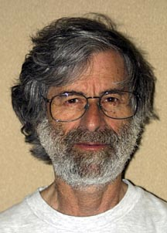

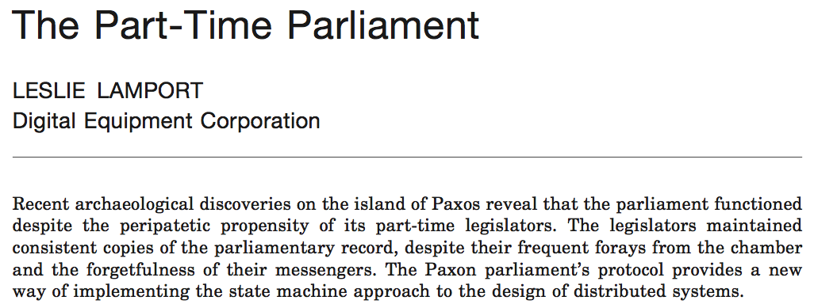
Consensus: the classic paper
ACM TOCS:
Transactions on Computer Systems
Submitted: 1990. Accepted: 1998
Introduced:

Slide 49
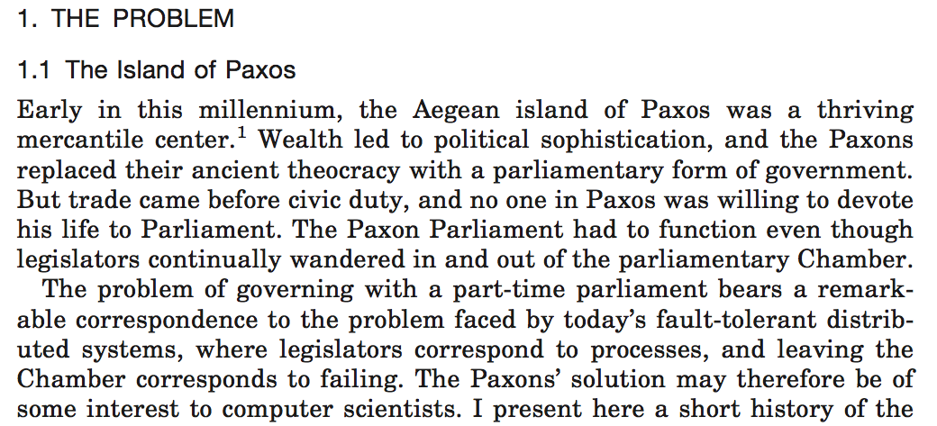



Slide 50
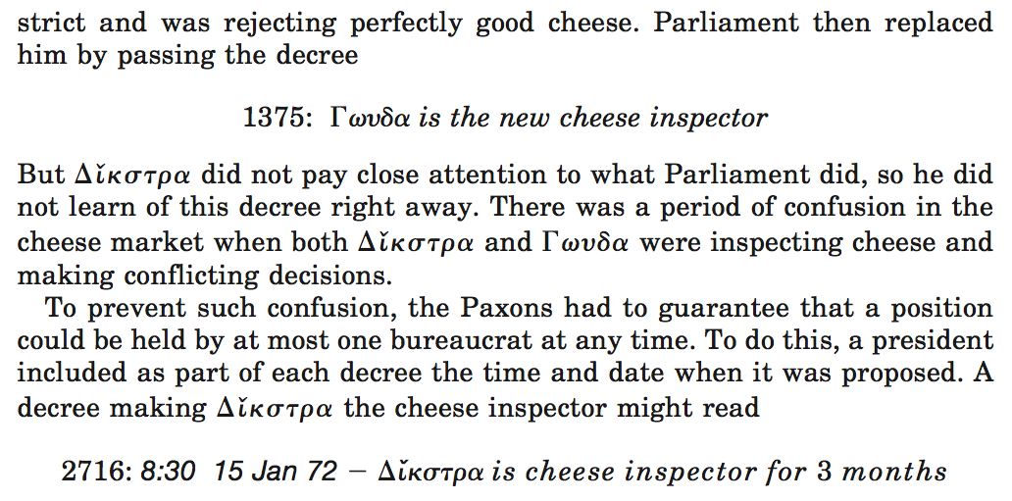
???

Slide 51
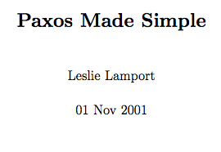
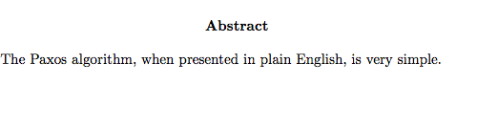
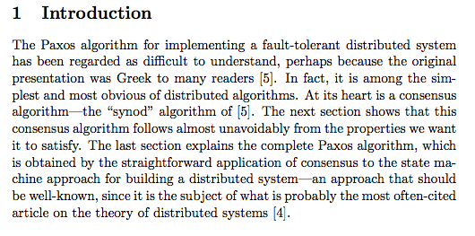
v2.0

Slide 52
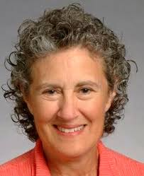
“Other” consensus algorithms
Viewstamped Replication (VR)
Barbara Liskov / Brian Oki 1988
Chapter on “Replication”, 2010
Raft
Diego Ongaro, John Ousterhout et. al., 2014
VR is the same as Paxos, but explained more directly. It was ahead of its time, and its significance was not recognized.
“Everything I know about systems I learned from Barbara Liskov.”
Raft is the same as VR, but has different vocabulary and minor differences to the message protocol and leader election.

Slide 53
Systems and terminology, and p3
Raft, VR, and Paxos are “the same”.
These slides mix graphics and terms from all three of these consensus presentations.
What is said applies to Raft and the lab p3.
For p3, we focus on two parts of Raft: leader election and log repair.
For p3, there are no clients and no new requests to the service. It is “just as if” the servers all restart after a series of failures, and they must agree on the history of actions.

Slide 54
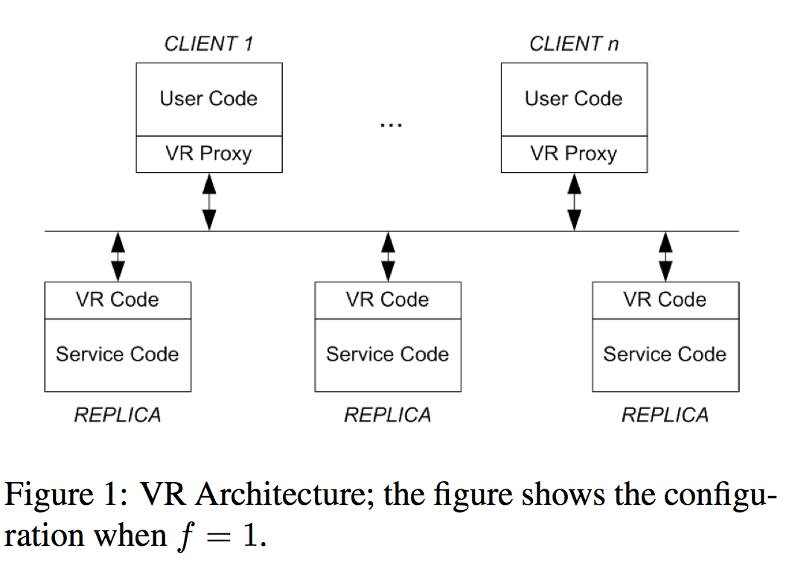
VR
In VR, the leader is chosen from among the replicas; the non-leader replicas (2f of them) serve as backup servers to tolerate up to f concurrent failures.

Slide 55
VR: proxy
VR proxy code runs in each client.
Discover/track the leader and send requests to it.
Tag requests with a monotonic sequence number.
Suppress duplicate replies.
The user code forms the requests: VR is independent of the application, so we say nothing more about it.

Slide 56
Service Code
Each replica runs a copy of the application-defined Service Code, which maintains the application state.
The Service Code receives a sequence of commands/operations and executes them in order (RSM).

Slide 57
VR Code
The VR code accepts requests and sequences them.
When a requested operation has committed, the VR code passes it to the the Service Code (RSM) to execute.
Once the Service Code receives an operation, you can’t take it back! It is committed for all time!
It maintains operation history as an append-only log.

Slide 58
Goal: Replicated Log
Clients
shl
Consensus Module
State Machine
Consensus Module
State Machine
Consensus Module
State Machine
Servers
Log
Log
Log
add
jmp
mov
shl
add
jmp
mov
shl
add
jmp
mov
shl
Replicated log => replicated state machine
All servers execute same commands in same order
Consensus module ensures proper log replication
System makes progress as long as any majority of servers are up
Failure model: fail-stop (not Byzantine), delayed/lost messages

Slide 59
The operation log / sequence
The committed operation log has a sequence of entries.
Paxos: slots
VR: op-numbers
Raft: log entry / log index
Goal: agree on an action/op/command for each index.
Each replica maintains its log: a sequence of actions that it has accepted (agreed to).
Note: each replica might keep its log in memory, or on stable storage (“disk”), as it chooses. There is no requirement that any part of the log on any replica survives restarts—if our failure assumption is true: a majority of replicas are up, at any time, always, no matter what.
Let us suppose that each protocol round is concerned only with choosing an action for the “next” log entry.

Slide 60
How to agree on the next entry?
This is not rocket science: we can make it sound hard, but let’s try to make it sound easy.
It is easy:
Pick a leader (primary) from among the replicas.
The leader receives requests/commands/actions from clients.
The leader picks a sequence for the actions, and tells the other replicas (the secondary replicas).
Once a majority of replicas have heard and agreed on each (index, action) pair, the action is committed for that index.
The leader responds to the clients after commit.
All replicas apply committed actions in the agreed commit order.
→ All replicas converge to the same state.

Slide 61
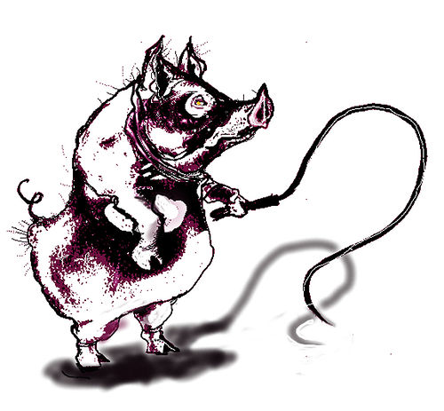

The players
Leader / primary
Become leader.
Rewrite history.
Dictate the future.
Stay leader forever.
If deposed goto step 1.
Acceptor / secondary
Adopt leader.
Tell it your history.
Accept whatever the leader says.
Write it all down.
If a new leader appears, goto step 1.

Slide 62
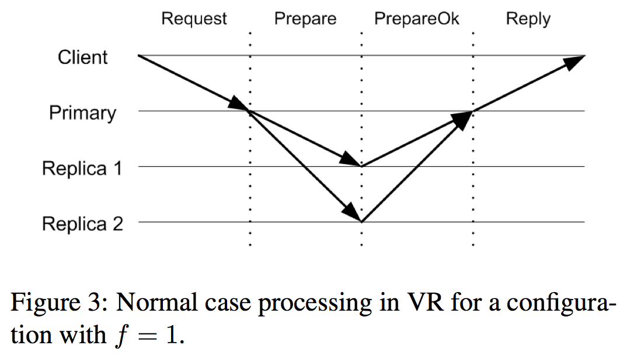
VR: Reaching consensus
It’s easy if you have a leader and everybody follows!
(propose)
(accept)
Majority accepted? Commit!

Slide 63
The easy part: a stable view
^{client}
^{commit!}
^{commit!}
^{commit!}
^{primary}
^{leader}
^{prepare}
^{notify}
^{prepare}
^{notify}
^{prepare}
^{notify}
A leader may send multiple ops to accepters in each prepare message (e.g., as in Raft AppendRPCs).
Safety: All majority-accepted operations must survive into future views, even if failure strikes and nobody knows that they have committed. (“First writer wins forever.”)

Slide 64
VR: Learning of commitment
^{+notify}
^{commit!}
At some point after the operation has committed, the primary informs the other replicas about the commit. This need not be done immediately. A good time to send this information is on the next PREPARE message, as piggy-backed information; only the op-number of the most recent committed operation needs to be sent.
When a non-primary replica learns of a commit, it waits until it has executed all earlier operations and until it has the request in its log. Then it executes the operation by performing the upcall to the service code.

Slide 65
Does this algorithm work?
That’s really all there is to it, if we have good leaders:
Leaders rule only with consent of the governed: they rule only if a majority of acceptors adopt and follow.
Leaders don’t fight: if somebody else is leading, then they follow or get out of the way.
Leaders accept and promulgate the consensus view of history. They don’t try to change the past.
Leaders decide and apply their decisions consistently.
Also: acceptors may fail and forget, but they do not lie.

Slide 66
Why is consensus hard?
OK, maybe it is rocket science…
What if the leader fails?
What if the network is partitioned? Could there are leaders on either side of the partition?
Or it there appear to be failures and partitions because the network is slow?
What if a partition heals, so now there are two leaders?
What if replicas stall, or fail and then recover? How do they get back up to date?
Answer: establish clear rules for who the leader is, for every contingency. Keep the leader up to date. The leader keeps others up to date. And vote: majority rules.

Slide 67
Recap: an RSM replica group
(propose)
(accept)
Majority accepted? Commit!
Each replica is a copy of the application server, with all of its state. Replicas keep a log of operations (at least in memory) and apply them in order to their state. The consensus protocol ensures that their states converge. We assume that only that the app is deterministic and that always some majority is functioning correctly; faulty replicas just stop, and may restart “empty” and resync.

Slide 68
Consensus oversimplified
If leader appears failed and now is a good time to run, declare candidacy.
Become leader by majority vote.
Discover and affirm history.
Propose values for new log slots in order; notify others if majority accepts.
Adopt leader.
Tell it your history.
Accept whatever the leader says.
Write it all down.
If a new leader appears, goto step 1.

Slide 69
Raft in normal operation
AppendEntries @i
entries: [v1,v2]
committed=i
AppendEntries @i+2
entries: [v3,v4]
committed=i+2
“OK”
“OK”
Leader
Followers
log [v1,v2]
log [v3,v4]
commit [v1,v2]
Followers accept whatever the leader proposes.
Accept everything, even if it overwrites log history.

Slide 70
A nasty scenario…
C
A
P
Network partition: leader L1 survives with minority.
How to make progress where we can do it safely?
How to avoid accepting requests where it might be unsafe?
Partition heals → L1 and L2 both try to lead.
How to establish which leader is “current”, so L1 steps down?
How to reconcile conflicting histories in the logs?
L1
L2
A happy group of 5 replicas.
Oops, network partition. Leader L1 survives on minority side.
L2 is elected on majority side; L1 struggles on.
Partition heals. L1 hears L2 and steps down.

Slide 71
A nasty scenario…
C
A
P
Network partition: leader survives in minority side.
How to make progress where we can do it safely?
How to avoid accepting requests where it might be unsafe?
Answer: majority rules. Leader requires a majority vote (quorum). Majority side elects new leader (L2) and continues.
No requests can commit under L1: no majority. But they try!
Partition heals → L1 and L2 both try to lead.
How to establish which leader is “current”, so L1 steps down?
How to reconcile conflicting histories in the logs?
Answer: monotonically increasing terms / views. Everyone can see that L1 is an old expired leader from an earlier term. L1 steps down and yields to L2. Uncommitted log entries written under L1 are overwritten with L2’s history.

Slide 72
The importance of majority (quorum)
C
A
P
In order to lead and serve client requests, a leader L1 must continually receive votes from a majority of the group (a quorum).
The quorum rule protects consistency (C) in a network partition: at most subgroup commits to the log, so it does not diverge.
But it sacrifices availability (A). If a majority of replicas fail, it would be safe for the survivors to serve clients. But they must not, because this case is indistinguishable from a network partition.
L1 and F1 cannot commit log entries because they do not have a quorum. So they cannot serve clients → no Availability if the majority had merely failed.
L2 can gain a quorum from the other followers, so they can continue to serve requests together in close cooperation.
F1
L1
L2
The quorum rule protects Consistency of the shared log in a partition. At most one side of a partition makes progress: there cannot be two disjoint majorities.

Slide 73
Rejecting a leader from the past
The protocol runs as a sequence of views or terms.
A new view/term begins when some participant (e.g., L2) declares an election (e.g., because L2 does not hear the old leader L1).
Winning requires a quorum → at most one leader per view/term.
Nobody pays attention to a leader/candidate L1 from the past, and L1 steps down if L1 learns of a term later than its own.
F2
F1
L1
L2
L1
L2
L2
During the partition, L2 declares candidacy in a new term and wins a quorum. When the partition heals, F2 rejects messages from L1, whose term has expired. F1 learns of the new term and defects to L2, also rejecting L1. L1 learns of the new term and steps down.

Slide 74
Terms
Term 1
Term 2
Term 3
Term 4
Term 5
time
Elections
Split Vote
Normal Operation
Time divided into terms:
Election
Normal operation under a single leader
At most 1 leader per term
Some terms have no leader (failed election)
Each server maintains current term value
Key role of terms: identify obsolete information

Slide 75
Spelling it out: views/terms
In general, a participant P may leave a group temporarily due to loss of connectivity or failure/restart.
The group moves on, and when P rejoins the group, P’s state is seen to be stale: P can’t participate correctly.
E.g., in consensus, P’s log has diverged or has missing entries, P’s view of the identity of the group’s leader is no longer correct.
Consensus (and other distributed protocols) need some way to detect stale participants and reintegrate them.
Consensus uses view/term for this purpose.
Tag messages with the view/term, tag state with the view/term, and compare tags to detect staleness.

Slide 76
Numbering the views (terms)
Every message in the protocol carries the sender’s current view# (term).
If the receiver has a higher view# than the sender, it ignores and rejects the message.
Stale participants can do no damage.
If a participant learns of a view# v higher than its own, it sets its view# to v.
The view# is an example of a logical clock, a foundational concept in distributed systems.
When a participant learns it is stale, it comes up to date.
E.g., in the “nasty scenario” example, L1 steps down, and L1 and F1 accept updates from new leader L2 to repair their logs.

Slide 77
Server States
At any given time, each server is either:
Leader: handles all client interactions, log replication
At most 1 viable leader at a time
Follower: completely passive (issues no RPCs, responds to incoming RPCs)
Candidate: used to elect a new leader
Normal operation: 1 leader, N-1 followers
timeout, new election
timeout, start election
receive votes from majority of servers
start
Follower
Candidate
Leader
“step down”
discover server with higher term
discover current server or higher term

Slide 78
Log Structure
term
1
2
3
4
5
6
7
8
log index
1 add
1 cmp
1 ret
2 mov
3 jmp
3 div
3 shl
3 sub
leader
command
1 add
1 cmp
1 ret
2 mov
3 jmp
1 add
1 cmp
1 ret
2 mov
3 jmp
3 div
3 shl
3 sub
followers
1 add
1 cmp
1 add
1 cmp
1 ret
2 mov
3 jmp
3 div
3 shl
committed entries
Log entry = index, term, command
Every entry is tagged with a term. These tags are used to detect stale entries, and in leader election and log repair.

Slide 79
Nasty scenario: getting nastier
A bare majority of replicas commit new entries under L2.
The minority writes new uncommitted entries under L1.
Then L2 and a follower (F3) fail, and the minority rejoins.
Progress is possible, but the replicas have divergent logs. All committed updates must be preserved.
How to recognize the lone survivor (F2) who knows the committed history, and who can pass it to the others?
F2
F2
F1
X
F3
L1
X
L2
L1
L2
L1

Slide 80
Nasty scenario: getting nastier
Answer: look at the terms in the log entries.
Every entry is tagged with a view#/term.
This is the key to the log repair protocol.
F2 rejects L1 because F2 knows a higher term than L1. L1 learns its term has expired, and L1 steps down.
A new election is declared → new term and new leader.
F2 has log entries from a higher term than the others. Higher terms dominate → the others accept F2’s entries.
F2
F2 rejects L1.
L1 steps down.
A new term begins.
An election starts.
In Raft, F2 wins because its log is most advanced (higher terms). F2’s log is used to repair the others. And the group continues.
L1

Slide 81
Log Consistency
High level of consistency between logs:
If log entries on different servers have same index and term:
They store the same command
The logs are identical in all preceding entries
If a given entry is committed, all preceding entries are also committed
1
2
3
4
5
6
1 add
1 cmp
1 ret
2 mov
3 jmp
3 div
1 add
1 cmp
1 ret
2 mov
3 jmp
4 sub

Slide 82
Log Inconsistencies
Leader changes can result in log inconsistencies:
log index
1
2
3
4
5
6
7
8
9
10
11
12
leader for term 8
1
1
1
4
4
5
5
6
6
6
(a)
1
1
1
4
4
5
5
6
6
Missing Entries
(b)
1
1
1
4
(c)
1
1
1
4
4
5
5
6
6
6
6
possible followers
(d)
1
1
1
4
4
5
5
6
6
6
7
7
Extraneous Entries
(e)
1
1
1
4
4
4
4
(f)
1
1
1
2
2
2
3
3
3
3
3

Slide 83
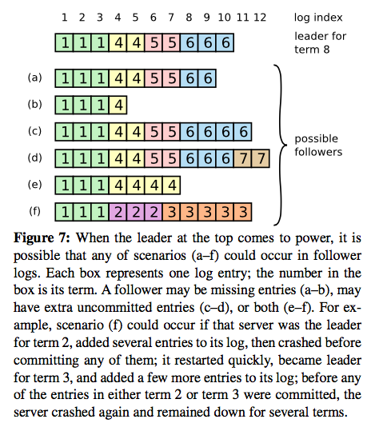

Slide 84
Raft in normal operation (stable term)
AppendEntries @i
term=t
last=(t, i)
entries: [v1,v2]
committed=i
AppendEntries @i+2
term=t
last=(t, i+2)
entries: [v3,v4]
committed=i+2
“OK”
“OK”
Leader
Followers
check (t,i)
log [v1,v2]
check (t,i+2)
log [v3,v4]
commit [v1,v2]
Followers accept whatever the leader proposes.
But first: validate that (term, index) are “in sync”.
Leader’s term is behind? → reject proposal: “I won’t follow you!”
Leader’s last=(t,i) is ahead? → reject proposal: “Catch me up!”
Once in sync, accept everything, even if it overwrites log history.

Slide 85
Raft: log repair
To bring a follower’s log into consistency with its own, the leader must find the latest log entry where the two logs agree, delete any entries in the follower’s log after that point, and send the follower all of the leader’s entries after that point.
All of these actions happen in response to the consistency check performed by AppendEntries RPCs. The leader maintains a nextIndex for each follower, which is the index of the next log entry the leader will send to that follower. When a leader first comes to power, it initializes all nextIndex values to the index just after the last one in its log (11 in Figure 7). If a follower’s log is inconsistent with the leader’s, the AppendEntries consistency check will fail in the next AppendEntries RPC.
After a rejection, the leader decrements nextIndex and retries the AppendEntries RPC. Eventually nextIndex will reach a point where the leader and follower logs match. When this happens, AppendEntries will succeed, which removes any conflicting entries in the follower’s log and appends entries from the leader’s log (if any).
Once AppendEntries succeeds, the follower’s log is consistent with the leader’s, and it will remain that way for the rest of the term.

Slide 86
Raft: leadership safety condition
Elections choose a sufficiently up-to-date leader:
Leader’s last(term) is at least as high as all its voters.
Leader’s last(index) is at least as high as all its voters with the same last(term).
Candidates/leaders step down when they see a better (more up-to-date) candidate/leader.
Safety property: a new leader has already seen (and remembers) at least all committed entries.
The new leader L won a majority, and so L is at least as up to date as a majority of replicas. Since any committed entry e was accepted by a majority of replicas, at least one of the voters v for L must have entry e, and since L is at least as up to date as v, L must have e as well.

Slide 87
Picking the Best Leader
Can’t tell which entries are committed!
During elections, choose candidate with log that contains all committed entries
Candidates include log info in RequestVote RPCs (index & term of last log entry)
Voting server V denies vote if its log is “more complete”: (lastTerm_{V} > lastTerm_{C}) || (lastTerm_{V} == lastTerm_{C}) && (lastIndex_{V} > lastIndex_{C})
1
2
3
4
5
1
1
1
2
2
committed?
1
1
1
2
1
1
1
2
2
unavailable during leader transition

Slide 89
Note
Leader election is the key difference of Raft from VR and Paxos. It leads to a little more thrashing around to pick a leader, but it avoids the need for new mechanisms to update the leader’s state.

Slide 90
Safety: committed entries always survive
In an earlier scenario, one replica (F2) survives to propagate committed log entries into a new term.
In fact: for any committed log entry e, at least one replica who knows of e survives into any new term, always.
Why? It requires a quorum to commit entries or elect a new leader, and any two quorums must intersect.
It is not possible to have two disjoint majorities! This is the key to the proof that Consensus is safe and consistent.
F2
F2
F1
X
X
L1
L2
L2
(1)
(2)
(3)
(4)

Slide 91
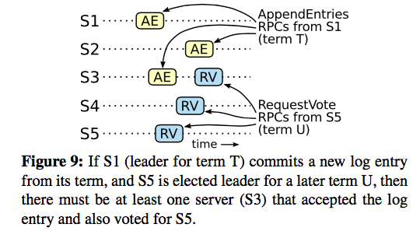
Raft: safety
Note: when a new leader L propagates older entries into a new term, L does not and cannot (always) know if those entries committed or not in the old term. But it does not matter: the set of “most up to date” entries is guaranteed to include all committed entries, so all committed entries survive into the new term. And once L propagates them to a quorum, they are known to have committed.

Slide 92
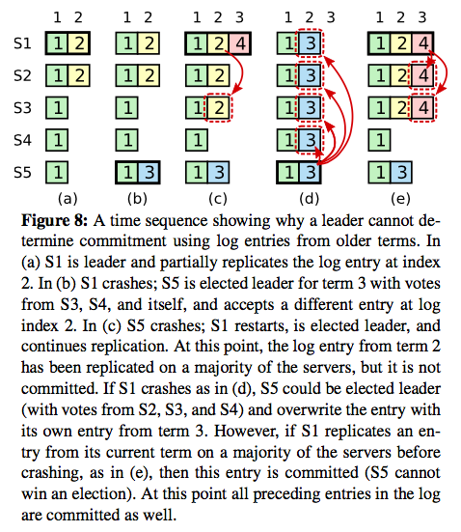

Slide 93
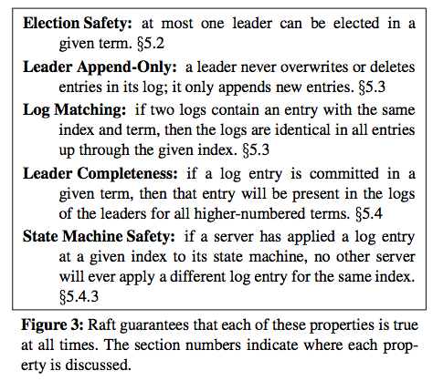

Slide 94
Summary
Leader/master coordinates, dictates consensus
View the service as a deterministic state machine.
Master (also called “primary”) dictates order of client operations.
→ All non-faulty replicas reach the same state.
Remaining problem: who is the leader?
Leader itself might fail or be isolated by a network partition.
Requires a scheme for “leader election” to choose a new leader.
Consensus is safe but not live: in the worst case (multiple repeated failures) it might not terminate.
But in practice Consensus gets the job done…if it can be done.
Raft is one variant of Consensus, with minor differences from older variants (VR and Paxos).

Slide 95
Liveness timeouts
All consensus systems rely on careful timeouts for liveness, because an election or view change disrupts any consensus in progress.
Contending leaders can “livelock” the consensus algorithm.
VR: “More generally liveness depends on properly setting the timeouts used to determine whether the primary is faulty so as to avoid unnecessary view changes.”
Note: also want fast failover times → tight timeouts!
Must balance these competing considerations.
Raft: randomized timeouts to avoid contending leaders.

Slide 96

Consensus in Practice
Lampson: “Since general consensus is expensive, practical systems reserve it for emergencies.”
e.g., to select a primary/master, e.g., a lock server.
Zookeeper
Google Chubby service (“Paxos Made Live”)
Pick a primary with Paxos. Do it rarely; do it right.
Primary holds a “master lease” with a timeout.
Renew by consensus with primary as leader.
Primary is “czar” as long as it holds the lease.
Master lease expires? Fall back to Paxos.
(Or BFT.)

Slide 97
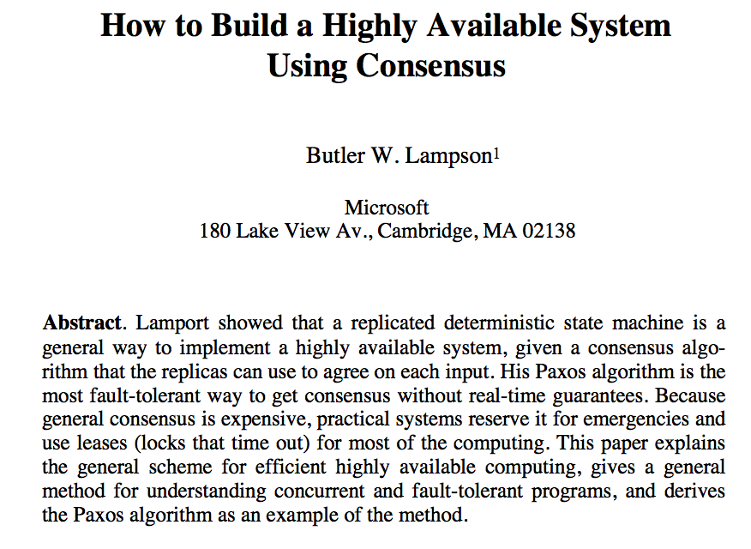
[Lampson 1995]

Slide 98

Butler W. Lampson
http://research.microsoft.com/en-us/um/people/blampson/
Butler Lampson is a Technical Fellow at Microsoft Corporation and an Adjunct Professor at MIT…..He was one of the designers of the SDS 940 time-sharing system, the Alto personal distributed computing system, the Xerox 9700 laser printer, two-phase commit protocols, the Autonet LAN, the SPKI system for network security, the Microsoft Tablet PC software, the Microsoft Palladium high-assurance stack, and several programming languages. He received the ACM Software Systems Award in 1984 for his work on the Alto, the IEEE Computer Pioneer award in 1996 and von Neumann Medal in 2001, the Turing Award in 1992, and the NAE’s Draper Prize in 2004.

