Slide 1
Services and Scale
Jeff Chase
Duke University

Slide 2




A simple, familiar example
request
“GET /images/fish.gif HTTP/1.1”
reply
client (initiator)
server
sd = socket(…);
connect(sd, name);
write(sd, request…);
read(sd, reply…);
close(sd);
s = socket(…);
bind(s, name);
sd = accept(s);
read(sd, request…);
write(sd, reply…);
close(sd);

Slide 3

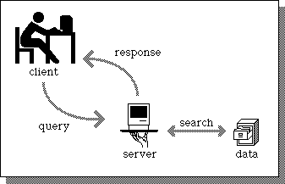
A service
Client
request
Web Server
client
reply
server
App Server
DB Server
Store

Slide 4

The Steve Yegge rant, part 1
Products vs. Platforms
Selectively quoted/clarified from http://steverant.pen.io/, emphasis added. This is an internal google memorandum that ”escaped”. Yegge had moved to Google from Amazon. His goal was to promote service-oriented software structures within Google.
So one day Jeff Bezos [CEO of Amazon] issued a mandate....[to the developers in his company]:
His Big Mandate went something along these lines:
1) All teams will henceforth expose their data and functionality through service interfaces.
2) Teams must communicate with each other through these interfaces.
3) There will be no other form of interprocess communication allowed: no direct linking, no direct reads of another team's data store, no shared-memory model, no back-doors whatsoever. The only communication allowed is via service interface calls over the network.

Slide 5
The Steve Yegge rant, part 2
Products vs. Platforms
4) It doesn't matter what technology they use. HTTP, Corba, PubSub, custom protocols -- doesn't matter. Bezos doesn't care.
5) All service interfaces, without exception, must be designed from the ground up to be externalizable. That is to say, the team must plan and design to be able to expose the interface to developers in the outside world. No exceptions.
6) Anyone who doesn't do this will be fired.
7) Thank you; have a nice day!

Slide 6

SaaS platforms
New!
$10!
A study of SaaS application frameworks is a topic in itself.
Rests on material in this course
We’ll cover the basics
  Internet/web systems and core distributed systems material
But we skip the practical details on specific frameworks.
  Ruby on Rails, Django, etc.
Recommended: Berkeley MOOC
  Fundamentals of Web systems and cloud-based service deployment.
  Examples with Ruby on Rails
Web/SaaS/cloud
http://saasbook.info

Slide 7
Server performance
How many clients can the server handle?
What happens to performance as we increase the number of clients?
What do we do when there are too many clients?

Slide 8
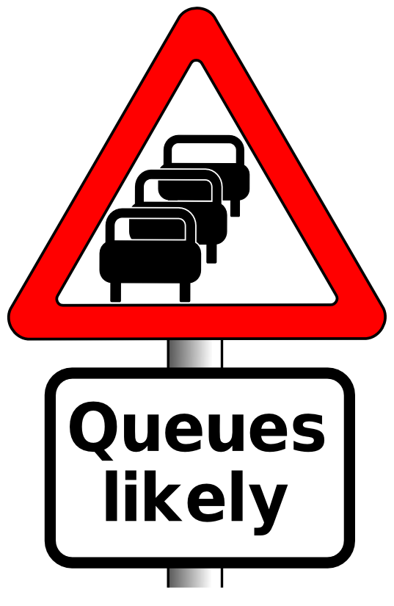
Understanding performance: queues
offered load
request stream @
arrival rate λ
Request == task == job
Handle request: task occupies center for D time units (its service demand).
Service
Center
Note: real systems are networks of centers and queues. To maximize overall utilization/throughput, we must think about how the centers interact. (For example, go back and look again at multi-level feedback queue with priority boosts for I/O bound jobs.)
But we can also “squint” and think of the entire network as a single queueing center (e.g., a server), and we won’t go too far astray.
CPU
Disk

Slide 9
Queuing Theory for Busy People
Requests wait here in FIFO queue
Handle request: task occupies center for mean service demand D time units
offered load
request stream @
arrival rate λ
(requests/time)
“M/M/1” Service Center
Big Assumptions (at least for this summary)
  Single service center (e.g., one core), with no concurrency.
  Queue is First-Come-First-Served (FIFO, FCFS).
  Independent request arrivals at mean rate λ (poisson arrivals).
  Requests have independent service demands at the center.
  i.e., arrival interval (1/λ) and service demand (D) are exponentially distributed (noted as “M”) around their means.
  These assumptions are rarely exactly true for real systems, but they give a rough (“back of napkin”) understanding of queue behavior.

Slide 10
Ideal throughput: cartoon version
throughput == arrival rate
The center is not saturated: it completes requests at the rate requests are submitted.
throughput == peak rate
The center is saturated. It can’t go any faster, no matter how many requests are submitted.
Ideal throughput
Response rate (throughput)
i.e., request completion rate
This graph shows throughput (e.g., of a server) as a function of offered load. It is idealized: your mileage may vary.
saturation
peak rate
Request arrival rate (offered load)

Slide 11
Throughput: reality
Thrashing, also called congestion collapse
Real servers/devices often have some pathological behaviors at saturation. E.g., they abort requests after investing work in them (thrashing), which wastes work, reducing throughput.
delivered throughput
(“goodput”)
Response rate (throughput)
i.e., request completion rate
saturation
Illustration only
Saturation behavior is highly sensitive to implementation choices and quality.
peak rate
Request arrival rate (offered load)

Slide 12
Utilization
What is the probability that the center is busy?
  Answer: some number between 0 and 1.
What percentage of the time is the center busy?
  Answer: some number between 0 and 100
These are interchangeable: called utilization U
The probability that the service center is idle is 1-U

Slide 13
Utilization: cartoon version
U = XD
X = throughput
D = service demand, i.e., how much time/work to complete each request (on average).
U = 1 = 100%
The server is saturated. It has no spare capacity. It is busy all the time.
saturated
1 == 100%
This graph shows utilization (e.g., of a server) as a function of offered load. It is idealized: each request works for D time units on a single service center (e.g., a single CPU core).
Utilization
(also called load factor)
saturation
peak rate
Request arrival rate (offered load)

Slide 14
The Utilization “Law”
If the center is not saturated then:
  U = λD = (arrivals/time) * service demand
Reminder: that’s a rough average estimate for a mix of arrivals with average service demand D.
If you actually measure utilization at the center, it may vary from this estimate.
  But not by much.

Slide 15
It just makes sense
The thing about all these laws is that they just make sense. So you can always let your intuition guide you by working a simple example.
If it takes 0.1 seconds for a center to handle a request, then peak throughput is 10 requests per second. So let's say the offered load λ is 5 requests per second.
Then U = λ*D = 5 * 0.1 = 0.5 = 50%.
It just makes sense: the center is busy half the time (on average) because it is servicing requests at half its peak rate. It spends the other half of its time twiddling its thumbs. The probability that it is busy at any random moment is 0.5.
Note that the key is to choose units that are compatible. If I had said it takes 100 milliseconds to handle a request, it changes nothing. But U = 5*100 = 500 is not meaningful as a percentage or a probability. U is a number between 0 and 1. So you have to do what makes sense. Our treatment of the topic in this class is all about formalizing the intuition you have anyway because it just makes sense. Try it yourself for other values of λ and D.

Slide 16
Understanding utilization and throughput
Throughput/utilization are “easy” to understand for a single service center that stays busy whenever there is work to do.
It is more complex for a network of centers/queues that interact, and where each task/job/request visits multiple centers.
And that’s what real computer systems look like.
  E.g., CPU, disk, network, and mutexes…
  Other synchronization objects
The centers can service requests concurrently!
Some may be slower than others; any bottlenecks limit overall throughput. If there is a bottleneck, then other centers are underutilized even if the overall system is saturated.

Slide 17
Understanding utilization and throughput
Is high utilization good or bad?
Good. We don’t want to pay $$$ for resources and then leave them idle. Especially if there is useful work for them to do!
Bad. We want to serve any given workload as efficiently as possible. And we want resources to be ready for use when we need them.
Utilization ←→ contention

Slide 18
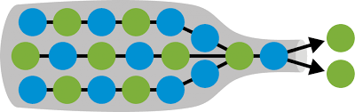
Understanding bottlenecks
In a multi-center queue system, performance is limited by the center with the highest utilization for any workload.
That’s the center that saturates first: the bottleneck.
Always optimize for the bottleneck.
E.g., it’s easy to know if your service is “CPU-limited” or “I/O limited” by running it at saturation and looking at the CPU utilization. (e.g., “top”).

Slide 19
Mean response time (R) for a center
R == D
The server is idle. The response time of a request is just the time to service the request (do requested work).
R = D + queuing delay (DN)
As the server approaches saturation, the queue of waiting requests (size N) grows without bound. (We will see why in a moment.)
R_{max}
saturation (U = 1:
U is server utilization)
Average response time R
Illustration only
Saturation behavior is highly sensitive to implementation choices and quality.
U
R
saturation
D
λ_{max}
Request arrival rate (offered load)

Slide 20
Little’s Law
For a FIFO/FCFS queue in steady state, mean response time R and mean queue length N are governed by:
      Little’s Law: N = λR
Why?
Suppose a task T is in the system for R time units.
During that time:
  λR new tasks arrive (on average)
  N tasks depart (all the tasks ahead of T, on average).
But in steady state, the flow in balances flow out.
  “Obviously”: throughput X = λ in steady state. Otherwise requests “bottle up” in the server -- not a steady state.

Slide 21
Inverse Idle Time “Law”
Service center saturates as 1/ λ approaches D: small increases in λ cause large increases in the expected response time R. At saturation R is unbounded (divide by zero: no idle time at saturation == 100% utilization).
R
U
1(100%)
Little’s Law gives mean response time R = D/(1 – U).
(“Service demand over the idle time”)
  Intuitively, an average task T’s response time R = D + DN.
  (Serve T at cost D, and N other tasks ahead of T in queue.)
  Substituting λR for N (by Little’s Law): R = D + D λR
  Substituting U for λD (by Utilization Law): R = D + UR
  R - UR = D → R(1 - U) = D → R = D/(1 - U)

Slide 22
Why Little’s Law is important
1. Intuitive understanding of FCFS queue behavior.
    Compute response time from demand parameters (λ, D).
    Compute N: how much storage is needed for the queue.
2. Notion of a saturated service center.
  Response times rise rapidly with load and are unbounded.
    At 50% utilization, a 10% increase in load increases R by 10%.
    At 90% utilization, a 10% increase in load increases R by 10x.
3. Basis for predicting performance of queuing networks.
    Cheap and easy “back of napkin” (rough) estimates of system performance based on observed behavior and proposed changes, e.g., capacity planning, “what if” questions.
  Guides intuition even in scenarios where the assumptions of the theory are not (exactly) met.

Slide 23

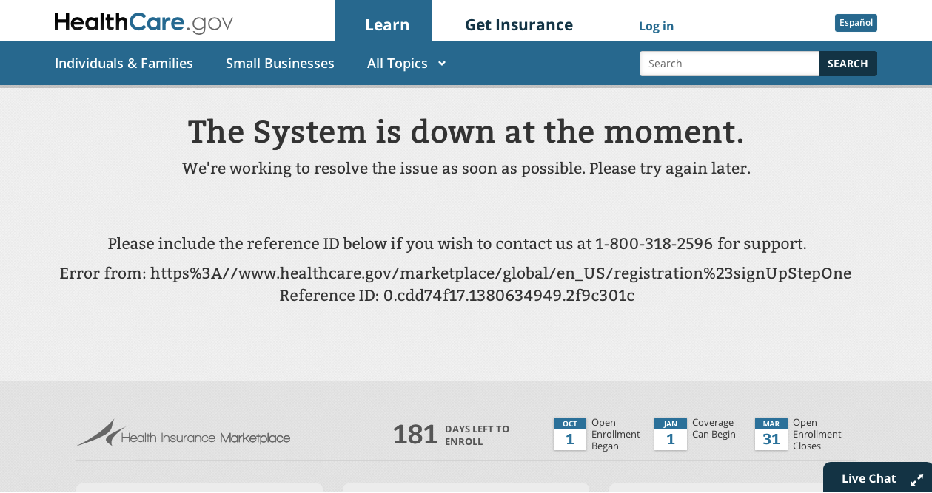
The problem of volume continues to be a top concern for the administration, Zients said. Right now, HealthCare.gov can comfortably handle between 20,000 and 25,000 users at a time. But at "peak volumes, some users still experience slower response times," he said.
Officials are also expecting traffic to spike at the end of the month and onward. So this weekend, the administration is adding more servers and data storage to help handle any additional load.
The goal is "to maintain good speed and response times at higher volumes," Zients said. "This is a key focus of our work now."

Slide 24
Managing scalable performance
Part 2

Slide 25
Improving performance (X and R)
Make the service center faster. (“scale up”)
  Upgrade the hardware, spend more $$$
Reduce the work required per request (D).
  More/smarter caching, code path optimizations, use smarter disk layout.
Add service centers, expand capacity. (“scale out”)
  RAIDs, blades, clusters, elastic provisioning
  N centers improves throughput by a factor of N: iff we can partition the workload evenly across the centers!
  Note: the math is different for multiple service centers, and there are various ways to distribute work among them, but we can “squint” and model a balanced aggregate roughly as a single service center: the cartoon graphs still work.

Slide 26
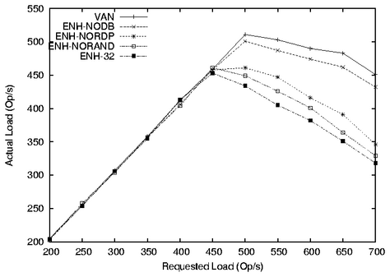
This graph shows how certain design alternatives under study impact a server’s throughput. The alternatives reduce per-request work(D or overhead) and/or improve load balancing. (This is a graph from a random research paper: the design alternatives themselves are not important to us.)
saturation
Measured
throughput
(“goodput”)
Higher numbers are better.
Note how throughput degrades in overload on this system.
Offered load (requests/sec)

Slide 27
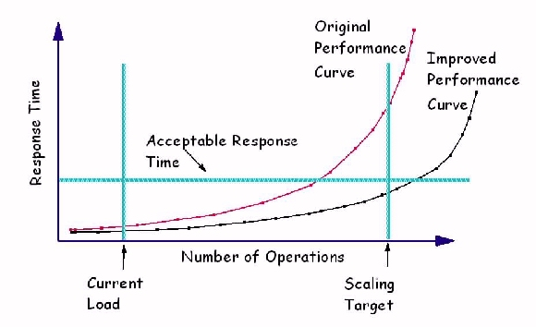
Saturation and response time
In the real world we don’t want to saturate our systems.
We want systems to be responsive, and saturated systems aren’t responsive.
How to measure maximum capacity of a server?
Characterize max request rate λ_{max} this way:
Define a response time objective: maximum acceptable response time (R_{max}): a simple form of Service Level Objective (SLO).
Increase λ until system response time surpasses R_{max} : that is λ_{max}.
λ_{max}
R_{max}
λ
[graphic from IBM.com]

Slide 28
Improving response time
If we improve the service for “higher capacity” by any means, the effect is to push the response time curve out to the right.
λ_{max}
R_{max}
λ
[graphic from IBM.com]

Slide 29

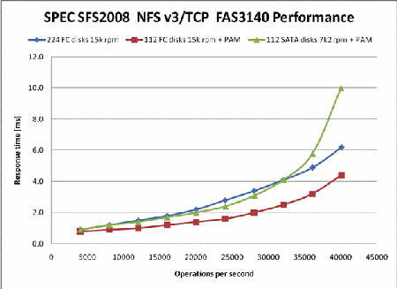
Illustration: if we improve/expand the service by any means, the effect is to push the R curve out to the right. Roughly.

Slide 30
Managing overload
What should we do when a service is in overload?
Overload: service is close to saturation.
Overload → work queues grow without bound, increasing memory consumption and response time.
λ > λ_{max}
Throughput
X
λ
λ_{max}
offered load

Slide 31
Options for overload
Thrashing
  Keep trying and hope things get better. Accept each request and inject it into the system. Then drop requests at random if some queue overflows its memory bound. Note: leads to dropping requests after work has been invested, wasting work and reducing throughput (e.g., “congestion collapse”).
Admission control or load conditioning
  Reject requests as needed to keep system healthy. Reject them early, before they incur processing costs. Choose your victims carefully, e.g., prefer “gold” customers, or reject the most expensive requests.
Dynamic provisioning or elastic scaling
  E.g., acquire new capacity “on the fly” (e.g., from a cloud provider), and shift load over to the new capacity.

Slide 32
Scaling a service
Dispatcher
Work
Support substrate
Server cluster/farm/cloud/grid
Data center
Incremental scalability. Add servers or “bricks” for scale and robustness.
Issues: state storage, server selection, request routing, etc.

Slide 33
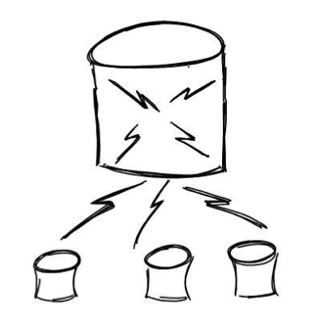
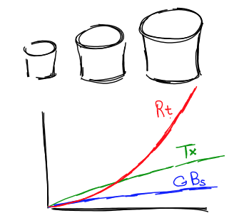
Scale-up vs. scale-out
http://dbshards.com/dbshards/database-sharding-white-paper/

Slide 34

Concept: load spreading
Spread (“deal”) the data across a set of storage units.
  Make it “look like one big unit”, e.g., “one big disk”.
  Redirect requests for a data item to the right unit.
The concept appears in many different settings/contexts.
  We can spread load across many servers too, to make a server cluster look like “one big server”.
  We can spread out different data items: objects, records, blocks, chunks, tables, buckets, keys….
  Keep track using maps or a deterministic function (e.g., a hash).
Also called sharding, declustering, striping, “bricks”.

Slide 35
Service scaling and bottlenecks
Scale up by adding capacity incrementally?
“Just add bricks/blades/units/elements/cores”...but that presumes we can parallelize the workload.
“Service workloads parallelize easily.”
  Many independent requests: spread requests across multiple units.
  Problem: some requests use shared data. Partition data into chunks and spread them across the units: be sure to read/write a common copy.
Load must be evenly distributed, or else some unit saturates before the others (bottleneck or hot spot).
A bottleneck limits throughput and/or may increase response time for some class of requests.
Work
Storage tier

Slide 36

Storage tier: key-value stores
Distributed application
put(key, data)
get (key)
data
[image adapted from Morris, Stoica, Shenker, etc.]
Distributed hash table
lookup(key)
node
node
….
node
Example of how to scale the storage tier.
Web Tier
Storage Tier
A-F
Replication
Remote DC
Incrementally scalable?
Balanced load?
G-L
Web Tier
Storage Tier
A-F
G-L
M-R
M-R
S-Z
S-Z
[image adapted from Lloyd, etc., Don’t Settle for Eventual]

Slide 37
Bottlenecks and hot spots: analysis
1. Suppose requests are divided evenly among N servers. Mean per-request processing time is D, and also each request reads data from a storage tier at mean cost 2D.
Simplistic assumption (for now): all nodes are single-threaded.
If there are N servers in the storage tier, what is the maximum throughput of the system? What is the utilization of the first tier?
How should we provision capacity to “fix it”?
2. Suppose one of the N servers takes 2D per request.
What is the impact on throughput?
What is the impact on response time?
Is the effect equivalent if the server has demand D but receives requests at double the rate of the others? How is it different?
3. Suppose the request rate doubles? What then?

Slide 38
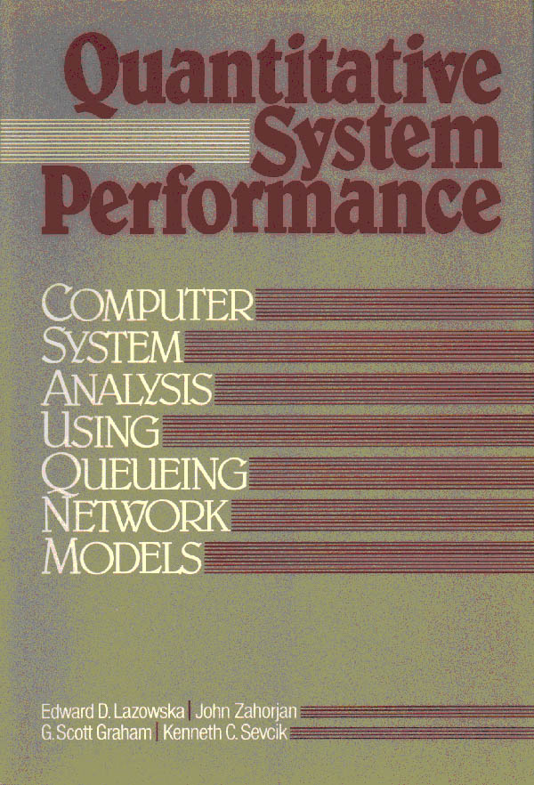
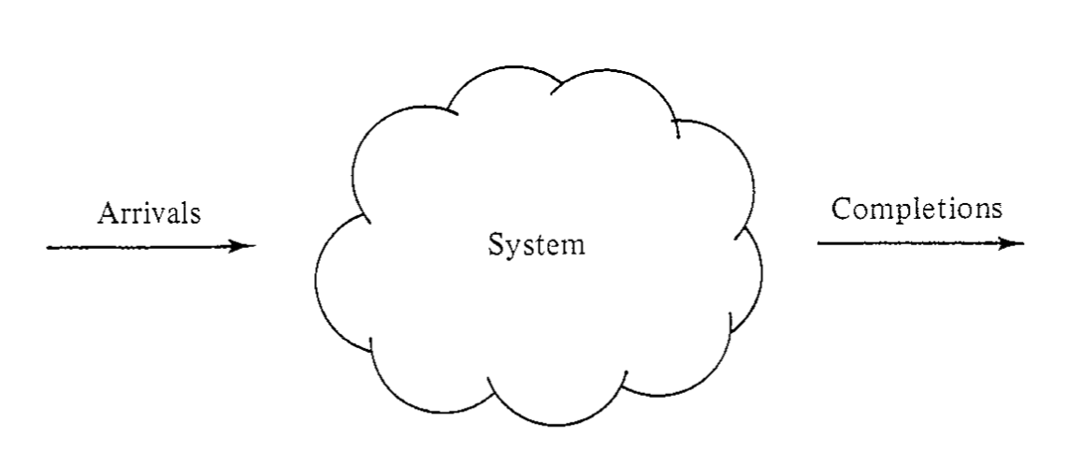
Varying workload
Fixed system
Varying performance

Slide 39
The math also works in the other direction….
Varying workload
Varying system
(use elastic scaling)
Fixed performance
(meet SLO)

Slide 40
“Elastic Cloud”
Resource Control
Feedback for elastic provisioning
(see RightScale)
Varying workload
Varying system
Target performance

Slide 41
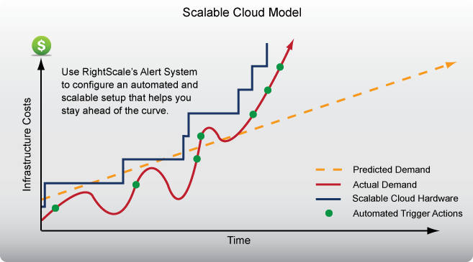
Elastic scaling: “pay as you grow”

Slide 42
Elastic scaling: points
What are the “automated triggers” that drive scaling?
  Monitor system measures: N, R, U, X (from previous class)
  Use models to derive the capacity needed to meet targets
    Service Level Objectives or SLO for response time
    target average utilization
How to adapt when system is under/overloaded?
  Obtain capacity as needed, e.g., from cloud (“pay as you grow”).
  Direct traffic to spread workload across your capacity (servers) as evenly and reliably as you can. (Use some replication.)
  Rebalance on failures or other changes in capacity.
  Leave some capacity “headroom” for sudden load spikes.
  Watch out for bottlenecks! But how to address them?

Slide 43

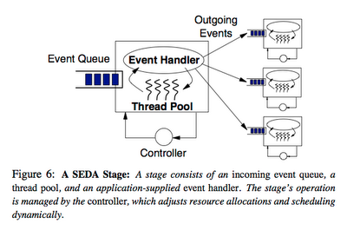
SEDA: An architecture for well-conditioned scalable internet services
A 2001 paper, mentioned here because it offers basic insight into server structure and performance.
Internally, server software is “like” server hardware: requests “flow through” a graph of processing stages.
SEDA is a software architecture to manage this flow explicitly.
We can control how much processing power to give to each stage by changing the number of servers, or threads dedicated to it (SEDA on a single server).
We can identify bottlenecks by observing queue lengths. If we must drop a request, we can pick which queue to drop it from.
Component
(stage)
Component

Slide 44
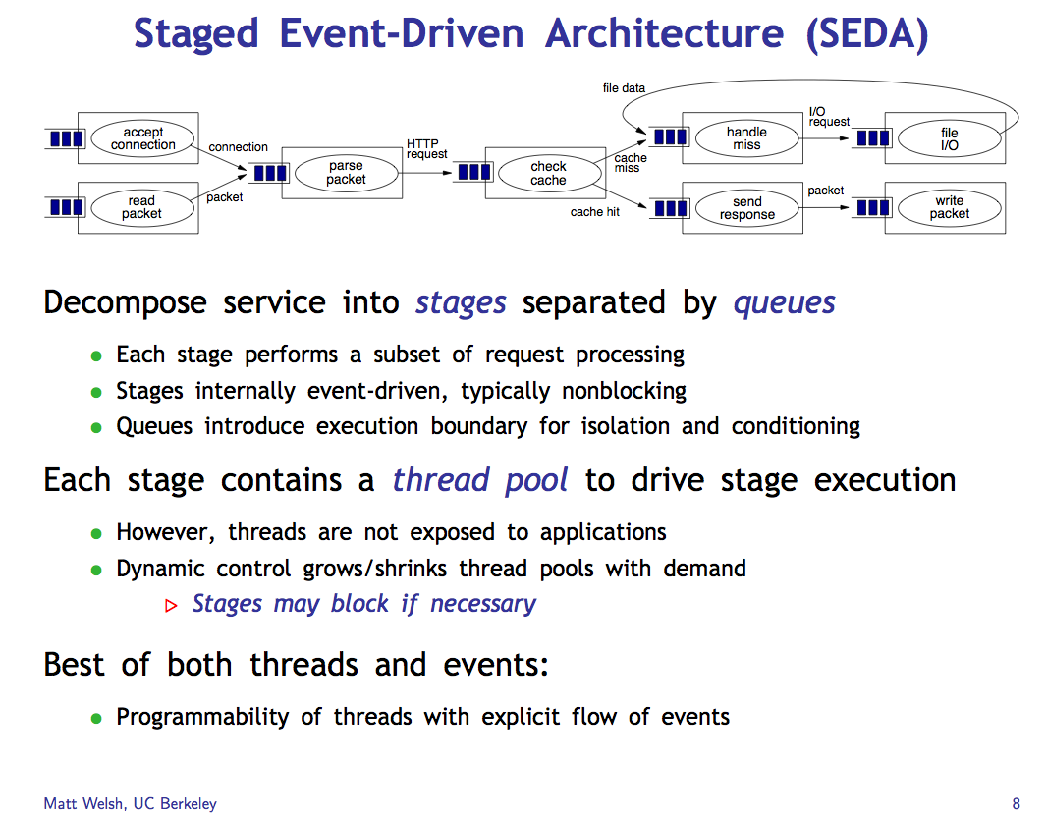
Compare to our earlier treatment of event-driven models and thread pools.

Slide 45
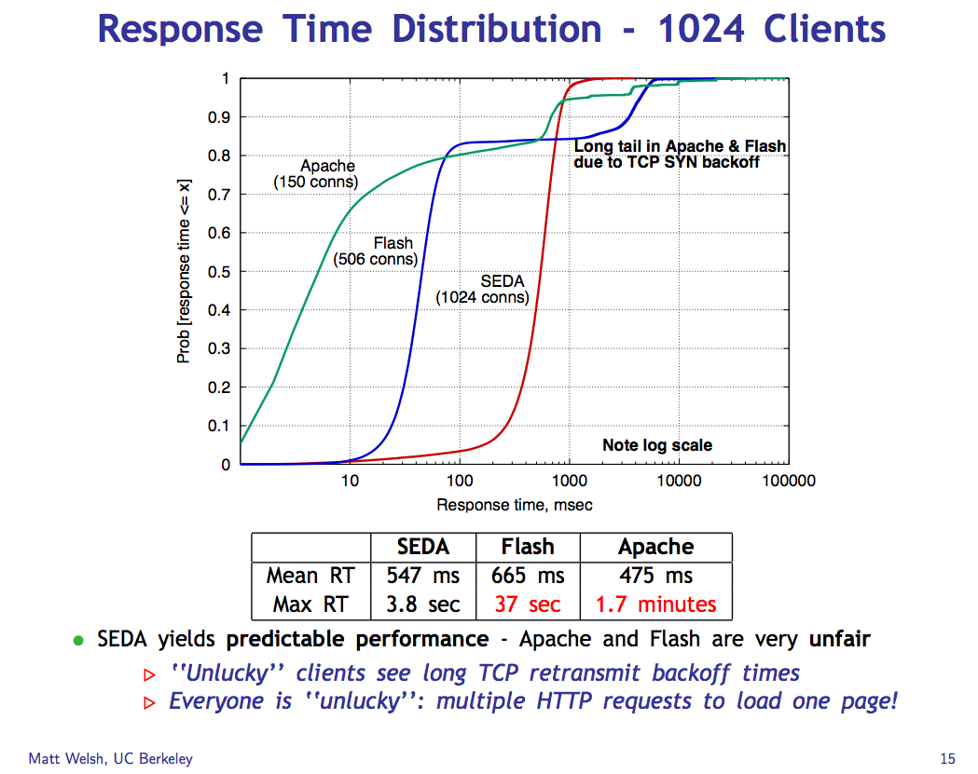

Slide 46
Cumulative Distribution Function (CDF)
80% of the requests (90-10) have response time R with x1 < R < x2.
“Tail” of 10% of requests with response time R > x2.
90%
quantile
A few requests have very long response times.
What’s the mean R?
50%
(median)
median value
10%
quantile
R
x1
x2
Understand how/why the mean (average) response time can be misleading.

Slide 47
SEDA Lessons
Mean/average values are often not useful to capture system behavior, esp. for bursty/irregular measures like response time.
  You have to look at the actual distribution of the values to understand what is happening, or at least the quantiles.
Long response time tails can occur under overload, because (some) queues (may) GROW, leading to (some) very long response times.
  E.g., consider the “hot spot” example earlier.
A staged structure (multiple components/stages separated by queues) can help manage performance.
  Provision resources (e.g., threads) for each stage independently.
  Monitor the queues for bottlenecks: underprovisioned stages have longer queues.
  Choose which requests to drop, e.g., drop from the longest queues.
Note: staged structure can also help simplify concurrency/locking.
  SEDA stages have no shared state. Each thread runs within one stage.

Slide 48
Limits of scalable performance
Part 3

Slide 49
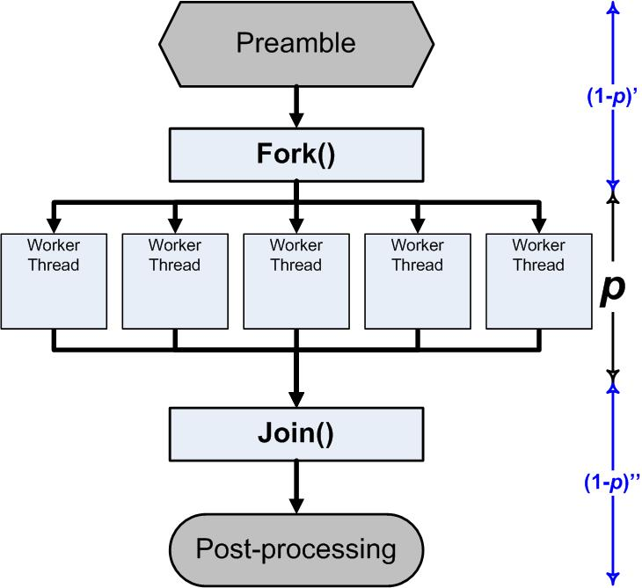
Parallelization
A simple treatment
A program has some work to do. We want to do it fast. How?
Do it on multiple computers/cores in parallel.
But we won’t be able to do all of the work in parallel.
Suppose some portion p of the work can be done in parallel.
Then a portion 1-p is serial.
How much does that help?
Some portion will be serialized.
E.g.:
startup,
locking
combining results
access to a specific disk
http://blogs.msdn.com/b/ddperf/archive/2009/04/29/parallel-scalability-isn-t-child-s-play-part-2-amdahl-s-law-vs-gunther-s-law.aspx

Slide 50
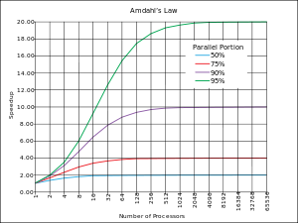
Amdahl’s Law
Normalize runtime = 1
(On a single core.)
Now parallelize:
Parallel portion: P (0 ≤ P ≤1)
Serial portion: 1-P
N-way parallelism (N cores)
Runtime is now:
P/N + (1-P)
Even if “infinite parallelism”, runtime is 1-P in the limit. It is determined by the serial portion.
Bottleneck: limits performance.
Speedup = before/after
Bounded by 1/(1-P)
1/(1 - 0.95)
P
1/(1 - 0.90)
1/(1 - 0.75)
speedup
1/(1 – 0.50)
N
Law of Diminishing Returns
“Optimize for the primary bottleneck.”

Slide 51
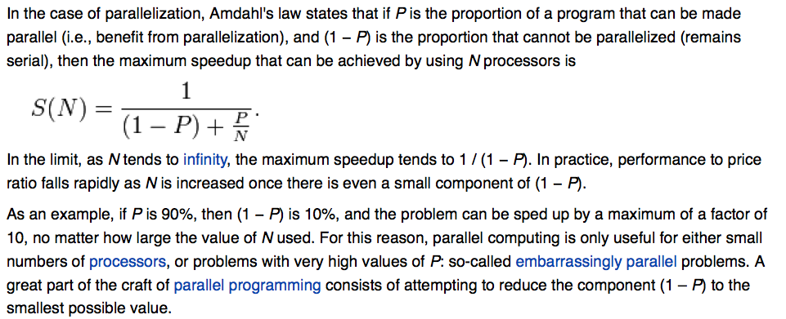
Amdahl’s Law
What is the “serial portion” that “cannot be parallelized”?
- Mutexes/critical sections
- Combining results from parallel portions (e.g., “reducers”)
- …

Slide 52

Virtual Cloud hosting
“Cloud computing is a model for enabling convenient, on-demand network access to a shared pool of configurable computing resources (e.g., networks, servers, storage, applications, and services) that can be rapidly provisioned and released with minimal management effort or service provider interaction.”
US National Institute for Standards and Technology
Part 4
http://www.csrc.nist.gov/groups/SNS/cloud-computing/

Slide 53

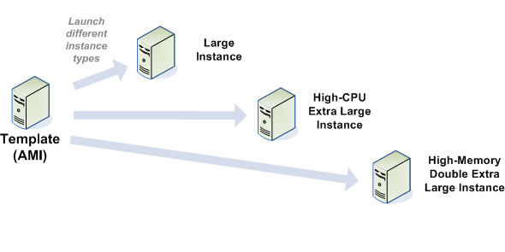
EC2 Elastic Compute Cloud
The canonical public cloud
Virtual Appliance Image
Client
Cloud Provider(s)
Service
Guest
Host

Slide 54
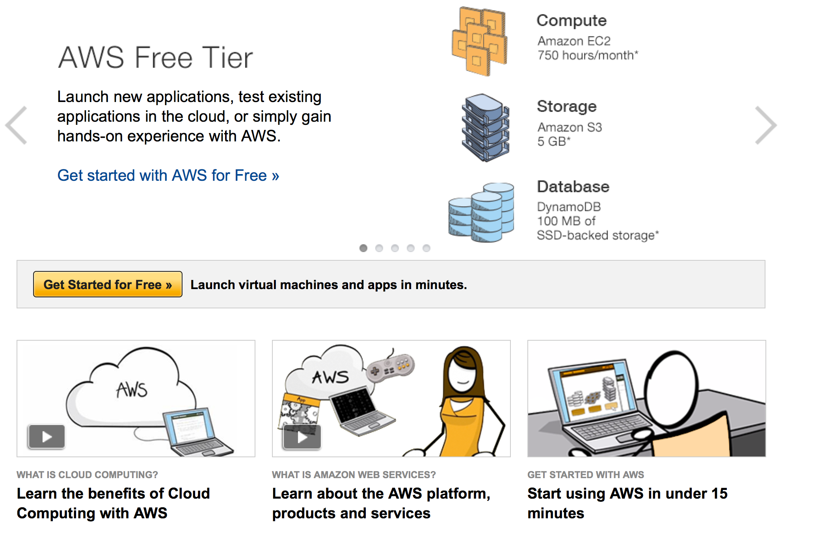

Slide 55
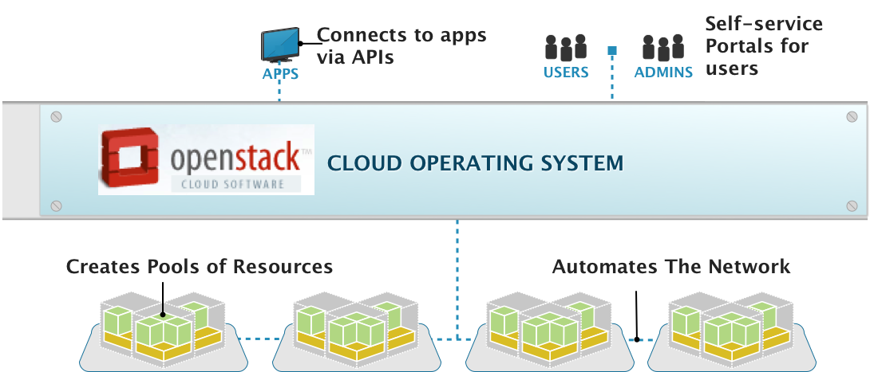
OpenStack, the Cloud Operating System
Management Layer That Adds Automation & Control
[Anthony Young @ Rackspace]

Slide 56
Host/guest model
Client
Cloud Provider(s)
Service
Guest
Host
Service is hosted by a third party.
  flexible programming model
  cloud APIs for service to allocate/link resources
  on-demand: pay as you grow

Slide 57



IaaS: Infrastructure as a Service
Client
Service
EC2 is a public IaaS cloud (fee-for-service).
Deployment of private clouds is growing rapidly w/ open IaaS cloud software.
Platform
Hosting performance and isolation is determined by virtualization layer
Virtual Machines (VM): VMware, KVM, etc.
OS
VMM
Physical
Notes:
The EC2 APIs come from Amazon but these clouds can be deployed anywhere.

Slide 58
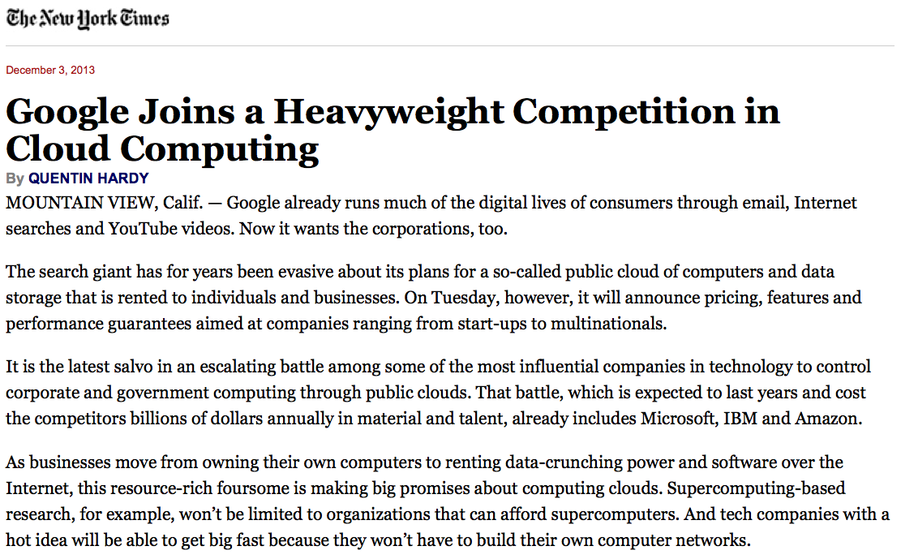

Slide 59
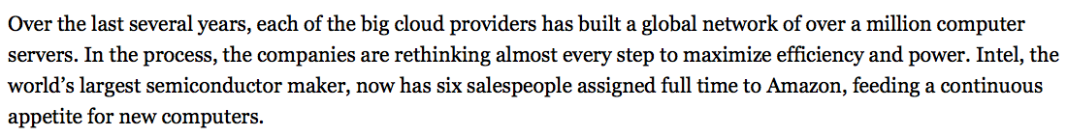
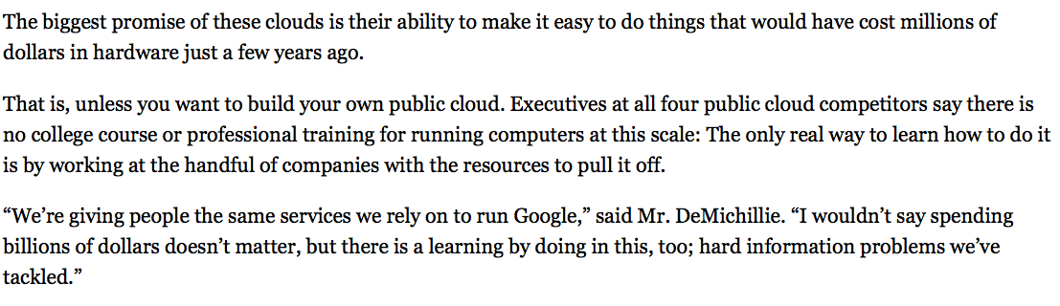

Slide 60
Native virtual machines (VMs)
Slide a hypervisor underneath the kernel.
  New OS layer: also called virtual machine monitor (VMM).
Kernel and processes run in a virtual machine (VM).
  The VM “looks the same” to the OS as a physical machine.
  The VM is a sandboxed/isolated context for an entire OS.
Can run multiple VM instances on a shared computer.
guests
host
hypervisor (VMM)

Slide 61






guest VM1
guest VM2
guest VM3
guest or tenant
VM contexts
P1A
P2B
P3C
OS kernel 1
OS kernel 2
OS kernel 3
hypervisor/VMM
host

Slide 62
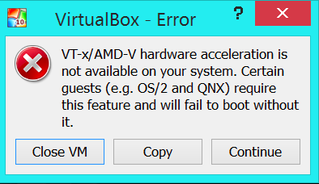
Virtualization support: VT
These VMs can run a full OS with a kernel and multiple processes with direct execution: they are not interpreted!
Kernel, process, and hypervisor all run on the same cores, at full speed. (Note: distinct from Java JVM.)
VMs used to be implemented in all sorts of goofy ways.
Since 2007-2010 chip vendors offer hardware support.
Intel VT and VT-d, AMD-V
+ new CPU modes
+ new CPU events/transitions
+ a new level of VA translation
Extended Page Tables (EPT)

Slide 63
VT in a Nutshell
New VM mode bit
  Orthogonal to CPL (e.g., kernel/user mode)
If VM mode is off → host mode
  Machine “looks just like it always did” (“VMX root”)
If VM bit is on → guest mode
  Machine is running a guest VM: “VMX non-root mode”
  Machine “looks just like it always did” to the guest, BUT:
  Various events trigger gated entry to hypervisor (in VMX root)
  A “virtualization intercept”: exit VM mode to VMM (VM Exit)
  Hypervisor (VMM) can control which events cause intercepts
  Hypervisor can examine/manipulate guest VM state and return to VM (VM Entry)

Slide 64
VT: core modes
guest VM1
guest VM2
VMX non-root mode
“guest mode”
(user or kernel)
CPU events
trap, fault, interrupt and return
OS kernel 1
OS kernel 2
VMExit and VMEnter
intercept and return
vm-enter
vm-enter
vm-exit
vm-exit
VMX root mode
“host mode”
(user or kernel)
hypervisor/VMM
host

Slide 65


CPU Virtualization With VT-x
Two new VT-x operating modes
  Less-privileged mode
  (VMX non-root) for guest OSes
  More-privileged mode
  (VMX root) for VMM
Two new transitions
  VM entry to non-root operation
  VM exit to root operation
Virtual Machines (VMs)
Ring 3
Apps
Apps
Ring 0
OS
OS
VM Exit
VM Entry
VMX
Root
VM Monitor (VMM)
Execution controls determine when exits occur
  Access to privilege state, occurrence of exceptions, etc.
  Flexibility provided to minimize unwanted exits
VM Control Structure (VMCS) controls VT-x operation
  Also holds guest and host state

Slide 66

Virtual Machines + Virtual Memory
“VA”
“PA”
EPT
“MA”

Slide 67
Three address spaces
“VA”
0
Current Guest Process
Guest OS
Virtual
Address Spaces
“PA”
0
Virtual RAM
Virtual
Frame
Buffer
Virtual
Devices
Virtual
ROM
Physical
Address Spaces
0
“MA”
RAM
Devices
Frame
Buffer
ROM
Machine
Address Space

Slide 68
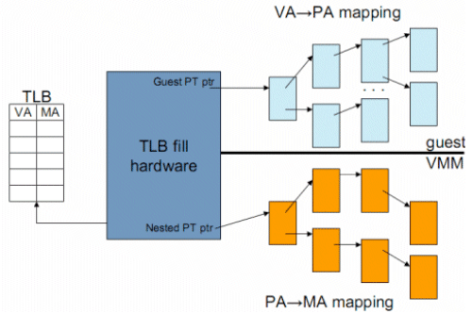
TLB caches VA->MA mappings

Slide 69
Image/Template/Virtual Appliance
A virtual appliance is a program for a virtual machine.
  Sometimes called a VM image or template
The image has everything needed to run a virtual server:
  OS kernel program
  file system
  application programs
The image can be instantiated as a VM on a cloud.
  Not unlike running a program to instantiate it as a process

Slide 70



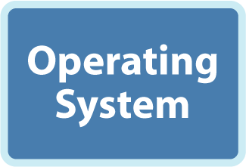



Thank you, VMware

Slide 71
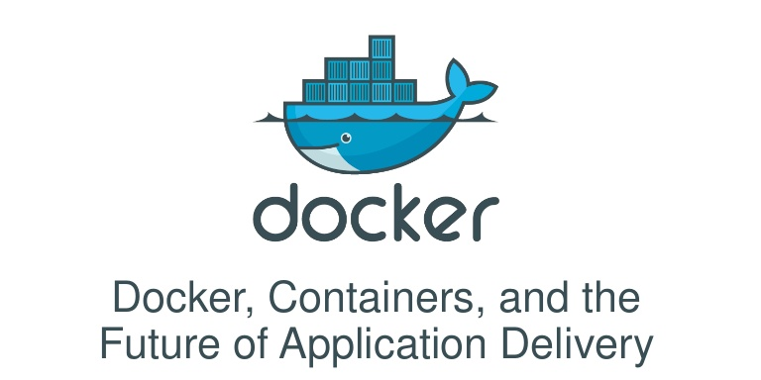
Containers
Note: lightweight container technologies offer a similar abstraction for software packaging and deployment, based on an extended process model.
  E.g., Docker and Google Kubernetes

Slide 72
NOTREACHED
Part 5

Slide 73


GENI: slices and federation
Not to be tested.
My “slice” runs across
the evolving GENI federation.
Campus
#3
Commercial
Clouds
Backbone #1
Campus
My GENI Slice
Access
#1
Corporate
GENI suites
Research
Testbed
Backbone #2
TTG
Other-Nation
Projects
Campus rack
Slice: an end-to-end virtual network context spanning multiple sites, with configurable topology and properties, e.g., containment and isolation.

Slide 74



ExoGENI.net
Not to be tested.
transportfabrics
L2/L3
L2/L3
campus net
ExoGENI Rack
A packaged small-scale cloud site for a campus, lab, or PoP.
OpenFlow
Linked to a federated hosting platform for tenant networks (slices).

Slide 75

ExoGENI.net: cartoon version
Not to be tested.
Not shown: dynamic slice adaptation under automated control
“Make my slice.”
GENI control framework for federated orchestration
Open Resource Control Architecture
“Instantiate VMs and VLANs x, y, z.”
“Link sites with circuits.”
“Enable external SDN controller for x, y, z.”
Network provider
OpenFlow
Site A
Site B

