Slide 1
Storage Etc.
Jeff Chase
Duke University

Slide 2
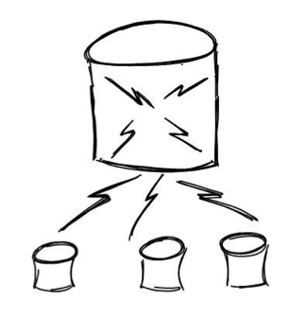
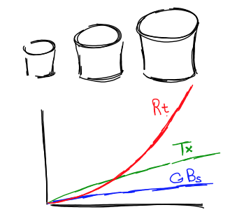
http://dbshards.com/dbshards/database-sharding-white-paper/

Slide 3
Block storage API
Multiple storage objects: dynamic create/destroy
Each object is a sequence of logical blocks
Blocks are fixed-size
Read/write whole blocks, or sequential ranges of blocks
Storage address: object + logical block offset
How to allocate for objects on a disk?
How to map a storage address to a location on disk?

Slide 4

Example: AWS Simple Storage Service

Slide 5
Amazon S3 (Simple Storage Service) Basics
Amazon S3 stores data as objects within buckets. An object is comprised of a file and optionally any metadata that describes that file.
To store an object in Amazon S3, you upload the file you want to store to a bucket. When you upload a file, you can set permissions on the object as well as any metadata.
Buckets are the containers for objects. You can have one or more buckets. For each bucket, you can control access to the bucket (who can create, delete, and list objects in the bucket), view access logs for the bucket and its objects, and choose the geographical region where Amazon S3 will store the bucket and its contents.
http://docs.aws.amazon.com/AmazonS3/latest/gsg/AmazonS3Basics.html

Slide 6
Memory/storage hierarchy
Computing happens here, at the tip of the spear. The cores pull data up through the hierarchy into registers, and then push updates back down.
small and fast
(ns)
registers
caches
L1/L2
In general, each layer is a cache over the layer below.
off-core
L3
off-chip
main memory (RAM)
big and slow
(ms)
You are here.
off-module
disk, other storage, network RAM
Cheap bulk storage

Slide 7
The block storage abstraction
Read/write blocks of size b on a logical storage device (“disk”).
A disk is a numbered array of these basic blocks. Each block is named by a unique number (e.g., logical BlockID).
CPU (typically executing kernel code) forms buffer in memory and issues read or write command to device queue/driver.
Device DMAs data to/from memory buffer, then interrupts the CPU to signal completion of each request.
Device I/O is asynchronous: the CPU is free to do something else while I/O in progress.
Transfer size b may vary, but is always a multiple of some basic block size (e.g., sector size), which is a property of the device, and is always a power of 2.
Storage blocks containing data/metadata are cached in memory buffers while in active use: called buffer cache or block cache.

Slide 8
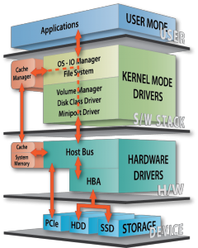
[Calypso]

Slide 9
Storage stack
Databases, Hadoop, etc.
We care mostly about this stuff.
File system API. Generic, for use over many kinds of storage devices.
Device driver software is a huge part of the kernel, but we mostly ignore it.
Standard block I/O internal interface.
Block read/write on
numbered blocks on each device/partition.
For kernel use only: DMA + interrupts.
Many storage technologies, advancing rapidly with time.
Rotational disk (HDD): cheap, mechanical, high latency.
Solid-state “disk” (SSD): low latency/power, wear issues, getting cheaper.
[Calypso]

Slide 10
Anatomy of a read
3. Check to see if requested data (e.g., a block) is in memory. If not, figure where it is on disk, and start the I/O.
6. Return to user mode.
5. Copy data from kernel buffer to user buffer in read.
(kernel mode)
2. Enter kernel for read syscall.
1. Compute
(user mode)
4. sleep for I/O (stall)
Wakeup by interrupt.
CPU
seek
transfer (DMA)
Disk
Time

Slide 11
Improving utilization for I/O
Some things to notice about the “anatomy” fig.
The CPU is idle when the disk is working.
The disk is idle when the CPU is working.
If their service demands are equal, each runs at 50%.
  Limits throughput! How to improve this?
  How to “hide” the I/O latency?
If the disk service demand is 10x the CPU service demand, then CPU utilization is at most 10%.
  Limits throughput! How to improve this?
  How to balance the system?

Slide 12
Prefetching for high read throughput
Read-ahead (prefetching)
  Fetch blocks into the cache in expectation that they will be used.
  Requires prediction. Common for sequential access.
1. Detect access pattern.
Reduce I/O stalls
2. Start prefetching

Slide 13
Sequential read-ahead
Prediction is easy for sequential access. “Most files are read and written sequentially.”
Read-ahead also helps reduce seeks by reading larger chunks if data is laid out sequentially on disk.
App requests block n
App requests block n+1
n
n+1
n+2
System prefetches block n+2
System prefetches block n+3

Slide 14
Challenge: I/O and scheduling
Suppose thread T does a lot of I/O.
T blocks while the I/O is in progress.
When each I/O completes, T gets back on the readyQ.
Where T waits for threads that use a lot of CPU time.
  While the disk or other I/O device sits idle!
T needs only a smidgen of CPU time to get its next I/O started.
Why not let it jump the queue, and get the disk going so that both the disk and CPU are fully utilized?
This is a form of shortest job first (SJF) scheduling, also known as shortest processing time first (SPT).

Slide 15
Mixed Workload
Notes:
I/O task has to wait its turn for the CPU, and the result is that it gets a tiny fraction of the performance it could get.
By contrast the compute bound
We could shorten the RR quantum, and that would help, but it would increase overhead.
what would this do under SJF? Every time the task returns to the CPU, it would get scheduled immediately!

Slide 16
Two Schedules for CPU/Disk
1. Naive Round Robin
5
5
1
1
4
CPU busy 25/37: U = 67%
Disk busy 15/37: U = 40%
2. Add internal priority boost for I/O completion
33% improvement in utilization
When there is work to do,
U == efficiency. More U means better throughput.
CPU busy 25/25: U = 100%
Disk busy 15/25: U = 60%

Slide 17
Estimating Time-to-Yield
How to predict which job/task/thread will have the shortest demand on the CPU?
  If you don’t know, then guess.
    Weather report strategy: predict future D from the recent past.
We can “guess” well by using adaptive internal priority.
  Common technique: multi-level feedback queue.
  Set N priority levels, with a timeslice quantum for each.
  If thread’s quantum expires, drop its priority down one level.
    “It must be CPU bound.” (mostly exercising the CPU)
  If a job yields or blocks, bump priority up one level.
    “It must be I/O bound.” (blocking to wait for I/O)

Slide 18
Example: a recent Linux rev
“Tasks are determined to be I/O-bound or CPU-bound based on an interactivity heuristic. A task's interactiveness metric is calculated based on how much time the task executes compared to how much time it sleeps. Note that because I/O tasks schedule I/O and then wait, an I/O-bound task spends more time sleeping and waiting for I/O completion. This increases its interactive metric.”
Key point: interactive tasks get higher priority for the CPU, when they want the CPU (which is not much).

Slide 19
Multilevel Feedback Queue
Many systems (e.g., Unix variants) implement internal priority using a multilevel feedback queue.
Multilevel. Separate ready queue for each of N priority levels.
  Use RR on each queue; look at queue i+1 only if queue i is empty.
Feedback. Factor a task’s previous behavior into its priority.
Put each ready/awakened task at the tail of the q for its priority.
I/O bound tasks
high
Tasks holding resouces
Tasks with high external priority
GetNextToRun selects task
at the head of the highest
priority queue: constant time, no sorting
low
CPU-bound tasks
ready queues
indexed by priority
Priority of CPU-bound
tasks decays with system
load and service received.
Notes:
Linux uses a bitmap priority array to figure which queues are populated. X86 provides a find-first-set-bit instruction.
That is the vaunted Linux “O(1)” scheduler.

Slide 20
MFQ

Slide 21
Challenge: data management
Data volumes are growing enormously.
Mega-services are “grounded” in data.
How to scale the data tier?
  Scaling requires dynamic placement of data items across data servers, so we can grow the number of servers.
  Sharding divides data across multiple servers or storage units.
  Caching helps to reduce load on the data tier.
  Replication helps to survive failures and balance read/write load.
  Caching and replication require careful update protocols to ensure that servers see a consistent view of the data.

Slide 22
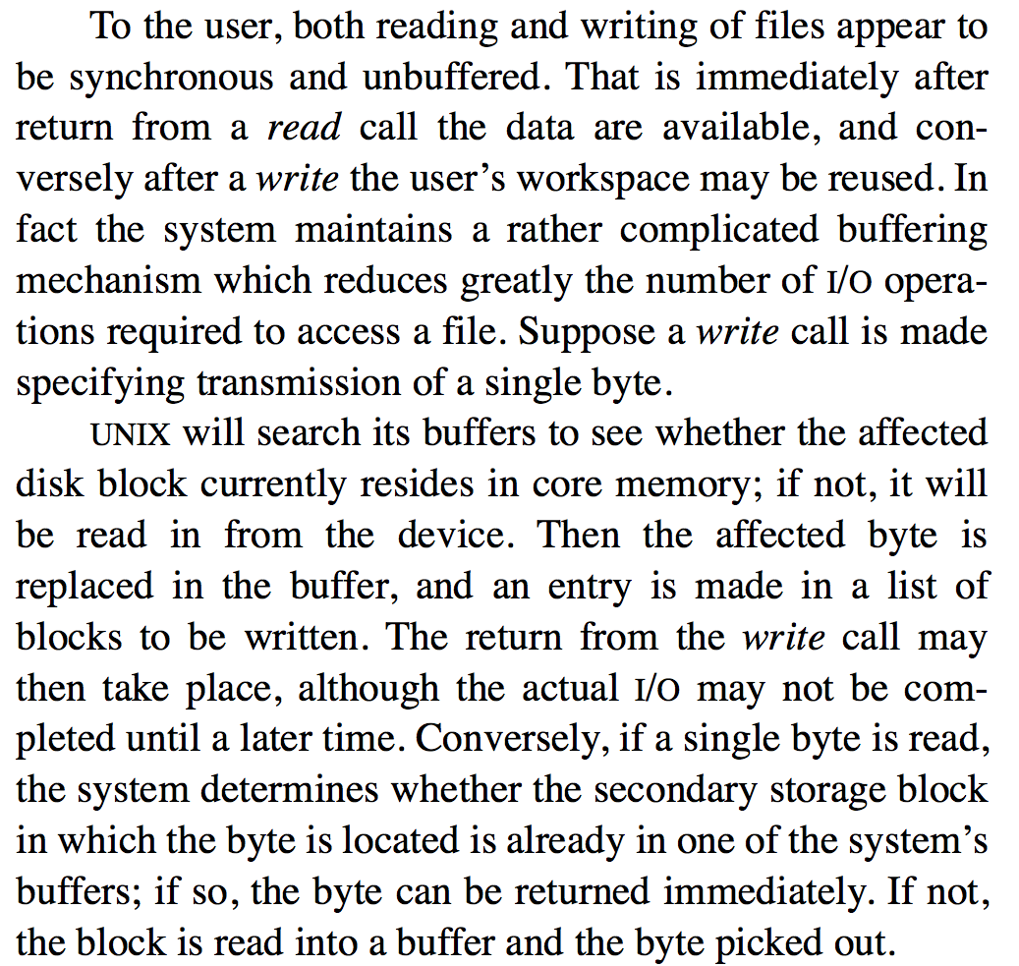
The Buffer Cache
Proc
Memory
File
cache
Ritchie and Thompson The UNIX Time-Sharing System, 1974

Slide 23
Editing Ritchie/Thompson
The system maintains a buffer cache (block cache, file cache) to reduce the number of I/O operations.
Suppose a process makes a system call to access a single byte of a file. UNIX determines the affected disk block, and finds the block if it is resident in the cache. If it is not resident, UNIX allocates a cache buffer and reads the block into the buffer from the disk.
Then, if the op is a write, it replaces the affected byte in the buffer. A buffer with modified data is marked dirty: an entry is made in a list of blocks to be written. The write call may then return. The actual write might not be completed until a later time.
If the op is a read, it picks the requested byte out of the buffer and returns it, leaving the block in the cache.
Proc
Memory
File
cache

Slide 24
I/O caching
BlockID
Buffer headers
describe contents of buffers
BlockID = 12
5
Cache directory (hash table)
10
home
15
cached
20
read
fetch
write
push
app threads
Request read and write operations on byte ranges of files
memory
A set of available frames (buffers) for block I/O caching, whose use is controlled by the system
An array of numbered blocks on storage

Slide 25

Concept: load spreading
Spread (“deal”) the data across a set of storage units.
  Make it “look like one big unit”, e.g., “one big disk”.
  Redirect requests for a data item to the right unit.
The concept appears in many different settings/contexts.
  We can spread load across many servers too, to make a server cluster look like “one big server”.
  We can spread out different data items: objects, records, blocks, chunks, tables, buckets, keys….
  Keep track using maps or a deterministic function (e.g., a hash).
Also called sharding, declustering, striping, “bricks”.

Slide 26
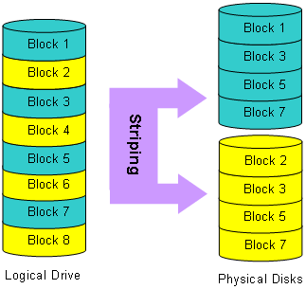
Example: disk arrays and striping
One way to grow:
Buy more disks
“Deal the blocks”
Keep track of them
Spread the I/O
How to keep track of the blocks? Given a request for block n in the “logical drive”, which disk to send it to? Which block on that disk?
4
6
8
pantherproducts.co.uk

Slide 27
Example: striping in Lustre, a Parallel FS
The 1st stripe
The 2nd stripe
“chunk”
or block
A file
c₀
c₁
c₂
c₃
c₄
c₅
c₆
c₇
c₈
c₉
Example:
stripe width=4
c₈
c₇
c₄
c₀
c₅
c₆
Object₀
Object₁
Object₂
Object₃
Target₂₃
Target₂₄
Target₂₅
Target₂₆

Slide 28

Lustre
Lustre is an open-source parallel file system widely used in supercomputers.
A Lustre file system contains a collection of many disk servers, each with multiple disks (“targets”).
Large bursts of reads/writes on large striped files use many targets in parallel.
Clients
I/O Routers
OSS
(server)
OST
(target)

Slide 29
Load spreading and performance
What effect does load spreading across N units have on performance, relative to 1 unit?
What effect does it have on throughput?
What effect does it have on response time?
How does the workload affect the answers?
E.g., what if striped file access is sequential?
What if accesses are random?
What if the accesses follow a skewed distribution, so some items are more “popular” than others?

Slide 30
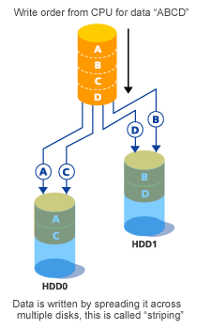
RAID 0
Striping
Sequential throughput?
Random throughput?
Random latency?
Read vs. write?
Cost per GB?
Pure declustering
Fujitsu

Slide 31


What about failures?
X
Systems fail. Here’s a reasonable set of assumptions about failure properties for servers/bricks (or disks)
  Fail-stop or fail-fast fault model
  Nodes either function correctly or remain silent
  A failed node may restart, or not
  A restarted node loses its memory state, and recovers its secondary (disk) state
If failures are random/independent, the probability of some failure is linear with the number of units.
  Higher scale → less reliable!
If a disk in a striped storage system fails, we lose the entire file! (It’s no good with all those holes.)

Slide 32
What is the probability that a disk fails in an array of N disks at any given time?
Let's make some reasonable assumptions (not always true, but reasonable) about the disks in the array:
Disk failures are independent: a disk doesn't "know" what happens to other disks when it "decides" to fail.
Disks all have the same probability of failure in any given point in time (or any given interval): no disk is more or less prone to failing to any other.
Disk failures are evenly distributed in time: no interval in time is more prone to disk failures than any other interval.
So the probability of any given disk failing in any given interval (of some fixed length) is a constant. Let us call this constant F.
It is an axiom of elementary probability that:
- The probability of either A or B occurring (but not both) is P(A) + P(B) - P(A and B).
- The probability of both A and B occurring is P(A)*P(B).
Well, if F is a small number (it is), then the probability of two disks failing in the same interval is F-squared, a very small number. So forget about that.
So the probability that any one of N disks fails in some given interval is NF.

Slide 33
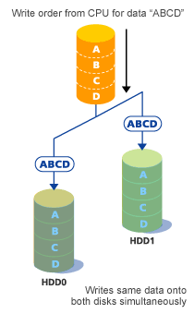
RAID 1
Mirroring
Sequential throughput?
Random throughput?
Random latency?
Read vs. write?
Cost per GB?
Pure replication
Fujitsu

Slide 34
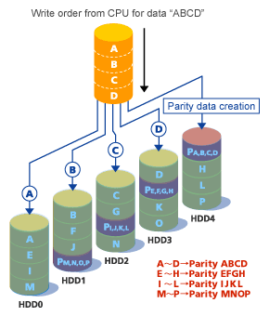
Building a better disk: RAID 5
Market standard
Striping for high throughput for pipelined/batched reads.
Data redundancy: parity
Parity enables recovery from one disk failure.
Cheaper than mirroring
Random block write must also update parity for stripe
Distributes parity: no“hot spot” for random writes
Fujitsu

Slide 35
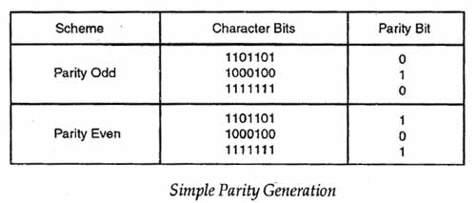
Parity
A parity bit (or parity block) is redundant information stored with a string of data bits (or a stripe of data blocks). Parity costs less than full replication (e.g., mirroring), but allows us to reconstruct the data string/stripe if any single bit/block is lost.

Slide 36
Just to spell it out: a stripe is an array of blocks, one block per disk in the disk array. Each block is an array of bits ("memory/storage is fungible"). In RAID-5, one of the blocks of each stripe is a parity block. Each bit in the parity block contains parity over the corresponding bits in the data blocks (i.e., the result of a bitwise XOR, exclusive-or).
Q: If two bits/blocks are lost, your even/odd state may not be changed. Therefore, how do you recover from a failure in this situation?
A: A classic RAID 5 can survive only a single disk failure. That is why many deployments are using alternatives with more redundancy, e.g., "RAID-6" (two parity disks) or "RAID-10" (essentially a mirrored pair of RAID-5 units, 2x5=10).
Q: How do you know which bit/block was lost?
A: It is presumed that disk drive failure is detectable by external means. One possibility is that the disk drive is "fail stop": if it fails, it simply stops serving requests. Or the failed disk reports errors when you try to use it. It is presumed that a disk doesn't ever lie about the stored data (essentially a "byzantine" failure). Fortunately, this assumption is almost always true.
So: in a classic RAID-5, if you know which drive has failed, it is easy to rebuild each stripe from the contents of the remaining disks. For each stripe, the failed disk either contains the parity block of that stripe, or it contains some data block of the stripe. These cases are symmetric: either way the array can rebuild the contains of the missing block.
Note that recovery is very expensive. The recovery process must read the contents of all surviving disks, and write parity data to a replacement disk. That means that a disk failure must be repaired quickly: if a drive fails in your RAID, you should replace it right away.

Slide 37
Q: Can you specify the differences between read and write on that same slide for the different raids? I know you said in class that for raid 1 reads get faster and writes get slower? Could you explain that and also for the other raids?
A: Once you understand the RAID 0, 1, 5 patterns (striping, mirroring, and parity), all of these differences are "obvious". The differences stem from different levels of redundancy. Redundancy increases $$$ cost but it also improves reliability. And redundancy tends to make writes more expensive than reads: redundant data must be kept up to date in a write, but it may allow more copies to choose from for load-balancing reads.
Always be careful and precise about "faster" and "slower". For example, for random accesses, throughput goes up with RAIDs but latency (minimum response time, not counting queuing delays) is unchanged: you still have to reach out with a disk arm to get to that data. This example underscores that “faster” and “slower” also depend on characteristics of the workload.
Also, “faster” and “slower” are relative, so you must specify a baseline. Writes on RAID-1 are slower than for RAID-0, because writes in RAID-1 have to go to all disks. In RAID-0 or RAID-5 you can write different data to multiple disks in parallel, but not in RAID-1. But RAID-1 is no slower for writes than a single disk---just more expensive. Also, RAID-1s can load-balance better than RAID-0 or RAID-5 for random read workloads. For any given block, you have N disks to choose from that have a copy of the block, so you can choose the least loaded. So read throughput on a RAID-1 is N times better than a single disk.
RAID-5 suffers for random write throughput because any write of a data chunk that is smaller than a whole stripe must also write a parity block. For a stream of random single-block writes, that means RAID-5 is doing twice as much work as RAID-0. So throughput will be lower.

Slide 38
Names and layers
User
view
notes in notebook file
Application
fd
notefile: fd, byte range*
bytes
File System
block#
device, block #
Disk Subsystem
surface, cylinder, sector
Add more layers as needed.

Slide 39
More (optional) layers of mapping
Files
There could be many more layers than this!
map
Logical disk volumes or objects
For “storage virtualization”…
map
Physical disks
It’s turtles all the way down.

Slide 40
Which block?
When an app requests to read/write a file at offset i, how to know which block contains that byte i on storage?
We need a map!
We know which logical block it is in the file (simple arithmetic), but how do we know which block it is on disk?
We need a map!

Slide 41
Block maps
Large storage objects (e.g., files, segments) may be mapped so they don’t have to be stored contiguously in memory or on disk.
object
Idea: use a level of indirection through a map to assemble a storage object from “scraps” of storage in different locations.
The “scraps” can be fixed-size slots: that makes allocation easy because the slots are interchangeable (fixed partitioning). Fixed-size chunks of data or storage are called blocks or pages.
map
Examples: page tables that implement a VAS.
One issue now is that each access must indirect through the map…

Slide 42
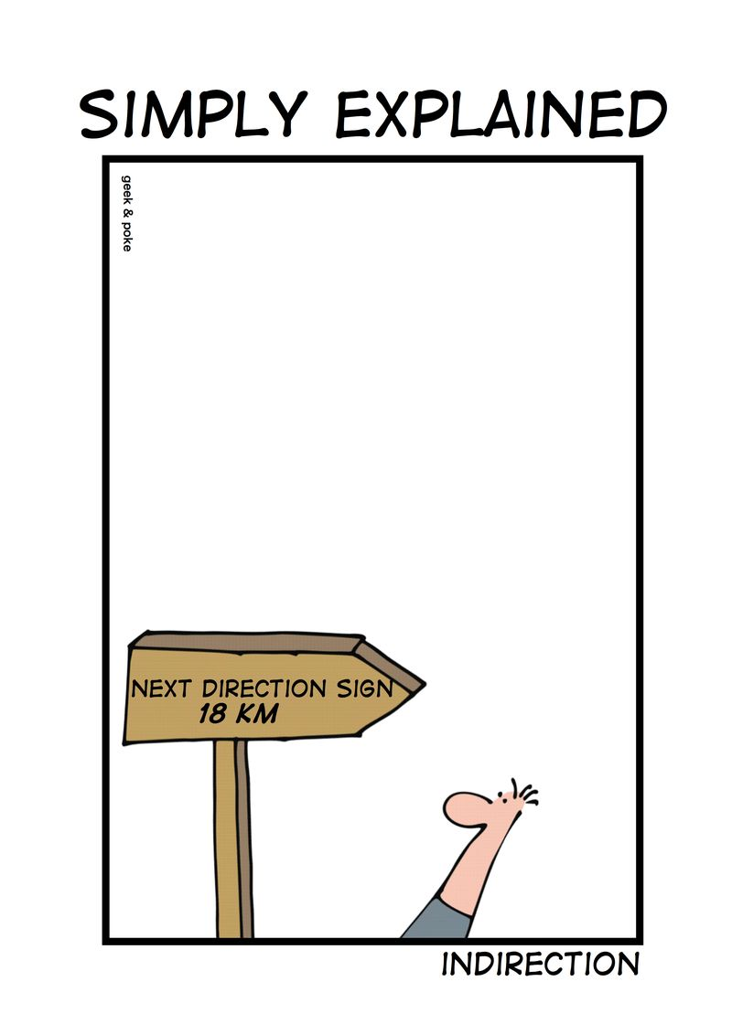
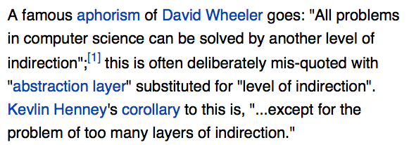
Indirection

Slide 43
Using block maps
Files are accessed through e.g. read/write syscalls: the kernel can chop them up, allocate space in pieces, and reassemble them.
Allocate in units of fixed-size logical blocks (e.g., 4KB, 8KB).
Each logical block in the object has an address (logical block number or logical blockID): a block offset within the object.
Use a block map data structure.
  Index by logical blockID, return underlying address
  Example: inode indexes file blocks on disk
  Maps file+logical blockID to disk block #
  Example: page table indexes pages in memory
  Maps VAS+page VPN to machine frame PFN
Index map with name, e.g., logical blockID #.
Note: the addresses (block # or PFN) might themselves be blockIDs indexing another level of virtual map!
Read address of the block from map entry.

Slide 44
To put it another way
Variable partitioning is a pain. We need it for heaps, and for other cases (e.g., address space layout).
But for files/storage we can break the objects down into “pieces”.
  When access to files is through an API, we can add some code behind that API to represent the file contents with a dynamic linked data structure (a map).
  If the pieces are fixed-size (called pages or logical blocks), we can use fixed partitioning to allocate the underlying storage, which is efficient and trivial.
  With that solution, internal fragmentation is an issue, but only for small objects. (Why?)
That approach can work for VM segments too: we have VM hardware to support it (since the 1970s).

Slide 45
Representing files: inodes
There are many many file system implementations.
Most of them use a block map to represent each file.
Each file is represented by a corresponding data object, which is the root of its block map, and holds other information about the file (the file’s “metadata”).
In classical Unix and many other systems, this per-file object is called an inode. (“index node”)
The inode for a file is stored “on disk”: the OS/FS reads it in and keeps it in memory while the file is in active use.
When a file is modified, the OS/FS writes any changes to its inode/maps back to the disk.

Slide 46
Inodes
A file’s data blocks could be “anywhere” on disk. The file’s inode maps them. Each entry of the map gives the disk location for the corresponding logical block.
A fixed-size inode has a fixed-size block map.
How to represent large files that have more logical blocks than can fit in the inode’s map?
attributes
Once upo
n a time
/nin a l
block map
and far
far away
,/nlived t
he wise and sage
wizard.
inode
An inode could be “anywhere” on disk. How to find the inode for a given file? Assume: inodes are uniquely numbered: we can find an inode from its number.
data blocks on disk

Slide 47
Classical Unix inode
A classical Unix inode has a set of file attributes (below) in addition to the root of a hierarchical block map for the file. The inode structure size is fixed, e.g., total size is 128 bytes: 16 inodes fit in a 4KB block.
/* Metadata returned by the stat and fstat functions */
struct stat {
dev_t st_dev; /* device */
ino_t st_ino; /* inode */
mode_t st_mode; /* protection and file type */
nlink_t st_nlink; /* number of hard links */
uid_t st_uid; /* user ID of owner */
gid_t st_gid; /* group ID of owner */
dev_t st_rdev; /* device type (if inode device) */
off_t st_size; /* total size, in bytes */
unsigned long st_blksize; /* blocksize for filesystem I/O */
unsigned long st_blocks; /* number of blocks allocated */
time_t st_atime; /* time of last access */
time_t st_mtime; /* time of last modification */
time_t st_ctime; /* time of last change */
};
Not to be tested

Slide 48
Representing Large Files
inode
Classical Unix file systems
inode == 128 bytes
Each inode has 68 bytes of attributes and 15 block map entries that are the root of a tree-structured block map.
direct
block
map
indirect
block
double
indirect
block
Suppose block size = 8KB
12 direct block map entries: map 96KB of data.
One indirect block pointer in inode: + 16MB of data.
One double indirect pointer in inode: +2K indirects.
Maximum file size is 96KB + 16MB + (2K*16MB) + ...
indirect
blocks
The numbers on this slide are for illustration only.

Slide 49
Skewed tree block maps
Inodes are the root of a tree-structured block map.
  Like hierarchical page tables, but
These maps are skewed.
  Low branching factor at the root.
  “The further you go, the bushier they get.”
  Small files are cheap: just need the inode to map it.
  …and most files are small.
Use indirect blocks for large files.
  Requires another fetch for another level of map block
  But the shift to a high branching factor covers most large files.
Double indirect blocks allow very large files.

Slide 50
Inodes on disk
Where should inodes be stored on disk?
They’re a fixed size, so we can dense-pack them into blocks. We can find them by inode number. But where should the blocks be?
Early Unix reserved a fixed array of inodes at the start of the disk.
  But how many inodes will we need? And don’t we want inodes to be stored close to the file data they describe?
Second-gen file systems (FFS) reserve a fixed set of blocks at known locations distributed throughout the storage volume.
Newer file systems add a level of indirection: make a system inode file (“ifile”) in the volume, and store inodes in the inode file.
  That allows a variable number of inodes (ifile can grow), and they can be anywhere on disk: the ifile is itself a file indexed by an inode.
  Originated with Berkeley’s Log Structured File System (LFS) and NetApp’s Write Anywhere File Layout (WAFL).

Slide 51
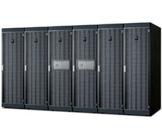
File systems today: “Filers”
Network-attached (IP)
RAID appliance
Multiple protocols
  iSCSI, NFS, CIFS
Admin interfaces
Flexible configuration
Lots of virtualization: dynamic volumes
Volume cloning, mirroring, snapshots, etc.
NetApp technology leader since 1994 (WAFL)

Slide 52
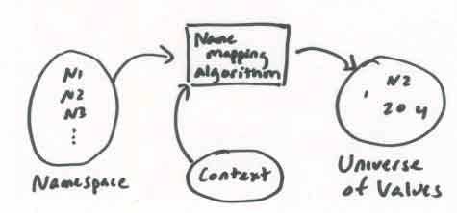
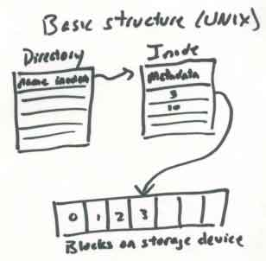
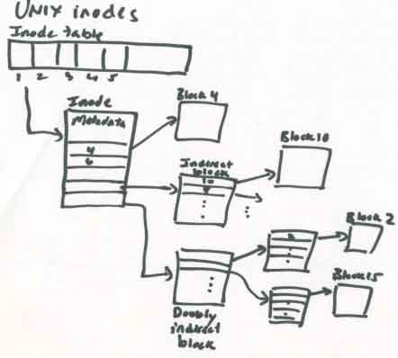
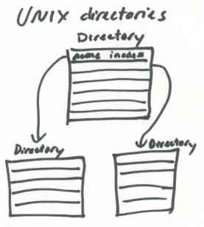
http://web.mit.edu/6.033/2001/wwwdocs/handouts/naming_review.html

Slide 53
Filesystem layout on disk
inode 0
bitmap file
inode 1
root directory
inode 1
root directory
fixed locations on disk
wind: 18
11100010
00101101
10111101
11100010
00101101
10111101
0
snow: 62
0
once upo
n a time
/n in a l
rain: 32
10011010
00110001
00010101
hail: 48
file blocks
allocation
bitmap file
for disk blocks
bit is set iff the corresponding block is in use
00101110
00011001
01000100
and far
far away
, lived th
inode
This is a toy example (Nachos).

Slide 54
A Filesystem On Disk
sector 0
sector 1
allocation
bitmap file
directory
file
wind: 18
11100010
00101101
10111101
0
snow: 62
0
once upo
n a time
/n in a l
rain: 32
10011010
00110001
00010101
hail: 48
00101110
00011001
01000100
and far
far away
, lived th
Data

Slide 55
A Filesystem On Disk
sector 0
sector 1
allocation
bitmap file
directory
file
wind: 18
11100010
00101101
10111101
0
snow: 62
0
once upo
n a time
/n in a l
rain: 32
10011010
00110001
00010101
hail: 48
00101110
00011001
01000100
and far
far away
, lived th
Metadata

Slide 56
Directories
A directory contains a set of entries. Each directory entry is a record mapping a symbolic name to an inode number. The inode can be found on disk from its number.
directory
inode
wind: 18
0
snow: 62
There can be no duplicate name entries: the name-to-inode mapping is a function.
0
rain: 32
hail: 48
A creat or mkdir operation must scan the directory to ensure that creates are exclusive.
Note: implementations vary. Large directories are problematic.
inode 32
Entries or free slots are typically found by a linear scan.

Slide 57
Q: Can you characterize the difference between page table maps and inode maps?
A: Page tables and inode maps are similar in that they are both block maps for locating data given block offsets in a logical storage object. A VAS is a logical storage object: a space of sequentially numbered pages/blocks that could be stored anywhere in memory. A file is a logical storage object: a space of sequentially numbered blocks that could be stored anywhere on disk.
Both kinds of logical storage objects can be large, and both kinds can be sparse. And, no surprise, the data structures they use are almost identical: a tree-structured map. There are some differences too, and you should understand why they exist.
One key difference: the pointers in an inode block map are disk addresses. The map exists to find data on “disk”. Note: that is true for all of the file system metadata structures. File system code must read the metadata structures from disk into memory in order to find and access files, and then modify the metadata and write it back as files are created and destroyed and shrink and grow, to keep track of files and their names, locations, and properties.
In contrast, the pointers in a page table are "physical" memory addresses. The map exists to find data in memory.
Inode block maps are “skewed” because they are optimized for small files and dense files. Most files are written sequentially (they are “dense” with no “holes”), and most files are small. For small files the inode map is very compact, yet it can grow (by adding indirect blocks) as the file grows. Page tables are optimized for sparseness of VAS: a VAS is a collection of segments that may be widely separated, with empty regions (“holes”) between them. The tree structure is compact because we don’t need to allocate maps for the holes: just leave the branch empty.

Slide 58
Safety of metadata
How to protect integrity of the metadata structures?
  Metadata is a complex linked data structure, e.g., a tree.
  Must be “well-formed” after a crash/restart, even if writes are lost.
  …or, must be possible to restore metadata to a consistent state with a scrub (file system check or “fsck”) on restart after a crash.
once upo
n a time
/n in a l
dir inode
wind: 18
0
and far
far away
, lived th
file inode
snow: 62
0
rain: 32
dir entries
file blocks
hail: 48

Slide 59
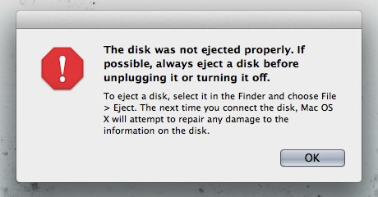

Slide 60
Atomic updates: the recovery problem
The safe metadata update problem in file systems is a simplified form of the atomic update and recovery problem for databases.
We want to make a group of related updates to a complex linked data structure, e.g., to create a new file. The updates could be all over the disk.
But we could crash at any time, e.g., in the middle of the group of updates.
We need some way to do atomic commit: either all of the updates in each group complete, or none of them do. And we want it to be fast.
The concern is similar to concurrency control: we don’t want software to “see” an inconsistent state that violates structural invariants.
once upo
n a time
/n in a l
dir inode
file blocks
wind: 18
0
and far
far away
, lived th
file inode
snow: 62
0
rain: 32
dir entries
hail: 48

Slide 61
Disk write behavior (cartoon version)
Disk may reorder pending writes.
  Limited ordering support (“do X before Y”).
  Host software can enforce ordering by writing X synchronously: wait for write of X to complete before issuing Y.
Writes at sector grain are atomic (512 bytes?).
Writes of larger blocks may fail “in the middle”.
Disk may itself have a writeback cache.
  Even “old” writes may be lost.
  (The cache can be disabled.)

Slide 62
Atomic commit: shadowing
Shadowing is used in NetApp WAFL:
Write Anywhere File Layout
Write each modified block to a new location.
Update block maps to point to the new locations.
3. Write the new block map to disk with a single disk write.
Shadowing presumes that the data is mapped by a block map on disk, that the disk is large enough to store both the old version and the modified data, and that we can update the block map on disk with a single (atomic) disk write. To grow the block map we can make it hierarchical.

Slide 63
Shadowing
1. starting point
modify purple/grey blocks
2. write new blocks to disk
prepare new block map
3. write new block map
(atomic commit)
and free old blocks
(optional)
Shadowing is a basic technique for atomic commit and recovery. It is used in WAFL.
Just to spell it out: if the system crashes before step 3, then the update fails, but the previous version is still intact. To abort the failed update we just need to free any blocks written in step 2. Step 3 completes the update: it replaces the old map with the new. Because it is a single disk write, the system cannot fail “in the middle”: it either completes or it does not: it is atomic. Once it is complete, the new data is safe.

Slide 64
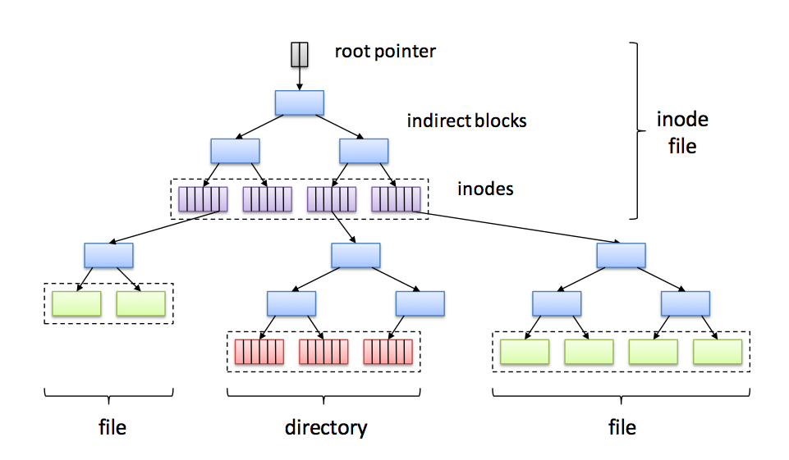

On-disk metadata structures
Write Anywhere File Layout (WAFL)
Root inode
Inodes for user files and directories

Slide 65
WAFL and Writes
Any modified data/metadata can go anywhere on the disk.
  The WAFL metadata structure assures this: every piece of metadata is linked in a tree rooted in the root pointer.
An arbitrary stream of updates can be installed atomically.
  Retain the old copy: “no overwrite”
  Switch to new copy with a single write to the root (shadowing).
WAFL’s design naturally maintains multiple point-in-time consistent snapshots of each file volume.
  Old copy lives on as a point-in-time snapshot.

Slide 66
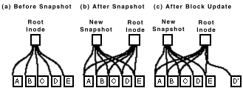
WAFL Snapshots
The snapshot mechanism is used for user-accessible snapshots and for transient “consistency points”.

Slide 67
WAFL’s on-disk structure (high level)
Root Inode
Metadata
File Data Blocks
Notes:
Green: active file system
Key point: never overwrite existing data
CP: flush all “dirty” buffers to disk, update the root inode (move the active file system forward)
Root Inode -> Inode File -> Blockmap
Nets you:
Snapshot
Dedupe

Slide 68
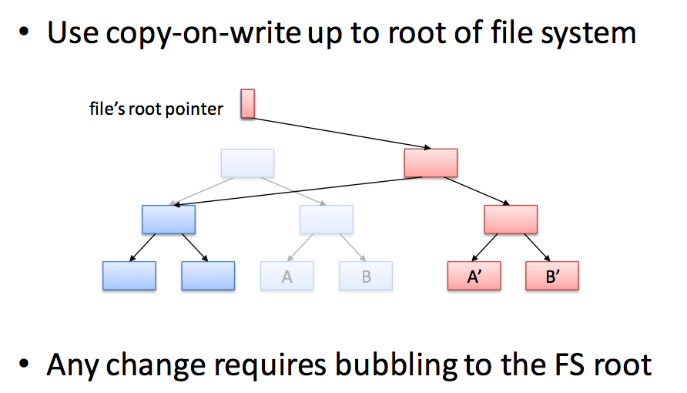
Another Look
Write new copies of A and B and every piece of metadata on the path back to the root.
Suppose I modify blocks A and B.

Slide 69
Storage system performance
How to get good storage performance?
  Build better disks: new technology, SSD hybrids.
  Gang disks together into arrays (RAID logical devices).
  Smart disk head scheduling (when there is a pool of pending requests to choose from).
  Smarter caching: better victim selection policies
  Asynchronous I/O: prefetching, read ahead, “write behind”
  Location, location, location: smart block placement
It’s a big part of the technology of storage systems.

Slide 70
Building better file systems
The 1990s was a period of experimentation with new strategies for high-performance file system design.
The new file systems generally used the FFS mechanisms and data structures, but changed the policies for block allocation.
  Block allocation policy: where to place new data (or modified old data) on the storage volume? Which block number to choose?
  “File system design is 99% block allocation.” - Larry McVoy
  Example: Group large-file data into big contiguous chunks called clusters or extents that can be read or written as a unit (larger b). [McVoy91] and [Smith/Seltzer96]
  Example: Write modified data and metadata wherever convenient to minimize seeking: e.g., “log-structured” file systems (LFS) [Rosenblum91] and NetApp’s WAFL [Hitz95]. Note: requires a level of indirection so the FS can write each version of an inode to a different location on the disk. (See WAFL’s inode file.)

Slide 71
WAFL and the disk system
WAFL generates a continuous stream of large-chunk contiguous writes to the disk system.
  WAFL does not overwrite the old copy of a modified structure: it can write a new copy anywhere. So it gathers them together.
Large writes minimize seek overhead and deliver the full bandwidth of the disk.
WAFL gets excellent performance by/when using many disks in tandem (“RAID”)…
…and writing the chunks in interleaved fashion across the disks (“striping”).
Old copies of the data and metadata survive on the disk and are accessible through point-in-time “snapshots”.

Slide 72
Block placement and layout
One key assumption: “seeks waste time”.
  Blocks whose addresses (logical block numbers) are close together are cheaper to access together.
  “Sequentialize!”
Location, location, location:
  Place data on disk carefully to keep related items close together (smart block allocation).
  Use larger b (larger blocks, clustering, extents, etc.)
  Smaller s (placement / ordering, sequential access, logging, etc.)

Slide 73
Access time
How long to access data on disk?
  5-15 ms on average for access to random location
  Includes seek time to move head to desired track
    Roughly linear with radial distance
  Includes rotational delay
    Time for sector to rotate under head
  These times depend on drive model:
    platter width (e.g., 2.5 in vs. 3.5 in)
    rotation rate (5400 RPM vs. 15K RPM).
    Enterprise drives use more/smaller platters spinning faster.
  These properties are mechanical and improve slowly as technology advances over time.
Track
Sector
Arm
Cylinder
Platter
Head

Slide 74
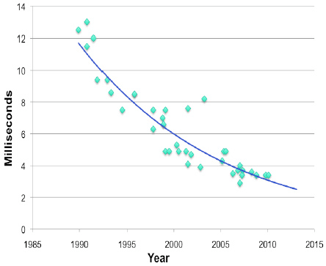
Average seek time
“The seek time is due to the mechanical motion of the head when it is moved from one track to another. It is improving by about 5% CAGR. In general, this is a mature technology and is not likely to change dramatically in the future. “
IBM Research Report 2011
GPFS Scans 10 Billion Files in 43 Minutes

Slide 75
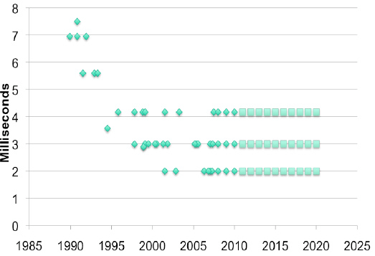
Rotational latency
The average disk latency is ½ the rotational time of the disk drive. As you can see from its recent history…[it] has settled down to three values 2, 3 and 4.1 milliseconds. These are ½ the inverses of 15,000, 10,000 and 7,200 revolutions per minute (RPM), respectively.
It is unlikely that there will be a disk rotational speed increase in the near future. In fact, the 15K RPM drive and perhaps the 10K RPM drive may disappear from the marketplace…driven by the successful combination of SSD and slower disk drives into storage systems that provide the same or better performance, cost and power.
Drives spin at a fixed constant RPM. (A few can “shift gears” to save power, but the gains are minimal.)
IBM Research Report 2011
GPFS Scans 10 Billion Files in 43 Minutes

Slide 76
Effective bandwidth
Seeks are overhead: “wasted effort”. It is a cost s that the device imposes to get to the data. It is not actually transferring data.
This graph is obvious. It applies to so many things in computer systems and in life.
b/(sB+b)
1
Spindle bandwidth B
100%
Effective bandwidth is efficiency or goodput
What percentage of the time is the busy resource (the disk head) doing useful work, i.e., transferring data?
b/B s (seek)
Transfer size b

Slide 77
Effective bandwidth
Effective bandwidth or bandwidth utilization is the share or percentage of potential bandwidth that is actually delivered. E.g., what percentage of time is the disk actually transferring data, vs. seeking etc.?
Define
b Block size
B Raw disk bandwidth (“spindle speed”)
s Average access (seek+rotation) delay per block I/O
Then
Transfer time per block = b/B
I/O completion time per block = s + (b/B)
Delivered bandwidth for I/O request stream = bytes/time = b/(s + (b/B))
Bandwidth wasted per I/O: sB
So
Effective bandwidth: bandwidth utilization/efficiency (%): b/(sB + b)
[bytes transferred over the “byte time slots” consumed for the transfer]

Slide 78
Effective bandwidth by access time
b/(sB+b)
1
Spindle bandwidth B (90 MB/s)
100%
b=256K
b=64K
b=4K
access time s
5ms
Bigger is better. Other things being equal, effective bandwidth is higher when access costs can be amortized over larger transfers. High access cost is the reason we use tapes primarily for backup! As B grows and s is unchanged, disks are looking more and more like tapes! (Jim Gray)

