Slide 1
Compsci 101, Language, Lamdas, Libraries
Owen Astrachan
Kristin Stephens-Martinez
April 17, 2018

Slide 2
W is for …
World Wide Web
Where http meets tcp/ip?
WiFi
We need and use this every day
Windows
From OS to ...

Slide 3
PFTLFW
Review work remaining in Compsci 101
Labs, APTs, Assignments, APT/Data Quiz
Lab for this week and APT/Data quiz
What and when
Python language and libraries
From operator.itemgetter to lambda

Slide 4
Work and Due Dates
APT 6, due on Thursday 4/19
What's required? What's optional? Why?
Input to the Green Dance/Creative assignment?
https://www.youtube.com/playlist?list=PLl6wh3hSLvVu3MdE70jV24NwrOaNTls5A
http://www.thegreendance.com/

Slide 5
Recommender Assignment
Transform data into a common format
Make recommendations using collaborative filtering
http://bit.ly/101spring18-partners
April 18

Slide 6
APT Data Quiz
Read files, use dictionaries, answer questions
Lab is a model for this
Depending on when you take it, you may get a different data set and/or different questions

Slide 7
Data
Using Python to answer questions about data
4400+ lines of airport data, 2003-2016
What is the busiest airport?
Code,Month,Year,Cancelled,Carriers,Delayed,Total,Ontime,City,Name
"TPA","January",2016,146,8,1095,5996,4748,"Tampa, FL"," Tampa International"
Code,Month,Year,Cancelled,Carriers,Delayed,Total,Ontime,City,Name
"ATL","June",2003,216,11,5843,30060,23974,"Atlanta, GA"," Hartsfield-Jackson Atlanta International"
"BOS","June",2003,138,14,1623,9639,7875,"Boston, MA"," Logan International"
"BWI","June",2003,29,11,1245,8287,6998,"Baltimore, MD"," Baltimore/Washington International Thurgood Marshall"
"CLT","June",2003,73,11,1562,8670,7021,"Charlotte, NC"," Charlotte Douglas International"
...
"SEA","January",2016,104,10,1274,9739,8330,"Seattle, WA"," Seattle/Tacoma International"
"SFO","January",2016,449,10,3825,13206,8912,"San Francisco, CA"," San Francisco International"
"SLC","January",2016,84,8,1175,8699,7426,"Salt Lake City, UT"," Salt Lake City International"
"TPA","January",2016,146,8,1095,5996,4748,"Tampa, FL"," Tampa International"

Slide 8
Defining and Solving the Problem
Most average number of flights/month
Every line of the file is a month of data
Track total # flights, and count how many lines
Store and sort by total/count
Header row reminder
Code,Month,Year,Cancelled,Carriers,Delayed,Total,Ontime,City,Name
Accumulate: total += int(line[6])

Slide 9
Tracking Two Quantities
Similarities here compared to EatDrink APT
https://www2.cs.duke.edu/csed/pythonapt/eatdrinkcontest.html
[total # flights, # months] and [total time, # tasks]
Track for each TLAC or each contestant
Use d[name] = [0,0] to initialize
Use d[name][1] += 1 to update ... What?
Notes:
Why not use a tuple?

Slide 10
Reading Data
Converting data from strings to ..., e.g., in APT
for one in data: x = one.split()
time = x[1].split(":")
Still need to convert strings to ints, e.g., to get seconds in APTs
JSON data avoids int/string/float conversion
Data automagically converted, see Assign 6

Slide 11
Completing this APT with help
https://www2.cs.duke.edu/csed/pythonapt/eatdrinkcontest.html
How do we break ties? Sorting first ..

Slide 12
APT WOTO
http://bit.ly/101spring18-april17-1

Slide 13
Nancy Leveson: Software Safety
(1995) AIAA Information Systems Award for "developing the field of software safety and for promoting responsible software and system engineering practices where life and property are at stake."
Therac 25: Radiation Machine
https://hackaday.com/2015/10/26/killed-by-a-machine-the-therac-25/
Software v. Safeware

Slide 14
Abstraction
What does operator.itemgetter(1) do?
Function that compares elements being sorted
Rather than use list/tuple, use function result
("sam", [1,5,7,9], ...) sort by list-length?

Slide 15
Simple Sorting
Explaining what each line here means ...
How are tuples or lists sorted?
Notes:
Why does 'c' tuple come before 'a' tuple come before 'b' tuple?

Slide 16
Sorting by sum of tup[1]: a list
How do we apply a function to each tuple?
Why is this the order?
Why is ('c', [1,1,5,8]) last?
What is the parameter passed to tupsum?

Slide 17
Creating anonymous functions
Avoid the need to create/label a function just used once, e.g., for sorting
How do we define function tupsum? Where?
What if we only need it to sort, called a million times for sorting, but never used again?
What is lambda?
Syntactic sugar for a normal function definition
https://docs.python.org/3/tutorial/controlflow.html

Slide 18
Create a function on the fly
Keyword lambda
lambda args : args-expression
def flen(t) : return len(t[1])
Use key=flen to sort, equivalent

Slide 19
Why is lambda used?
It doesn't matter at all
https://en.wikipedia.org/wiki/Alonzo_Church
Lisp and Scheme have lambda expressions
Guido, the BDFL, learned to live with lambda

Slide 20
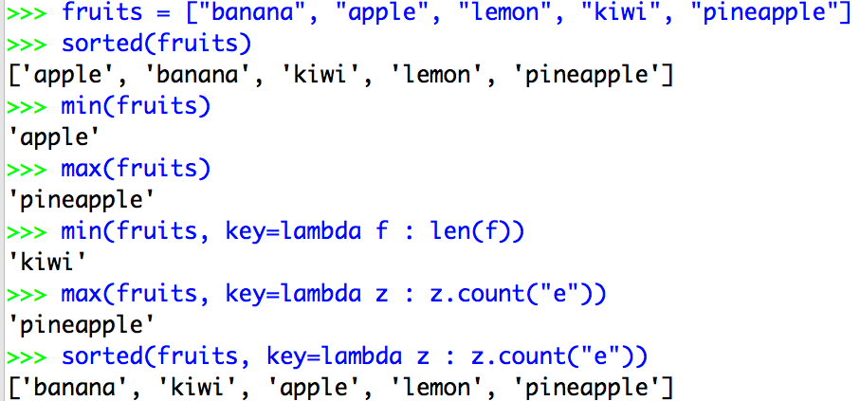
Syntax and Semantics of Lambda
Major use: single variable function as key

Slide 21
What is a lambda expression?
It's a function object, treat like expression/variable
Like list comprehensions, access variables

Slide 22
What about List Comprehensions?
List comprehensions and lambda expressions have access to enclosing scope: closures
Advice: don't do this, create named function

Slide 23
WOTO
http://bit.ly/101spring18-april17-2

Slide 24
Questions

