Slide 1
Compsci 101, Functions
Owen Astrachan
Kristin Stephens-Martinez
January 23, 2018

Slide 2
C is for …
Computer Science and Computing
  It’s what we do
Collaboration
  Review the policy
Cookies
  Good for the web and for …
CSV
  Comma Separated Values: Data
Notes:
Reminder: we missed class, so could make you come to a Saturday or double up, took a vote and said no Saturday.

Slide 3
PFTD and toward PFTW
Functions in Python
  Decomposition, parameters, calling
Flow of Control
  How does a program execute, how do function calls work?
Program Development and Execution
  How do you run a program, test a program, debug a program

Slide 4
Where were we?
Last time we read/solved the BMI APT
  Project, Module, Code, Fail/Red, Pass/Green
The function calculate was in the BMI module
  The function call can be from elsewhere
  The APT framework imports BMI module and calls the function you wrote

Slide 5
BMI dissected
What is formula? How to use and re-use?
  Functions allow code to be re-used
  Square root, len, BMI.calculate
How do we validate/test our code?
  APT testing harness
def bmi(weight, height):
return 703.07 * weight/(height*height)
if bmi(170,72) < 18.5:
print ("underweight")
call replaced by return value, why use function?

Slide 6
Understanding Execution
Using PythonTutor: https://goo.gl/7R1zUK
  How are functions defined?
  Where does execution begin?
  What is the global frame?
  What is a local/function frame?
What is if __name__ == “__main__”:
  Where execution begins
  Optional but useful for APTs
Notes:
PythonTutor: All models are wrong, but some are useful – George Box https://en.wikipedia.org/wiki/All_models_are_wrong

Slide 7

Anatomy of Return Statement
Execution is one line/statement at a time
  After one statement, next statement
  Calling a function transfers control to function
    When finished? Control transferred back
Return value replaces function call
  x = math.sqrt(25)
  if bmi(170,72) < 18.5:
  print("underweight")
None returned by default!

Slide 8
What PythonTutor Demonstrates
What happens when program is first “executed”?
  Functions are referenced in global frame
  Execution begins in main program block
What happens when function called?
  Arguments passed as parameters to function
    See green and red arrows when executing
  Control passes to function which executes
  Return value replaces function call

Slide 9
What we saw, learned
Variable names are local to a function
  Use useful names when possible
Parameter names v argument names
  Argument can be value/expression
  Types must agree! Int to float? Ok. Int to String?
Understand and visualize your code
  Helps in debugging, need mental model

Slide 10
WOTO Redux
http://bit.ly/101spring18-jan16-2
Notes:
Maybe this is all correct, I’m out of gas

Slide 11
Testing BMI.calculate
The function calculate is in Module BMI
  Wrote the function, how to call it?
  You can test if you provide main!
  Alternatively, import into PyDev Console
In PyDev console
  Must write import BMI
  Must call BMI.calculate(3,2) for example
Notes:
Must

Slide 12
APT Testing and Submission
You wrote the code, how is it tested?
  Submit .py module with function to server
  Server tests and checks by calling your function
The APT testing framework calls your code!
  Don’t call us, we’ll call you: Hollywood principle
Test, Submit, Reflect
  Make sure you do all three! See web pages

Slide 13
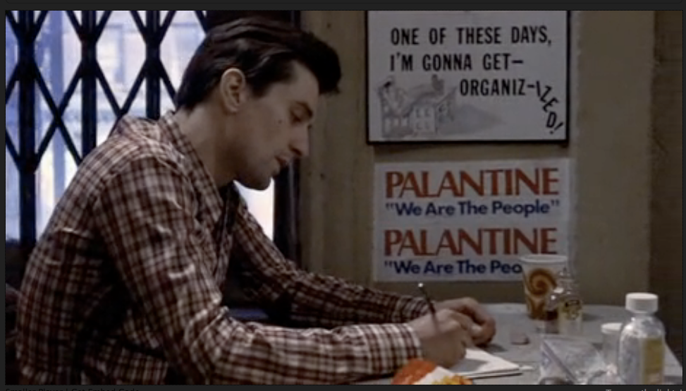
Organization Matters
https://www.youtube.com/watch?v=1ve57l3c19g
Notes:
This is an all time favorite of mine, may not be something you want to do? Apparently Susan still uses it too I think when Robert de Niro looks at Cybil Shepard in the clip it's clear that he's infatuated with her. It's a long time ago. We are still infatuated with teaching and coding and we hope they will be. We also want to be organizized with building programs.

Slide 14
BMI on "real" data
Preview of what's coming
  How do we process data from class?
  Read a file that's line-oriented
  Extract data from each line
  Clean/process the data
  Use the BMI.calculate function
  Make decisions based on return value
Open, Loop, Convert, Index, Select

Slide 15
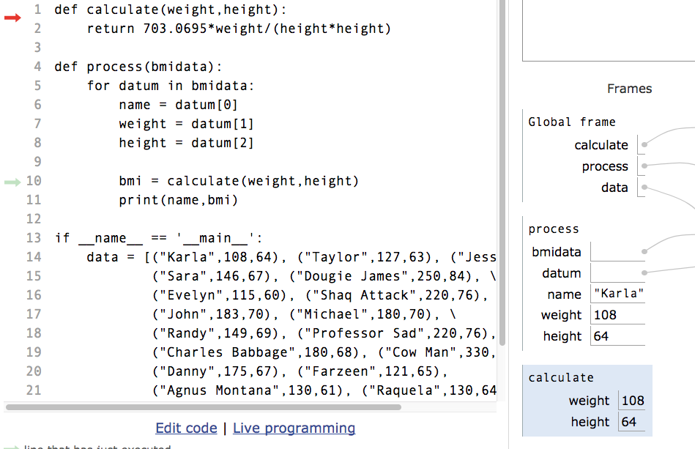
    PythonTutor Captured in this Screenshot? https://goo.gl/g45obn

Slide 16
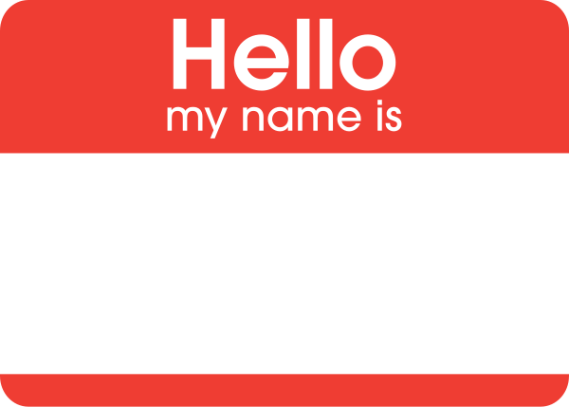
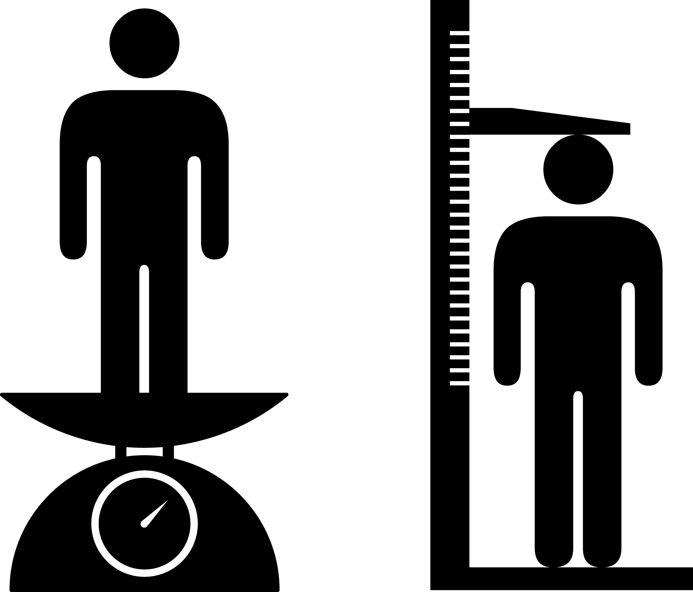
Preview of Flow of Control
There’s a loop in the function process
  “examine” each datum in parameter bmidata
  In the body of the loop use datum
What are the types of name, weight, height?
  How can you tell? Where do you look?

Slide 17

The Unknown (no fear)
Other variables in function process
  Parameter: bmidata
  Looped element: datum
What can you do with these? Hypotheses and looking for something similar you do know
  What’s passed as argument to process?
  What’s done with datum in loop body?

Slide 18
WOTO
http://bit.ly/101spring18-jan23-2
Sneak Preview: lists and tuples

Slide 19
Luis von Ahn, Duke 2000 and 2017

Slide 20
Why Use Functions?
Re-use code/abstractions in multiple contexts
  Sqrt, wordcount, URL-Webpage examples
Test code/abstractions separately from their use
  Develop independently, use with confidence
Easier to change, re-use in different contexts
  Relevant to Assignment 1: TotemPoles

Slide 21
Songs as Examples
Modify for pig and oink, fox and ???
Old MacDonald had a farm, Ee-igh, Ee-igh, oh!
And on his farm he had a horse, Ee-igh, Ee-igh, oh!
With a neigh neigh here
And a neigh neigh there
Here a neigh there a neigh everywhere a neigh neigh
Old MacDonald had a farm, Ee-igh, Ee-igh, oh!

Slide 22
First Version
BadBarnyard.py
https://goo.gl/RVPiyk
The first version is accessible as part of zip project
  https://www2.cs.duke.edu/courses/spring18/compsci101/code/
  See the main web page for tab
Benefits? Easy to see it works?

Slide 23
Re-use and Use of code
We provide code for discussion in class
  We want you to be able to access it
  Can provide all modules in online folder
  Can provide zip file you can download and use
Sometimes we’ll use PythonTutor
  Helps visualize program execution

Slide 24
Bundle Related Code in Function
Create cow(), pig(), horse(), fox()
  Grouping makes it easier to reason about
  Grouping makes it easier to extract a more generalized/re-usable function
See Farmyard.py module

Slide 25
From Farmyard.py
def pigVerse():
return hadFarm() + \
refrain() + \
"And on his farm he had a pig," + \
refrain() + \
"With an Oink Oink here\n" + \
"and an Oink Oink there\n" + \
"Here an Oink, there an Oink\n" + \
"Everywhere an Oink, Oink\n" + \
hadFarm() + \
refrain()

Slide 26
Anatomy of multi-line return
Lines that are extended to next line end in \
  Used when long single line hard to read!
The character ‘\n’ indicates a newline
  AKA escape sequence, e.g., ‘\t’ and ‘\\’
  Used to force newline when printing!
Function returns a string, how do you know?
  What are refrain() and hadFarm()
  Name, type, value

Slide 27
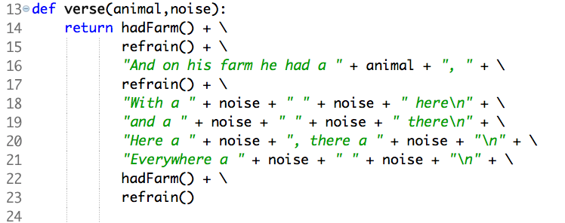
Replace oink with variable
pigVerse to verse, Farmyard to Farmyard2

Slide 28
Functions Summarized
Function call and Function definition related
  Call must provide correct arguments
  Names don’t matter, types are important
Functions help design, implement, organize
  Without functions no APIs, no big programs
  Opening a file would be 100’s of lines, instead it’s f = open(“hello.txt”)

Slide 29
Final WOTO
http://bit.ly/101spring18-jan23-3
Correctness counts

