Slide 1
Compsci 101, First Day
Owen Astrachan
Kristin Stephens-Martinez
January 11, 2018

Slide 2
Introduction to Computer Science
https://www2.cs.duke.edu/courses/spring18/compsci101/
AKA http://bit.ly/101spring18
Notes:
Images are free for re-use under pleasure, thinking, computer science. Three goals we have for you in this course: thinking in general, and thinking like a “computer scientist” in particular, which is the title of the free book we use. Rather than computer scientist, we might think about “educated citizen and creator of the world including the cyber and virtual world
Pleasure is what we want you to feel when your programs work and things make sense. Particularly, “enjoy today” and don’t fret about what’s coming
Computer science is about working in teams or working at least together. There’s no “lone wolf” or “lonesome cowboy/cowgirl” mentality. This image captures that, and it popped up!
We’ll be doing WOTO-style problems often in class/lab. WOrk TOgether

Slide 3
Today you'll need computer science
“Our species needs, and deserves, a citizenry with minds wide awake and a basic understanding of how the world works.”
-Carl Sagan
Notes:
Today this “universe” carl sagan talks about is also a digitial and virtual universe. So instead of the cosmos and the universe in space? It’s the digital and cyber universe we need to understand to be an effect citizen in our world
Who is the carl sagan of today? Next slide

Slide 4
Who Studies the Universe Today?
Science literacy is the artery through which the solutions of tomorrow's problems flow.
No one is dumb who is curious. The people who don't ask questions remain clueless throughout their lives.
Knowing how to think empowers you far beyond those who know only what to think.
Notes:
Today’s Carl Sagan? These quotes all relate to computer science and compsci 101 if we look at them correctly. HOW TO THINK like a computer science, not WHAT a computer scientist thinks
Science literacy today requires basic computer science/programming – to help make sense of data at least
CURIOUS will come up on the next slide, remember this

Slide 5
Compsci 101 Prerequisite
Notes:
Curious George. What does he have? Curiosity – what do you need *before* taking Compsci 101? You need to be a curious student at Duke. It will take more than curiosity to succeed – but being curious is a great pre-req and we’ll leverage that curiosity during the semester.

Slide 6
PFTD and toward PFTW
Be able to articulate why 101 is the right course for you, in terms of being able to complete it with understanding
Be able to explain what work is expected, collaboration policies, exams, discussions, assignments, APTs
Understand the role of programming in Computer Science, what a program is, how to read a program
Know what work you should complete before the end of next week
Notes:
Almost every Tuesday we’ll begin with a Plan for the Day and a Plan for the Week. We start late this week
Walk through goals, make sure you review this slide at the end of class? Did we provide enough background and information to help you be able
To do the things on this slide?

Slide 7
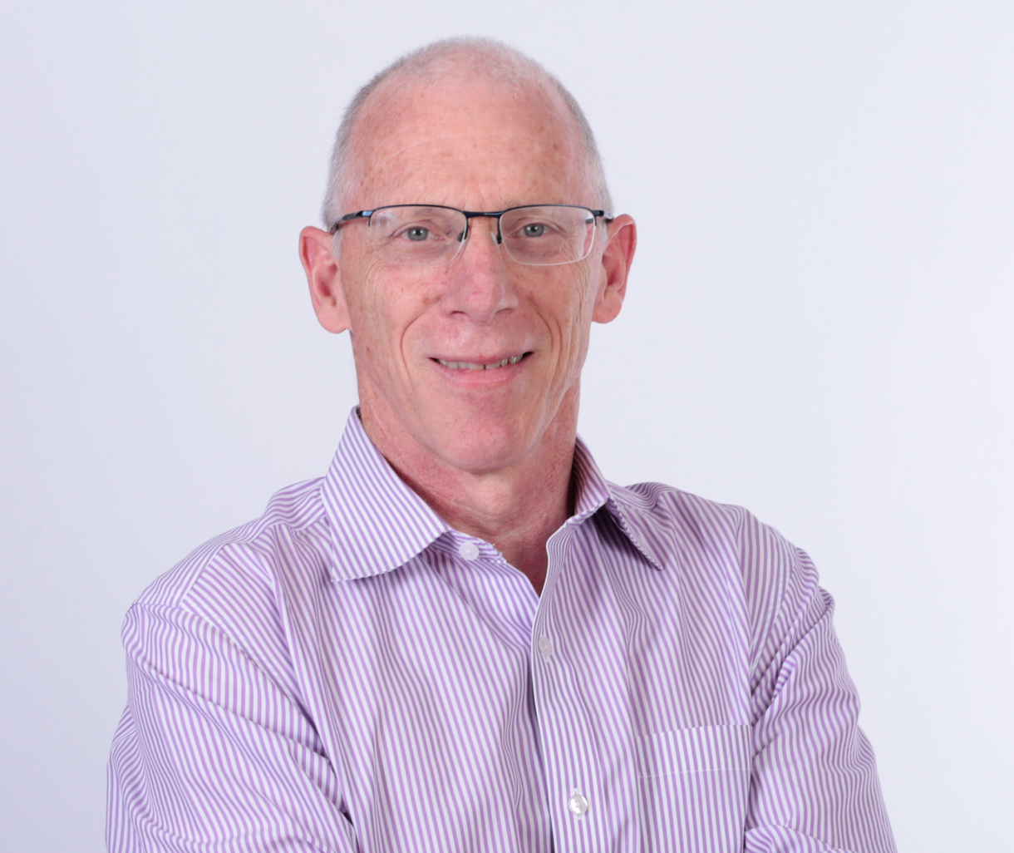
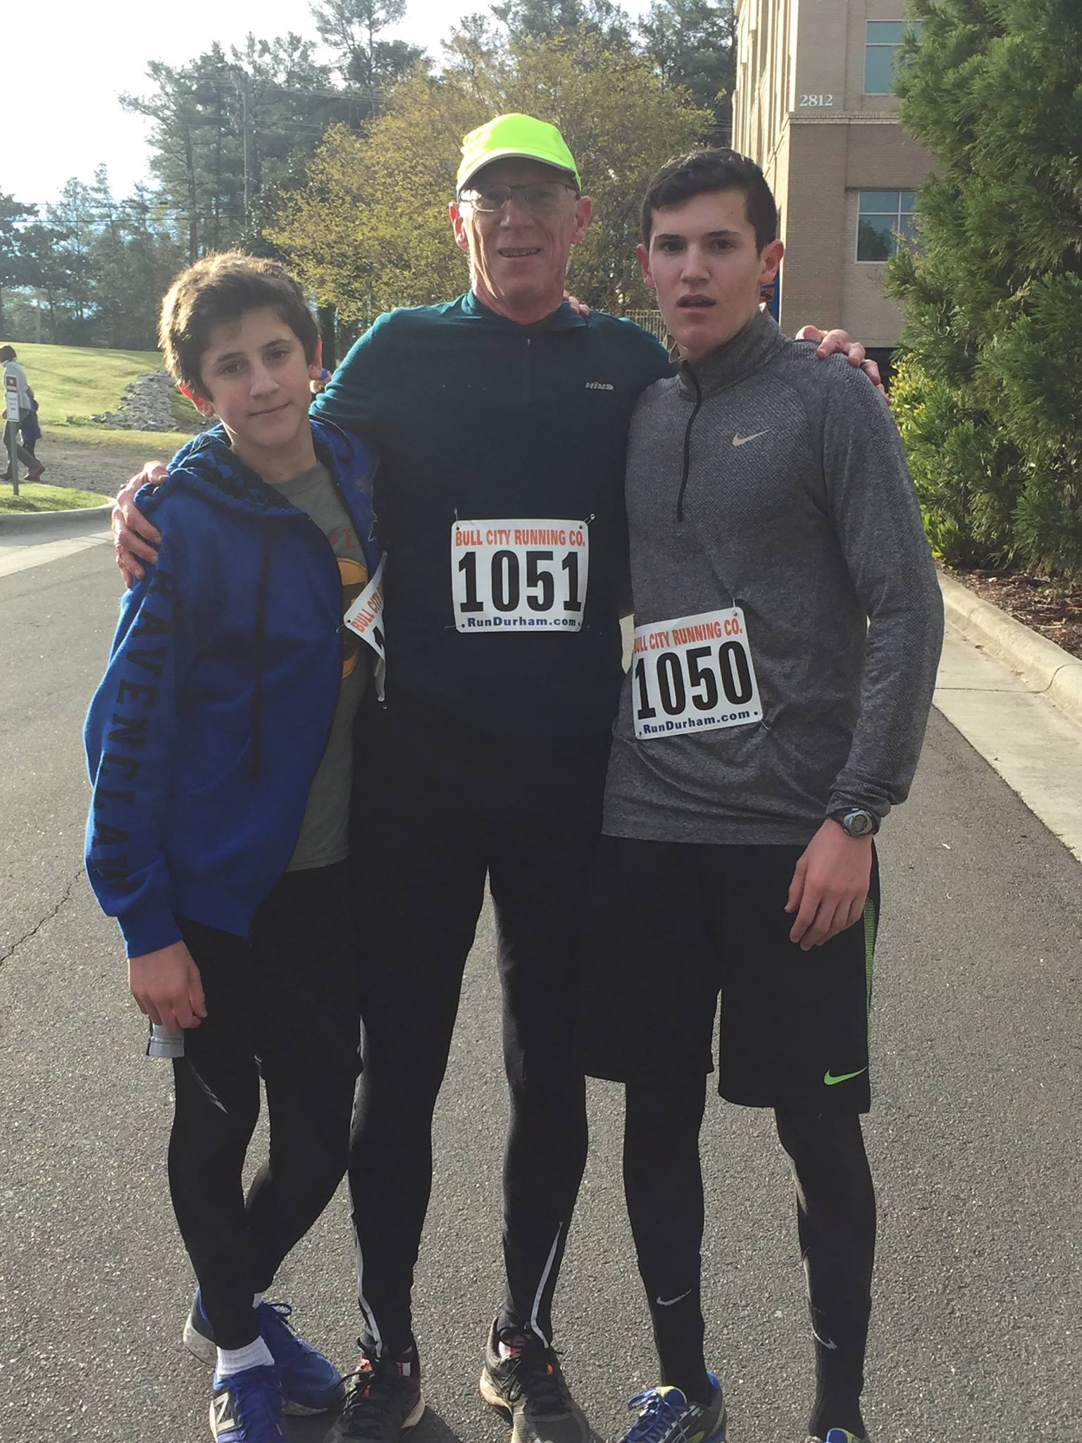
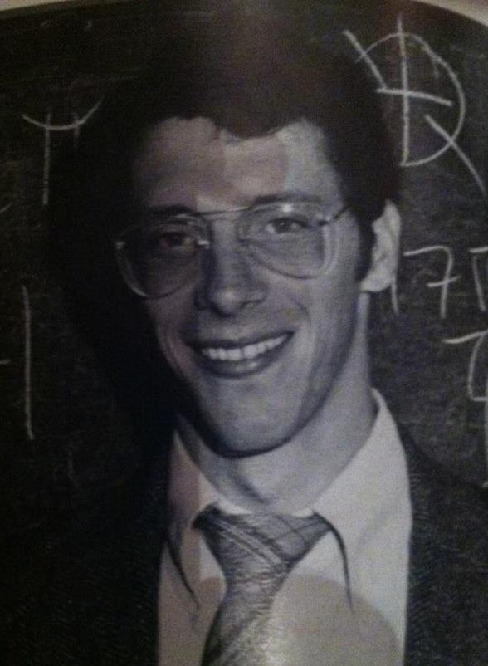
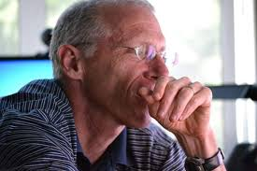
Who am I?
Notes:
Talk about who I am in preparation for knowing who they are

Slide 8
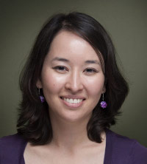
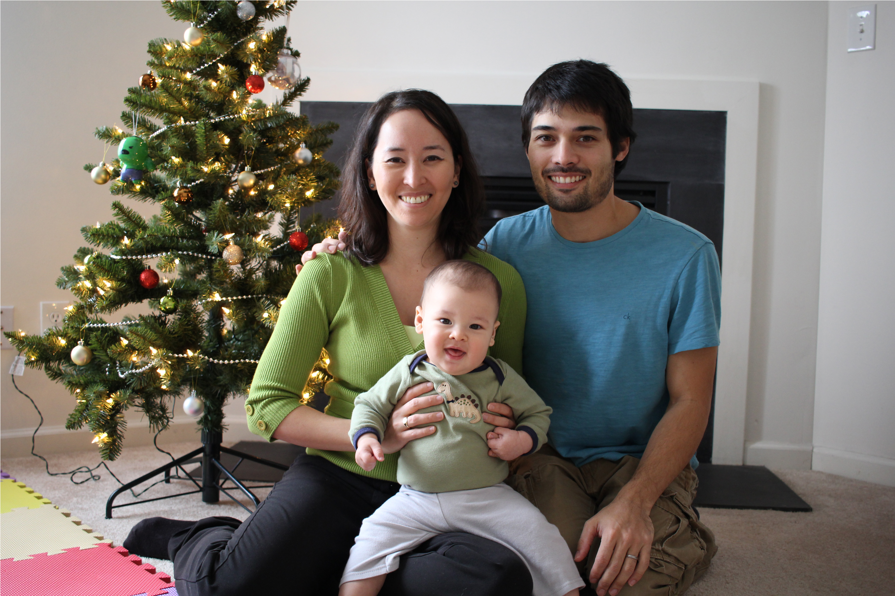
Who am I?
Notes:
Talk about who I am in preparation for knowing who they are

Slide 9
A is for …
Algorithm
Step-by-step instructions realized in a program
Abstraction
Hiding things is powerful
APT
Problem Solving
API
Using Libraries
Notes:
We have 26 lectures and 2 midterms: 28 class meetings. On days we lecture we’ll talk about words related to compsci 101 and computer science to help anchor our discussion and to help monitor the progress we’re making from the first class to the last class. If we start at class 0, what number is the last class?

Slide 10
What is Computer Science?
http://bit.ly/101spring18-jan11-1
See calendar on web page and Sakai for links
http://bit.ly/101spring18
What are we studying in Compsci 101?
WOTO
Notes:
We’ll do these WOTO activities/questions every class. Typically 1-3 based on participation and 1 based on correctness. You learn from what you and others answer. Work collaboratively in groups of 2-3 as you can. We keep these live during a small window in class. Can you complete them if not in class? Yes. Can you type in someone’s name who’s not in class? Sure – and we can’t check, but that goes against the spirit of the Duke Community standard. This is a small % of your final grade, enough to provide an incentive to be in class. That’s about community. We are positive you’ll know more people in class and be part of a community if you actually attend class.
If you view all sildes and lectures at 2x speed on your own time? You may learn the material. But don’t expect to get these 3% class/woto points.
See bit.ly links in Sakai and on course calendar page
---
After students fill out form: give them 5 minutes. Go over answers. Easy to see short answers. For “what is computer science”? We’ll scroll through a few and then do google.com autocomplete
What is …
What is computer science
--
Then go to wikipedia and look at the succinct answer that was partially created during an exercise exactly like this one 3 years ago! And still there

Slide 11
What is Computer Science?
Notes:
The apps/sites at the top are ones you encounter every day. These apps scale. What are they? Left to right students might answer
1-2-3: snap
1-2-3:facebook
1-3-3: instagram
And so on.
But what about the “icons” at the bottom which represent interdisciplinary contributions of computer science? Volunteers to answer?
Genomic and personalized genomic medicine. Turns out The human genome project and sequencing depended on computer science
Self driving cars. Totally dependent on computer science and large amounts of data. Huge
Machine learning. More about training, also about learning – what does this mean? Combination of linear algebra, math, statistics, computer science
But also accessible via APIs!!!

Slide 12
What is Computer Science?
What is it that distinguishes it from the separate subjects with which it is related? What is the linking thread which gathers these disparate branches into a single discipline? My answer to these questions is simple --- it is the art of programming a computer. It is the art of designing efficient and elegant methods of getting a computer to solve problems, theoretical or practical, small or large, simple or complex.
C.A.R. (Tony) Hoare
Notes:
Both art and science. Elegance, not always science? This isn’t a universally held view, but it is cmomon. And Tony Hoare is a turing award winner, a Knight of the British Empire and the inventor of quicksort.

Slide 13
Some Goals for 101
Given a problem statement & a real data source, design, develop, debug, and test a Python program that uses appropriate standard libraries to solve the problem.
Differentiate between code that solves a problem and code that solves a problem in a way that is generalizable or uses abstractions and concepts appropriately
Notes:
Read these and discuss these as goals we’ll touch on throughout the semester. Do some skills transcend Python? Yes, absolutely. Grounded in Python, but abstractions are universal.

Slide 14
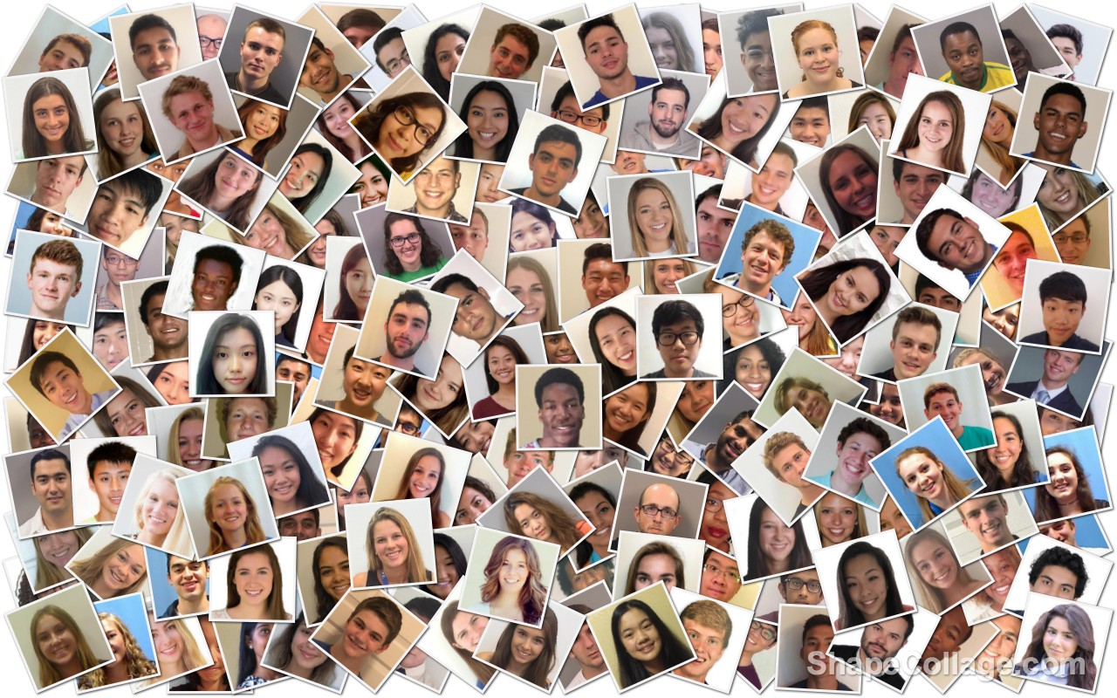
Who are you?
Notes:
Collage from section 1 students
https://docs.google.com/forms/d/1R4M5HKbfRS7VjBnyKBwuO8_IF5T07a-0slcG-M7-_kc/edit#responses
Discuss who they are based on survey

Slide 15
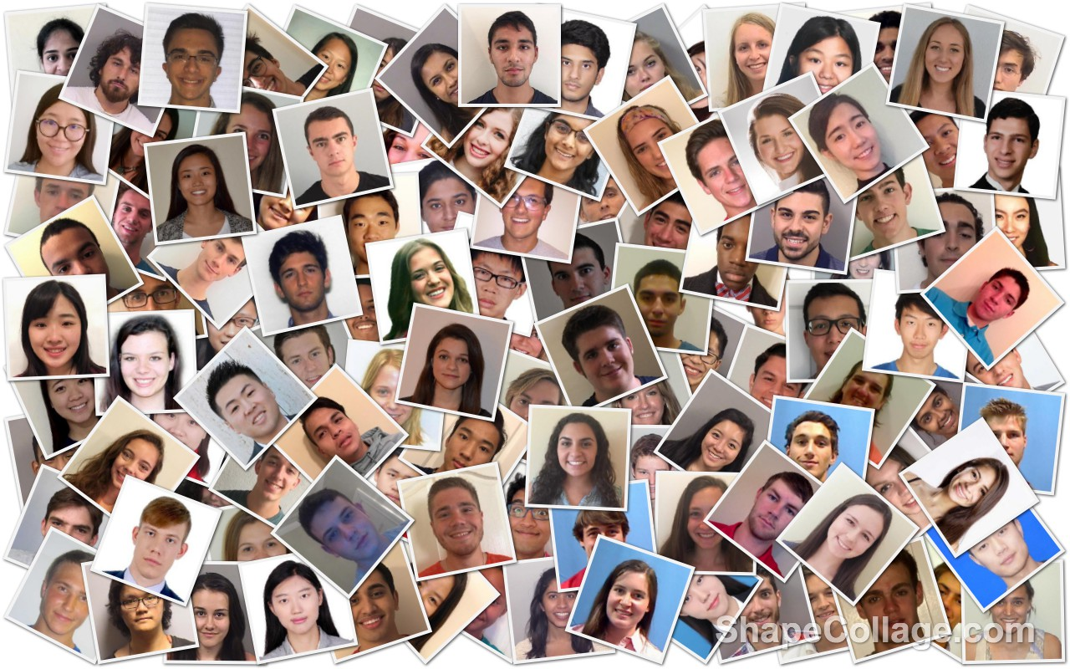
Who are you?
Notes:
Collage from section 2 students
https://docs.google.com/forms/d/1R4M5HKbfRS7VjBnyKBwuO8_IF5T07a-0slcG-M7-_kc/edit#responses

Slide 16
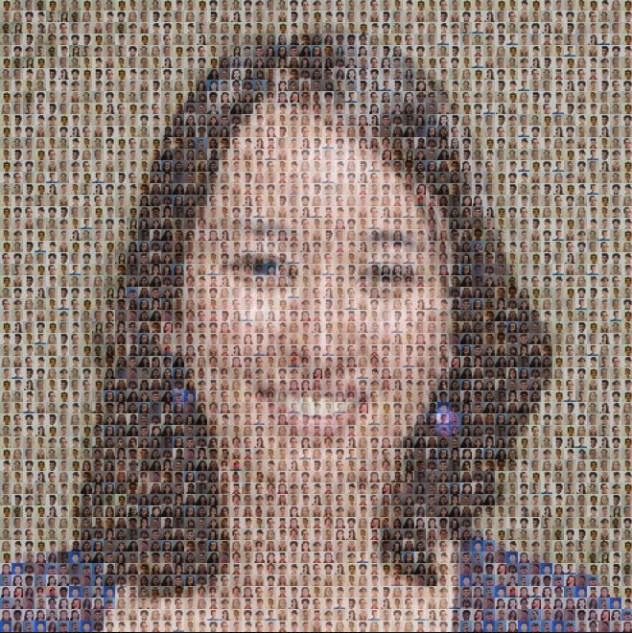
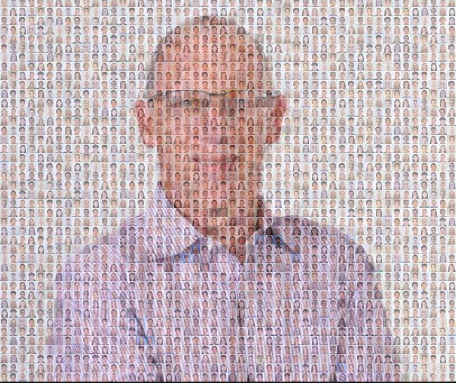
Who are you?
Notes:
Photo mosaic using algorithms to “fit” section pictures to section instructors. Each image created by using an algorithm to fit photos of students in section 1 to ola and in section 2 to ksm.
Photo mosaic was patented software at one time, but the patent was thrown out as “obvious”. Topic for later courses in computer science.

Slide 17
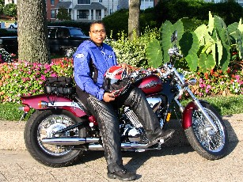
Latanya Sweeney
I am a computer scientist with a long history of weaving technology and policy together to remove stakeholder barriers to technology adoption. My focus is on "computational policy" and I term myself a "computer (cross) policy" scientist. I have enjoyed success at creating technology that weaves with policy to resolve real-world technology-privacy clashes.
http://latanyasweeney.org/
Identify 87% of US population using (dob,zip,gender). Prof. Government and Technology @ Harvard, instrumental in HIPAA because if de-identification work. Former CTO of the FTC
Notes:
We touch on a computer scientist or someone in related discipline who contributes in interesting ways. Click on link, or google her, amazing contributions to CS and healthcare and policy. Scroll a little through background. Compsci and policy – that’s key these days, she was a pioneer in interdiscplinary CS

Slide 18
Course Logistics
Please see course website for details
http://bit.ly/101spring18
Note dates of midterm and final, note due dates, note policies (we will review)
See syllabus
See calendar
See announcements
Mirrored on Sakai
Notes:
Walk through key parts of website briefly. Calendar. Syllabus. Dates of midterm etc.

Slide 19
Course Logistics
Please see course website for due dates/grading
Midterm and Final Exams are assessments
Assignments and APTs are where you will practice and learn the material
Please note collaboration policies, APT answers, late policies
Why should you come to class?
Notes:
Stress collaboration and what we expect. Students here to learn, not learn to copy/paste. Note %’s of each part of the course
Why come to class? Maybe get a cupcake, maybe sing a song, maybe learn about computer science while building community. Get 3% of the points of you come 75% of the time

Slide 20
Textbook for Compsci 101
Please make sure you use the right course
DukeCompsci101
Keep up with readings and quizzes, chapters and topics outlined on website
Notes:
Walk through registering for the course, perhaps get someone who hasn’t to ”volunteer” so we can register them for the DukeCompsci101 book

Slide 21
Learning to Program
You’ll learn more than coding
Algorithm development, software design
Practice, Practice, Practice
A way of thinking
A set of skills
A way of life
Notes:
We don’t have duolingo, but invented by Luis von Ahn from Duke, honorary degree and macarthur award. Programming is not like a foreign language.
Mess up grammar? No problem. Use the masculine intead of feminine in talking about La Diabla? Or El Diabla? No problem.
But both require practice and a a way of thinking and help you learn a set of skills.

Slide 22
Python Programming
https://www.python.org
Multi-paradigm
Procedural
Functional
Object-Oriented
Simple, many libraries, widely used
Guido van Rossom is BDFL
Notes:
Invented recently. Late 80’s early 90’s. We’ll use it as a procedural language. Hints of functional. Hints of objects. Those will happen in later courses.
Why Python? Widely used, many many companeis. Scientists use it. Polisci and pubpol use it. Widely adopted.
BDFL is benevolent dictator for life, Guido’s title. He works at Google now

Slide 23
Understanding Python Code
print ("hello world")
hello world
Notes:
Traditional program The C programming language published in 1978. Old. Really old. No internet, computers not widely used. This is an easy first program we discuss for historical reasons.
What does it do? Show them! Show them in Eclipse and perhaps the VM. But we’ll use a different first program.

Slide 24
Understanding Code
import urllib.request
url = https://www2.cs.duke.edu/csed/data/kjv10.txt
f = urllib.request.urlopen(url)
st = f.read().decode('utf-8')
st = st.lower()
total = len(st)
print ("total # chars = ",total)
print ("total # z’s = ",st.count("z"))
for ch in "abcdefghijklmnopqrstuvwxyz": print (ch,st.count(ch))
Notes:
Can run in eclipse and in VM and in trinket.io
Let’s look at output. What does it do? How does it do it?
We don’t expect you to understand how. We’ll tell you what. This is somewhat daunting but very very short. We use it to illustrate that perhaps you can read a program even without understanding it. We’ll see if that’s right.
Run it – what does it do? Counts how many times every character A-Z occurs in the King James version of the bible. (working on koran/quran)

Slide 25
Understanding Code
total # chars = 4345018
total # z’s = 2977
a 275338
b 48761
c 54774
d 157899
e 411615
…
v 30340
w 65328
x 1565
y 58494
z 2977
import urllib.request
url = https://…/kjv10.txt
f = urllib.request.urlopen(url)
st = f.read().decode('utf-8')
st = st.lower()
total = len(st)
print ("total # chars = ",total)
print ("total # z’s = ",st.count("z"))
for ch in "abcdefghijklmnopqrstuvwxyz":
print (ch,st.count(ch))
Notes:
Just to show what this does on a slide, likely skip over this and go right to group questions.

Slide 26
Questions
http://bit.ly/101spring18-jan11-2
What can you understand using analytical skills and following instructions?
Notes:
Five minutes, see where we are, discuss answers that class develops! That will take likely another 5 minutes

Slide 27
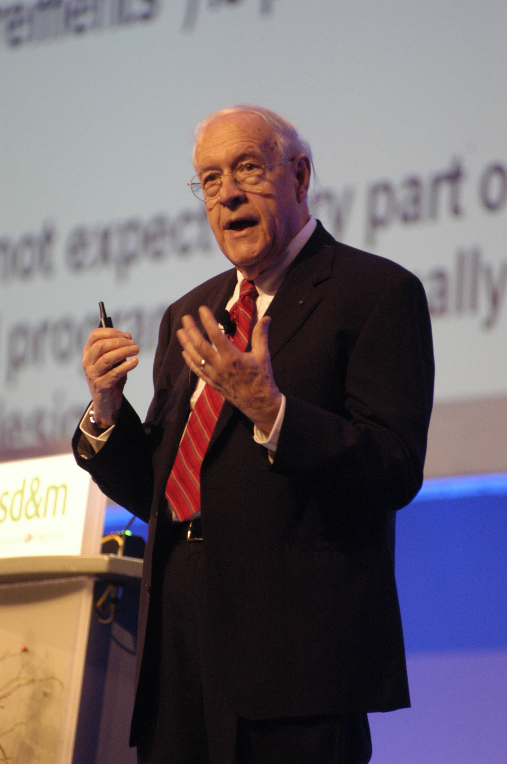
Duke Connection: Fred Brooks '53
What Would FB Say?
"The most important single decision I ever made was to change the IBM 360 series from a 6-bit byte to an 8-bit byte, thereby enabling the use of lowercase letters. That change propagated everywhere."
"Fred Brooks" by Copyright owned by SD&M (www.sdm.de) - Request for picture sent by email to Fred Brooks by uploader (Mark Pellegrini; user:Raul654) Fred sent this photo back, along with contact information for Carola Lauber at SD&M, who gave copyright permission.. Licensed under CC BY-SA 3.0 via Wikimedia Commons - https://commons.wikimedia.org/wiki/File:Fred_Brooks.jpg#/media/File:Fred_Brooks.jpg
Notes:
Duke valedictorian, turing award winner, founder of dept at UNC. Divided loyalties.
He practically invented software engineering, but what is his most important decision? Lower case letter support!
WHAT WOULD WE DO OTHERWISE!!!

Slide 28
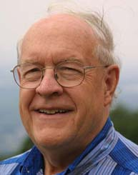
Why is Programming Fun?
First is the sheer joy of making things
Second is the pleasure of making things that are useful
Third is the fascination of fashioning complex puzzle-like objects of interlocking moving parts
Fourth is the joy of always learning
Finally, there is the delight of working in such a tractable medium. The programmer, like the poet, works only slightly removed from pure thought-stuff.
Notes:
Read – we want to keep the fun in programming!!!

Slide 29
WOTO Correctness Counts
http://bit.ly/101spring18-jan11-3

