Slide 1
Authorization and Identity
Based on slides provided by
Jeff Chase and Landon Cox

Slide 2
Unix uid (user identifier)
Users have unique user identifiers (uids), e.g. bmm is 3371
Every process runs “as” some uid
When a user logs in, uid for shell (e.g., bash) is set to the user’s uid.
When a new process runs, by default uid for the process is inherited from the process that launched it.

Slide 3
Access Control through uid
System calls check uid to see if user has privileges to perform certain operations.
E.g., in general for process running as uid = 3371, system call “unlink” won’t delete a file whose owner is uid = 2642.
System calls may grant special privileges to certain uids, e.g., uid = 0 is root.

Slide 4
setuid system call
#include <sys/types.h>
#include <unistd.h>
int setuid(uid_t uid);
Sometimes it’s convenient to change process uid
Function setuid does this if current uid = 0
Example: login changes uid from 0 to 3371 (bmm)
setuid is used to reduce privileges

Slide 5
The setuid bit: another way to setuid
The mode bits on a program file may be tagged to setuid to owner’s uid on exec*.
This is called setuid bit. Some call it the most important innovation of Unix.
It enables users to request protected ops by running secure programs that execute with the uid of the program owner, and not the caller of exec*.
The user cannot choose the code: only the program owner can choose the code to run with the program owner’s uid.
Parent cannot subvert/control a child after program launch: a property of Unix exec*.
Example: sudo program runs as root, checks user authorization to act as superuser, and (if allowed) executes requested command as root.

Slide 6
Unix setuid: two mechanisms
Alice
Refine the privilege of this process (using setuid syscall).
Root
(admin/superuser)
uid = “root”
setuid(“alice”)
login
exec
tool
uid=“root”
shell
uid=“alice”
creat(“power”)
write(…)
chmod(+x,setuid=true)
fork
uid=“alice”
shell
power
exec(“power”)
owner=“root”
755 (exec perm)
setuid bit = true
uid=“root”!!!!
Amplify/escalate the privilege of processes running this trusted program (using setuid bit).
open(“secret”)
power
secret
read, write…
owner=“root”, 600

Slide 7
running as root vs. protected mode
These mechanisms are orthogonal!
When a new process is launched with uid = 0, by default execution begins in user mode, not protected mode.
Switch to protected mode on trap, exception, interrupt.
Note: if superuser wants to run arbitrary code in protected mode, can modify the kernel, which is owned by uid 0.

Slide 8
Access control
Insight: sometimes simple inheritance of uids is insufficient
Tasks involving management of “user id” state
Logging in (login)
Changing passwords (passwd)
Why isn’t this code just inside the kernel?
This functionality doesn’t really require interaction w/ hardware
Would like to keep kernel as small as possible (less code run in protected mode!)
How are “trusted” user-space processes identified?
Run as super user or root (uid 0)
Like a software kernel mode
If a process runs under uid 0, then it has more privileges

Slide 9
Access control
Why does login need to run as root?
Needs to check username/password correctness
Needs to fork/exec process under another uid
Why does passwd need to run as root?
Needs to modify password database (file)
Database is shared by all users
What makes passwd particularly tricky?
Easy to allow process to shed privileges (e.g., login)
passwd requires an escalation of privileges
How does UNIX handle this?
Executable files can have their setuid bit set
If setuid bit is set, process inherits uid of image file’s owner on exec

Slide 10
Access control
How does kernel know if system call is allowed?
Looks at user id (uid) of process making the call
Looks at resources accessed by call (e.g., file or pipe)
Checks access-control policy associated with resource
Decides if policy allows uid to access resources
How is a uid normally assigned to a process?
On fork, child inherits parent’s uid

Slide 11
MOO accounting problem
Game client (uid x)
Multi-player game called Moo
Want to maintain high score in a file
Should players be able to update score?
Yes
Do we trust users to write file directly?
No, they could lie about their score
“x’s score = 10”
High score
“y’s score = 11”
Game client
(uid y)

Slide 12
MOO accounting problem
Game client (uid x)
Multi-player game called Moo
Want to maintain high score in a file
Could have a trusted process update scores
Is this good enough?
“x’s score = 10”
Game server
High score
“x:10
y:11”
“y’s score = 11”
Game client
(uid y)

Slide 13
MOO accounting problem
Game client (uid x)
Multi-player game called Moo
Want to maintain high score in a file
Could have a trusted process update scores
Is this good enough?
Can’t be sure that reported score is genuine
Need to ensure score was computed correctly
“x’s score = 100”
Game server
High score
“x:100
y:11”
“y’s score = 11”
Game client
(uid y)

Slide 14
MOO accounting problem
Game
client
(uid moo)
Multi-player game called Moo
Want to maintain high score in a file
How does setuid solve our problem?
Game executable is owned by trusted entity
Game cannot be modified by normal users
Users can run executable though
High-score is also owned by trusted entity
This is a form of trustworthy computing
Only trusted code can update score
Root ownership ensures code integrity
Untrusted users can invoke trusted code
Shell
(uid x)
“fork/exec
game”
“x’s score = 10”
High score
(uid moo)
“y’s score = 11”
Shell
(uid y)
“fork/exec
game”
Game client
(uid moo)

Slide 15
Concept: access control matrix
We can imagine the set of all allowed accesses for all subjects over all objects as a huge matrix.
obj1
obj2
Alice
RW
---
Bob
R
RW
How is the matrix stored?

Slide 16
Concept: ACLs and capabilities
How is the matrix stored?
ACL
obj1
obj2
Alice
RW
---
capability list
Bob
R
RW
Capabilities: each subject holds a list of its rights and presents them as proof of access rights. In many systems, a capability is an unforgeable reference/token that confers specific rights to access a specific object.
Access control list (ACL): each object stores a list of identifiers of subjects permitted to access it.

Slide 17
Concept: roles or groups
roles, groups
objects
wizard
student
obj1
obj2
Alice
yes
no
wizard
RW
---
Bob
no
yes
student
R
RW
A role or group is a named set S of subjects. Or, equivalently, it is a named boolean predicate that is true for subject s iff s ∈ S.
Roles/groups provide a level of indirection that simplifies the access control matrix, and makes it easier to store and manage.

Slide 18
File permissions in Unix (vanilla)
The owner of a Unix file may tag it with a “mode” value specifying access rights for subjects. (Don’t confuse with kernel/user mode.)
Unix “mode bits” are a simple/compressed form of an access control list (ACL). Later systems like AFS and AWS have richer ACLs.
Subject types = {owner, group, other/anyone} [3 subject types]
Access types = {read, write, execute} [3 bits for each of 3 subject types]
If the file is executed, should the system setuid the process to the userID of the file’s owner. [1 bit, the setuid bit]
10 mode bits total: (3x3)+1. Usually given in octal: e.g., “777” means all 9 bits are set: anyone can r/w/x the file, but no setuid.
Unix provides a syscall for owner to set the owner, group, and mode on each file (inode). A command utility of the same name calls it.
chmod, chown, chgrp on file or directory
“Group” was added later and is a little more complicated: a user may belong to multiple groups.

Slide 19
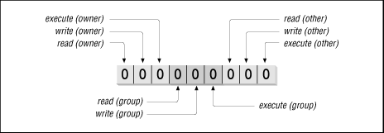
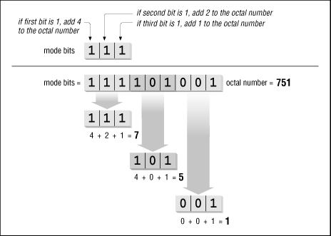
Unix file accessmode bits

Slide 20
Using the Unix access mode bits A simple example
Bob wants to read file foo.
Owner=Alice, group=students, mode 640
The owner of file foo is Alice, and the file is associated with the group students.
Is Bob Alice? No. So the owner bits don’t apply.
Is Bob in the group students?
Yes: group members have access “4”: the read is permitted.
No: Bob is “other”. “Other” has access “0”: the read is rejected.

Slide 21
Trusting Programs
In Unix
Programs you run use your identity (process UID).
Maybe you even saved them with setuid so others who trust you can run them with your UID.
The programs that run your system run as root.
You trust these programs.
They can access your files
send mail, etc.
Or take over your system…
Where did you get them?

Slide 22
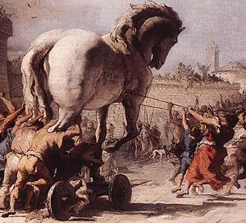
Any program you install or run can be a Trojan Horse vector for a malware payload.

Slide 23
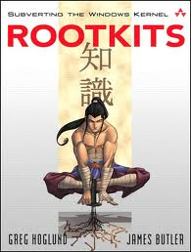
Rootkit
If an attacker obtains root or subverts/compromises the kernel (Trusted Computing Base), then all bets are off.
The machine is “rooted”: the attacker has full control.
Attacker may install a rootkit: software that maintains continuous and/or undetectable control.
A rootkit can:
Log keystrokes
Hook system APIs
Open attacker backdoor
Subvert (re)boot
Etc….

Slide 24
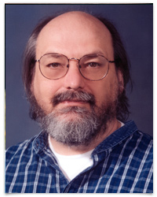

Slide 25
Trusting Trust
Perhaps you wrote them yourself.
Or at least you looked at the source code…
You built them with tools you trust.
But where did you get those tools?

Slide 26
Where did you get those tools?
Thompson’s observation: compiler hacks cover tracks of Trojan Horse attacks.

Slide 27
Login backdoor: the Thompson Way
Step 1: modify login.c
(code A) if (name == “ken”) login as root
This is obvious so how do we hide it?
Step 2: modify C compiler
(code B) if (compiling login.c) compile A into binary
Remove code A from login.c, keep backdoor
This is now obvious in the compiler, how do we hide it?
Step 3: distribute a buggy C compiler binary
(code C) if (compiling C compiler) compile code B into binary
No trace of attack in any (surviving) source code

