Slide 1

Bitcoin and Blockchains
Based on “Bitcoin Tutorial” presentation by
Joseph Bonneau, Princeton University
Bonneau slides marked “JB”

Slide 2
Bitcoin
Bitcoin is a combination of several things: a currency, a payment system, and a collection of algorithms and hardware and software implementations.
The goal of bitcoin is to enable payments with low transaction costs. (Or perhaps the goal is to make central banks obsolete?)
Bitcoin can also sometimes provide anonymity.
Market price: https://blockchain.info/charts/market-price
Rewards and fees per transaction: https://blockchain.info/stats
bmm

Slide 3
Double spending: why ecash is hard
Sign_{A}(Transfer X to Bob)
Bob
Redeem X?
BANK
Alice
Redeem X?
Sign_{A}(Transfer X to Charlie)
Charlie
Sign_{Z}(Transfer X to Alice)
JB

Slide 4
Solution: Maintain a global public append-only log
The block chain –a public ledger of all transactions.
(In Bitcoin, the log is extended in increments of blocks, each of which may contain thousands of transactions.)
...
Sign_{A}(Transfer X to B)
...
Sign_{A}(Transfer X to C)
bmm

Slide 5
Proof-of-Work Consensus Algorithm
Goal is to reach consensus on log.
Differences from Raft / Paxos:
Participants may be malicious
Number of participants is unknown
Anyone may participate (permissionless), and identities are unknown
Vote based on amount of work performed, rather than one vote per participant (why?) [As long as participants with half of computing power follow the protocol, the blockchain can’t be corrupted.]

Slide 6
Getting started
Download software to create a Bitcoin wallet (see https://bitcoin.org/en/choose-your-wallet)
The wallet holds the private keys you use to prove you own specific Bitcoins.
The software creates public/private key pairs for you as needed. For each pair, there is a corresponding bitcoin address, e.g., 3J98t1WpEZ73CNmQviecrnyiWrnqRhWNLy, which is a 160-bit hash and checksum (based on SHA-256, not SHA-1!) of the public key. Bitcoins are sent to addresses.
The wallet also contains software that allows you to send and receive bitcoins. You send bitcoins by registering your payments in the block chain, which is bitcoin’s public ledger containing all transactions since the beginning of bitcoin.
bmm

Slide 7
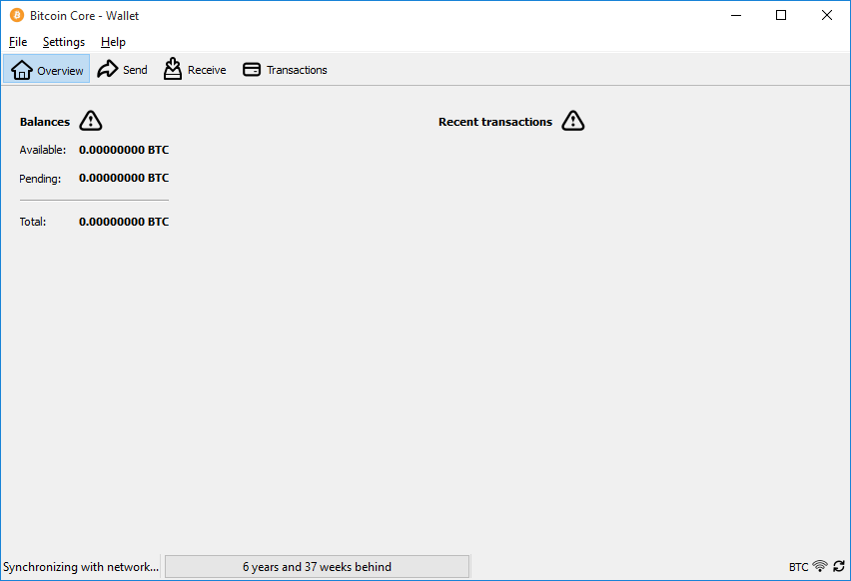
Bitcoin Core (original) wallet on first start-up
bmm

Slide 8
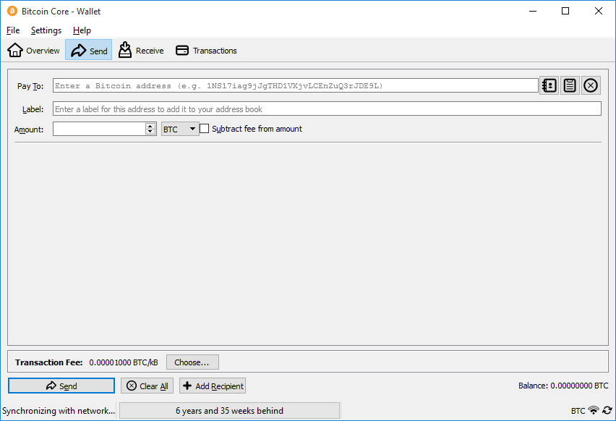
Send
bmm

Slide 9
Spending a Bitcoin
A transaction is of the form “send these Bitcoins from address Y to address Z”
Specific Bitcoins are described as outputs of previous transactions.
The transaction is signed with the private key of address Y and broadcast, along with the public key of Y, to the payment network
A transaction might also include a transaction fee, to be described later.
bmm

Slide 10
Bitcoin mining
Approximately every ten minutes, one lucky Bitcoin miner earns a reward for extending the block chain by one block.
Mining reward: 12.5 Bitcoin
Mining is the only mechanism for creating new bitcoins. The total number of Bitcoins will never exceed 21M. (Bitcoins in circulation: https://blockchain.info/charts/total-bitcoins)
The rewarded miner also receives all (optional) transaction fees in the block.
bmm

Slide 11
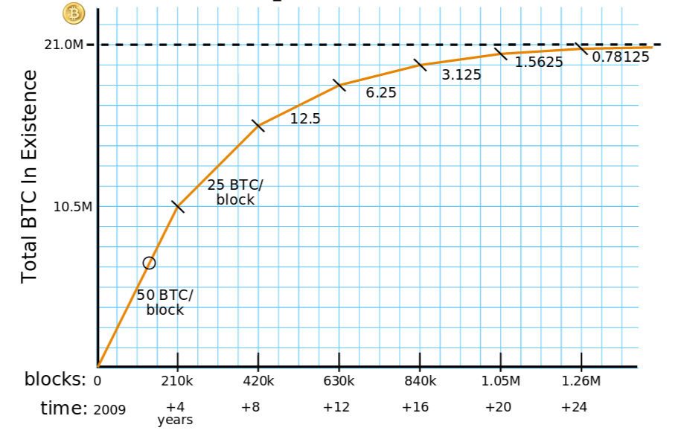
Mining rewards
JB
Courtesy:
Brian Warner

Slide 12
How is a new block created?
A Bitcoin miner creates a block by
Gathering a set of pending transactions, prioritizing those with transaction fees
Verifying the transactions
Gives the reward and transaction fees to himself/herself
Solving a hashing problem
On March 3, 2017, according to https://blockchain.info/q, average number of transactions per block is 2250 (On October 3, 2015: 1609; on October 2014: 411), current number of pending unconfirmed transactions is 77407 (On October 3, 2015: 3492).
bmm

Slide 13
How is a transaction verified?
“send these Bitcoins from address Y to address Z”
The miner first checks the signature using the public key for address Y.
compute hash of public key for Y, which should be Y
check signature of transaction using public key for Y
Then the miner checks the public ledger to verify that Y hasn’t already sent these Bitcoins to someone else.
bmm

Slide 14
The Hashing Problem
To extend the blockchain, a miner creates a new block, which has a block header. The block header contains:
block version number
SHA-256 hash of previous block header
SHA-256 hash of new transactions to include in the blockchain, including creation of reward bitcoins (e.g., 12.5 new BTC)
current target / difficulty
timestamp
nonce
Block is valid if SHA-256(SHA-256(header)) leads in enough zeros, as determined by current difficulty. Miner has to find the right nonce by trial and error!
Difficulty chosen so that the time until the first miner wins is about ten minutes, on average.
bmm

Slide 15
Target and Difficulty
A miner can win if his/her hash value is below the current 256-bit target, i.e., the hash value has enough leading zeros.
Probability that a given nonce will produce a winning hash value is target / 2²⁵⁶
difficulty = difficulty_1_target / target, where difficulty_1_target = 2²²⁴
Expected time (in seconds) to mine a block = 2²⁵⁶ / (target * hashrate)
= difficulty * 2³² / hashrate
Difficulty was 440,779,902,286 on March 3, 2017.
Difficulty is adjusted every 2016 blocks. If a new block is added in ten minutes, 2016 blocks are added in exactly two weeks.

Slide 16
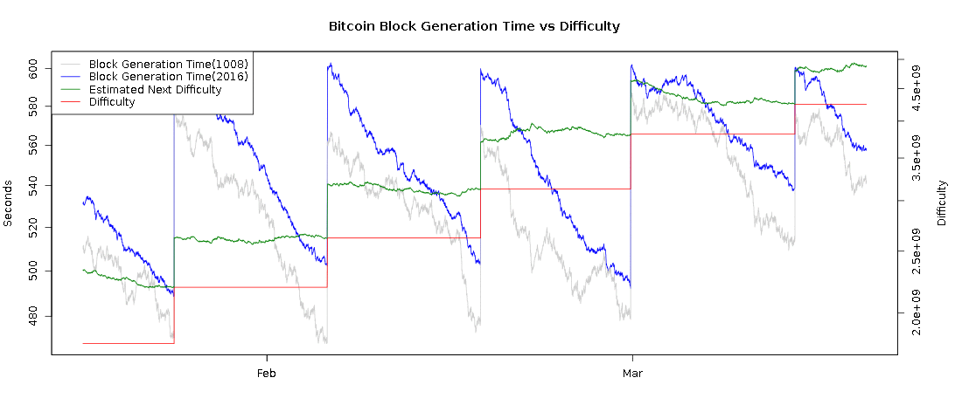
Difficulty adjustment
10 minutes
2 weeks
JB
bitcoinwisdom.com

Slide 17
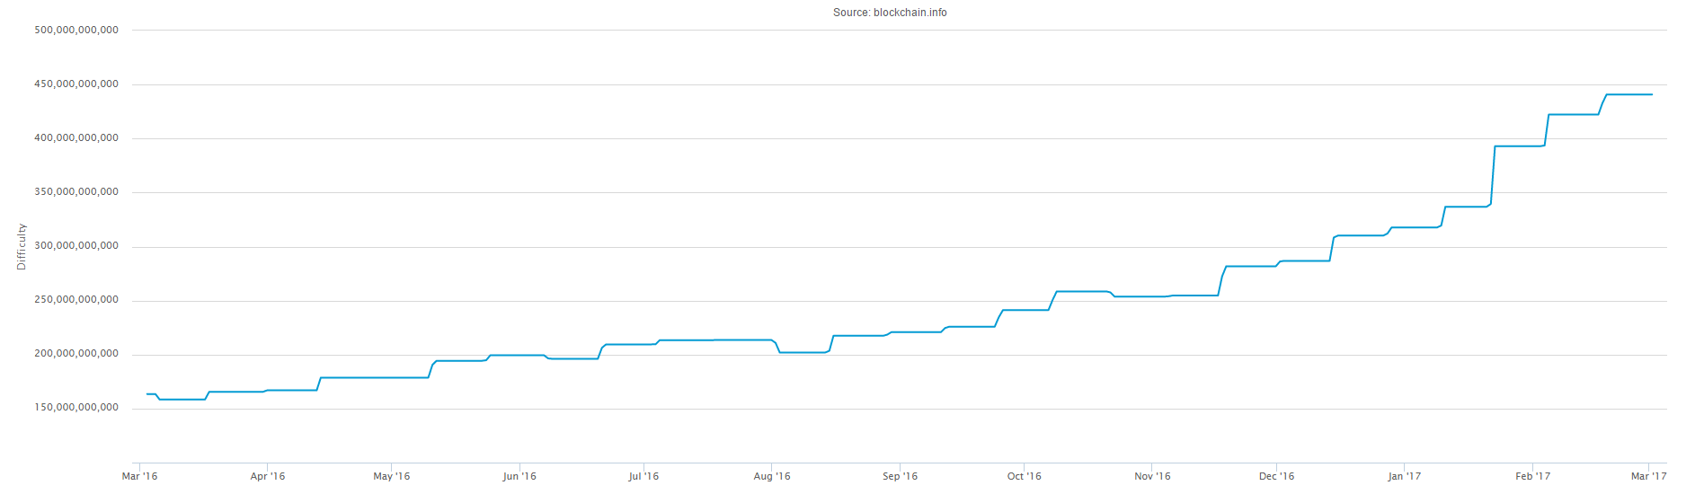
Difficulty Adjustment
Observe no drop in difficulty when reward fell from 25BTC to 12.5BTC on July 9,2016.
bmm

Slide 18
Total network capacity
9.2x10¹⁸ hashes per block (every 10 minutes!) on average, based on difficulty level on March 3, 2017
3.44x10¹⁵ hashes per second network wide on March 3, 2017
JB / bmm

Slide 19
Bitcoin Peer-to-Peer Network
Bitcoin communications are decentralized.
The P2P network is composed of homogeneous nodes.
Volunteers run DNS servers that return random sets of Bitcoin nodes.
Network topology is random.
Transaction and block records are broadcast to all nodes (scalability issues!).
Nodes announce availability of (hashes of) records to their neighbors.

Slide 20
Transaction Confirmations
A transaction is said to have received k confirmations if it has been published in a block that has been added to the blockchain, and k-1 more blocks have also been added.
A transaction is typically considered “confirmed” once it has 6 confirmations.
Newly minted Bitcoins are typically considered confirmed once they have received 100 confirmations.
bmm

Slide 21
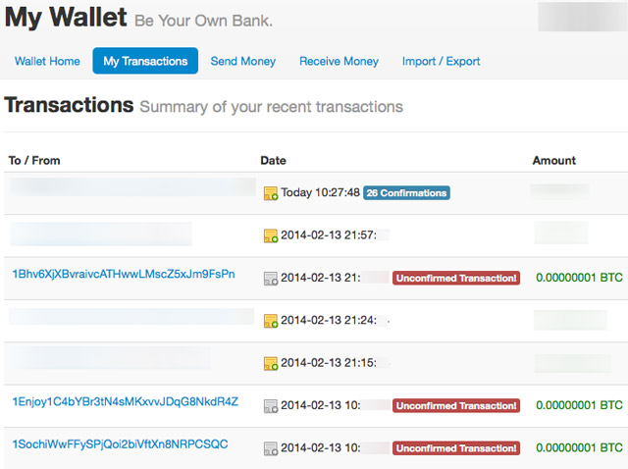
Transaction confirmation (~6 blocks)

Slide 22
A fork can occur when two miners publish blocks simultaneously. Such blocks are almost always in conflict.
Give reward to X.
Give reward to Y.
Give reward to Z.
bmm

Slide 23
Effort spent on a fork that eventually loses is wasted.
Give reward to X.
Give reward to Y.
Give reward to Z.
bmm

Slide 24
To break ties, choose branch with greater number of zeros in hash.
SHA-256(Block_{N-1}, n) = 0x00000000000046a3f89...
SHA-256(Block_{N-1}, n) = 0x00000000000000008c71...
Give reward to X.
Give reward to Y.
Give reward to Z.
bmm

Slide 25
More generally, longest chain wins.
Sign_{A}(Transfer X to B)
Where length is measured in terms of sum of difficulties of blocks in chain.
bmm

Slide 26
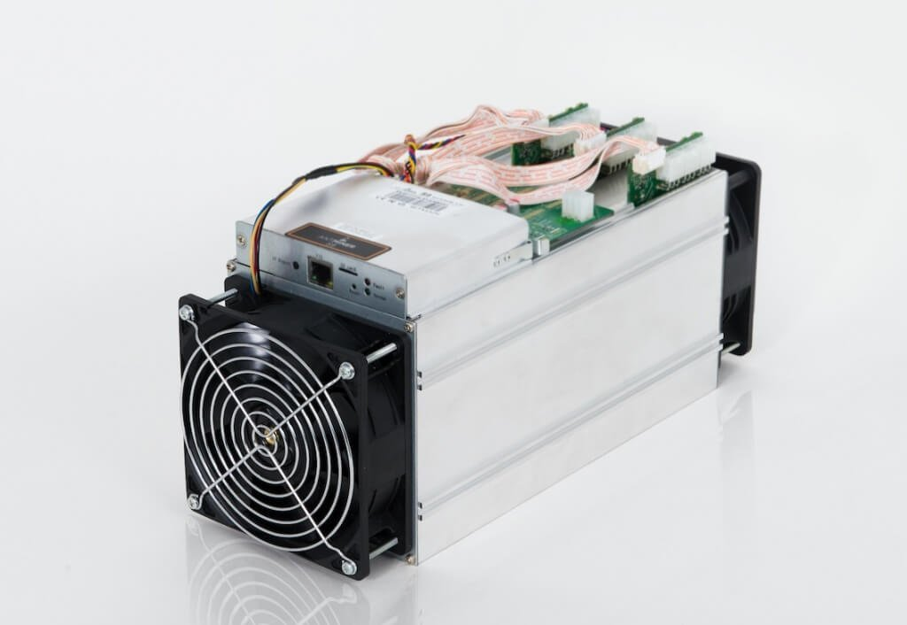
Mining Hardware
13.5 TH/s, 1323W
$3120 + $274 for power supply
Total mining capacity today equivalent to 711,000 of these, worth about $2B, 940MW, $412M spent on electricity annually at $0.05/kWh.
Mining capacity concentrated in China.
Antminer S9

Slide 27

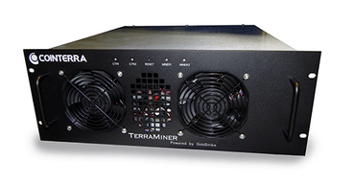
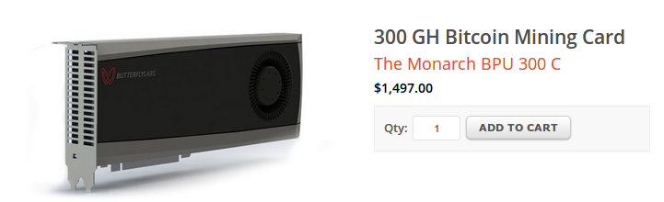
Mining pools
Mint(25, K_{POOL})
0x00000000000000003f89...
0x000000000000a877902e...
0x0000000000001e8709ce...
0x00000000000000003f89...
0x000000000000490c6b00...
0x00000000000007313f89...
0x00000000000045a1611f...
JB

Slide 28
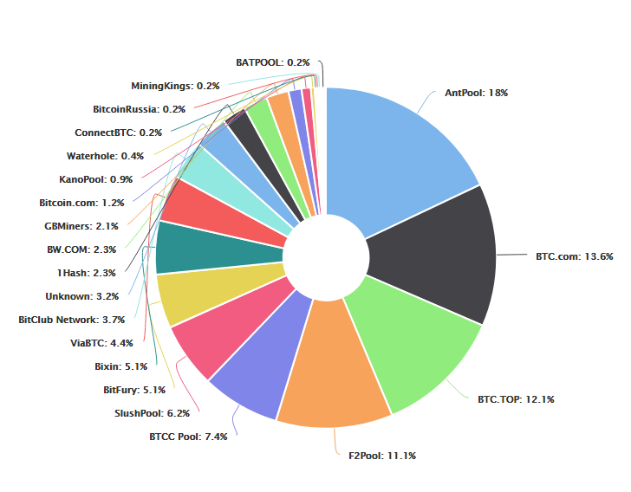
Mining pools
At times in the past, one pool, Ghash.IO had over 51% of the computing power.
51% attack: If one pool has more power than all others combined, they can decide which transactions are added to the blockchain and collect all rewards and fees.
bmm
https://blockchain.info/pools

Slide 29
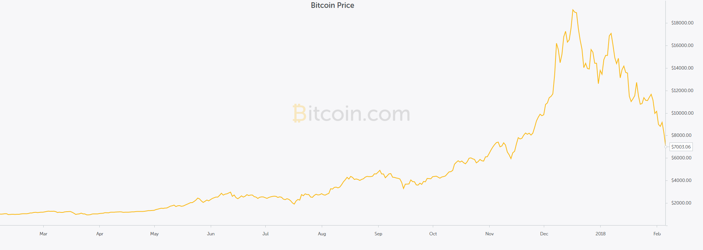
Bitcoin Market Prices over Past Year
https://charts.bitcoin.com/chart/price

Slide 30
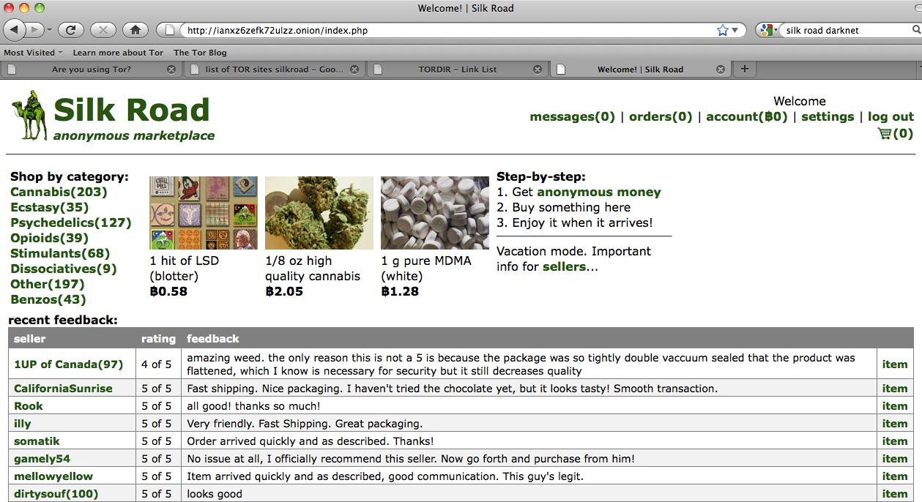
Black Markets
JB
Traveling the Silk Road: A measurement analysis of a large anonymous online marketplace
Nicolas Christin, WWW 2013
Silk Road: US$14M in Revenue in 2012 [Christin 2012]

Slide 31
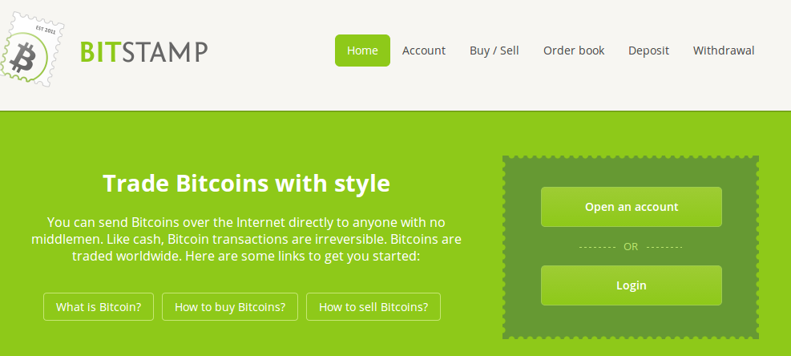
Bitcoin exchanges – buy and sell bitcoin using different currencies
JB
Beware the middleman: Empirical analysis of Bitcoin-exchange risk
Tyler Moore and Nicolas Christin, Financial Crypto 2013

Slide 32
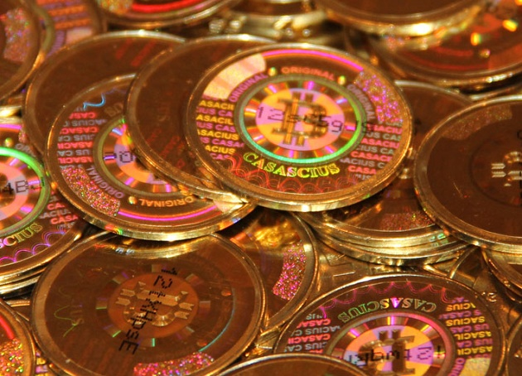
Physical Bitcoin (a gimmic?)
private key is embedded in coin and can be accessed (possibly electronically) only by physically breaking the coin
trust creator to destroy any record of private key
bmm
http://media.coindesk.com/2014/09/casascius-coins.jpg

Slide 33
A transaction history is recorded for every Bitcoin
Key to anonymity is to avoid tying any personal information to your Bitcoin addresses
Use an address only once
Self-mined Bitcoins, using an anonymizing network to connect to the payment system, are hardest to trace
Anonymity?
bmm

Slide 34


Mixes
JB

Slide 35
Mixes today
Caution: Mixing services may themselves be operating with anonymity. As such, if the mixing output fails to be delivered or access to funds is denied there is no recourse. Use at your own discretion.
-The Bitcoin Wiki
An inquiry into money laundering tools in the Bitcoin ecosystem
Möser, Malte, Rainer Böhme, and Dominic Breuker, ECRIME 2013
JB

Slide 36
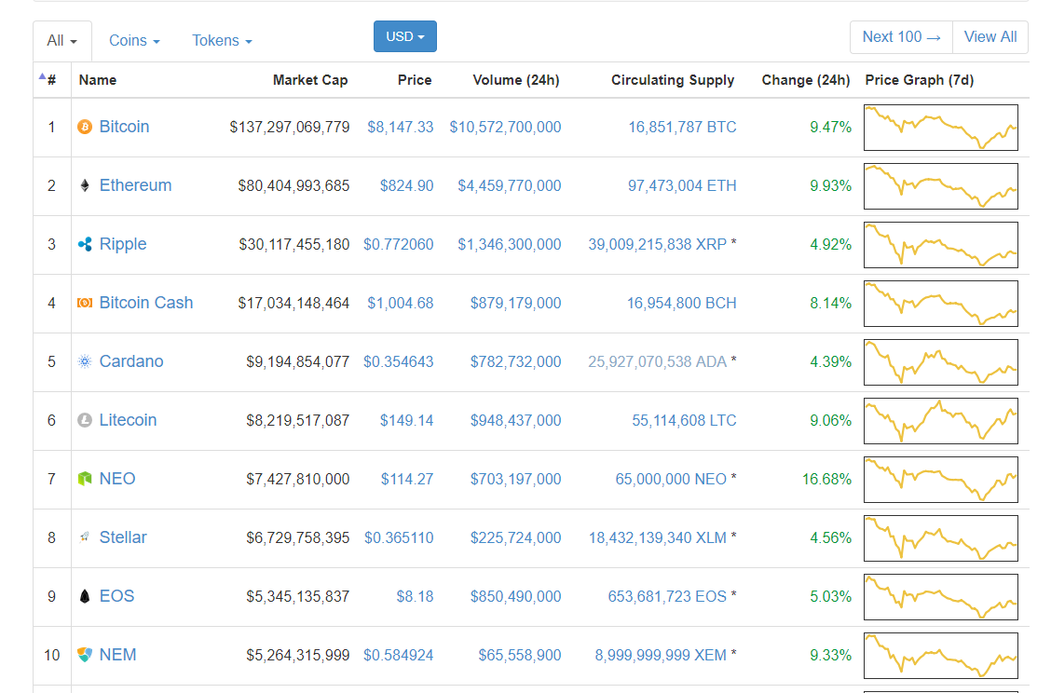
Other Cryptocurrencies
bmm
https://coinmarketcap.com/

Slide 37
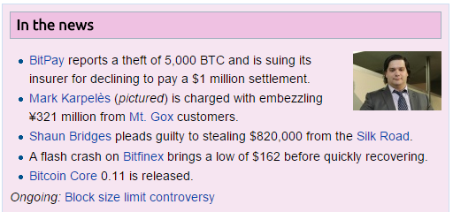
Bitcoin in the news
https://en.bitcoin.it/wiki/Main_Page
bmm

