Slide 1
Buffer
overflows
and other memory safety vulnerabilities
History
Memory layouts
Buffer overflow fundamentals
*These slides are available courtesy of Dave Levin

Slide 2
Software security
Security is a form of dependability
Does the code do “what it should”
Distinguishing factor: an active, malicious attacker
Attack model
The developer is trusted
But the attacker can provide any inputs
Malformed strings
Malformed packets
etc.
What harm could an attacker possibly cause?

Slide 3
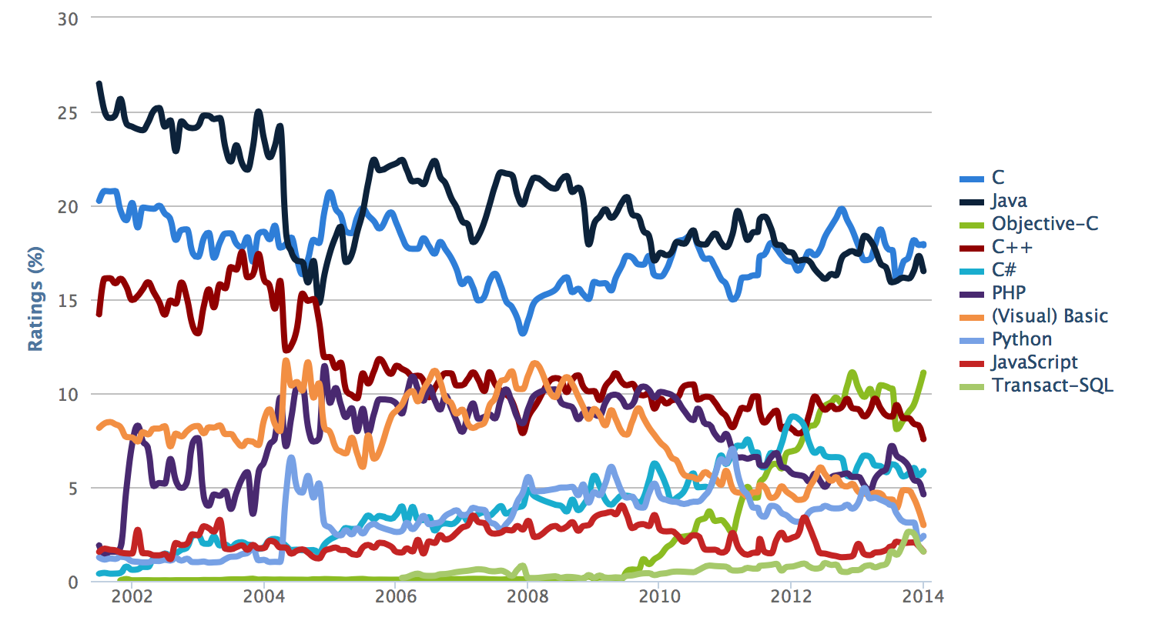
We’re going to focus on C
C is still very popular
http://www.tiobe.com

Slide 4
We’re going to focus on C
Many mission critical systems are written in C
Most kernels & OS utilities
fingerd
X windows server
Many high-performance servers
Microsoft IIS
Microsoft SQL server
Many embedded systems
Mars rover
But the techniques apply more broadly
Wiibrew

Slide 5
We’re going to focus on C
The harm can be substantial
1988
1999
2000
2001
2002
2003
Morris worm
Propagated across machines (too aggressively, thanks to a bug)
One way it propagated was a buffer overflow attack against a vulnerable version of fingerd on VAXes
Sent a special string to the finger daemon, which caused it to execute code that created a new worm copy
Didn’t check OS: caused Suns running BSD to crash
End result: $10-100M in damages, probation, community service
Professor at MIT

Slide 6
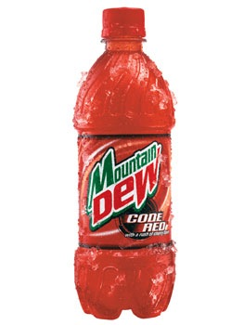
We’re going to focus on C
The harm can be substantial
1988
1999
2000
2001
2002
2003
CodeRed
Exploited an overflow in the MS-IIS server
300,000 machines infected in 14 hours

Slide 7
We’re going to focus on C
The harm can be substantial
1988
1999
2000
2001
2002
2003
SQL Slammer
Exploited an overflow in the MS-SQL server
75,000 machines infected in 10 minutes

Slide 8
Buffer overflows are prevalent
% of vulnerabilities that are buffer overflows
https://nvd.nist.gov/vuln/search

Slide 9
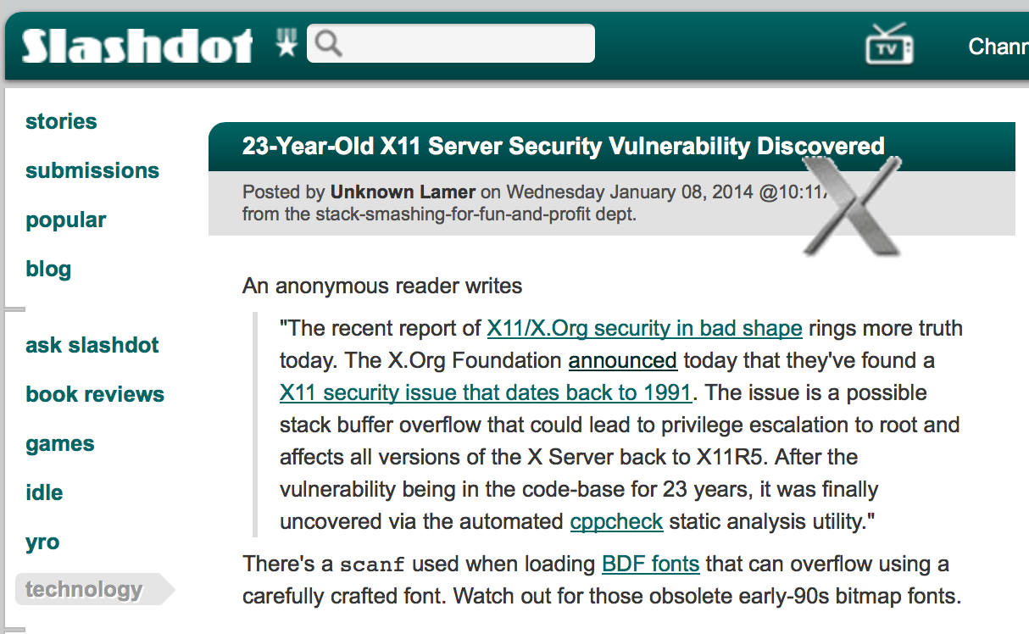

Slide 10
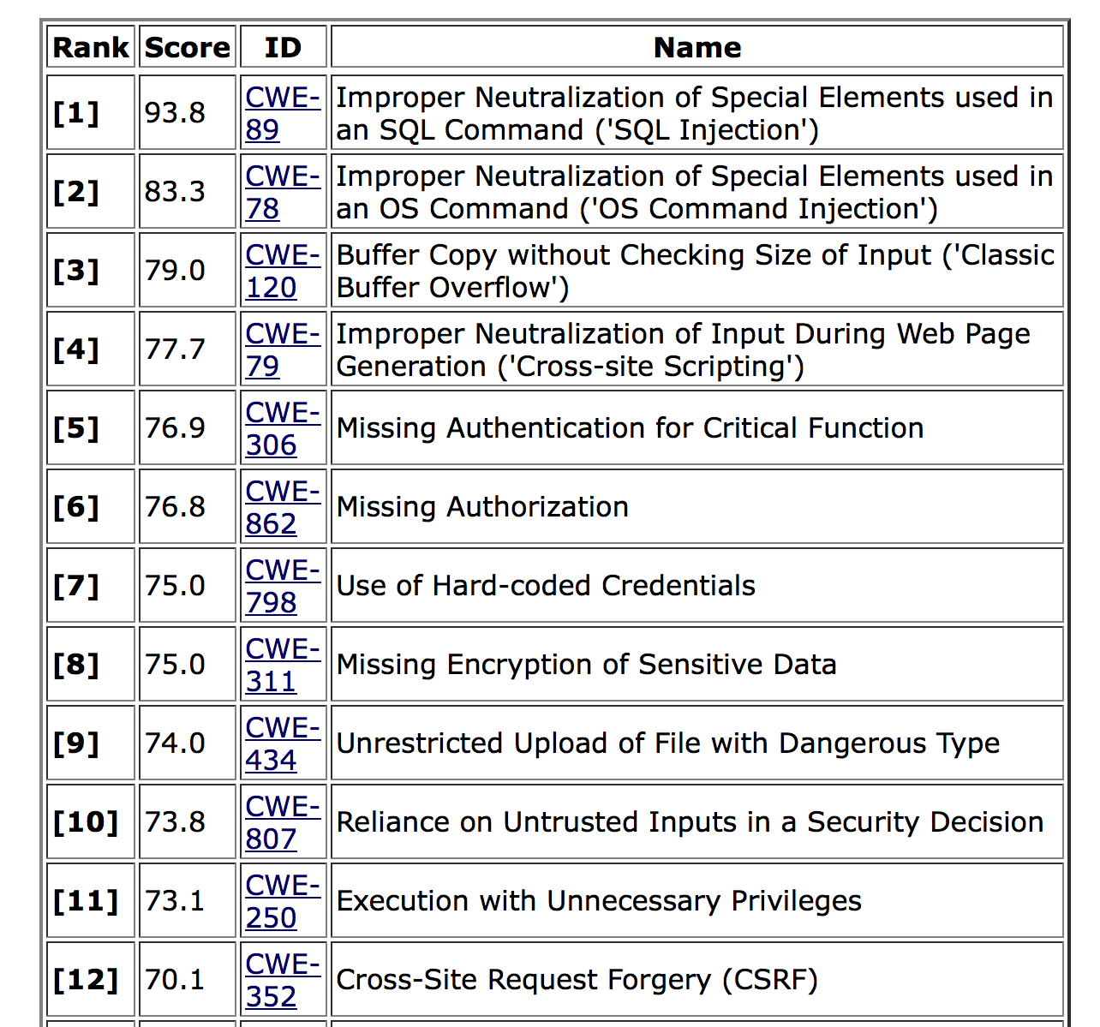
2011 CWE/SANS Top 25 Most Dangerous Software Errors
This class
http://cwe.mitre.org/top25/

Slide 11
Our goals
Understand how these attacks work, and how to defend against them
These require knowledge about:
The compiler
The OS
The architecture
Analyzing security requires a whole-systems view

Slide 12
Memory layout

Slide 13
Refresher
How is program data laid out in memory?
What does the stack look like?
What effect does calling (and returning from) a function have on memory?

Slide 14
All programs are stored in memory
4G
0xffffffff
The process’s view
of memory is that
it owns all of it
In reality, these are
virtual addresses;
the OS/CPU map
them to physical
addresses
0
0x00000000

Slide 15
The instructions themselves are in memory
4G
0xffffffff
...
0x4c2 sub $0x224,%esp
0x4c1 push %ecx
0x4bf mov %esp,%ebp
0x4be push %ebp
...
Text
0
0x00000000

Slide 16
Data’s location depends on how it’s created
4G
0xffffffff
Set when process starts
cmdline & env
int f() { int x;
…
Stack
Runtime
Heap
malloc(sizeof(long));
Uninit’d data
static int x;
Known at
compile time
Init’d data
static const int y=10;
Text
0
0x00000000

Slide 17
We are going to focus on runtime attacks
Stack and heap grow in opposite directions
Allows us not to have
to declare their size
0x00000000
0xffffffff
Heap
3
2
1
Stack
Stack
pointer
push 1 push 2 push 3
return

Slide 18
Stack layout when calling functions
What do we do when we call a function?
What data need to be stored?
Where do they go?
How do we return from a function?
What data need to be restored?
Where do they come from?
Code examples

Slide 19
The instructions themselves are in memory
4G
0xffffffff
...
Note: in this
example, code is executed from bottom to top!
0x5bf mov %esp,%ebp
<func> 0x5be push %ebp
...
...
0x4a7 mov $0x0,%eax
0x4a2 call <func>
0x49b movl $0x804..,(%esp)
0x493 movl $0xa,0x4(%esp)
%eip
Text
...
0
0x00000000

Slide 20
What Needs To Be Stored?
The old %eip register

Slide 21
Accessing variables
void func(char *arg1, int arg2, int arg3)
{
int loc2;
...
loc2++;
...
}
Q: Where is (this) loc2?
A: -8(%ebp)
0x00000000
0xffffffff
…
loc2
loc1
???
???
%eip
arg1
arg2
arg3
caller’s data
Stack frame
0xbffff323
%ebp
Undecidable at compile time
- I don’t know where loc2 is,
- and I don’t know number of args,
- but loc2 is always 8B below start of frame
Frame pointer

Slide 22
What Needs To Be Stored?
The old %eip register
The old %ebp register

Slide 23
Returning from functions
int main()
{
...
func(“Hey”, 10, -3);
...
}
Q: How do we resume here?
0x00000000
0xffffffff
…
???
%eip
arg1
arg2
arg3
caller’s data
Stack frame
%ebp
Push next %eip before call

Slide 24
Returning from functions
int main()
{
...
func(“Hey”, 10, -3);
...
}
Q: How do we restore %ebp?
0x00000000
%esp
0xffffffff
???
%ebp
???
%eip
arg1
arg2
arg3
caller’s data
%ebp
%ebp
Push %ebp before locals
Set %ebp to current (%esp)
Set %ebp to(%ebp) at return

Slide 25
Stack layout when calling functions
void func(char *arg1, int arg2, int arg3)
{
char loc1[4]
int loc2;
int loc3;
}
0x00000000
0xffffffff
…
loc2
loc1
???
???
arg1
arg2
arg3
caller’s data
Local variables pushed in the
same order as
they appear in the code
Arguments pushed in reverse order
of code

Slide 26
Memory layout summary
Calling function:
Push arguments onto the stack (in reverse)
Push the address of the instruction you want to run after control returns to you
Jump to the function
Called function:
Push the old frame pointer onto the stack (%ebp)
Set my frame pointer (%ebp) to where the end of the stack is right now (%esp)
Push my local variables onto the stack
Called function (to return):
Deallocate local variables: %esp = %ebp
Restore base pointer: pop %ebp
Jump back to where they wanted us to: %eip = (%esp)
Calling function (on return):
Remove arguments from stack

Slide 27
Buffer overflows

Slide 28
Buffer overflows at 10,000 ft
Buffer =
Contiguous set of a given data type
Common in C
All strings are buffers of char’s
Overflow =
Put more into the buffer than it can hold
Where does the extra data go?
Well now that you’re experts in memory layouts…

Slide 29
A buffer overflow example
void func(char *arg1)
{
char buffer[4];
strcpy(buffer, arg1);
...
}
int main()
{
char *mystr = "AuthMe!";
func(mystr);
...
}
Upon return, sets %ebp to 0x0021654d
(perhaps in text segment!)
M
e
!
\0
00 00 00 00
%ebp
A u t h
4d 65 21 00
%eip
&arg1
buffer
SEGFAULT (0x00216551)

Slide 30
A buffer overflow example
void func(char *arg1)
{
int authenticated = 0;
char buffer[4];
strcpy(buffer, arg1);
if(authenticated) { ...
}
int main()
{
char *mystr = "AuthMe!";
func(mystr);
...
}
Code still runs; user now ‘authenticated’
M
e
!
\0
00 00 00 00
4d 65 21 00
A u t h
00 00 00 00
%ebp
%eip
&arg1
buffer
authenticated

Slide 31
User-supplied strings
In these examples, we were providing our own strings
But they come from users in myriad aways
Text input
Packets
Environment variables
File input…

Slide 32
void vulnerable()
{
char buf[80];
gets(buf);
}
void still_vulnerable()
{
char *buf = malloc(80);
gets(buf);
}

Slide 33
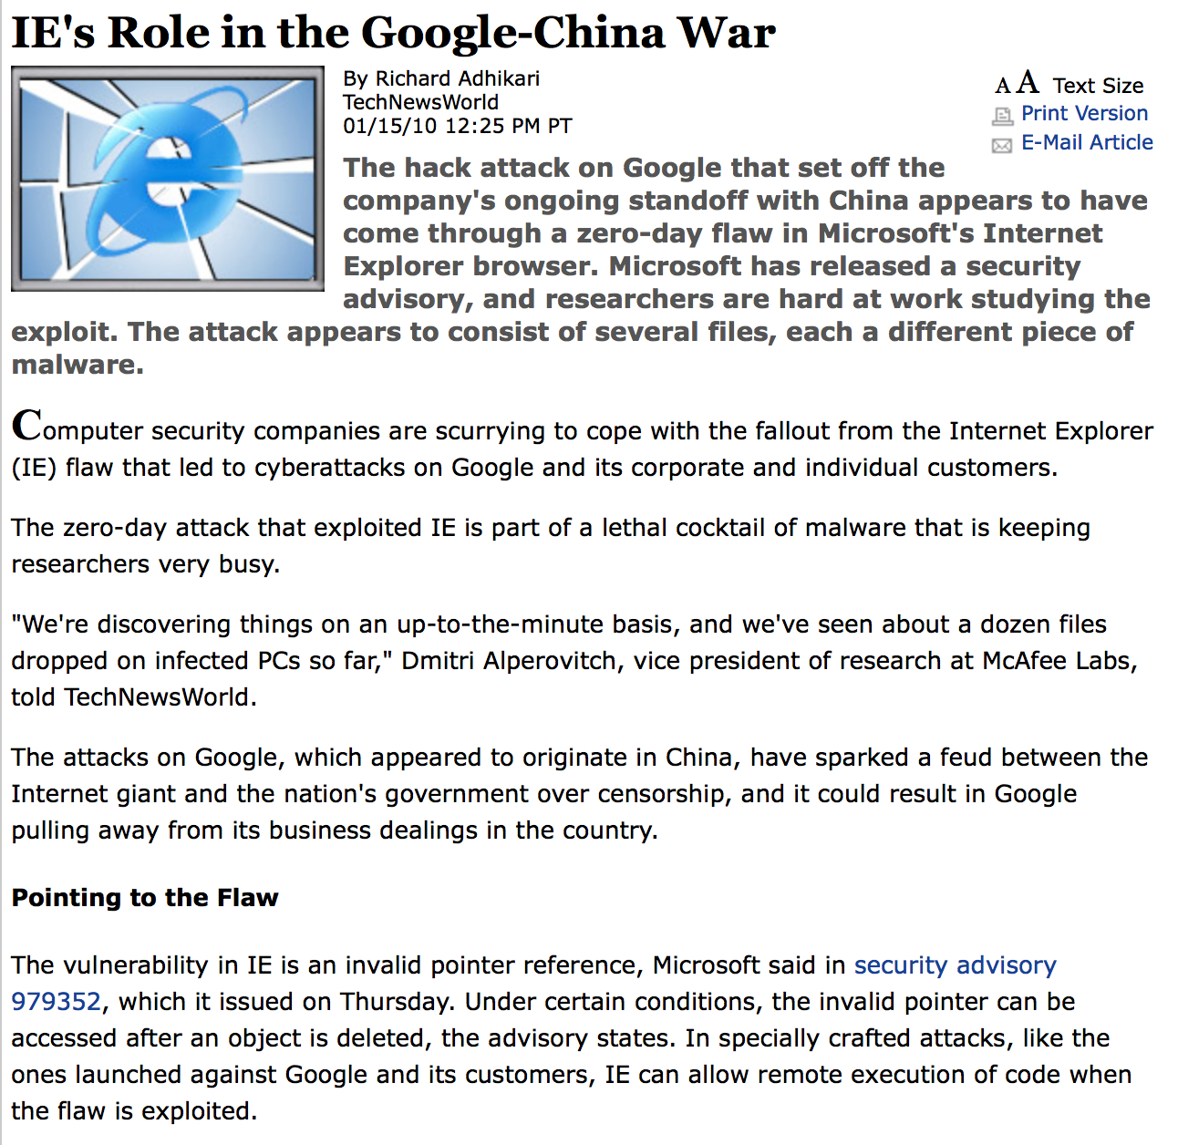
Google employees were
lured to malicious web sites,
where malware was injected
into IE. This malware then
downloaded more malware
packages.

Slide 34
void safe()
{
char buf[80];
fgets(buf, 64, stdin);
}
void safer()
{
char buf[80];
fgets(buf, sizeof(buf), stdin);
}

Slide 35
What’s the worst that could happen?
void func(char *arg1)
{
char buffer[4];
strcpy(buffer, arg1);
...
}
All ours!
00 00 00 00
%ebp
%eip
&mystr
buffer
strcpy will let you write as much as you want (til a ‘\0’)
What could you write to memory to wreak havoc?

Slide 36
Code injection

Slide 37
High-level idea
void func(char *arg1)
{
char buffer[4];
sprintf(buffer, arg1);
...
}
%eip
Text
...
00 00 00 00
%ebp
%eip
&arg1
…
Haxx0r c0d3
buffer
(1) Load my own code into memory
(2) Somehow get %eip to point to it

Slide 38
Base 16 Poetry
61cacafe
afadacad
abaddeed
adebfeda
cacabead
adeaddeb
-- hex poet
61c, a cafe
a fad, a cad,
a bad deed -
a deb fed a
caca bead.
a dead deb

Slide 39
This is nontrivial
Pulling off this attack requires getting a few things really right (and some things sorta right)
Think about what is tricky about the attack
The key to defending it will be to make the hard parts really hard

Slide 40
Challenge 1
Loading code into memory
It must be the machine code instructions (i.e., already compiled and ready to run)
We have to be careful in how we construct it:
It can’t contain any all-zero bytes
Otherwise, sprintf / gets / scanf / … will stop copying
How could you write assembly to never contain a full zero byte?
It can’t make use of the loader (we’re injecting)
It can’t use the stack (we’re going to smash it)

Slide 41
What kind of code would we want to run?
Goal: full-purpose shell
The code to launch a shell is called “shell code”
It is nontrivial to do it in a way that works as injected code
No zeroes, can’t use the stack, no loader dependence
There are many out there
And competitions to see who can write the smallest
Goal: privilege escalation
Ideally, they go from guest (or non-user) to root

Slide 42
Shellcode
#include <stdio.h>
int main( ) {
char *name[2];
name[0] = “/bin/sh”;
name[1] = NULL;
execve(name[0], name, NULL);
}
xorl %eax, %eax
pushl %eax
pushl $0x68732f2f
pushl $0x6e69622f
movl %esp,%ebx
pushl %eax
...
“\x31\xc0”
“\x50”
“\x68””//sh”
“\x68””/bin”
“\x89\xe3”
“\x50”
...
(Part of)
your
input
Assembly
Machine code

Slide 43
Shellcode357
/*
* s0t4ipv6@Shellcode.com.ar
* x86 portbind a shell in port 5074
* 92 bytes.
*/
char shellcode[] =
"\x31\xc0" // xorl %eax,%eax
"\x50" // pushl %eax
"\x40" // incl %eax
"\x89\xc3" // movl %eax,%ebx
"\x50" // pushl %eax
"\x40" // incl %eax
"\x50" // pushl %eax
"\x89\xe1" // movl %esp,%ecx
"\xb0\x66" // movb $0x66,%al
"\xcd\x80" // int $0x80
"\x31\xd2" // xorl %edx,%edx
"\x52" // pushl %edx
"\x66\x68\x13\xd2" // pushw $0xd213
"\x43" // incl %ebx
"\x66\x53" // pushw %bx
"\x89\xe1" // movl %esp,%ecx
"\x6a\x10" // pushl $0x10
"\x51" // pushl %ecx
"\x50" // pushl %eax
…
Pseudo-code
s = socket();
bind(s, 5074);
sd = accept(s);
dup2(sd, stdin);
dup2(sd, stdout);
exec*(“/bin/sh”);

Slide 44
Challenge 2
Getting our injected code to run
We can’t insert a “jump into my code” instruction
We have to use whatever code is already running
%eip
Text
...
00 00 00 00
%ebp
%eip
&arg1
…
\x0f \x3c \x2f ...
buffer
Thoughts?

Slide 45
Memory layout summary
Calling function:
Push arguments onto the stack (in reverse)
Push the address of the instruction you want run after control returns to you
Jump to the function
Called function:
Push the old frame pointer onto the stack (%ebp)
Set my frame pointer (%ebp) to where the end of the stack is right now (%esp)
Push my local variables onto the stack
Returning function:
Reset the previous stack frame: %ebp = (%ebp)
Jump back to where they wanted us to: %eip = 4(%ebp)

Slide 46
Hijacking the saved %eip
%eip
%ebp
Text
00 00 00 00
%ebp
%eip
...
0xbff
&arg1
…
\x0f \x3c \x2f ...
buffer
0xbff
But how do we know the address?

Slide 47
Hijacking the saved %eip
What if we are wrong?
%eip
%ebp
Text
00 00 00 00
%ebp
%eip
0xbff
...
0xbdf
&arg1
…
\x0f \x3c \x2f ...
buffer
0xbff
This is most likely data,
so the CPU will panic
(Invalid Instruction)

Slide 48
Challenge 3
Finding the return address
If we don’t have access to the code, we don’t know how far the buffer is from the saved %ebp
One approach: just try a lot of different values!
Worst case scenario: it’s a 32 (or 64) bit memory space, which means 2³² (2⁶⁴) possible answers
But without address randomization:
The stack always starts from the same, fixed address
The stack will grow, but usually it doesn’t grow very deeply (unless the code is heavily recursive)

Slide 49
Improving our chances: nop sleds
nop is a single-byte instruction
(just moves to the next instruction)
Jumping anywhere
here will work
%eip
%ebp
Text
00 00 00 00
%ebp
%eip
0xbff
0xbdf
&arg1
nop nop nop …
...
…
\x0f \x3c \x2f ...
buffer
0xbff
Now we improve our chances of guessing by a factor of #nops

Slide 50
Putting it all together
But it has to be something; we have to start writing wherever the input to gets/etc. begins.
good guess
%eip
padding
Text
00 00 00 00
%ebp
%eip
0xbff
0xbdf
&arg1
nop nop nop …
...
…
\x0f \x3c \x2f ...
buffer
nop sled
malicious code

Slide 51
Putting it all together
good guess
%eip
padding
Text
00 00 00 00
%ebp
%eip
nop nop nop …
\x0f \x3c \x2f ...
...
0xbdf
&arg1
…
buffer
nop sled
malicious code

Slide 52
Defenses

Slide 53
Recall our challenges
How can we make these even more difficult?
Putting code into the memory (no zeroes)
Getting %eip to point to our code
Finding the return address (guess the raw addr)

Slide 54
Detecting overflows with canaries
%eip
Text
00 00 00 00
02 8d e2 10
%ebp
%eip
0xbdf
&arg1
nop nop nop …
...
…
\x0f \x3c \x2f ...
buffer
canary
Before returning from the function, check the canary.
If not the expected value, abort!
What value should the canary have?

Slide 55
Canary values
From StackGuard [Wagle & Cowan]
Terminator canaries (CR, LF, NULL, -1)
Leverages the fact that scanf etc. don’t allow these
Random canaries
Write a new random value @ each process start
Save the real value somewhere in memory
Must write-protect the stored value
Random XOR canaries
Same as random canaries
But store canary XOR some control info, instead

Slide 56
Recall our challenges
How can we make these even more difficult?
Putting code into the memory (no zeroes)
Option: Make this detectable with canaries
Getting %eip to point to our code
Prohibit executing code stored on stack?
Finding the return address (guess the raw addr)

Slide 57
Return-to-libc
known location
good guess
%eip
padding
Text
00 00 00 00
%ebp
0x17f
%eip
0xbdf
0x20d
&arg1
nop nop nop …
...
…
\x0f \x3c \x2f ...
libc
buffer
nop sled
malicious code
...
exec()
printf()
...
“/bin/sh”
...
libc

Slide 58
Recall our challenges
How can we make these even more difficult?
Putting code into the memory (no zeroes)
Option: Make this detectable with canaries
Getting %eip to point to our code (dist but to eip)
Non-executable stack doesn’t prevent this
Finding the return address (guess the raw addr)

Slide 59
Address Space Layout Randomization (ASLR)
Basic idea: randomly select the locations of the stack, heap, text, segments, and executables, including system libraries, within the text segment
Slow to adopt
Linux in 2005
Vista in 2007 (off by default for compatibility with older software
OS X in 2007 (for system libraries), 2011 for all apps
iOS 4.3 (2011)
Android 4.0
FreeBSD: no

Slide 60
Format String Vulnerabilities
How might an attacker overcome address layout randomization?
Suppose a program accepts a user-provided input string and passes that as the first argument to the printf function.
The attacker could include the %x formatting directive in the input, which would cause printf to print the value stored in the memory location of the first variable argument to printf, thus leaking stack contents.
Example: programmer wrote printf(buffer);
Instead of printf(“%s”,buffer);

Slide 61
Defenses
Putting code into the memory (no zeroes)
Option: Make this detectable with canaries
Getting %eip to point to our code
Non-executable stack doesn’t prevent this
Finding the return address (guess the raw addr)
Address Space Layout Randomization
Good coding practices

Slide 62
void safe()
{
char buf[80];
fgets(buf, 80, stdin);
}
void safer()
{
char buf[80];
fgets(buf, sizeof(buf), stdin);
}

