Slide 1
Engineering a Content Delivery Network
Bruce Maggs

Slide 2
What does a CDN do?
DNS resolution
Delivery of static content (images, video, software)
Full-site (secure) web-site delivery
Delivery of live video
Defense against denial of service attacks

Slide 3
The Akamai Platform and Services
A Global Platform:
Delivering Content for 130,000+ Domains
All top 20 global ecommerce sites
All top 30 media & entertainment companies
16 of the top 20 global banks
All major anti-virus software vendors
240,000+ Servers
1,700+ Networks
3,300+ Physical Locations
750+ Cities
130+ Countries
Daily Statistics:
30+ Tbps traffic served
600+ million IPv4 addresses seen
3+ trillion requests served
260+ terabytes compressed logs

Slide 4
Benefits
Improved page load times
On demand scalability
Resistance to large-scale attacks

Slide 5
Impact of PLT on conversion on e-commerce Web sites
Source: Akamai, State of Online Retail Performance, 2017 Holiday Perspective

Slide 7
Largest DDOS Attacks by Year
GitHub
Gbps
Krebs

Slide 8
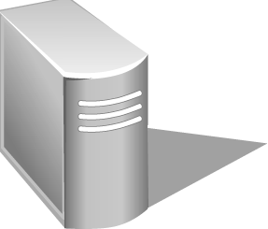
Akamai Kona Site Defender
Origin Server
End User
Origin Traffic
Akamai Traffic
10000
10000
1000
1000
100
100
10
10
1
1

Slide 9
Design Themes
Redundancy
Self-assessment
Fail-over at multiple levels
Robust algorithms

Slide 10
Embedded Image Delivery
Embedded URLs are Converted to ARLs
<html>
<head>
<title>Welcome to xyz.com!</title>
</head>
<body>
<img src=“
<img src=“
<h1>Welcome to our Web site!</h1>
<a href=“page2.html”>Click here to enter</a>
</body>
</html>
ak
http://www.xyz.com/logos/logo.gif”>
http://www.xyz.com/jpgs/background.jpg”>
Notes:
Very simple process.

Slide 11
Akamai DNS Resolution
4
xyz.com
.com .net
Root (Verisign)
5
10.10.123.5
xyz.com’s nameserver
akamai.net
a212.g.akamai.net
8
7
9
6
15.15.125.6
ak.xyz.com
select cluster
10
g.akamai.net
20.20.123.55
11
Akamai High-Level DNS Servers
12
a212.g.akamai.net
30.30.123.5
13
Akamai Low-Level DNS Servers
End User
Local Name Server
select servers within cluster
16
1
3
14
2
Browser’s Cache
15
OS
Notes:
One of many ways—don’t have to do cname but it is easy. Note that usually address is already in local name server and you don’t do all these steps.

Slide 12
Live Streaming Architecture
x
1 2 3 4
Satellite
Downlink
Satellite
Uplink
X
1 2 3 4
1 2 3 4
X X X X
Encoding
Entry Point
1 2 3 4
x
1 2 3 4
Top-level reflectors
Regions

Slide 13
Failures
Hardware
Network
Software
Configuration
Misperceptions
Attacks

Slide 14
Akamai Cluster
Servers pool resources
RAM
Disk
Throughput

Slide 15
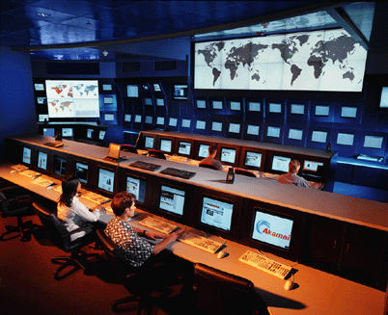

Slide 16
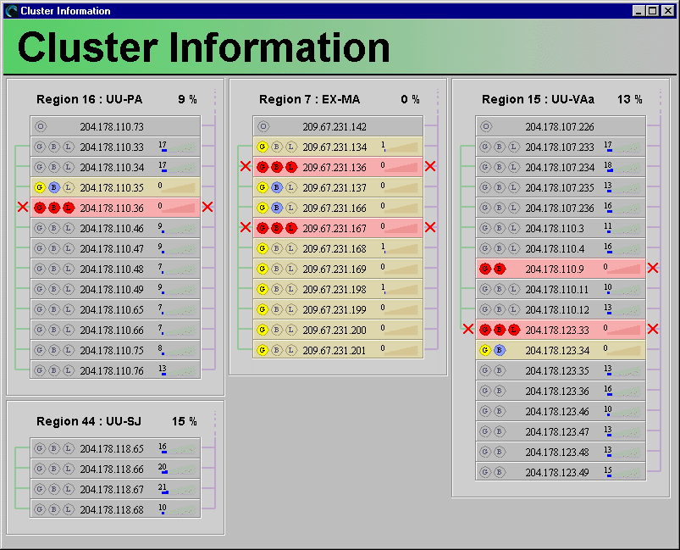
View of Clusters
buddy
suspended
hardware
failure
odd man
out
suspended
datacenter

Slide 17
Network Failures
E.g., congestion at public and private peering points, misconfigured routers, inaccessible networks, etc., etc., etc.

Slide 18
Core Points
X
1
2
3
4
Core point X is the first router at which all paths to nameservers 1, 2, 3, and 4 intersect.
X can be viewed as the straddling the core and the edge of the network.

Slide 19
Core Points
500,000 nameservers
reduced to
90,000 core points
7,000 account for 95% end-user load

Slide 20
Engineering Methodology
C programming language (gcc).
Reliance on open-source code.
Large distributed testing systems.
Burn-in on “invisible” system.
Staged rollout to production.
Backwards compatibility.

