Slide 1
The Operating System Kernel
Bruce Maggs
(original slides by Jeff Chase)
Duke University

Slide 2
Security Questions
How does the operating system isolate each process from the others?
  User process A should not be able to read or write the memory (e.g., data and instructions) of user process B.
How is the integrity of the operating system protected?
  User processes should not be able to arbitrarily read or write the memory belonging to the operating system.

Slide 3
Operating Systems: The Classical View
Programs run as
independent processes.
Each process has a private virtual address space and one or more threads.
data
data
Protected system calls
Protected OS kernel mediates access to shared resources.
Threads enter the kernel for OS services.
The kernel code and data are protected from untrusted processes.

Slide 4
Precap: the kernel
kernel
Today, all “real” operating systems have protected kernels.
The kernel is a program that resides in a file: the machine (firmware) loads it into memory and starts it (boot) on power-on/reset.
The kernel is (mostly) a library of service procedures shared by all user programs, but the kernel runs in a protected hardware mode.
User code cannot access internal kernel data structures directly.
User code can invoke the kernel only at well-defined entry points (system calls).
Kernel code is “just like” user code, but the kernel is privileged:
The kernel has direct access to all machine functions, and defines the handler entry points for CPU events: trap, fault, interrupt.
Once booted, the kernel acts as one big event handler.

Slide 5

The kernel
VAS
0x0
The kernel is just a program: a collection of modules and their state.
E.g., it may be written in C and compiled/linked a little differently.
  E.g., linked with –static option: no dynamic libs
At runtime, kernel code and data reside in a protected range of virtual addresses.
  The range (kernel space) is “part of” every VAS.
  VPN->PFN translations for kernel space are global.
    (Details vary by machine and OS configuration)
  Access to kernel space is denied for user programs because they don’t run in protected mode.
  Portions of kernel space may be non-pageable and/or direct-mapped to machine memory.
user
space
kernel
code
kernel
space
kernel
data
high

Slide 6
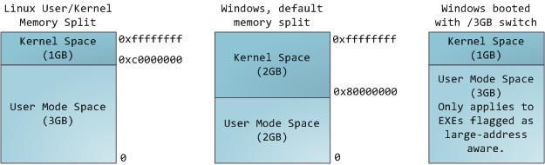
Where is the kernel?
N
The kernel is “present and mapped” in every process Virtual Address Space (on typical systems/machines).
On x64 Linux, any address with the high-order bit set is a kernel address: kernel resides in the “high half” of each VAS.

Slide 7
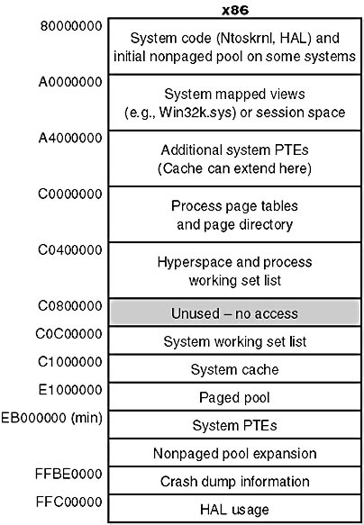
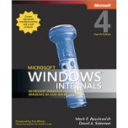
Windows IA-32
(Kernel space)
There are lots of different regions within kernel space to meet internal OS needs.
- page tables for various VAS
- page table for kernel space itself
- file block cache
  - internal data structures

Slide 8
CPU mode: user and kernel
CPU core
The current mode of a CPU core is represented by a field in a protected register.
We consider only two possible values: user mode or kernel mode (also called protected mode or supervisor mode).
If the core is in protected mode then it can:
  access kernel space
  access certain control registers
  - execute certain special instructions
mode
U/K
R0
Rn
PC
x
registers
If software attempts to do any of these things when the core is in user mode, then the core raises a CPU exception (a fault).

Slide 9
Entering the kernel
Suppose a CPU core is running user code in user mode:
  The user program controls the core.
  The core goes where the program code takes it…
  …as determined by its register state (context) and the values encountered in memory.
How does the OS get control back? How does the core switch to kernel mode?
  CPU exceptions: trap, fault, and interrupt
On an exception, the CPU transitions to kernel mode and resets the PC and SP registers.
  Set the PC to execute a pre-designated handler routine for that exception type.
  Set the SP to a pre-designated kernel stack.
user
space
Safe control transfer
kernel
code
kernel
space
kernel
data

Slide 10
Exceptions and interrupts
(“trap, fault, interrupt”)
intentional
happens every time
unintentional
contributing factors
synchronous
caused by an instruction
trap: system call
open, close, read, write, fork, exec, exit, wait, kill, etc.
fault
invalid or protected address or opcode, page fault, overflow, etc.
asynchronous
caused by some other event
“software interrupt” software requests an interrupt to be delivered at a later time
interrupt
caused by an external event: I/O op completed, clock tick, power fail, etc.

Slide 12

Entry to the kernel
Every entry to the kernel is the result of a trap, fault, or interrupt. The core switches to kernel mode and transfers control to a registered handler routine.
syscall trap/return
fault/return
OS kernel code and data for system calls (files, process fork/exit/wait, pipes, binder IPC, low-level thread support, etc.) and virtual memory management (page faults, etc.)
I/O completions
interrupt/return
timer ticks
The handler accesses the core register context to read the details of the exception (trap, fault, or interrupt). It may call other kernel routines.

Slide 13
Syscalls/traps
Programs in C, C++, etc. invoke system calls by linking to a standard library (libc) written in assembly.
  The library defines a stub or wrapper routine for each syscall.
  Stub executes a special trap instruction (e.g., chmk or callsys or syscall/sysenter instruction) to change mode to kernel.
  Syscall arguments/results are passed in registers (or user stack).
  OS+machine defines Application Binary Interface (ABI).
read() in Unix libc.a Alpha library (executes in user mode):
#define SYSCALL_READ 27 # op ID for a read system call
move arg0…argn, a0…an # syscall args in registers A0..AN
move SYSCALL_READ, v0 # syscall dispatch index in V0
callsys # kernel trap
move r1, _errno # errno = return status
return
Example read syscall stub for Alpha CPU ISA (defunct)

Slide 14
The kernel must be bulletproof
Secure kernels handle system calls verrry carefully.
User program / user space
Syscalls indirect through syscall dispatch table by syscall number. No direct calls to kernel routines from user space!
Kernel copies all arguments into kernel space and validates them.
user buffers
trap
copyout
copyin
Kernel interprets pointer arguments in context of the user VAS, and copies the data in/out of kernel space (e.g., for read and write syscalls).
What about references to kernel data objects passed as syscall arguments (e.g., file to read or write)?
read() {…}
write() {…}
kernel
Use an integer index into a kernel table that points at the data object. The value is called a handle or descriptor. No direct pointers to kernel data from user space!

Slide 15
Exceptions and interrupts
(“trap, fault, interrupt”)
intentional
happens every time
unintentional
contributing factors
synchronous
caused by an instruction
trap: system call
open, close, read, write, fork, exec, exit, wait, kill, etc.
fault
invalid or protected address or opcode, page fault, overflow, etc.
asynchronous
caused by some other event
“software interrupt” software requests an interrupt to be delivered at a later time
interrupt
caused by an external event: I/O op completed, clock tick, power fail, etc.
Usage note: some sources say that exceptions only occur as a result of executing an instruction, and so interrupts are not exceptions. But they are all examples of exceptional changes in control flow due to an event.

Slide 16
Accessible in user mode?

Slide 17
Virtual Addressing: Under the Hood
probe
page table
MMU
start
here
load
TLB
access
physical
memory
yes
miss
probe
TLB
access
valid?
raise
exception
hit
no
load
TLB
zero-fill
OS
no (first reference)
page on
disk?
(lookup and/or)
allocate
frame
page
fault?
fetch
from disk
kill
yes
legal reference
illegal reference

Slide 18
Hear the fans blow
int
main()
{
while(1);
}
How does the OS regain control of the core from this program?
No system calls! No faults!
How to give someone else a chance to run?
How to “make” processes share machine resources fairly?

Slide 19
Exceptions and interrupts
(“trap, fault, interrupt”)
intentional
happens every time
unintentional
contributing factors
synchronous
caused by an instruction
trap: system call
open, close, read, write, fork, exec, exit, wait, kill, etc.
fault
invalid or protected address or opcode, page fault, overflow, etc.
asynchronous
caused by some other event
“software interrupt” software requests an interrupt to be delivered at a later time
interrupt
caused by an external event: I/O op completed, clock tick, power fail, etc.
Usage note: some sources say that exceptions only occur as a result of executing an instruction, and so interrupts are not exceptions. But they are all examples of exceptional changes in control flow due to an event.

Slide 20

Timer interrupts
user mode
while(1);
…
resume
time
u-start
kernel “top half”
kernel mode
kernel “bottom half” (interrupt handlers)
clock interrupt
interrupt
return
boot
Enables timeslicing
The system clock (timer) interrupts periodically, giving control back to the kernel. The kernel can do whatever it wants, e.g., switch threads.
time →

Slide 21

Recap: timers, interrupts, faults, etc.
When processor core is running a user program, the user program/thread controls (“drives”) the core.
The hardware has a timer device that interrupts the core after a given interval of time.
Interrupt transfers control back to the OS kernel, which may switch the core to another thread, or resume.
Other events also return control to the kernel.
  Wild pointers
  Divide by zero
  Other program actions
  Page faults

Slide 22
Meltdown Processor Flaw
Modern “superscalar” processors execute multiple instructions simultaneously, sometimes speculatively
“Branch prediction” used to decide what to execute next when necessary
When a branch is incorrectly predicted, effects of instructions that should not have been executed are undone
… or are they? the code may have caused something to be brought into cache, and this can be detected by timing the cache

Slide 23
Meltdown
char *scratchpad = malloc(256 * 4096); \\ 256 pages of size 4096 bytes each
... somehow ensure scratchpad is entirely evicted from CPU cache ...
unsigned char *p = SOME_KERNEL_ADDRESS;
int x = rand() % 100;
unsigned char a;
unsigned char b;
if (x == 4){ // suppose CPU branch prediction speculates that this condition will be true
a = *p; // unauthorized read of kernel memory
// indirect access to scratchpad based on value a read from kernel memory
// brings cache line containing first 64 bytes of page a into cache
b = *(scratchpad + 4096 * a );
}

Slide 24
Detect Byte Value by Timing Cache Access
long long smallest_time = 9999999999999;
unsigned char leaked_a = 0;
for (int c = 0; c < 256; ++c) {
long long tsc0 = tsc();
char b = *(scratchpad + 4096 * c);
long long tsc1 = tsc();
long long tottime = tsc1 - tsc0;
if (tottime < smallest_time) {
// the smallest tottime is consequence of speculation
// made by CPU with "a" value, that brought a related
// memory page into the cache.
smallest_time = tottime;
leaked_a = c;
}
}
printf("Kernel byte %p = %02x", SOME_KERNEL_ADDRESS, leaked_a);
https://epxx.co/logbook/entries/meltdown_en.html

Slide 25
Mitigation
Redesign processor
Move kernel memory out of user process virtual address space

Slide 26
Recap: OS protection
A classical OS uses the hardware to protect itself and implements a limited direct execution model for untrusted user code.
Virtual addressing. Applications run in sandboxes that prevent them from calling procedures in the kernel or accessing kernel data directly (unless the kernel chooses to allow it).
Events. The OS kernel installs handlers for various machine events when it boots (starts up). These events include machine exceptions (faults), which may be caused by errant code, interrupts from the clock or external devices (e.g., network packet arrives), and deliberate kernel calls (traps) caused by programs requesting service from the kernel through its API.
Designated handlers. All of these machine events make safe control transfers into the kernel handler for the named event. In fact, once the system is booted, these events are the only ways to ever enter the kernel, i.e., to run code in the kernel.

Slide 27
Coarser abstraction: virtual machine
We’ve already seen a kind of virtual machine
  OS gives processes virtual memory
  Each process runs on a virtualized CPU
Virtual machine
  An execution environment
  May or may not correspond closely to physical reality

Slide 28
How do we virtualize?
Key technique: “trap and emulate”
  Untrusted/user code tries to do something it can’t
  Transfer control to something that can do it
  Evaluate whether thing is allowed
  If so, do it and return control. Else, kill process or throw exception.
Where have we seen trap and emulate?
  Virtual memory
  Process tries to access non-resident memory
  Trap to OS
  OS makes virtual page resident
  Retry instruction that caused fault
Generally useful technique, crucial for virtual machines
Ways to do this?
Rely on HW
Rewrite code

Slide 29
Virtual-machine options
Approaches to implementing VMs
Interpreted virtual machines
  Translate every VM instruction
  Kind of like on-the-fly compilation
  VM instruction → HW instruction(s)
Direct execution
  Execute instructions directly
  Emulate the hard ones

Slide 30

Interpreted virtual machines
Implement the machine in software
Must translate emulated to physical
  Java: byte codes → x86, PPC, ARM, etc
Software fetches/executes instructions
Program
(foo.class)
Interpreter
(java)
Byte code
x86
Looks a lot like a dynamic virtual memory translator

Slide 31
Java virtual machine
What is the (low-level) interface to the JVM?
  Java byte-code instructions
What abstraction does the JVM provide?
    JVM: Stack-machine architecture
    Dalvik (Android): Register-based architecture
The Java programming language
  High-level language compiled into byte code
  Library of services (kind of like a kernel)
  Like PHP, Python, C++/STL, C#

Slide 32
Direct execution
What is the interface?
  Hardware ISA (e.g., x86 instructions)
What is the abstraction?
  Physical machine (e.g., x86 processor)
Program
(Linux kernel)
x86
x86
Monitor
(VMware)
x86

Slide 33
Different techniques
Instruction-level emulation
  Bochs, QEMU
Full virtualization
  VMware
Paravirtualization (recompile guest OS for hardware interface different from physical hardware)
  Xen
Dynamic recompilation
  Virtual PC for Mac (recompile for PowerPC)

Slide 34
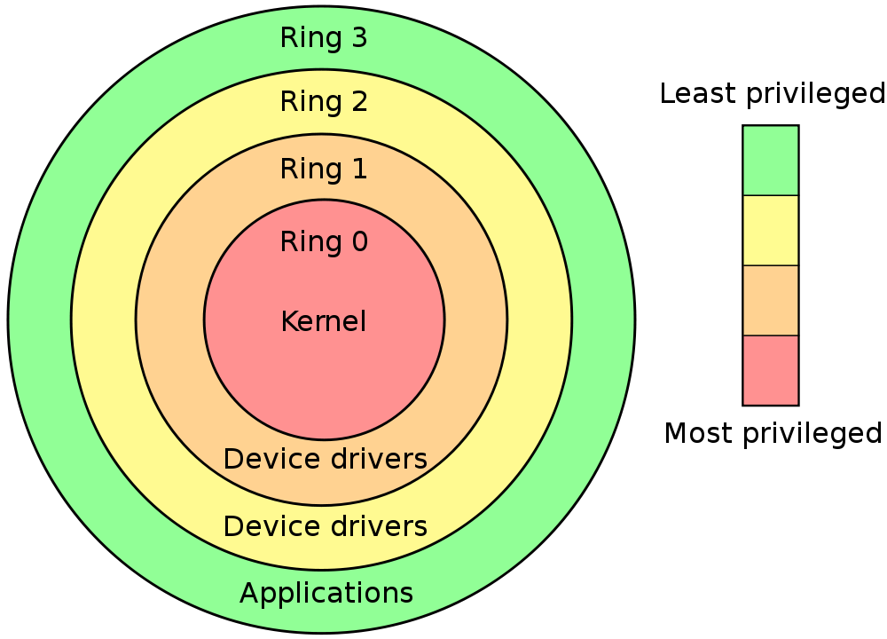

Slide 35
Traditional OS structure
App
App
App
App
Ring 3
Operating System
Ring 0
Host Machine

Slide 36
Virtual-machine structure
Guest
App
Guest
App
Guest
App
Ring 3
Guest OS
Guest OS
Guest OS
Ring 1
Virtual Machine Monitor (Hypervisor)
Ring 0
Host Machine

