Slide 1
Monetizing Attacks /
The Underground Economy
original slides by
Prof. Vern Paxson
University of California, Berkeley

Slide 2
Today
A look at profit-driven cybercrime …
  Monetization of malware
  Monetization of spam
… including the Underground Economy
  Elements
  Significance
  Infiltration/disruption

Slide 3
Monetizing Malware Locally
General malware monetization approaches:
  Keylogging: steal financial/email/social network accounts
  Ransomware
  Scareware (“fake AV”)

Slide 4
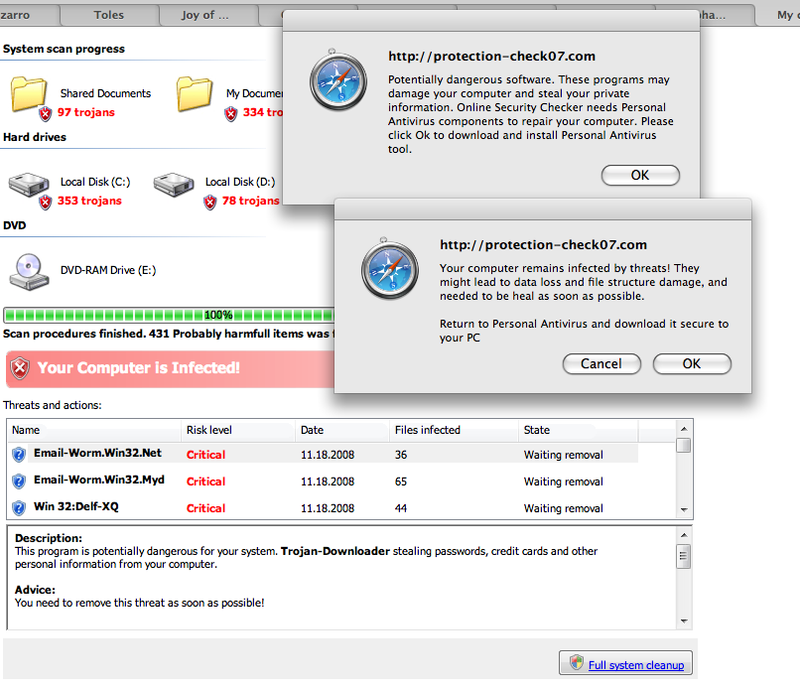

Slide 5
Monetizing Malware Locally
General malware monetization approaches:
  Keylogging: steal financial/email/social network accounts
  Ransomware
  Scareware (“fake AV”)
  Transaction generators (“man-in-the-browser”)
    Malware watches user’s surfing …
    … waits for them to log into banking site (say) …
    … and then injects additional banking transactions like “send $50,000 to Nigeria” …
    … and alters web server replies to mask the change in the user’s balance

Slide 6
Monetizing Large-Scale Malware
Monetization that leverages botnet scale
  DDoS (extortion)
  Spam
  Click fraud
  Scam infrastructure
    Hosting web pages (e.g., phishing)
    Redirection to evade blacklisting/takedown (DNS)
    Proxying traffic to thwart tracing / provide IP diversity
Which of these cause serious pain for infected user?
  None. Users have little incentive to prevent
  Externality (cost one party’s actions impose on another)

Slide 7
Spam & Spam Profit

Slide 8
Monetizing Spam
In what different ways can spammers make money off of sending spam?
  And who has incentives to thwart these schemes?
    (Other than law enforcement)
Scheme #1: advertise goods or services
  Examples: fake Rolexes, Viagra, university degrees
  Profit angle: increased sales
  Who’ll try to stop: brand holders

Slide 9
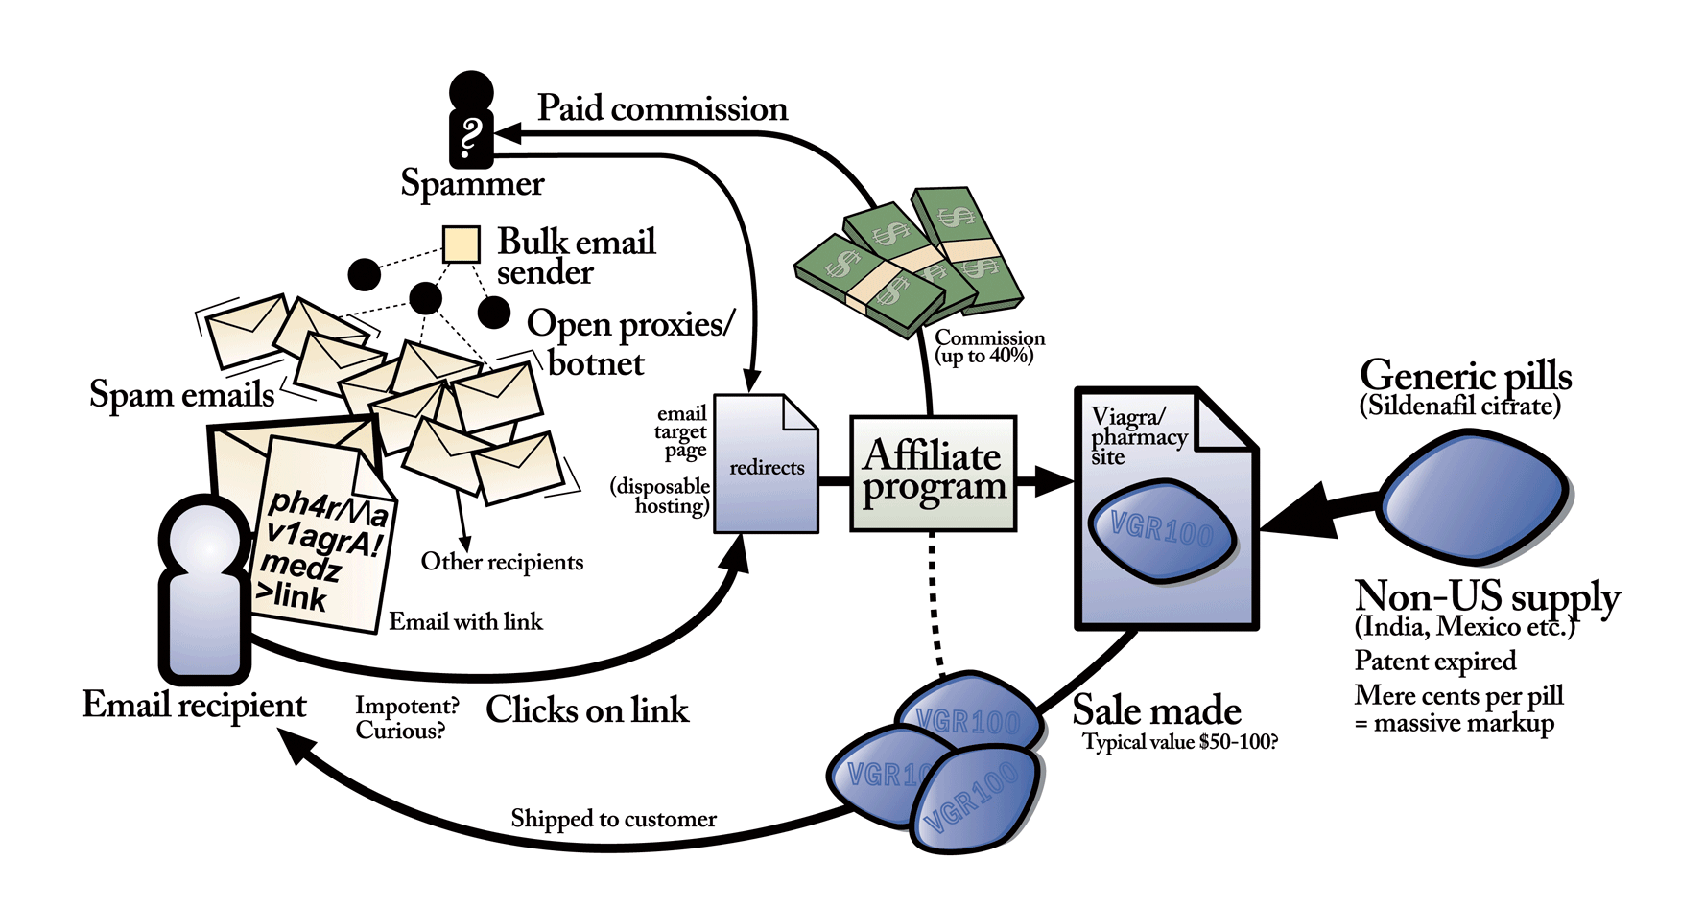
Anatomy of a modern Pharma spam campaign
Diagram by Stuart Brown
modernlifeisrubbish.co.uk

Slide 10
Monetizing Spam
In what different ways can spammers make money off of sending spam?
  And who has incentives to thwart these schemes?
    (Other than law enforcement)
Scheme #1: advertise goods or services
  Examples: fake Rolexes, Viagra, university degrees
  Profit angle: increased sales
  Who’ll try to stop: brand holders
Scheme #2: phishing
  Profit angle: transfer $$$ out of accounts; sell accounts to others; use accounts for better spamming (e.g. Facebook)
  Opponents: issuers of accounts
  Note: targeted phishing (“spear-phishing”) doesn’t actually need much in the way of spam due to low volume

Slide 11
Monetizing Spam, con’t
Scheme #3: scams
  Examples: pen pal relationships, 419 (“Nigerian”)
  Profit angle: con victim into sending money
  Opponents: scambaiters (e.g., www.419eater.com)
  Chapter 38, Article 419 of the Nigerian Criminal Code "Obtaining property by false pretenses; Cheating”
Scheme #4: recruiting crooks/underlings
  Examples: money mules, reshippers
  Profit angle: enables profiting from cybercrime
  Opponents: ?

Slide 12
Monetizing Spam, con’t
Scheme #3: scams
  Examples: pen pal relationships, 419 (“Nigerian”)
  Profit angle: con victim into sending money
  Opponents: scambaiters (e.g., www.419eater.com)
Scheme #4: recruiting crooks/underlings
  Examples: money mules, reshippers
  Profit angle: enables profiting from cybercrime
  Opponents: ?
Money mules take incoming (fraudulent) financial transfers to their bank accounts, wire-transfer 90% out of country, keep 10%

Slide 13
Monetizing Spam, con’t
Scheme #3: scams
  Examples: pen pal relationships, 419 (“Nigerian”)
  Profit angle: con victim into sending money
  Opponents: scambaiters (e.g., www.419eater.com)
Scheme #4: recruiting crooks/underlings
  Examples: money mules, reshippers
  Profit angle: enables profiting from cybercrime
  Opponents: ?
Reshippers receive shipments of goods (e.g., a laptop bought using a stolen account) and re-mail them outside the country
https://postalinspectors.uspis.gov/radDocs/consumer/ReshippingScam.html

Slide 14
Monetizing Spam, con’t
Scheme #5: pump-and-dump
  Example: “Falcon Energy (FPK) is about to go through the roof! Don’t miss out on $eriou$ Profit$!”
  Profit angle: penny-stock momentarily goes up,
  dump pre-bought shares when it does
  Opponents: Securities and Exchange Commission
  Note: unlike other monetization techniques, the “back channel” is out-of-band
    No link in messages back to the scammer
Scheme #6: recruiting bots
  Examples: “important security patch!”, “someone sent you a greeting card!”
  Profit angle: get malware installed on new machines
  Opponents: ?

Slide 15
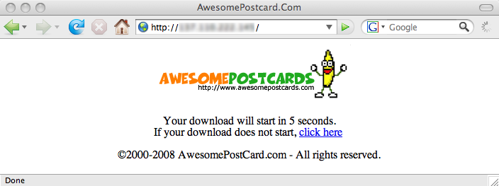
Welcome to Storm!
"230 dead as storm batters Europe“
(Windows virus spread by spam)
Would you like to be one of our newest bots?
Just read your postcard!
(Or even easier: just wait 5 seconds!)

Slide 16


The Storm Spambot
Infected systems
Reachability check
Overnet P2P protocol (UDP)‏

Slide 17


The Storm Botnet
Botmaster
Hosted infrastructure
HTTP
proxies
Operated using
“bulletproof hosting”
HTTP
Proxy
bots
Infected machines
TCP
Workers

Slide 18
Spam “Campaign” Mechanics
Botmaster
HTTP
proxies
HTTP
Proxy
bots
TCP
Workers

Slide 19
Campaign Mechanics: Harvest
Botmaster
give me a task!
@
@
@
@
@
@
HTTP
proxies
@
HTTP
Proxy
bots
TCP
Workers

Slide 20

Campaign Mechanics: Spamming
templates
dictionaries
addresses
Botmaster
HTTP
proxies
HTTP
Proxy
bots
TCP
Workers

Slide 21
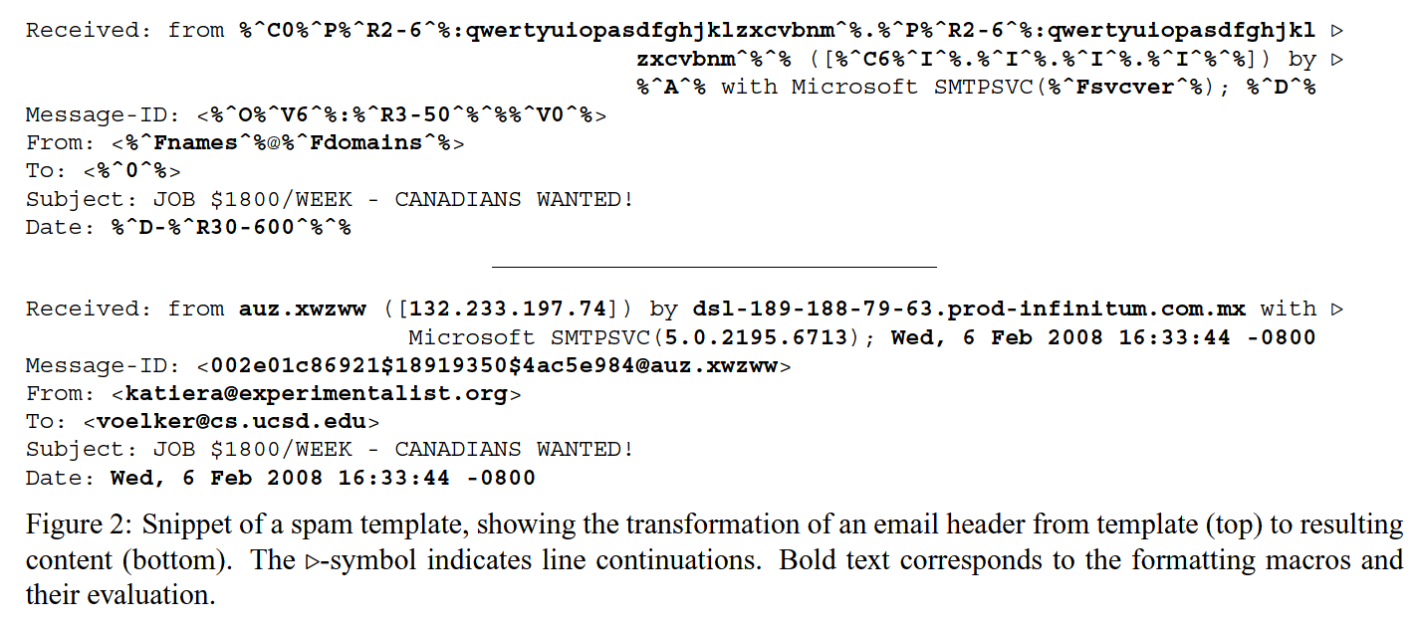
Synthetic diversity aims to thwart content-based anti-spam filtering

Slide 22
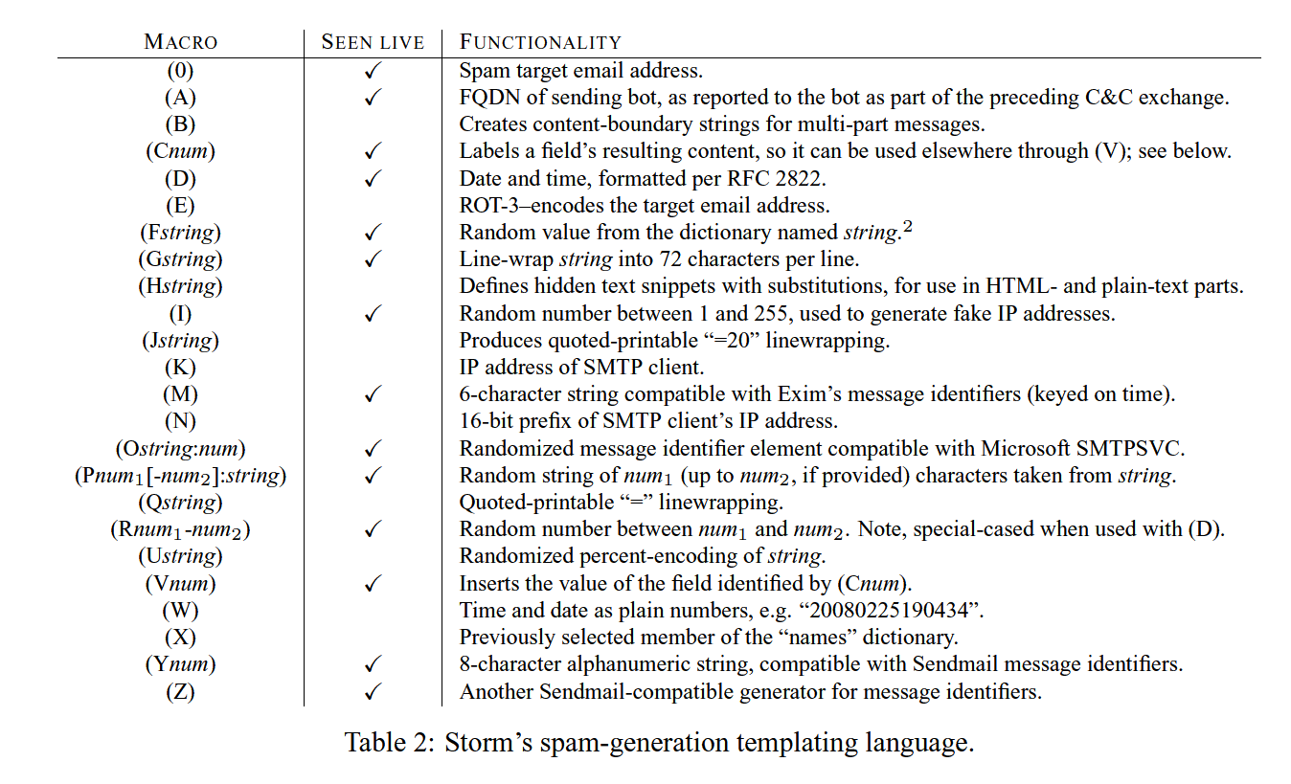

Slide 23
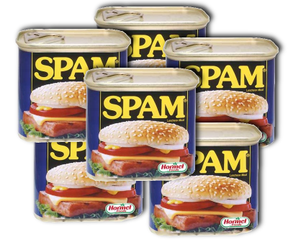
Campaign Mechanics: Spamming
templates
dictionaries
addresses
Botmaster
HTTP
proxies
HTTP
Proxy
bots
TCP
Workers

Slide 24
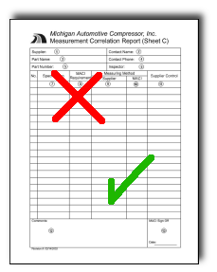
Campaign Mechanics: Reporting
Botmaster
HTTP
proxies
HTTP
Proxy
bots
TCP
Workers

Slide 25
The Rise of the Underground Economy

Slide 26
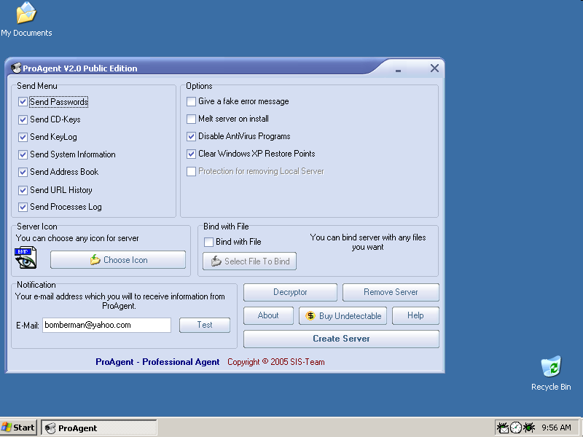
User creates customized malware and then distributes it to others. Infected machines report back.

Slide 27
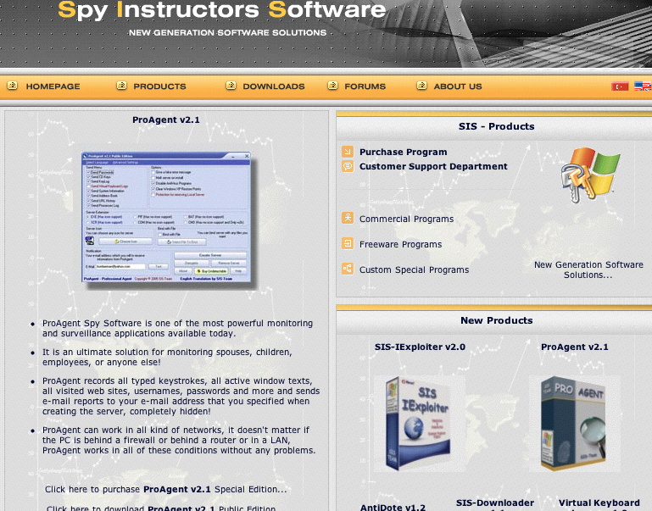
Notes:
Software comes with 150 page manual, support contract.

Slide 29
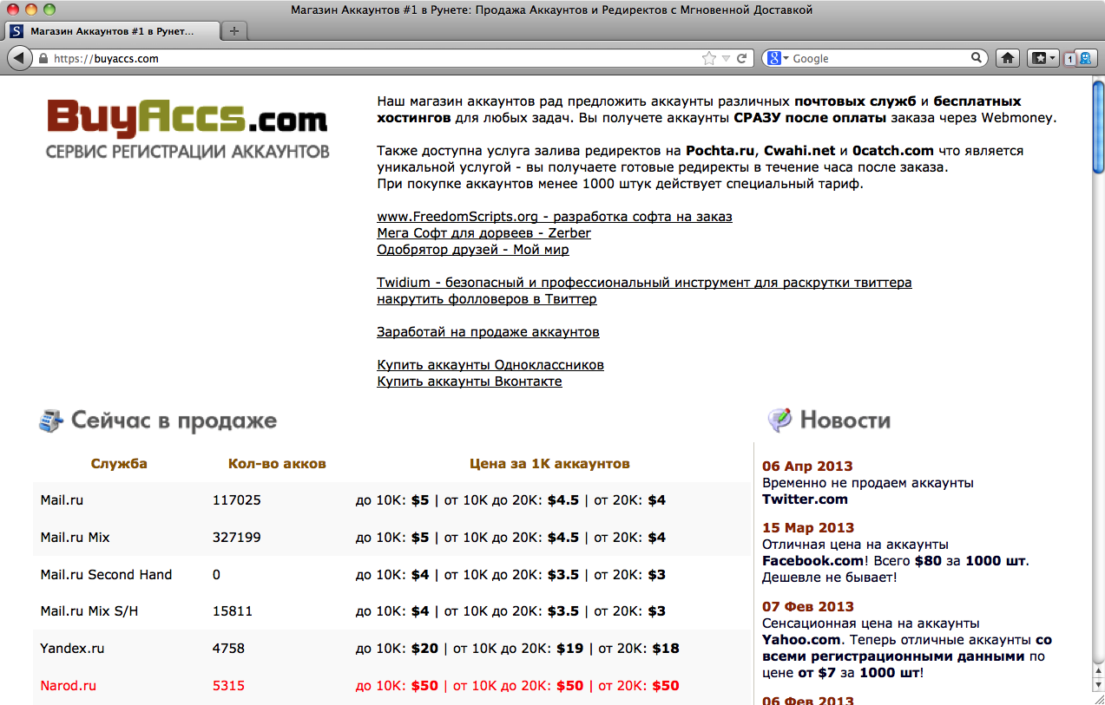

Slide 30
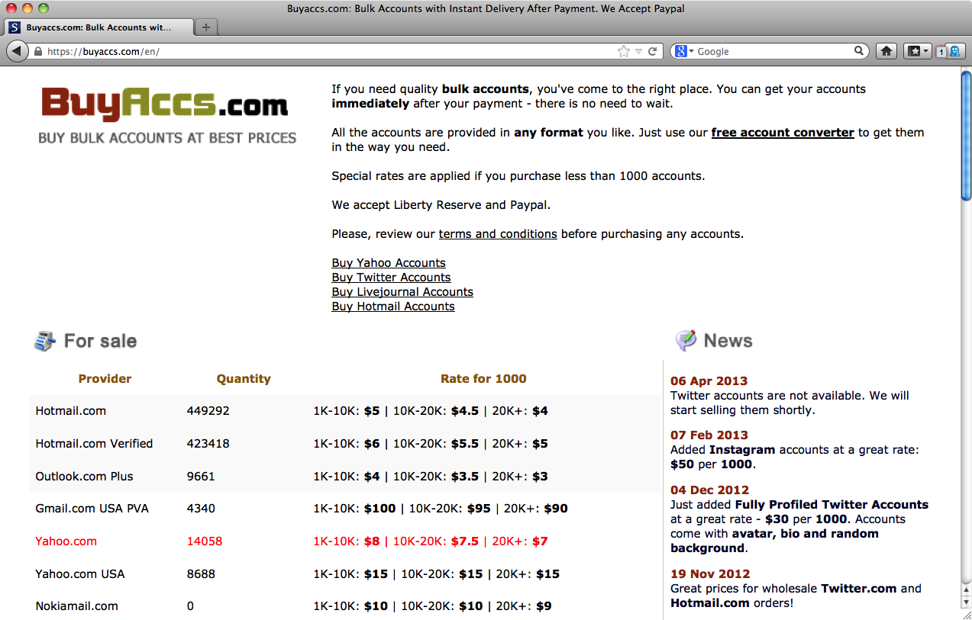


Slide 31
List of available accounts
Service for the sale of eBay auction accounts.
Dear users of eBay accounts, we are offering our accounts for your attention.
Regular clients and those that buy more than 5 accounts will get various bonuses and discounts.
All accounts come with access to the holder's email.
You can select an account (or accounts) from a list. Just tell me. Pay and receive. All accounts are verified before sale; if something doesn't work – 100% replacement.
Active or inactive – see for yourself for each user ID. I don't sort by activeness, since this is a subjective factor for each person.
Also for sale are PayPal accounts. Market prices. Not always available.
Payment with Webmoney.
Before buying be sure to read the FAQ.
I don't offer advice on use of my products.
I welcome work through Garant Service
Seller/buyer accounts up to 10 feeds -- $5
Etc.

Slide 33
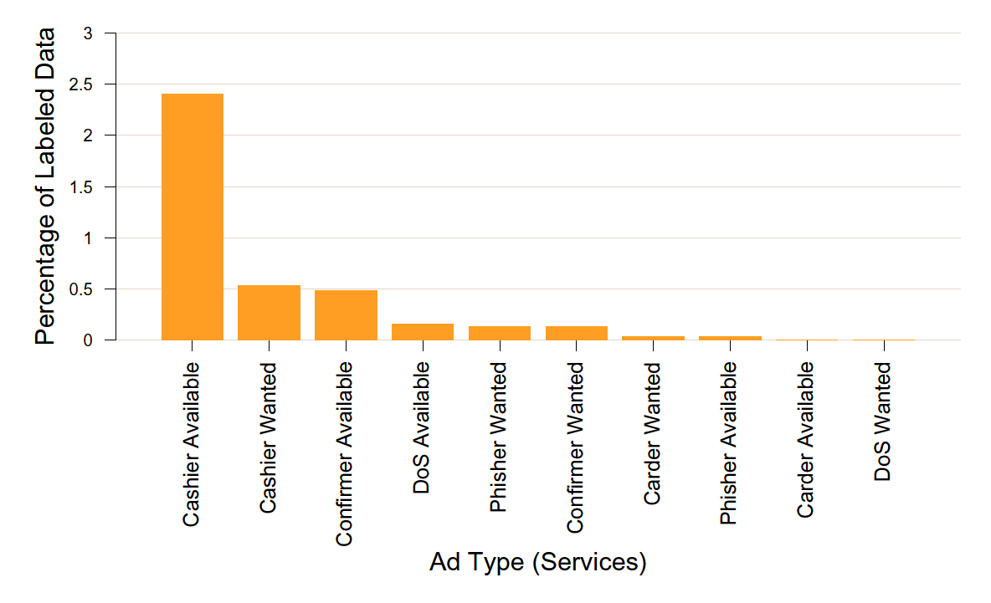
Marketplace Ads for Services

Slide 34
Marketplace Ads for Goods

Slide 35
Pay-Per-Install (PPI)

Slide 36
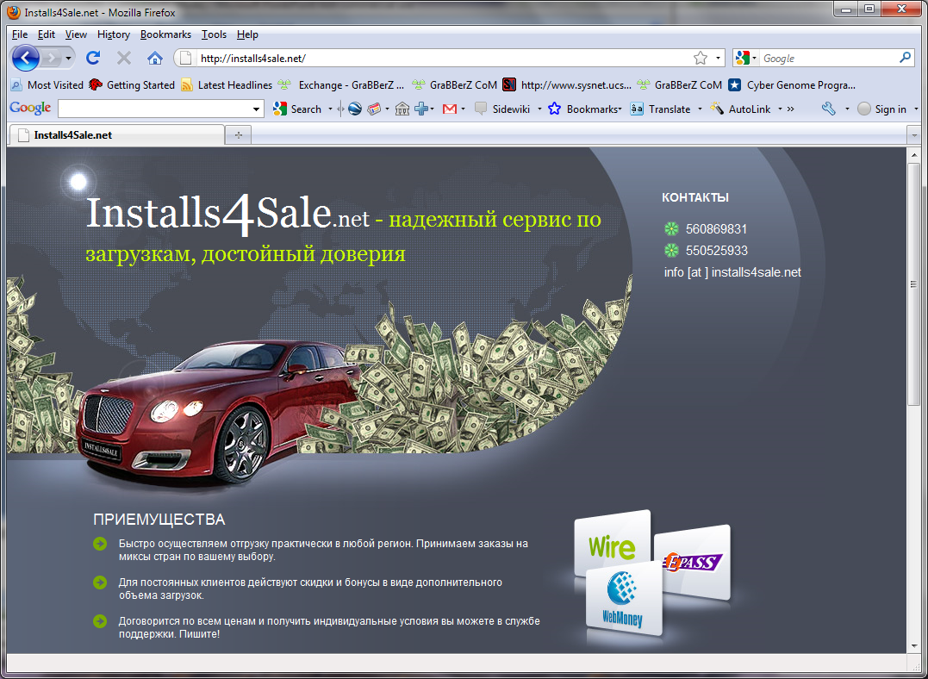
36

Slide 37
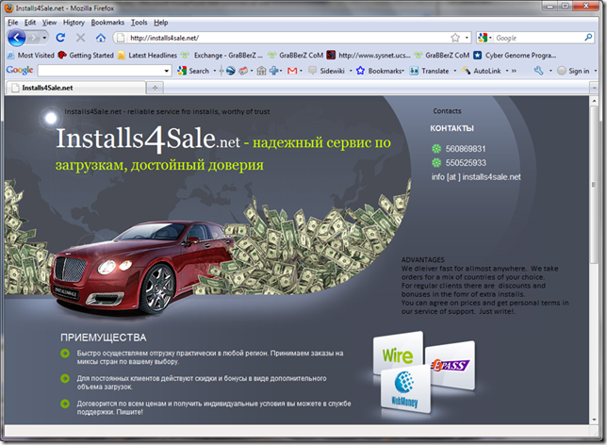

Slide 38
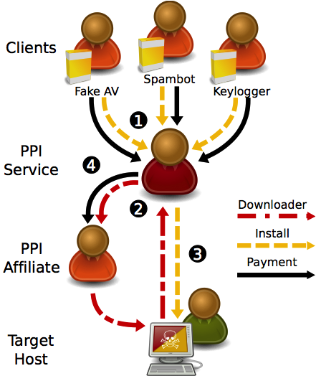

Slide 44
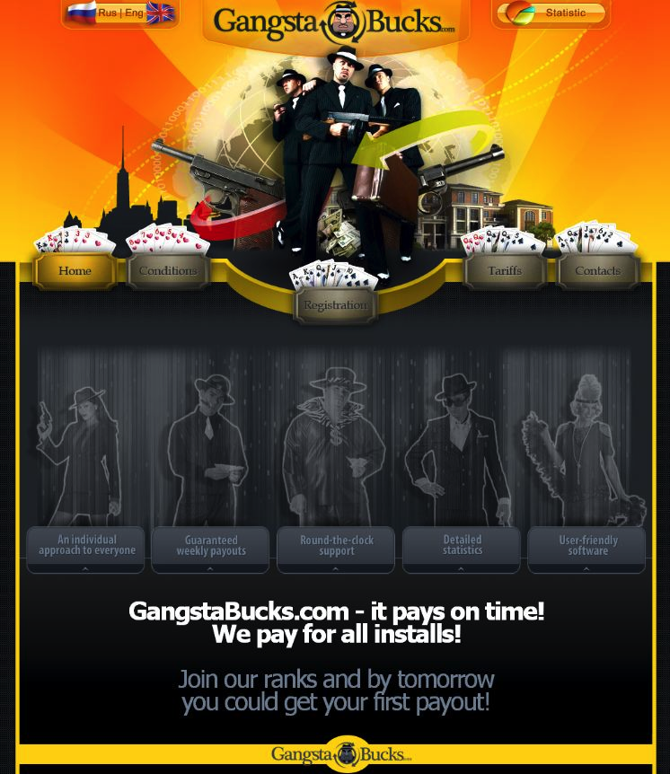

Slide 45
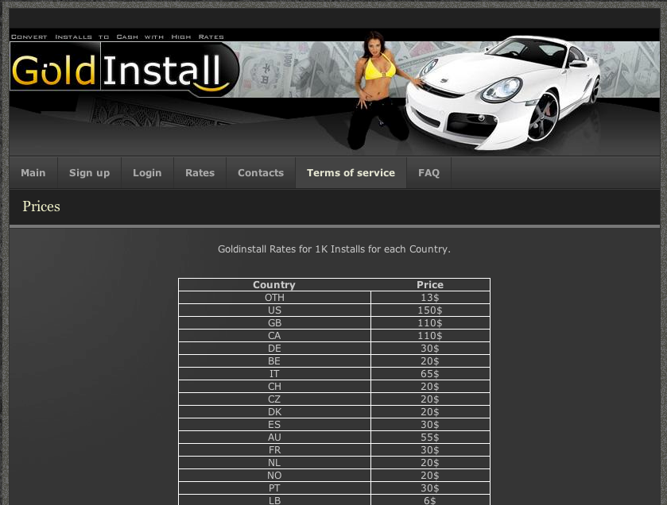

Slide 46
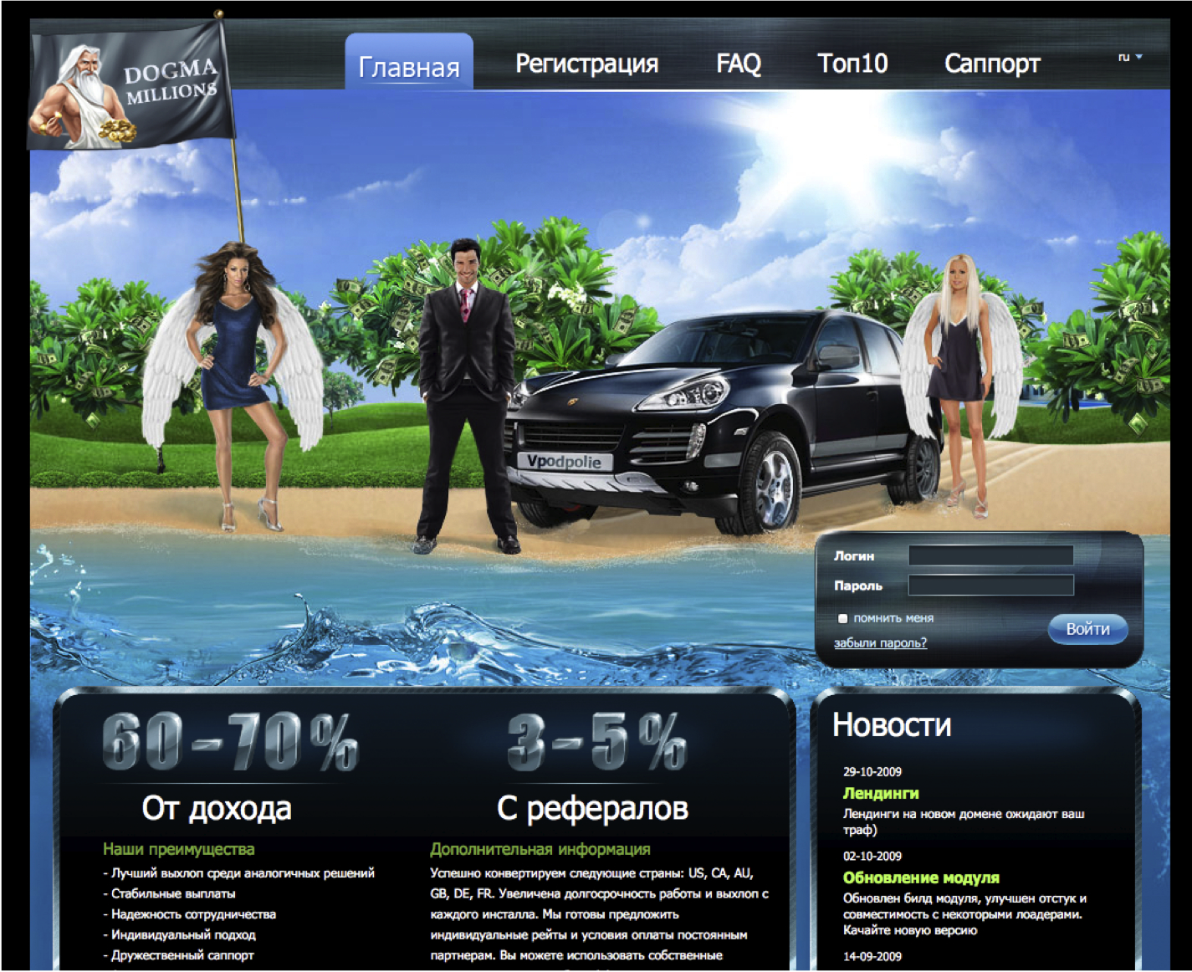

Slide 47
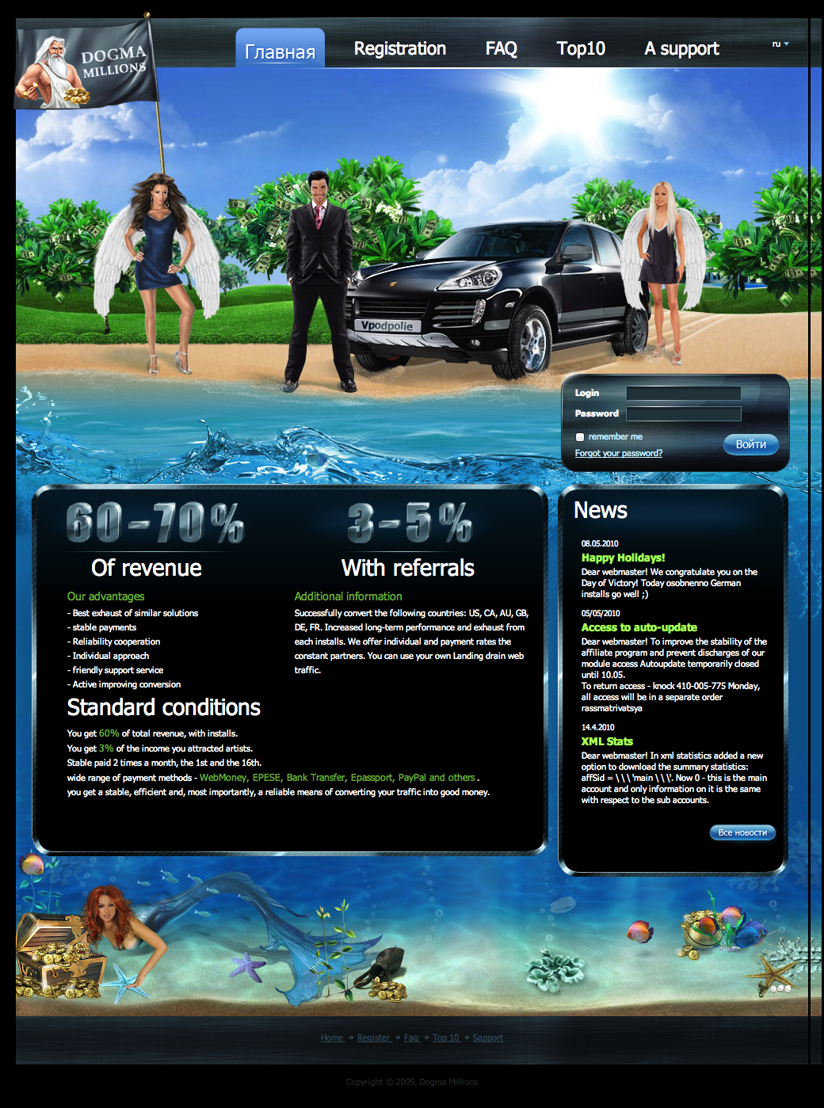

Slide 48
The Underground Economy
Why is its emergence significant?
Markets enable efficiencies
  Specialization: individuals rewarded for doing a single thing particularly well
Lowers barrier-to-entry
  Only need a single skill
  Some underground market activities are legal
Competition spurs innovation
  Accelerates arms race
  Defenders must assume a more pessimistic threat model
Facilitates non-$ Internet attacks (political, nation-state)
  Provides actors with cheap attack components
  Provides stealthy actors with plausible cover

Slide 49
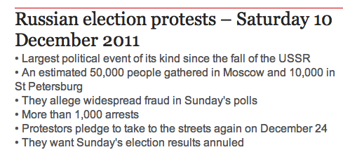
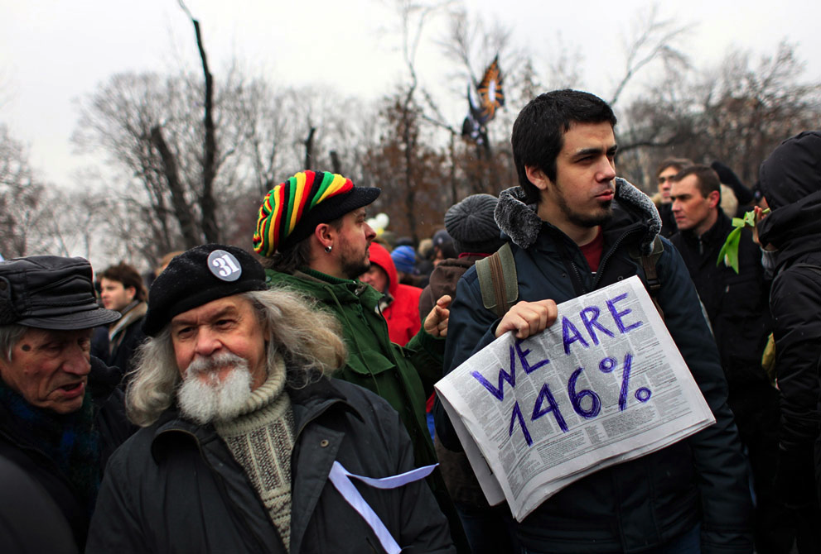
#триумфальная
(#triumphal)
26K Twitter accounts tweet 440K junk messages to drown out discourse / coordination.

Slide 50
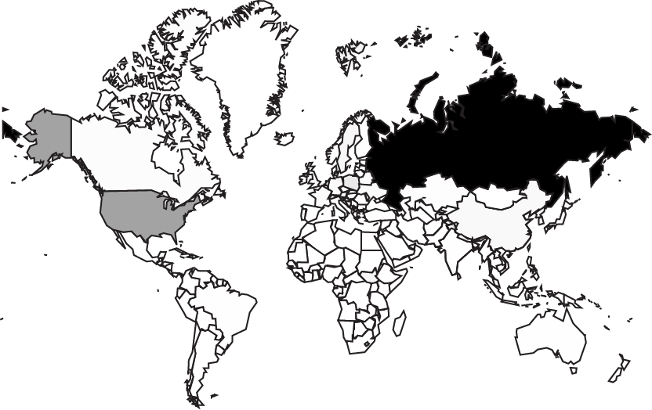
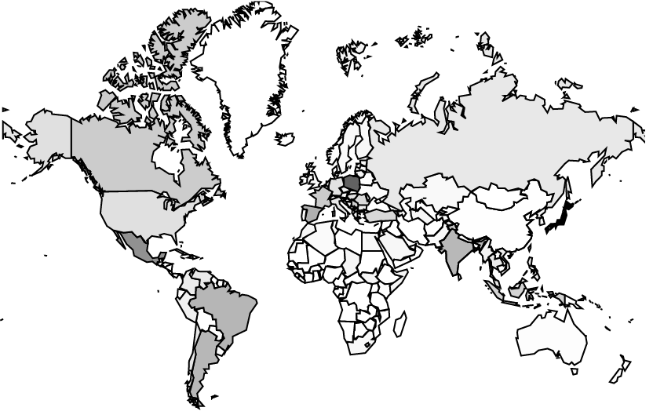
Geolocation of Logins
56%
1%
Nonspam Logins
Spam Logins

Slide 51
Geolocation of Logins
56%
1%
Nonspam Logins
Spam Logins
26K accounts purchased from spam-as-a-service program. Part of a “lot” of 975K. Used ~20K distinct IP addresses.

Slide 52
The Underground Economy, con’t
What problems do underground markets face?
Depending on marketplace architecture, can present a target / single point of failure
By definition, deals are between crooks
  Major issue of betrayal by “rippers”
Markets only provide major efficiencies if they facilitate deals between strangers
  Susceptible to infiltration

Slide 53
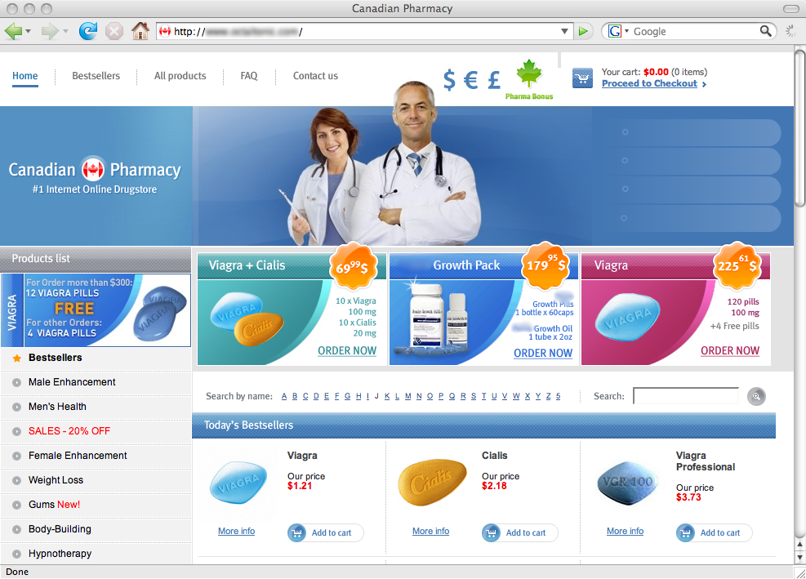
Welcome to Storm! What can we sell you?

Slide 54


Slide 55

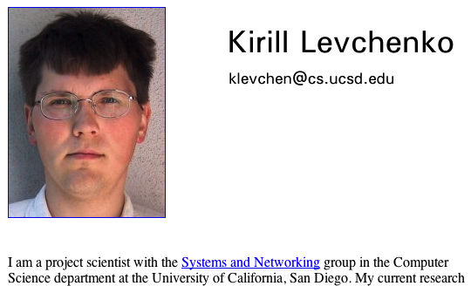

Slide 56

Template points to spammer’s server
Modified template points to our server

Slide 57
Life As A Spammer …
Storm infiltration study found:
  Modern spam campaigns can send 10s of billions of spams using mailing lists of 100s of millions of addresses
  3/4 to 5/6 of all spam delivery attempts fail before the message is even sent to the receiver’s server …
    … due to heavy & effective use of black-listing
  It takes around 20,000 “postcard” spams to get one person to visit the postcard site
    1 in 10 of the visitors will click to download the postcard
  It takes around 12,000,000 Viagra spams to get one person to visit the site and make a purchase (~$100)
  Even given those low rates, huge volume ⇒ profitable
~ $1.5-2M/year revenue

Slide 58
Life As A Spammer …
Storm infiltration study found:
  Modern spam campaigns can send 10s of billions of spams using mailing lists of 100s of millions of addresses
  3/4 to 5/6 of all spam delivery attempts fail before the message is even sent to the receiver’s server …
    … due to heavy & effective use of black-listing
  It takes around 20,000 “postcard” spams to get one person to visit the postcard site
    1 in 10 of the visitors will click to download the postcard
  It takes around 12,000,000 Viagra spams to get one person to visit the site and make a purchase (~$100)
  Even given those low rates, huge volume ⇒ profitable
Another study based on making purchases of spam-advertised pharamaceuticals found that 3 merchant banks hosted 95+% of all sales …
… suggesting a novel way to suppress spam is to undermine the credit-card processing
~ $1.5-2M/year revenue

Slide 59
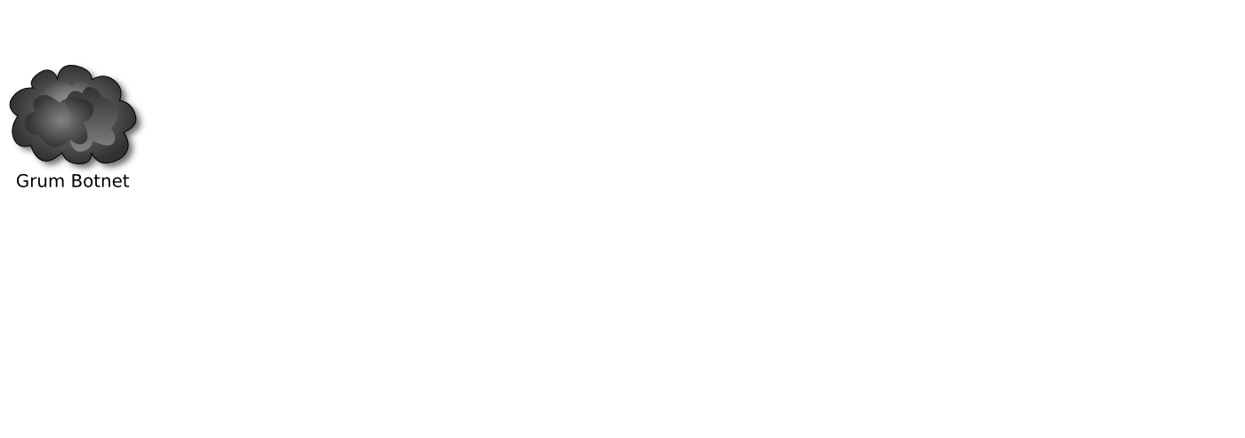
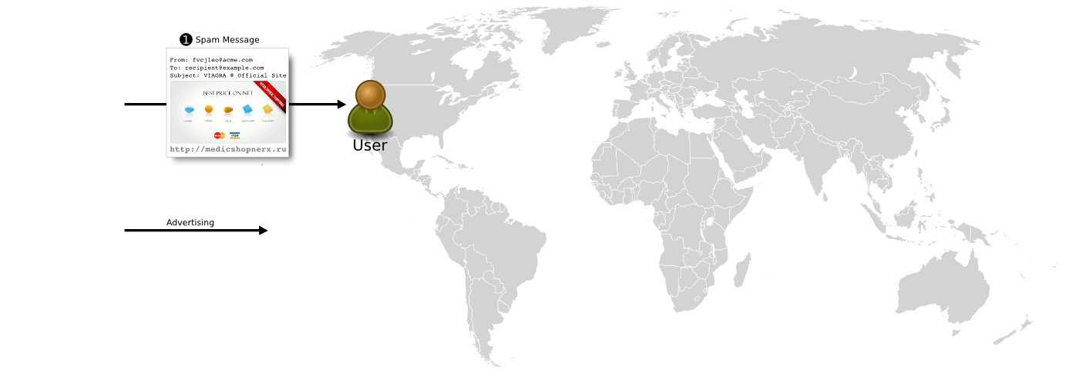

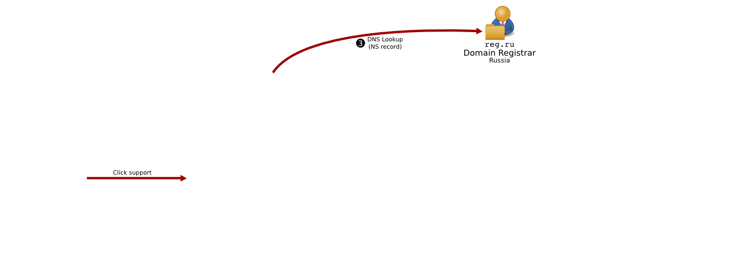
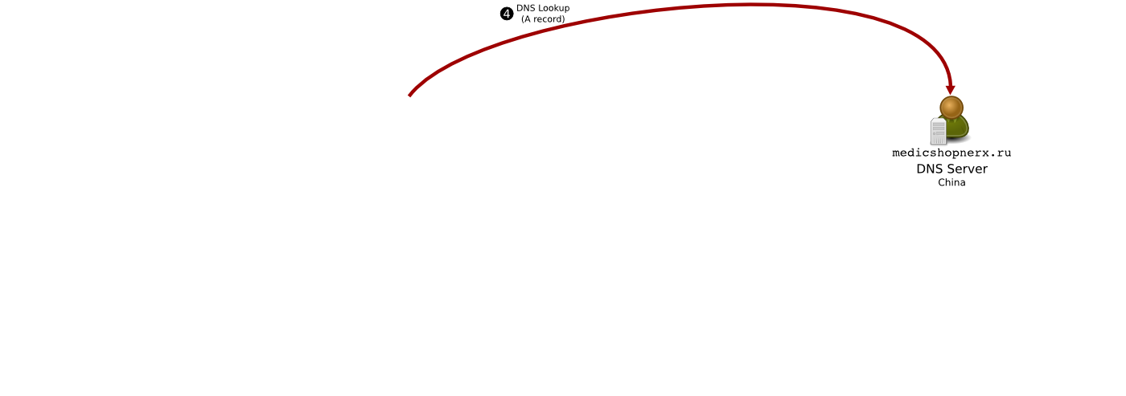

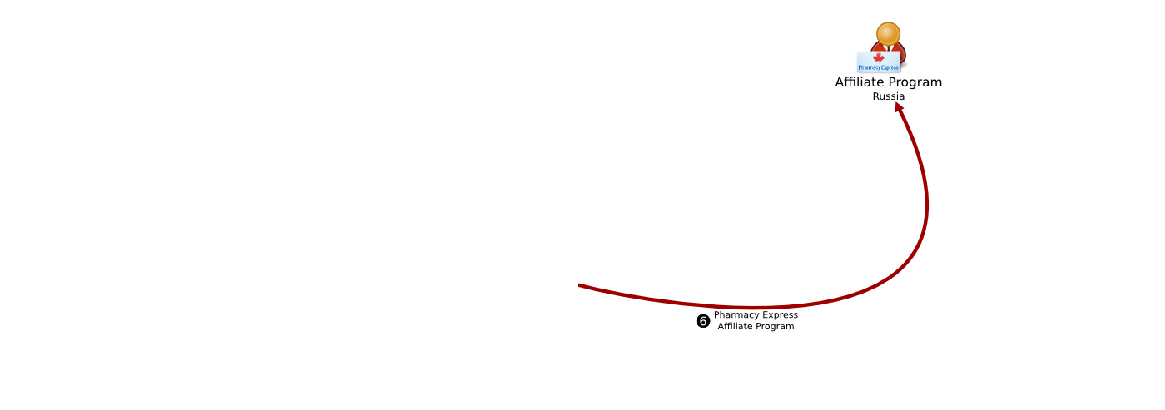
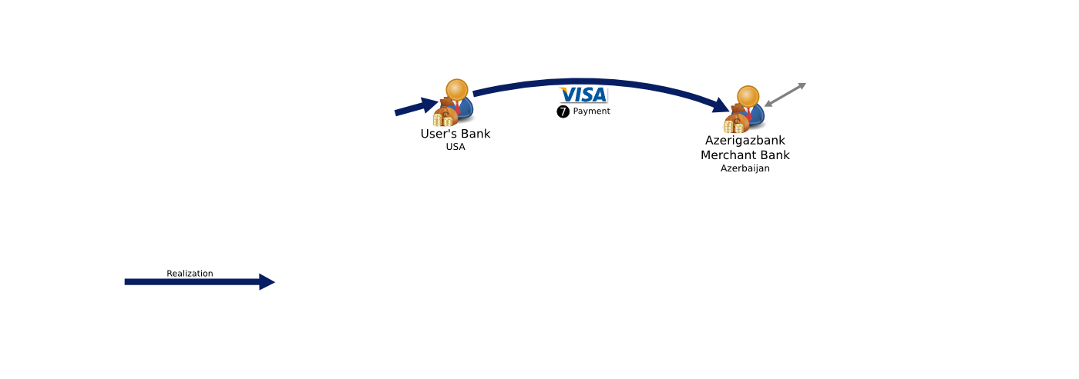
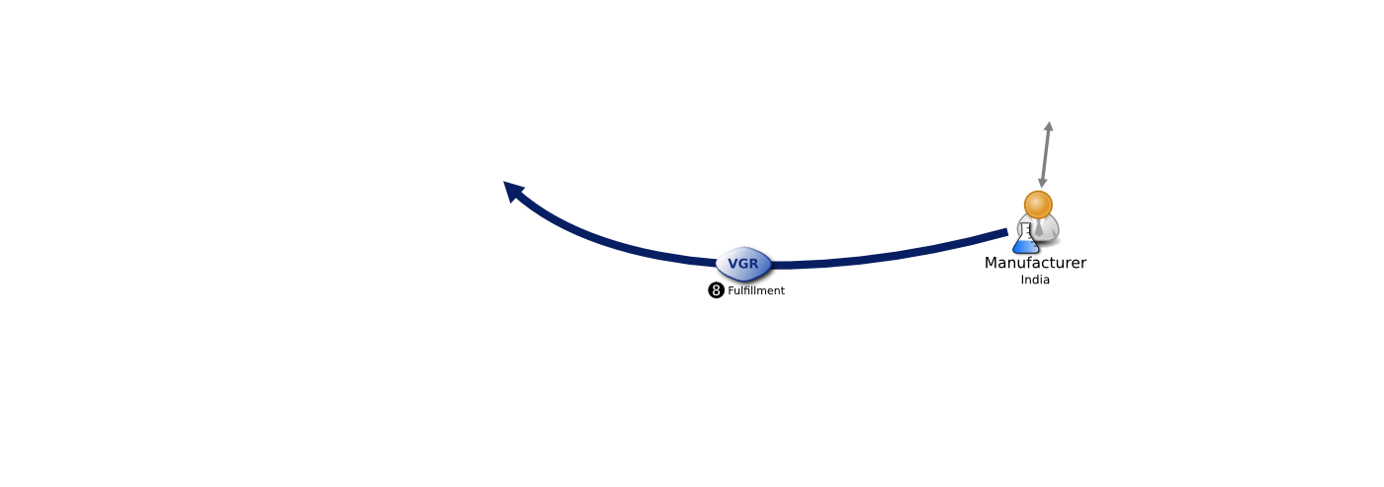
Phases of the Spam Value Chain
If we were to “snip” a link in this chain, which one would be the most disruptive for our least expenditure?
Measuring URLs, DNS servers, HTTP redirection, etc. all a matter of energetic crawling & recording.
But merchant banks / Visa / “fulfillment” ?

Slide 60

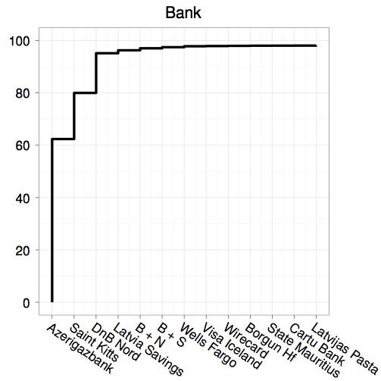
3 banks host
95+% of all sales
% of spam

Slide 61
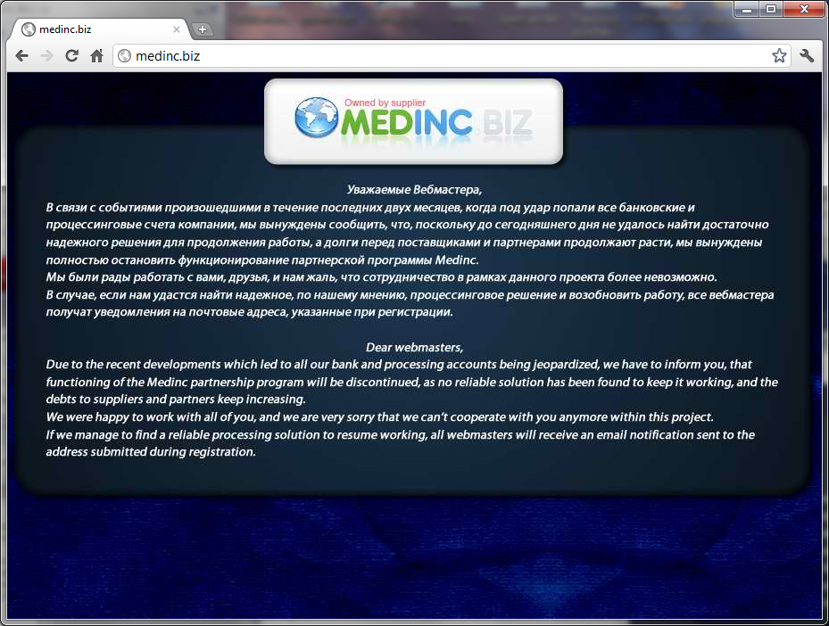
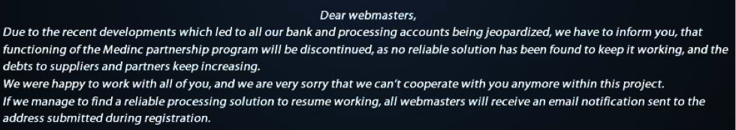

Slide 62
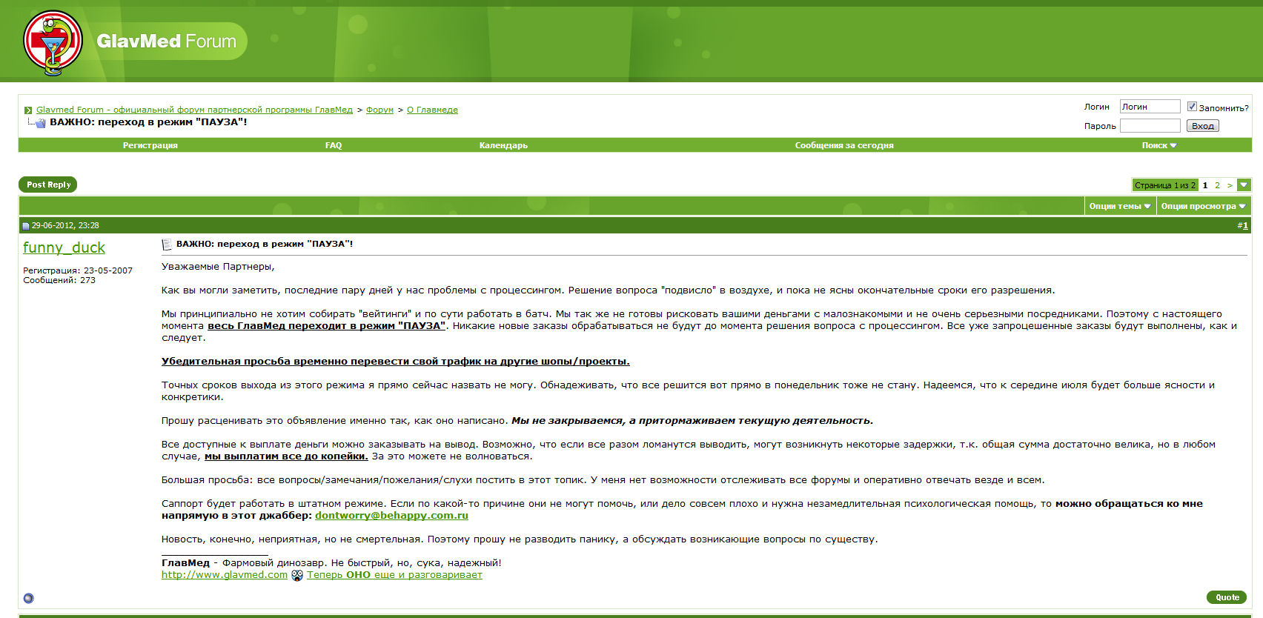
6/29/2012
Dear Partners,
As you may have noticed, in the last couple of days we've had problems with processing. We don't have a solution yet, and there is no concrete time when it will be resolved.
…….
From this point forward, GlavMed is switching to a "PAUSED" mode. No new orders will be processed until the processing issue is resolved.
……..
We urge you to temporarily switch your traffic to other shops/projects.

Slide 63
Measuring Pay-per-Install: The Commoditization of Malware Distribution
Juan Caballero, Chris Grier, Christian Kreibich, Vern Paxson
USENIX Security Symposium, August 2011

Slide 64
Infiltration opportunity

Slide 65
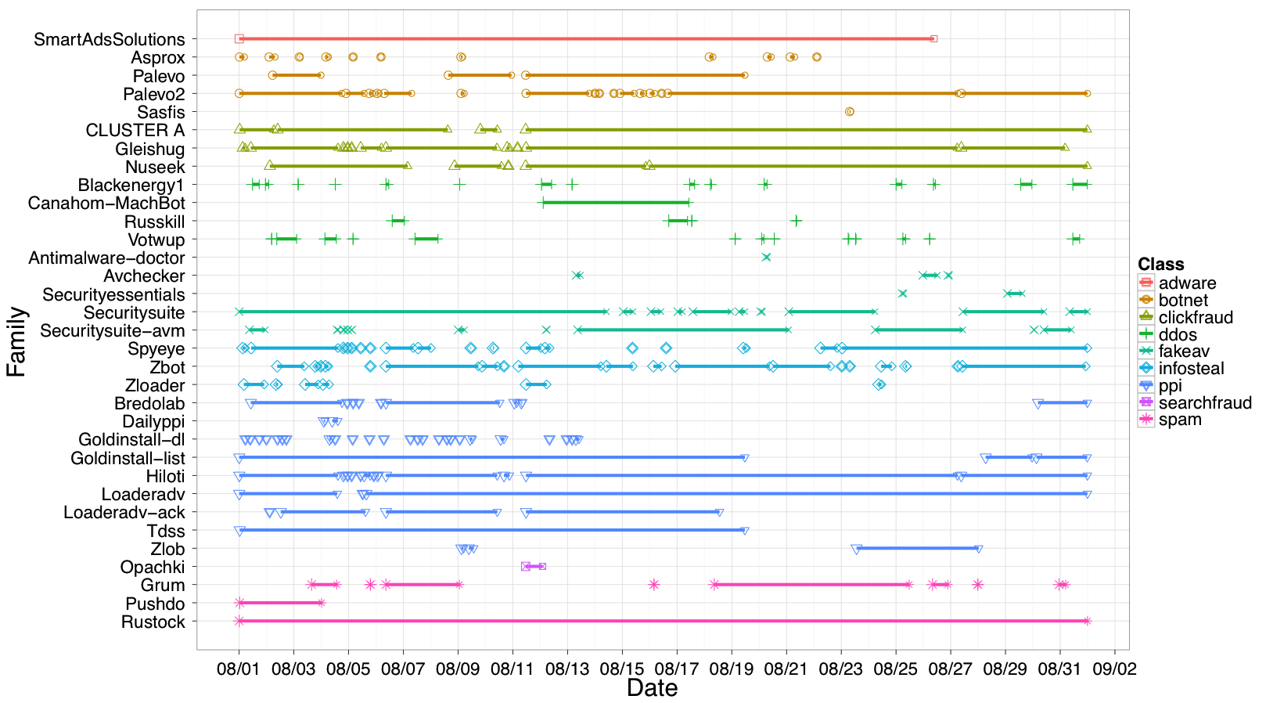
Via protocol emulation, extracted (“milked”) > 1M malicious binaries over 6 months

Slide 66
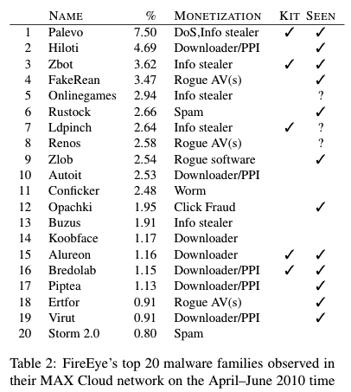
The majority of the world’s top malware appeared in PPI downloads

Slide 67
Axiom*of Criminal Laziness

Slide 68
Axiom* of Criminal Laziness
Cybercrooks will work energetically to sustain their current cash flow …
… but will not look out strategically beyond it to serve their long-term interests
(* Vern: This is my own working hypothesis to explain the observed
pace of attacker innovation - not something concretely established)

