Slide 1
Lecture 11 Graph Algorithms

Slide 2
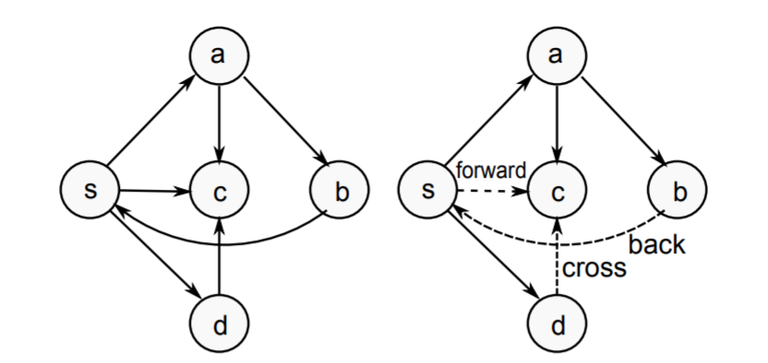
Type of Edges
Tree/Forward: pre(u) < pre(v) < post(v) < post(u)
Back: pre(v) < pre(u) < post(u) < post(v)
Cross: pre(v) < post(v) < pre(u) < post(u)

Slide 3
Application 1 – Cycle Finding
Given a directed graph G, find if there is a cycle in the graph.
What edge type causes a cycle?

Slide 4
Algorithm
DFS_cycle(u)
Mark u as visited
Mark u as in stack
FOR each edge (u, v)
IF v is in stack
(u,v) is a back edge, found a cycle
IF v is not visited
DFS_cycle(v)
Mark u as not in stack.
DFS
FOR u = 1 to n
IF u is not visited
DFS_cycle(u)

Slide 5
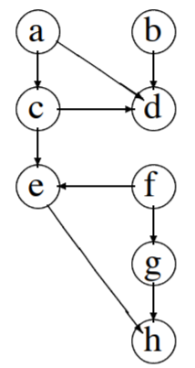
Application 2 – Topological Sort
Given a directed acyclic graph, want to output an ordering of vertices such that all edges are from an earlier vertex to a later vertex.
Idea: In a DFS, all the vertices that can
be reached from u will be reached.
Examine pre-order and post-order
Pre: a c e h d b f g
Post: h e d c a b g f
Output the inverse of post-order!

Slide 6
Breadth First Search
Visit neighbor first (before neighbor’s neighbor).
BFS_visit(u)
Mark u as visited
Put u into a queue
WHILE queue is not empty
Let x be the head of the queue
FOR all edges (x, y)
IF y has not been visited THEN
add y to the queue
Mark y as visited
Remove x from the queue
BFS
FOR u = 1 to n
BFS_visit(u)

Slide 7
Breadth First Search Tree
IF y is added to the queue while examining x, then
(x, y) is an edge in the BFS tree
1
1
2
3
2
3
4
4
5
5

Slide 8
BFS and Queue
BFS Order: The order that vertices enter (and exit) the queue
1
 | 2 | 3 | 4
 |  | 3 | 4 | 5
 |  |  | 4 | 5
 |  |  |  | 5
1
2
3
4
5

Slide 9
Application – Shortest Path
Given a graph, vertices (u, v), find the path between (u, v) that minimizes the number of edges.
Claim: The BFS tree rooted at u contains shortest paths to all vertices reachable from u.

Slide 10
Running Time of Graph Traversal Algorithms
For both BFS and DFS
  Enumerating all starting point takes O(n) time.
  In the recursive call/BFS_vsit, each edge is processed at most twice. This is O(m) time.
  Total running time = O(n+m)
For connected graphs: m > n - 2, so total running time is O(m).
If we just want to start at a fixed location, then the running time is also O(m).

