Slide 1
Lecture 16 Linear Program Duality

Slide 2
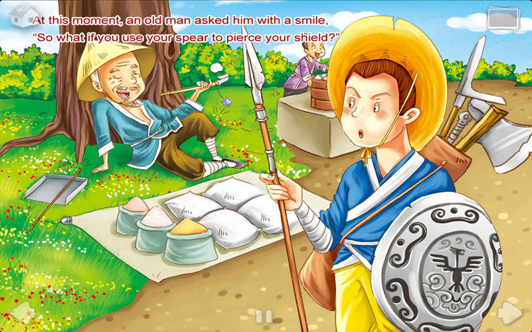
Duality

Slide 3
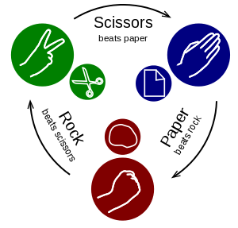
Two-Player Zero-sum Games
Game played with two competing players,
when one player wins, the other player loses.
Goal: Find the best strategy in the game

Slide 4
Game as a matrix
Can represent the game using a 2-d array
A[i, j] = if row player uses strategy i, column player uses strategy j, the payoff for the row player
Recall: payoff for the column player is - A[i, j]
 | R | P | S
R | 0 | -1 | 1
P | 1 | 0 | -1
S | -1 | 1 | 0

Slide 5
Pure Strategy vs. Mixed Strategy
Pure strategy: use a single strategy (correspond to a single row/column of the matrix)
Obviously not a good idea for Rock-Paper-Scissors.
Mixed strategy: Play Rock with probability p₁…
 | R | P | S
R | 0 | -1 | 1
P | 1 | 0 | -1
S | -1 | 1 | 0

Slide 6

Payoff of the game.
Let S_{row} be a mixed strategy for the row player, S_{col} be a mixed strategy for the column player.
Payoff for the row player:
$$P= 𝔼_{i∼S_{row}, j∼S_{col}}[A\left[i,j\right]]$$
 | 1 | 0 | 0
0.25 | 0 | -1 | 1
0.25 | 1 | 0 | -1
0.5 | -1 | 1 | 0

Slide 7


Solving two player games by LP
Try to use LP to find a good strategy for Duke.
 | A | B | C
A | 3 | 1 | -1
B | -2 | 3 | 2
C | 1 | -2 | 4

Slide 8
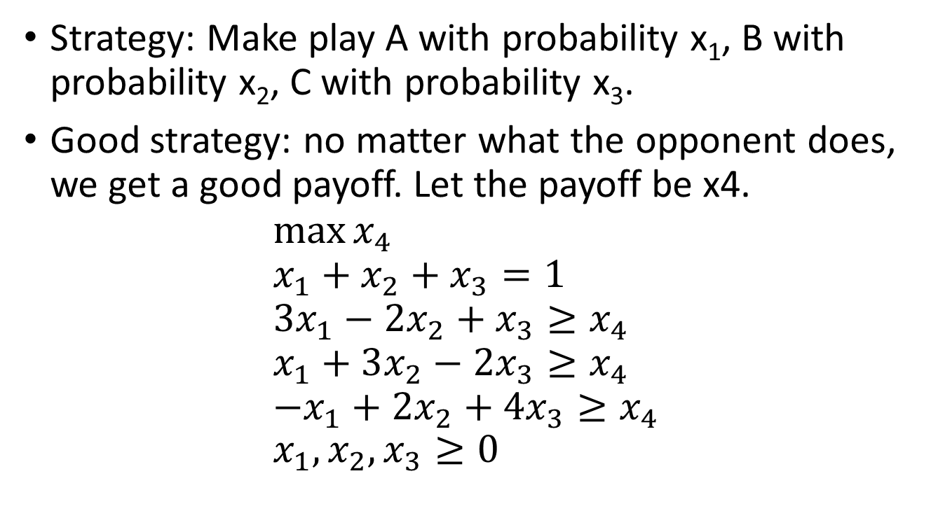
What is a good strategy for Duke?
 | A | B | C
A | 3 | 1 | -1
B | -2 | 3 | 2
C | 1 | -2 | 4
Strategy: Make play A with probability x₁, B with probability x₂, C with probability x₃.
Good strategy: no matter what the opponent does, we get a good payoff. Let the payoff be x4.
$$\max{x_{4}} \\ x_{1}+x_{2}+x_{3}=1 \\ 3x_{1}−2x_{2}+x_{3}≥x_{4} \\ x_{1}+3x_{2}−2x_{3}≥x_{4} \\ −x_{1}+{2x}_{2}+4x_{3}≥x_{4} \\ x_{1},x_{2},x_{3}≥0$$
Solution: (9,6,4,19)/19.

Slide 9
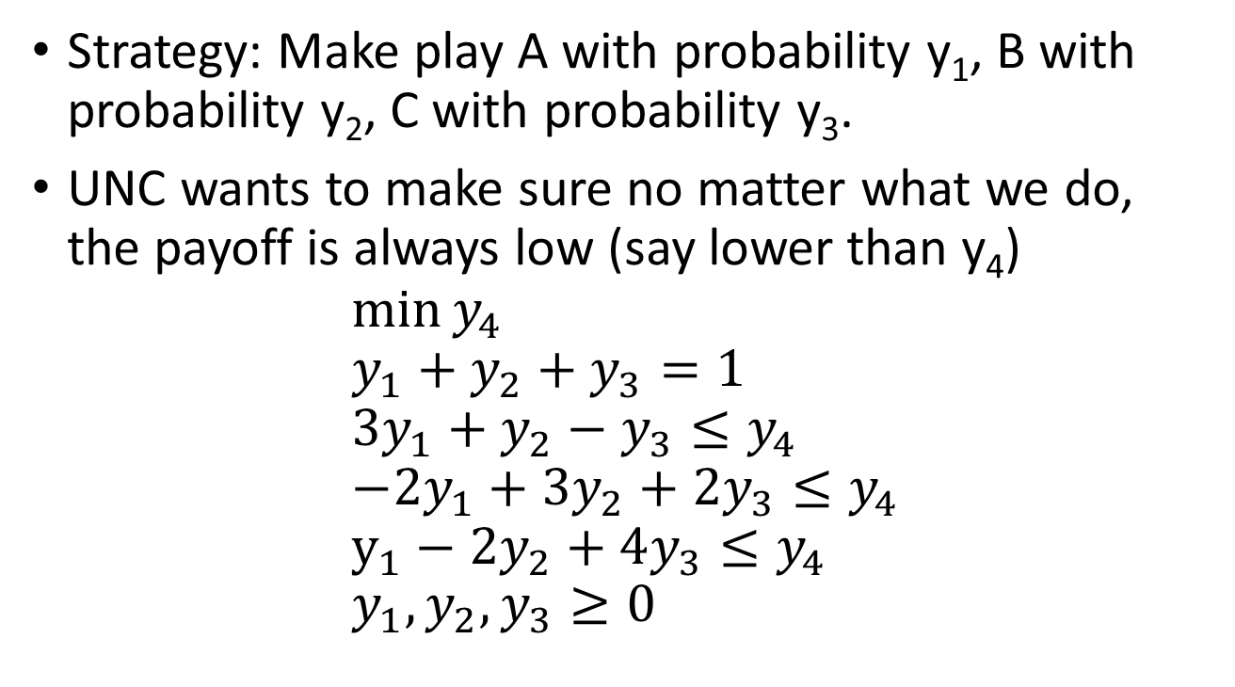
Duality: what would UNC do?
 | A | B | C
A | 3 | 1 | -1
B | -2 | 3 | 2
C | 1 | -2 | 4
Strategy: Make play A with probability y₁, B with probability y₂, C with probability y₃.
UNC wants to make sure no matter what we do, the payoff is always low (say lower than y₄)
$$\min{y_{4}} \\ y_{1}+y_{2}+y_{3}=1 \\ 3y_{1}+y_{2}−y_{3}≤y_{4} \\ −2y_{1}+3y_{2}+2y_{3}≤y_{4} \\ y_{1}−2y_{2}+4y_{3}≤y_{4} \\ y_{1},y_{2},y_{3}≥0$$
Solution: (1,1,1,3)/3.

Slide 10
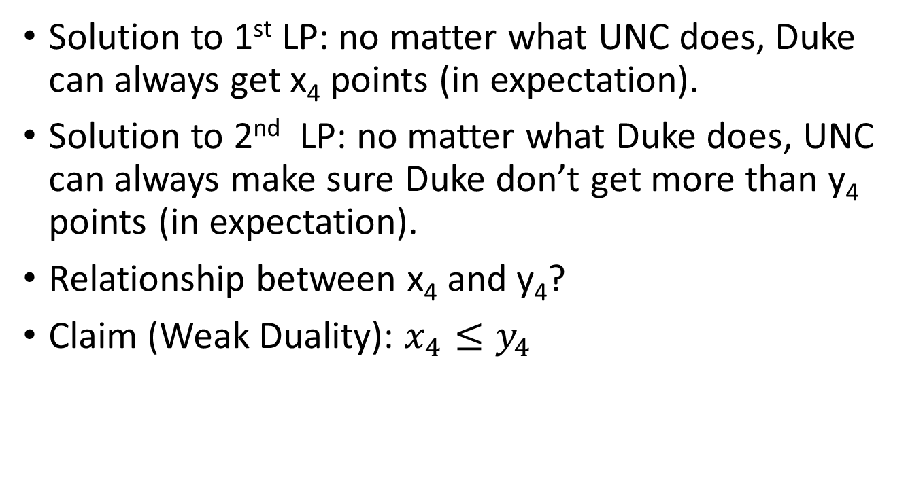
Comparing the Solution to two LPs
Solution to 1st LP: no matter what UNC does, Duke can always get x₄ points (in expectation).
Solution to 2nd LP: no matter what Duke does, UNC can always make sure Duke don’t get more than y₄ points (in expectation).
Relationship between x₄ and y₄?
Claim (Weak Duality): $x_{4}≤y_{4}$

Slide 11
Min-Max Theorem
Theorem [Von Neumann] For any two-player, zero-sum game, there is always a pair of optimal strategies and a single value V.
If the row player plays its optimal strategy, then it can guarantee a payoff of at least V.
If the column player plays its optimal strategy, then it can guarantee a payoff of at most V.
Corollary: The solution to the two LP must be equal.
(x₄=y₄)

Slide 12
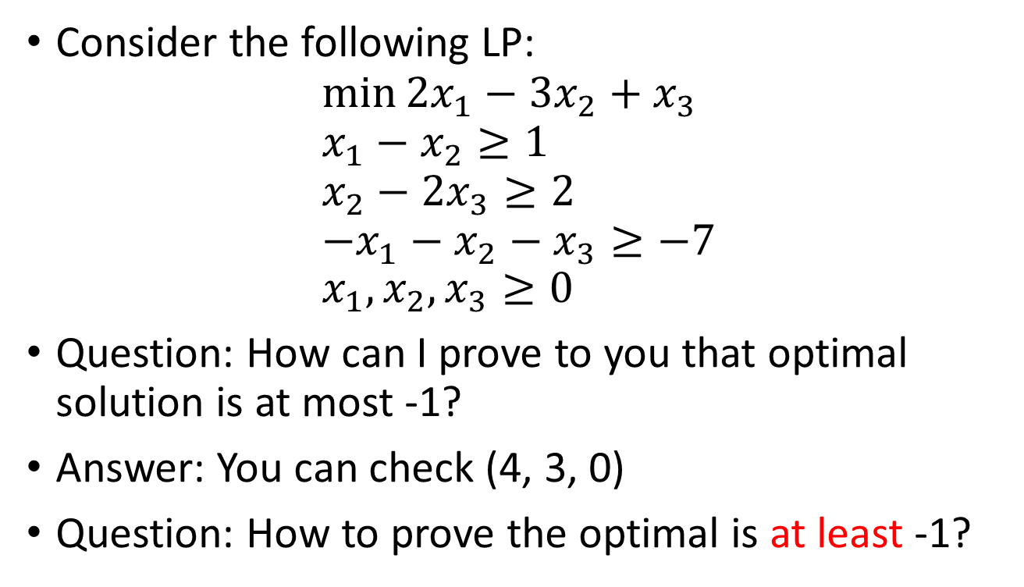
Duality for Linear Programs
Consider the following LP:
$$\min{2x_{1}−3x_{2}+x_{3}} \\ x_{1}−x_{2}≥1 \\ x_{2}−2x_{3}≥2 \\ −x_{1}−x_{2}−x_{3}≥−7 \\ x_{1},x_{2},x_{3}≥0$$
Question: How can I prove to you that optimal solution is at most -1?
Answer: You can check (4, 3, 0)
Question: How to prove the optimal is at least -1?

Slide 13
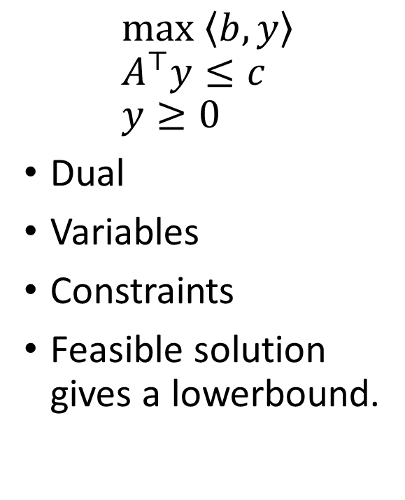
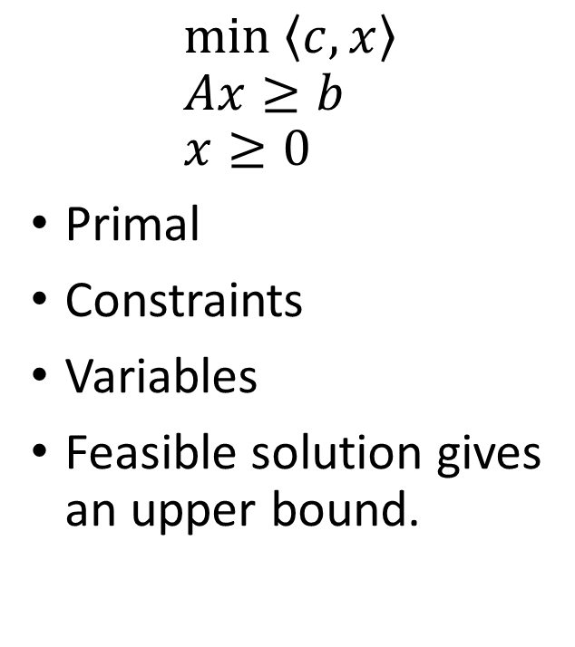
Dual LP
$$\min\left\langle c,x\right\rangle \\ Ax≥b \\ x≥0$$
Primal
Constraints
Variables
Feasible solution gives an upper bound.
$$\max\left\langle b,y\right\rangle \\ A^{⊤}y≤c \\ y≥0$$
Dual
Variables
Constraints
Feasible solution gives a lowerbound.
Strong Duality: The two LP has the same optimal value.

