Slide 1
Lecture 19 Randomized Algorithms

Slide 2

Randomized Algorithm
Algorithms that make use of random decisions.
Avoid worst-case of algorithms.
Note: Algorithm still works for all possible inputs.

Slide 3


Basic Probability - Recap
Random Variable: variable whose value depend on a random phenomenon.
X = 0 (tails) or 1 (heads)
with probability ½
X = 1, 2, 3, 4, 5, 6
with probability 1/6

Slide 4

Joint probabilities
X, Y result of two dice
Pr[X = 1, Y = 2] = 1/36
Independence
Pr[X = i, Y = j] = Pr[X = i]Pr[Y = j]
Let Z = X+Y
Pr[X = 1, Z = 8] = ? Pr[X = 2, Z = 7] = ?

Slide 5
Conditioning
What is the probability of X
given we already know value
of Y
If X = value of one die
Y = sum of two dice
Pr[X = 1|Y = 3] = ½ (2 cases (1,2), (2,1))
Pr[Y = 7|X = 5] = ??

Slide 6
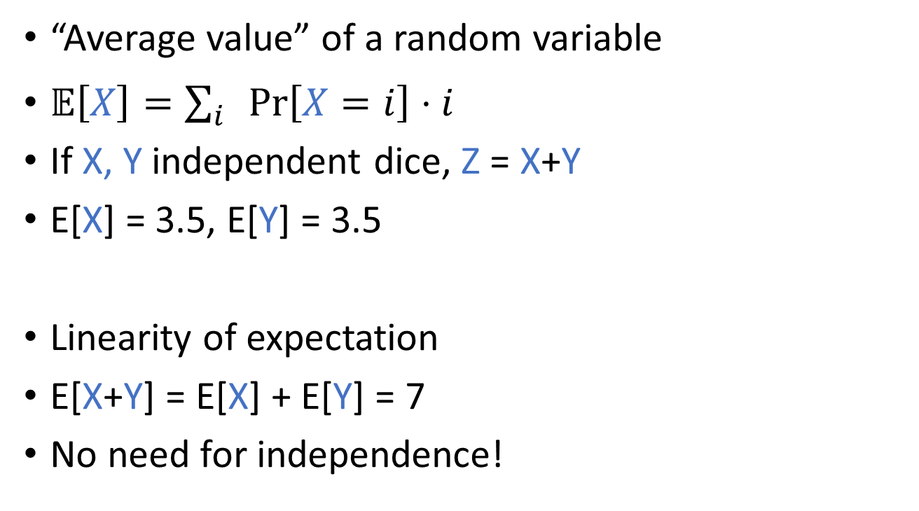
Expectation
“Average value” of a random variable
$𝔼\left[X\right]=\sum_{i}{\operatorname{Pr}\left[X=i\right]⋅i}$
If X, Y independent dice, Z = X+Y
E[X] = 3.5, E[Y] = 3.5
Linearity of expectation
E[X+Y] = E[X] + E[Y] = 7
No need for independence!

Slide 7
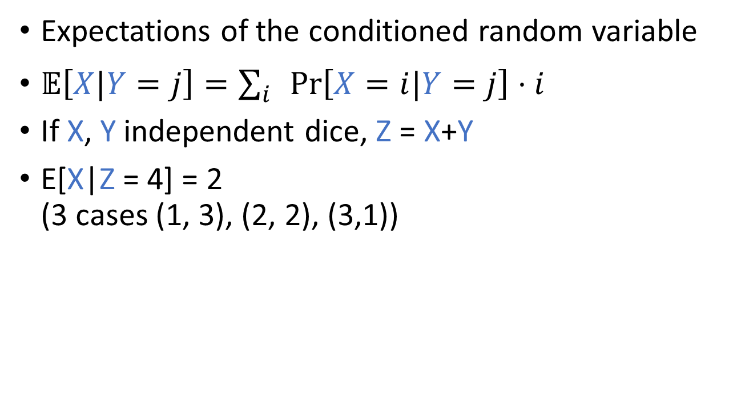
Conditional Expectations
Expectations of the conditioned random variable
$𝔼\left[X|Y=j\right]=\sum_{i}{\operatorname{Pr}\left[X=i|Y=j\right]⋅i}$
If X, Y independent dice, Z = X+Y
E[X|Z = 4] = 2
(3 cases (1, 3), (2, 2), (3,1))

Slide 8

Law of total expectations
$𝔼\left[X\right]=\sum_{j}{𝔼\left[X|Y=j\right]\operatorname{Pr}{[Y=j]}}$
Expected Running Time of ALG
Runtime of ALG after fixing the first decision
First Random Decision in ALG

Slide 9
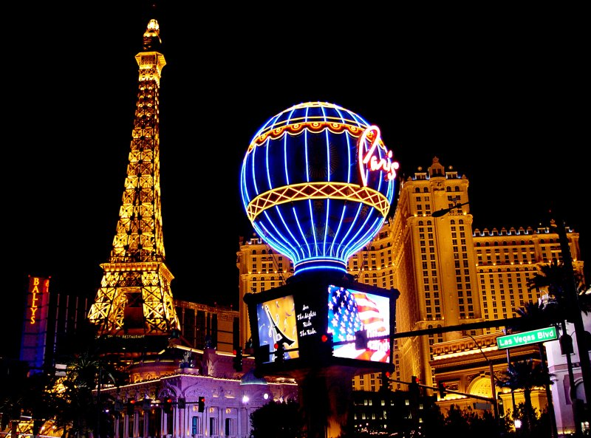
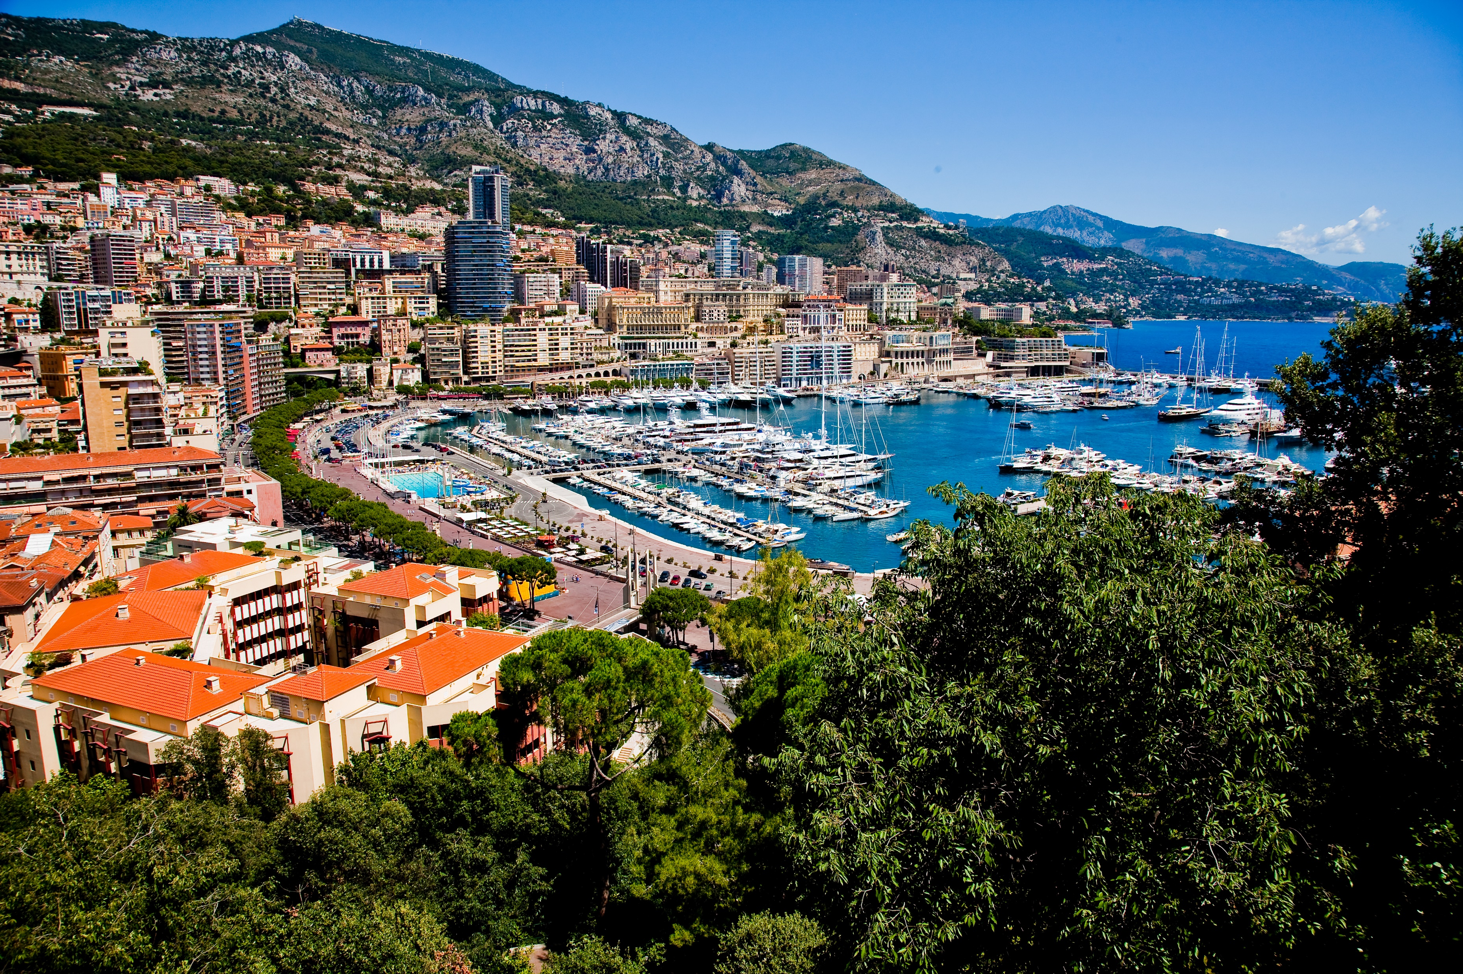
Las Vegas vs. Monte Carlo algorithms
Las Vegas Algorithm:
Always outputs the correct answer
Running time is random
Analysis: Compute expected running time.
Monte Carlo Algorithm:
Always run in a fixed amount of time.
Result may be incorrect.
Requirement: Result is correct with
probability at least 2/3.

Slide 10
Quicksort
Goal: Sort a list of numbers
a[] = {4, 2, 8, 6, 3, 1, 7, 5}
Algorithm:
Pick a random pivot number (say 3)
Partition the array into numbers smaller and larger than the pivot ({2, 1}, {4, 8, 6, 7, 5})
Recursively sort the two parts.

Slide 11
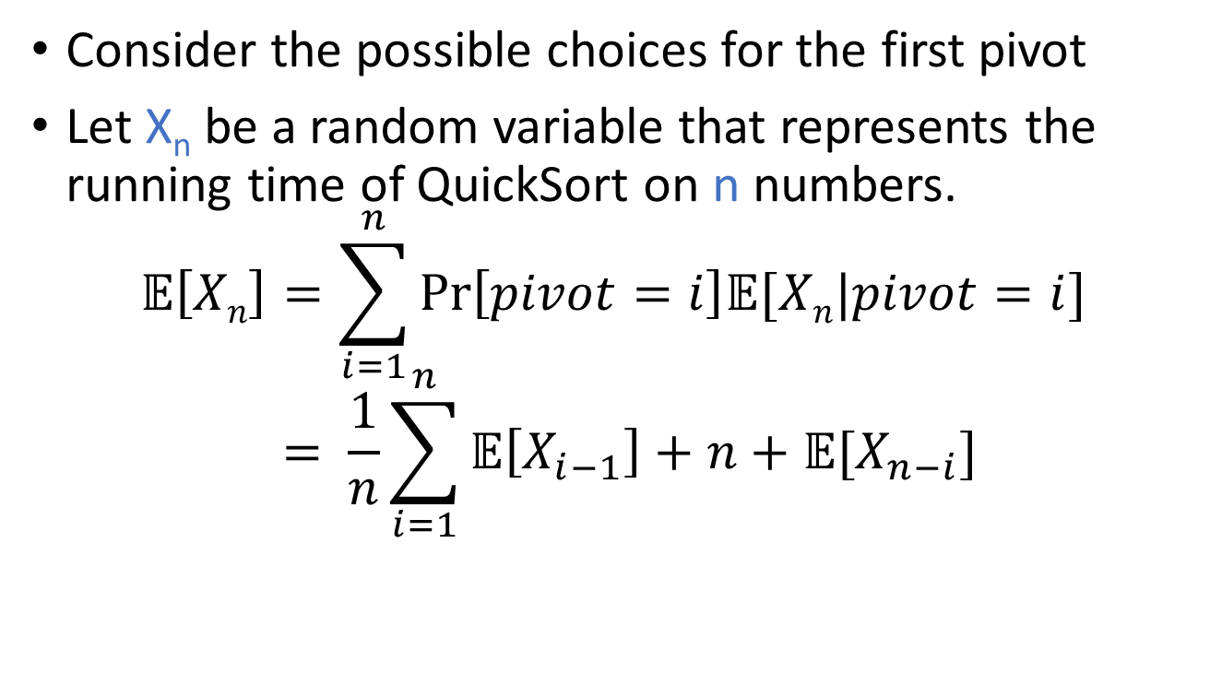
Recursion
Consider the possible choices for the first pivot
Let X_{n} be a random variable that represents the running time of QuickSort on n numbers.
$$𝔼\left[Xn\right]=\sum_{i=1}^{n}{\operatorname{Pr}\left[pivot=i\right]𝔼[Xn|pivot=i]} \\ = \frac{1}{n}\sum_{i=1}^{n}{𝔼\left[X_{i−1}\right]+n+𝔼[X_{n−i}]}$$
Left Part
Split cost
Right Part

