Slide 1
Lecture 20
Monte Carlo Algorithm
Hashing

Slide 2
QuickSelection
Goal: Given an array of numbers
Find the k-th smallest number.
Example:
a[] = {4, 2, 8, 6, 3, 1, 7, 5}
k = 3
Output = 3

Slide 3
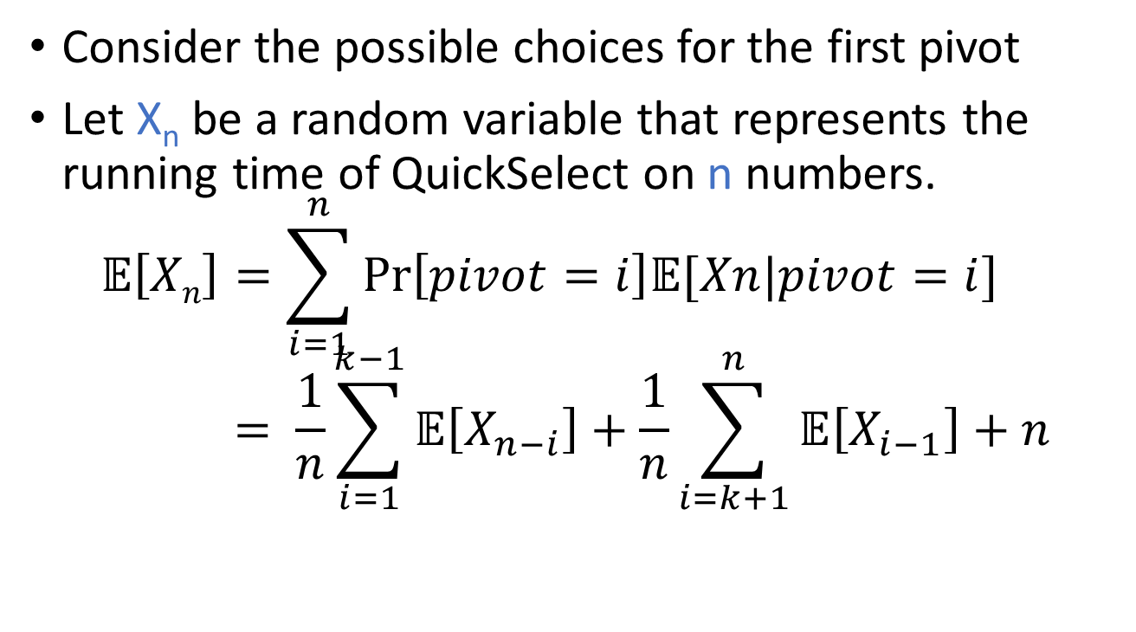
Recursion
Consider the possible choices for the first pivot
Let X_{n} be a random variable that represents the running time of QuickSelect on n numbers.
$$𝔼\left[Xn\right]=\sum_{i=1}^{n}{\operatorname{Pr}\left[pivot=i\right]𝔼[Xn|pivot=i]} \\ = \frac{1}{n}\sum_{i=1}^{k−1}{𝔼\left[X_{n−i}\right]}+\frac{1}{n}\sum_{i=k+1}^{n}{𝔼\left[X_{i−1}\right]}+n$$
Right Part
Left Part
Split cost

Slide 4
Monte Carlo Algorithm
Problem: Compute the area
of a circle.
Monte-Carlo algorithm
Count = 0
FOR i = 1 to n
Generate x, y from [-1,1]
IF x²+y² <= 1 THEN
Count = Count + 1
RETURN 4.0*Count/n

Slide 5
Variance
How far is a random variable from its expectation.
Var[X] = E[(X – E[X])²]
If X = 1 with probability p, and
X = 0 with probability 1-p
E[X] = p, Var[X] = p(1-p)
If X, Y independent, Var[X+Y] = Var[X] + Var[Y]

Slide 6
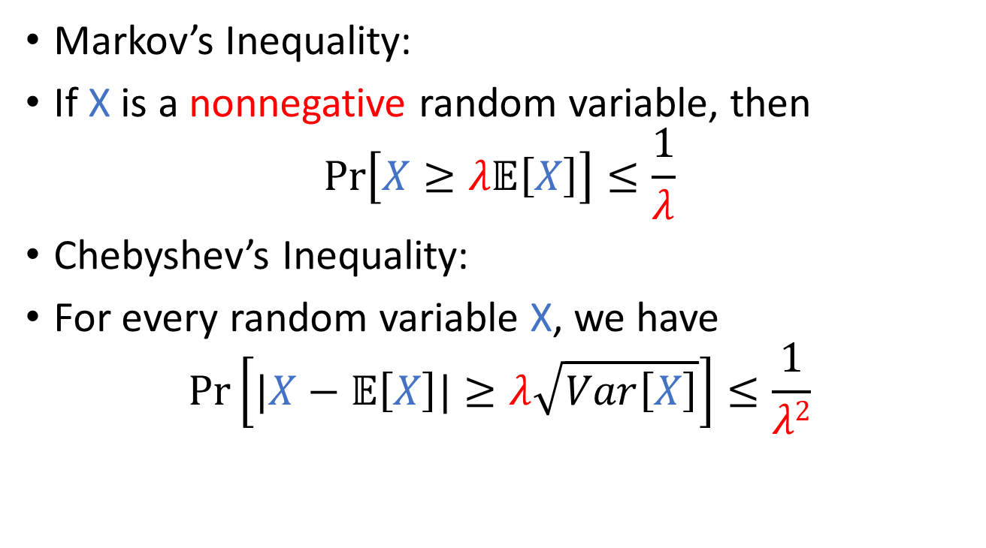
Markov/Chebyshev Inequality
Markov’s Inequality:
If X is a nonnegative random variable, then
$\operatorname{Pr}\left[X≥λ𝔼\left[X\right]\right]≤\frac{1}{λ}$
Chebyshev’s Inequality:
For every random variable X, we have
$\operatorname{Pr}\left[|X−𝔼\left[X\right]|≥λ\sqrt{Var\left[X\right]}\right]≤\frac{1}{λ2}$

Slide 7
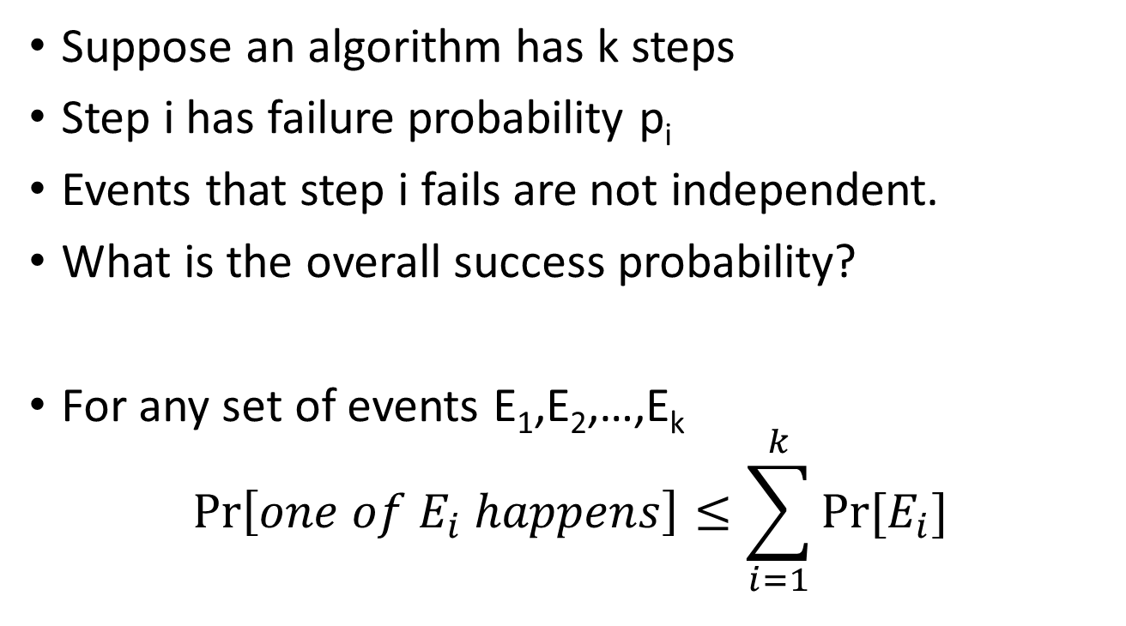
Union Bound
Suppose an algorithm has k steps
Step i has failure probability p_{i}
Events that step i fails are not independent.
What is the overall success probability?
For any set of events E₁,E₂,…,E_{k}
$$\operatorname{Pr}\left[one of E_{i} happens\right]≤\sum_{i=1}^{k}{\operatorname{Pr}{[E_{i}]}}$$

Slide 8
Hash Tables

Slide 9
Motivation: Set and Map
Goal: An array whose index can be any object.
Example: Dictionary
Dictionary[“hash”] = “a dish of diced or chopped meat and often vegetables…”
Properties:
1. Efficient lookup: Hope lookup is O(1)
2. Space: space is within constant factor to a list.
This lecture: maintain a set of numbers from
0 to N-1. N is very large (think N = 2³² or 2⁶⁴)

Slide 10
Motivation: Set and Map
Goal: An array whose index can be any object.
Example: Dictionary
Dictionary[“hash”] = “a dish of diced or chopped meat and often vegetables…”
Properties:
1. Efficient lookup: Hope lookup is O(1)
2. Space: space is within constant factor to a list.
This lecture: maintain a set of numbers from
0 to N-1. N is very large (think N = 2³² or 2⁶⁴)

Slide 11
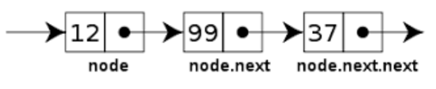
Naïve implementation of a set
Method 1: Maintain a linked list.
Problem: Lookup takes O(n) time.
Method 2: Use a large array
a[i] = 1 if i is in the set
Problem: Needs huge amount of memory.

Slide 12
Hashing
Idea: for each number, assign a random location
Example: {3, 10, 3424, 643523}
Store number i in a[f(i)]
f(i): hash function.

Slide 13
Collisions
Problem: want to add 123, f(123) = 4 = f(3424).
(This will always happen because of pigeon hole principle)
Solution: 123 and 3424 will share this location.
null | 10 | null | 3 | 3424 | null | null | null | null | 643523
123

Slide 14
Fixed Hash Function
If the hash function is fixed, then it can be very slow for some bad examples.
Example: We can try to find n numbers x₁, x₂, …, x_{n} such that f(x_{i}) = y for some fixed y
(always possible by pigeon hole principle)
Then hash table degenerates into a linked list.
Solution: Use a family of random hash functions.

Slide 15
When do we “randomly select” the hash function?
Idea 1: Choose a new hash function every time we make a query.
Does not work. We may store 123 at position 4 because f(123) = 4, but after we choose a new hash function, f’(123) may not be equal to 4.
Idea 2: Choose a random hash function when creating the hash table.
This makes sure we can access the numbers consistently, need to consider this in analysis.

Slide 16
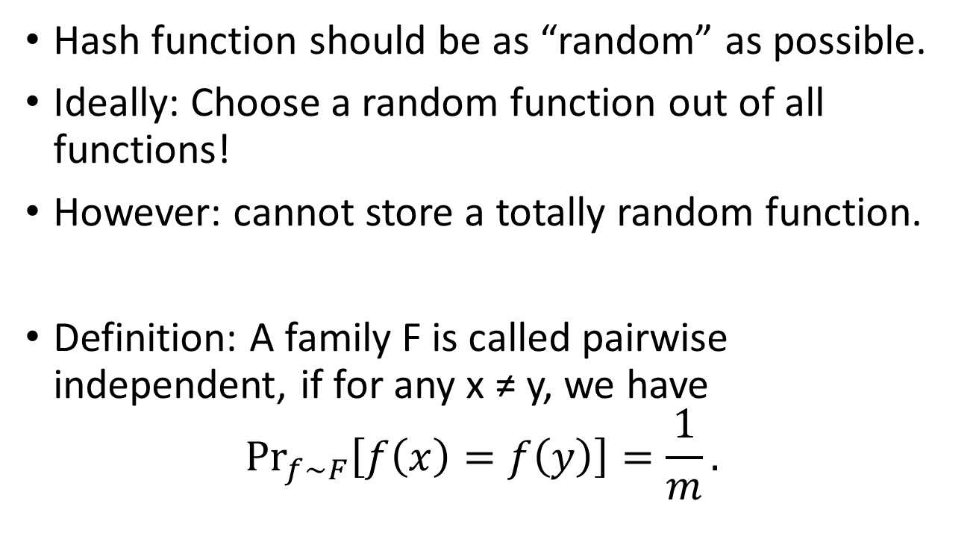
Universal Hash Function
Hash function should be as “random” as possible.
Ideally: Choose a random function out of all functions!
However: cannot store a totally random function.
Definition: A family F is called pairwise independent, if for any x ≠ y, we have
${Pr}_{f∼F}\left[f\left(x\right)=f\left(y\right)\right]=\frac{1}{m}.$

