Slide 1
Lecture 24 Amortized Analysis

Slide 2
“Amortized”
verb (used with object), amortized, amortizing.
1. Finance.
to liquidate or extinguish (a mortgage, debt, or other obligation), especially by periodic payments to the creditor or to a sinking fund.
to write off a cost of (an asset) gradually.
Definition from Dictionary.com

Slide 3
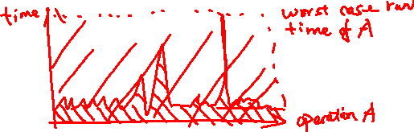
Amortized Analysis in Algorithms
Scenario: Operation A is repeated many times in an algorithm.
In some cases, Operation A is very fast.
In some other cases, Operation A can be very slow.
Idea: If the bad cases don’t happen very often, then the average cost of Operation A can still be small.

Slide 4
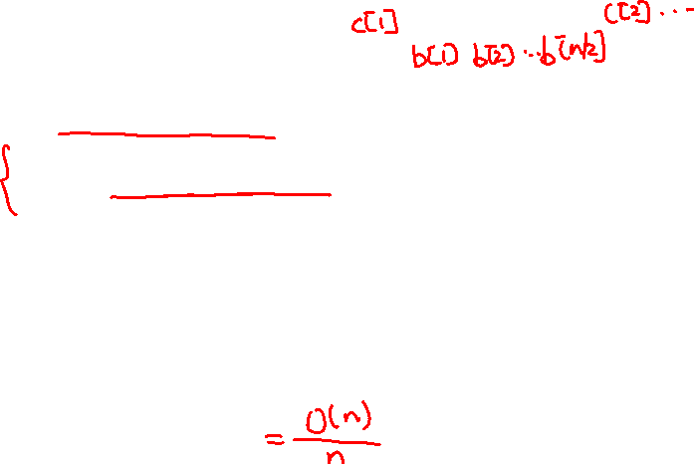
Amortized Analysis in disguise
MergeSort
For each iteration, steps 4-5 can take different time
Worst case: O(n) per iteration ➔ O(n²)?
The total amount of time 4-5 can take is O(n).
“Amortized Cost” = O(1)
Merge(b[], c[])
a[] = empty
i = 1
FOR j = 1 to length(c[])
WHILE b[i] < c[j]
a.append(b[i]); i = i+1
a.append(c[j]); j = j+1
RETURN a[]

Slide 5
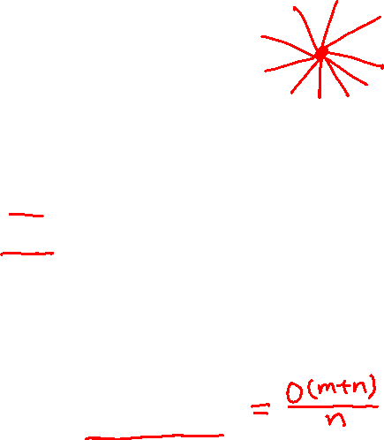
Amortized Analysis in disguise
DFS
For each vertex, the number of edges can be different.
If a graph has m = 5n edges, and there is one vertex connected to n/2 other vertices.
Worst case for a vertex: O(n) ➔ O(n²)?
No: the total amount of time is proportional to the number of edges.
“Amortized Cost” = O(m/n + 1)

Slide 6
Dynamic Array problem
Design a data-structure to store an array.
Items can be added to the end of the array.
At any time, the amount of memory should be proportional to the length of the array.
Example: ArrayList in java, vector in C++
Goal: Design a data-structure such that adding an item has O(1) amortized running time.

Slide 7
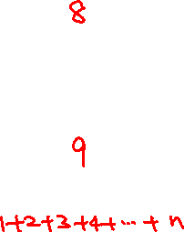
Why naïve approach does not work
a
1 | 2 | 3 | 4 | 5 | 6 | 7
a.add(8)
1 | 2 | 3 | 4 | 5 | 6 | 7 | 8
Need to allocate a new piece of memory,
copy the first 7 elements and add 8.
a.add(9)
1 | 2 | 3 | 4 | 5 | 6 | 7 | 8 | 9
Need to allocate a new piece of memory,
copy the first 8 elements and add 9.
Running Time for n add operation = O(n²)!
Amortized cost = O(n²)/n = O(n)

Slide 8

Designing the Data-Structure
We don’t want to allocate new memory every time.
Idea: when allocating new memory, allocate a larger space.
Init()
capacity = 1
length = 0
allocate an array a[] of 1 element
Add(x)
IF length < capacity THEN
a[length] = x
length = length+1
ELSE
capacity = capacity * 2
allocate a new array a[] of capacity elements
copy the current array to the new array
a[length] = x
length = length+1

Slide 9
How to Analyze?
There are 3 basic techniques to analyze the amortized cost of operations.
Aggregate Method
Accounting (charging) method
Potential Argument

Slide 10
Aggregate Method
Idea: Compute the total cost of n operations, divide the total cost by n.
What’s used in analyzing MergeSort and DFS.
Aggregate method for Dynamic Array: how many operations are needed for adding n numbers?

Slide 11
Accounting (charging) method
Idea: Small number of expensive operations, many normal operations
➔ If every normal operation pays a little bit extra, that can be enough to pay for the expensive operations.
Major step: Design a way of “charging” the expensive operations to the normal operations.

Slide 12
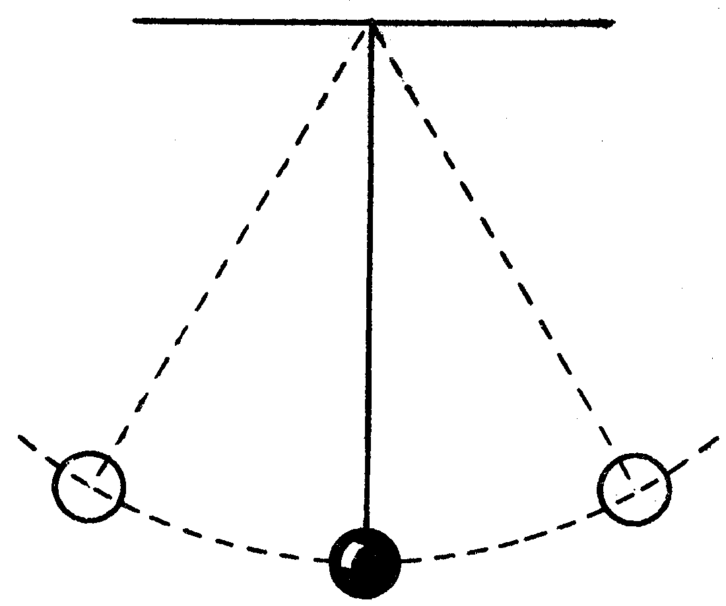

Potential Argument
Recall: Law of physics

Slide 13
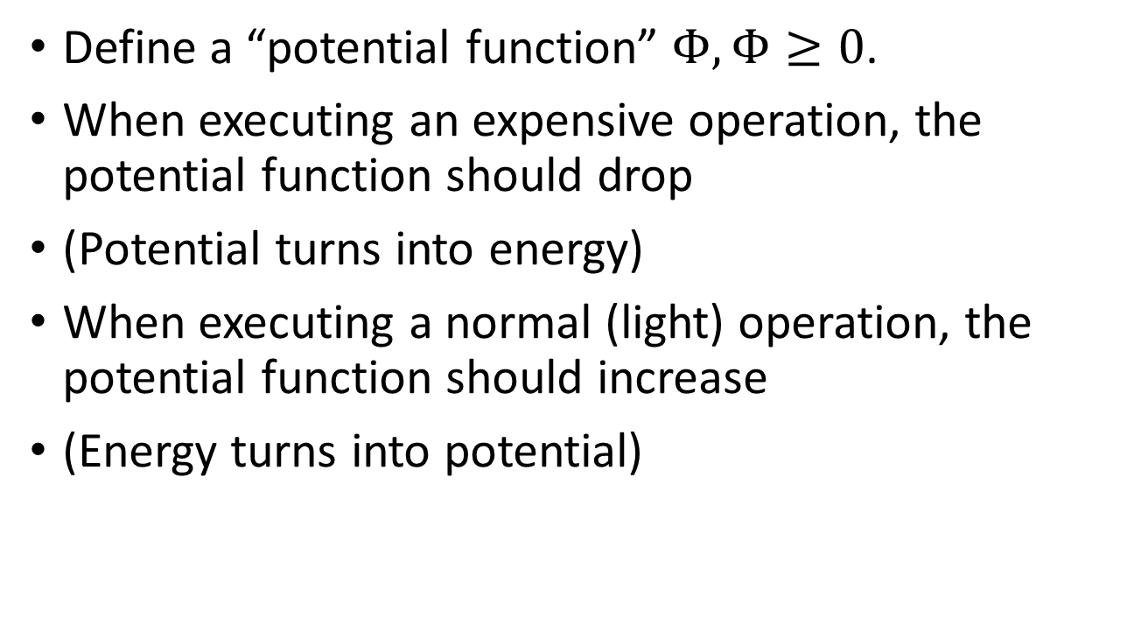
Potential Argument
Define a “potential function” $Φ,Φ≥0$.
When executing an expensive operation, the potential function should drop
(Potential turns into energy)
When executing a normal (light) operation, the potential function should increase
(Energy turns into potential)

Slide 14
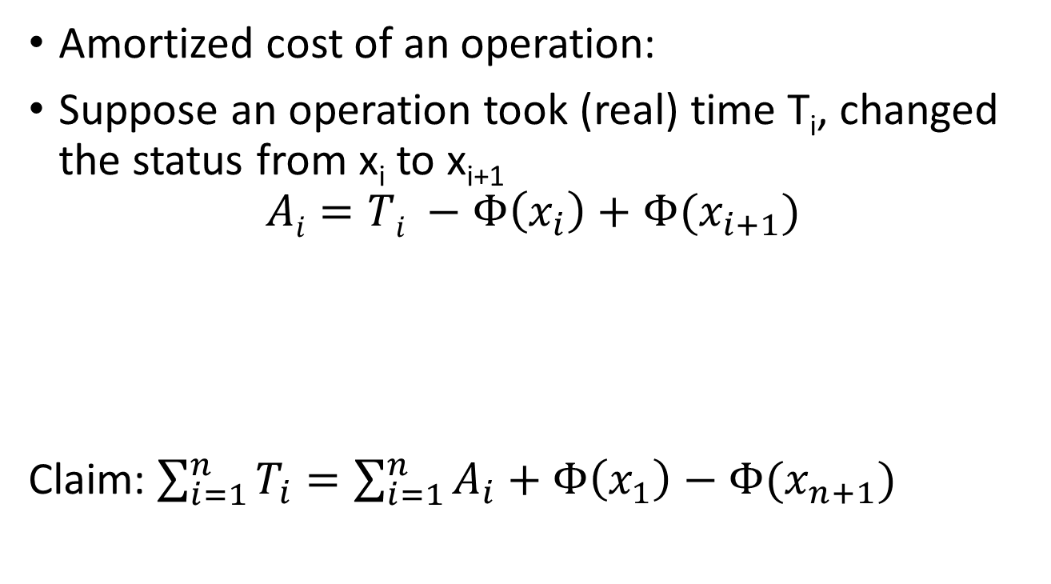
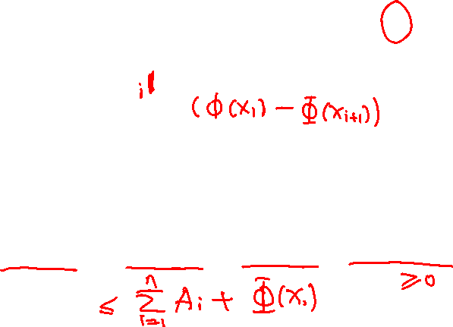
Potential Argument
Amortized cost of an operation:
Suppose an operation took (real) time T_{i}, changed the status from x_{i} to x_{i+1}
$$Ai=Ti −Φ\left(x_{i}\right)+Φ(x_{i+1})$$
Claim: $\sum_{i=1}^{n}{T_{i}}=\sum_{i=1}^{n}{A_{i}}+Φ\left(x_{1}\right)−Φ(x_{n+1})$
Amortized Cost
Real Cost
Potential Before
Potential After

Slide 15
Comparison between 3 methods
Aggregate method
  Intuitive
  Does not work very well if there are multiple operations
  (e.g. stack: push/pop; heap: insert/pop/decrease key)
Charging Method
  Flexible (you can choose what operations to charge on and how much to charge)
  Needs to come up with charging scheme
Potential Method
  Very flexible
  Potential function is not always easy to come up with.

Slide 16
Exam Details
5 Problems 20 points each
P1 will be warm-up, run graph algorithms/maybe some simple probability calculation
(I expect almost everyone can solve this).
P2 will be an algorithm design question (DP/Greedy)
P3 will be a graph algorithm question (DFS/BFS/Shortest Path/Spanning Tree)
P4 will ask you to write a linear program
P5 will ask you to do a reduction

