Slide 1
Lecture 3: Divide and Conquer

Slide 2
Example 3 Integer Multiplication
Input: two positive integers a, b
Output: a×b
What if a = 73489553479834257983745 and
b = 197878967893267834267324789?
Naïve algorithm: O(n²) time
(learned in elementary school)
?
multiply(a, b)
RETURN a*b

Slide 3
Divide and Conquer
a = 123,456 b = 654,321
How to divide?
Write a = 123,000 + 456, b = 654,000 + 321.
Then
a*b = 123*654*10⁶ + (123*321+456*654)*10³
+ 456*321.

Slide 4
First attempt
Partition a = a1*10^{n/2}+a2, b = b1*10^{n/2}+b2
Recursively compute A = a1*b1, B = a2*b1,
C = a1*b2, D = a2*b2
Output A*10^{n}+(B+C)*10^{n/2}+D
Multiply(a, b)
(wlog assume n = length(a) = length(b), pad 0 for the shorter number)
IF Length(a) <= 1 THEN RETURN a*b
Partition a into a = a1 * 10^{n/2}+a2, b = b1*10^{n/2}+b2
A = Multiply(a1, b1)
B = Multiply(a2, b1)
C = Multiply(a1, b2)
D = Multiply(a2, b2)
RETURN A*10^{n}+(B+C)*10^{n/2} + D
Need an algorithm for adding long numbers. Standard algorithm suffices (O(n))

Slide 5
Improving the algorithm
To make a divide and conquer algorithm faster
Make the merging step faster
Make the sub-problems smaller
Reduce the number of sub-problems
Observation:
(a1*b2+a2*b1) = (a1+a2)*(b1+b2) – a1*b1 – a2*b2

Slide 6
Improved Algorithm
Partition a = a1*10^{n/2}+a2, b = b1*10^{n/2}+b2
Recursively compute A = a1*b1, B = a2*b2,
C = (a1+a2)*(b1+b2)
Output A*10^{n}+(C-A-B)*10^{n/2}+B
Multiply(a, b)
(wlog assume n = length(a) = length(b), pad 0 for the shorter number)
IF Length(a) <= 1 THEN RETURN a*b
Partition a into a = a1 * 10^{n/2}+a2, b = b1*10^{n/2}+b2
A = Multiply(a1, b1)
B = Multiply(a2, b2)
C = Multiply(a1+a2, b1+b2)
RETURN A*10^{n}+(C-A-B)*10^{n/2} + B

Slide 7
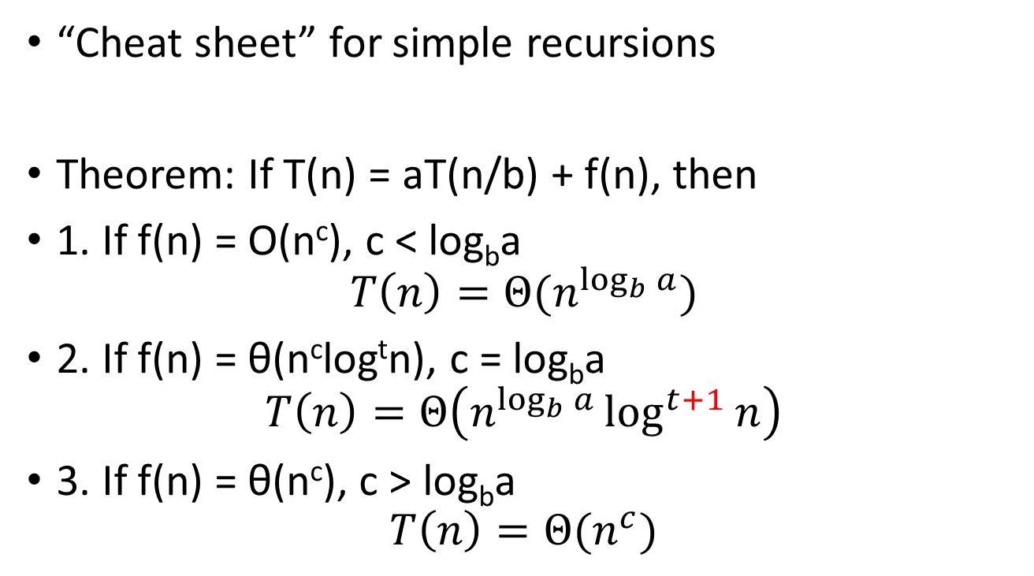
Master Theorem
“Cheat sheet” for simple recursions
Theorem: If T(n) = aT(n/b) + f(n), then
1. If f(n) = O(n^{c}), c < log_{b}a
$T\left(n\right)=Θ(n^{\log_{b}{a}})$
2. If f(n) = θ(n^{c}log^{t}n), c = log_{b}a
$$T\left(n\right)=Θ\left(n^{\log_{b}{a}}\log^{t+1}{n}\right)$$
3. If f(n) = θ(n^{c}), c > log_{b}a
$$T\left(n\right)=Θ(n^{c})$$

Slide 8
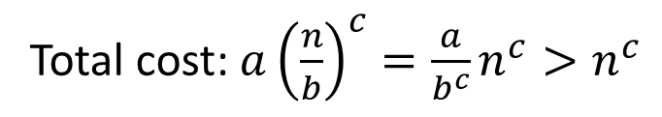
Understanding Master’s Theorem
Case 1, If f(n) = O(n^{c}), c < log_{b}a
n^{c}
(n/b)^{c}
(n/b)^{c}
……
(n/b)^{c}
a nodes of size n/b each
Total cost: $a{\left(\frac{n}{b}\right)}^{c}=\frac{a}{b^{c}}n^{c}>n^{c}$

Slide 9
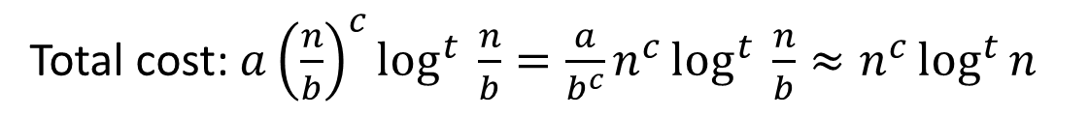
Understanding Master’s Theorem
Case 2, If f(n) = θ(n^{c}log^{t}n), c = log_{b}a
n^{c}log^{t}n
(n/b)^{c}log^{t}(n/b)
……
(n/b)^{c}log^{t}(n/b)
Total cost: $a{\left(\frac{n}{b}\right)}^{c}\log^{t}{ \frac{n}{b}}=\frac{a}{b^{c}}n^{c}\log^{t}{ \frac{n}{b}}≈n^{c}\log^{t}{n}$

Slide 10
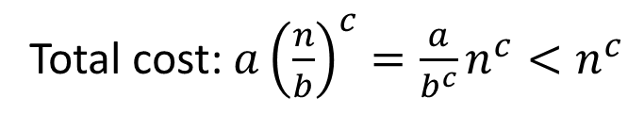
Understanding Master’s Theorem
Case 3, If f(n) = O(n^{c}), c > log_{b}a
n^{c}
(n/b)^{c}
(n/b)^{c}
……
(n/b)^{c}
a nodes of size n/b each
Total cost: $a{\left(\frac{n}{b}\right)}^{c}=\frac{a}{b^{c}}n^{c}<n^{c}$

Slide 11
Useful Facts about Log
log ab = log a + log b
log_{a}b = (log b) / (log a)
log a^{b} = b log a
a^(log_{b} c) = c^(log_{b} a)
  (easy to see if you take log b on both sides)
  ➔ (log_{b} a) (log_{b} c) = (log_{b} c) (log_{b} a)

