Slide 1
Anycast Networks
Shane (Xiao) Zhang
Bruce Maggs

Slide 2
Message distribution modes
Unicast
Broadcast
Multicast
Anycast

Slide 3

Unicast
The most common scenario
Message sent from one host to another
Example:
  ssh to a server
  Request a web page

Slide 4

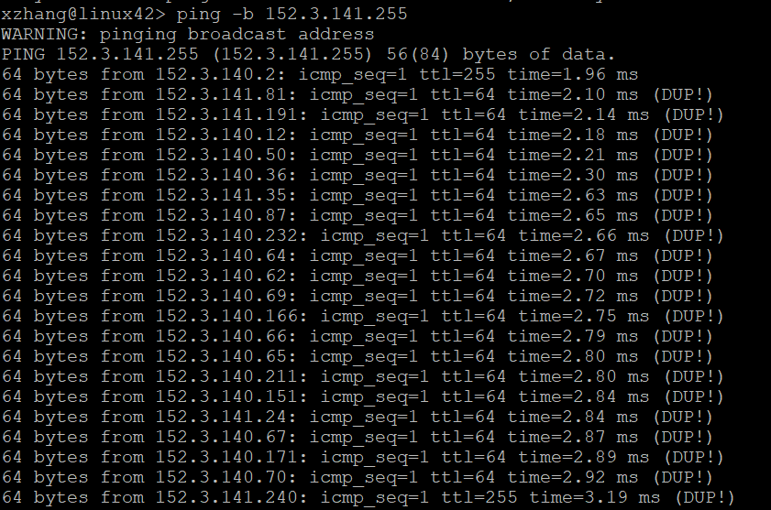
Broadcast
Usually used within a broadcast domain (i.e., local area network)
Examples
  DHCP discover message
  Broadcast ping with –b

Slide 5

Multicast
Send a message or a stream of messages to a specific group of hosts that subscribe to a multicast address
Typically used within a broadcast domain (i.e., within a local area network)
Protocol allows multicast across IP networks, but network operators don’t enable it. Why?
On a routed network, routers may create replicas of packets and send them to multiple destinations
Example
  IPTV
  OSPF Link-State Advertisements (LSAs) sent to special multicast IP addresses, e.g., 224.0.0.5 (all OSPF routers)

Slide 6
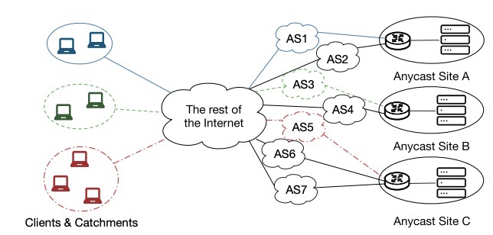
IP Anycast
Multiple sites share the same IP address
A datagram is routed to one of the sites
Site selected by routing policy
Only two entities are involved in the communication

Slide 7
Sites
Servers with a common IP address that provide identical services from different locations
  Each site might be just one single server
  Or could be a cluster with a load-balancer
Example services
  DNS
  CDN
  DDoS protection

Slide 8

How to build an Anycast System
Anycast Site A
Anycast Site B
Anycast Site C
Obtain a valid IP prefix and AS number
Peer with one or more ISPs that will readvertise the prefix
Announce the prefix from routers at different sites
Announce
23.1.0.0/24
Announce
23.1.0.0/24
Announce
23.1.0.0/24
A’s catchment
C’s catchment
B’s catchment

Slide 9
Potential Advantages of Anycast
If all goes well, a client’s traffic will be directed to a nearby site
More sites may result in better performance and more capacity
Anycast doesn’t require multiple rounds of DNS-resolution to direct clients to servers
Anycast avoids the need to decide which site to send each client or nameserver to

Slide 10
Anycast Applications
DNS
CDNs
DDOS protection

Slide 11
DNS applications
Authoritative name servers
  Root name servers, authorities for the root domain .
  a.root-server.net, b.root-server.net, …, m.root-server.net
  Top-level domain (TLD) name servers, authorities for .com, .net, .org, etc.
  Akamai (and other CDN) top-level name servers
Open resolving nameservers
  8.8.8.8 Google
  1.1.1.1 Cloudflare
https://root-servers.org/

Slide 12
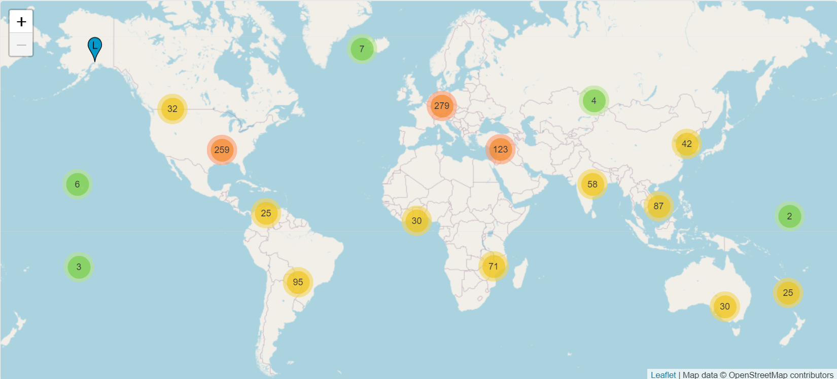
Root server physical locations
https://root-servers.org/ (Go to this page and click on circles)

Slide 13
CDN Application (Cloudflare)
Cloudflare and (for full-site delivery) customer domain names resolve to anycast addresses
E.g., 103.21.244.0/22 (see https://www.cloudflare.com/ips/)
Unlike Akamai CDN, doesn’t use DNS-based redirection
DNS response doesn’t depend on client or client’s resolving name server IP address

Slide 14
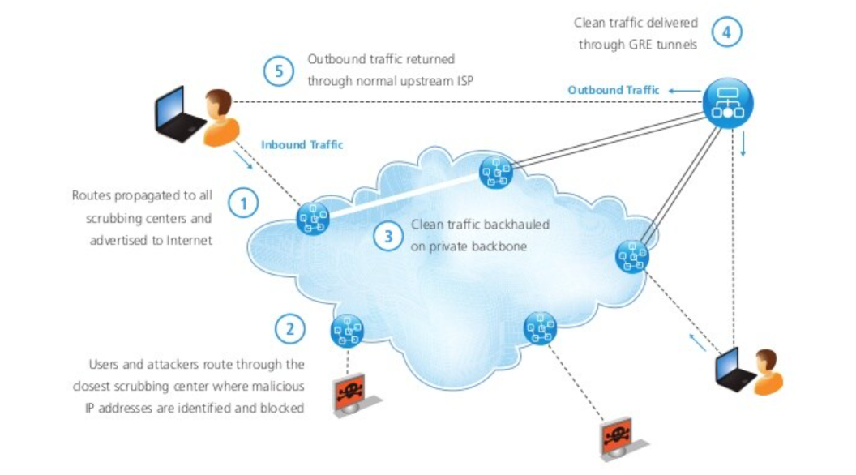
Prolexic-Anycast DDoS Mitigation System
Triangular routing: client → scrubber → server → client

Slide 15
Potential Problems with Anycast
Client’s traffic not always sent to a nearby site
  Routing policy is not designed to choose the nearest site
  Routers can’t distinguish the shortest route among several candidates anyway
Different datagrams in a TCP connection might be directed to different anycast instances
  Selecting ECMP (equal-cost multipath) paths based on 4-tuple (source address, source port, destination address, destination port) alleviates this problem
  Long-lived connections are vulnerable to route changes

Slide 16
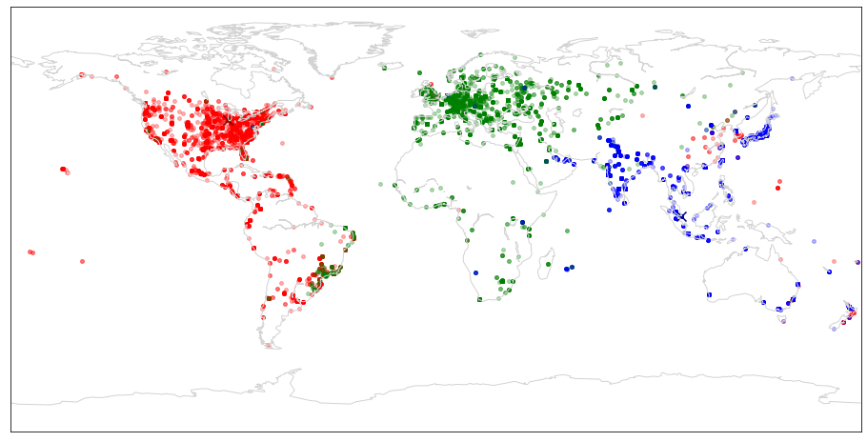





Ideal anycast behavior
Ideal avg RTT 62 ms
Anycast Site
Client
A three-site deployment: Chicago, London, and Singapore
Notes:
Ideally, we expect that clients will reach the closest anycast site so as to minimize the latency between a client and a service. For example, in this picture, we deploy a service at three anycast sites. One in Chicago, one in London and one in Singapore. (show animation of three anycast sites only).
Ideally, this is what we want the catchment to look like, each client reaches its closest site, as shown by the different colored dots.
CL
If the catchment follows this ideal distribution, the average client round trip time to their catchment sites will be only 62ms.

Slide 17
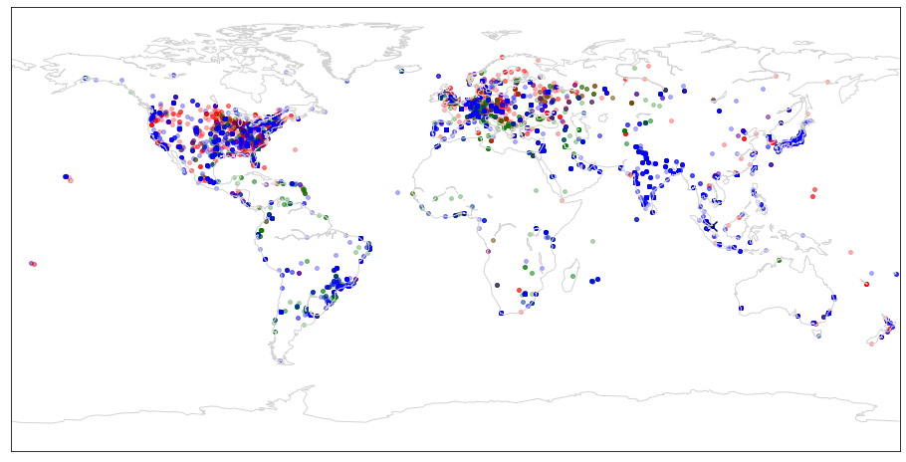
IP anycast does not minimize latency
Ideal avg RTT 62 ms
Actual avg RTT 133 ms
Clients reach far-away sites
Notes:
However, this pictures shows what the actual catchments look like. Clients do not necessarily reach their closest sites. Many clients in America and Europe reach the site in Singapore.
CL
the average client round trip time to an anycast site reaches 133ms in this case, which is more than twice as the ideal case.

Slide 18
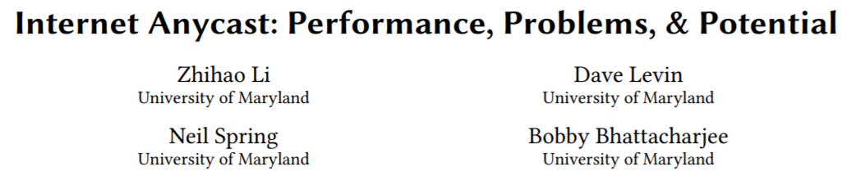
Measuring distance to root servers
D-root server service logs
  Contain the IP addresses of clients
RIPE Measurement Trace
  Use DNS CHAOS query to determine catchments
  CHAOS query can retrieve a site- and prefix-specific ID text
  9000 probes, 180 countries and 3587 ASes
  Measure 9 out of 13 DNS root servers

Slide 19
CHAOS Query
dig @199.7.91.13 CH TXT hostname.bind. chaos
;; Warning, extra class option
; <<>> DiG 9.11.3-1ubuntu1.9-Ubuntu <<>> @199.7.91.13 CH TXT hostname.bind. chaos
; (1 server found)
;; global options: +cmd
;; Got answer:
;; ->>HEADER<<- opcode: QUERY, status: NOERROR, id: 14509
;; flags: qr rd; QUERY: 1, ANSWER: 1, AUTHORITY: 0, ADDITIONAL: 1
;; WARNING: recursion requested but not available
;; OPT PSEUDOSECTION:
; EDNS: version: 0, flags:; udp: 1450
;; QUESTION SECTION:
;hostname.bind. CH TXT
;; ANSWER SECTION:
hostname.bind. 0 CH TXT "abva1.droot.maxgigapop.net"
;; Query time: 12 msec
;; SERVER: 199.7.91.13#53(199.7.91.13)
;; WHEN: Fri Oct 18 14:39:05 EDT 2019
;; MSG SIZE rcvd: 81
Notes:
Chaos query can distinguish different anycast replicas

Slide 20
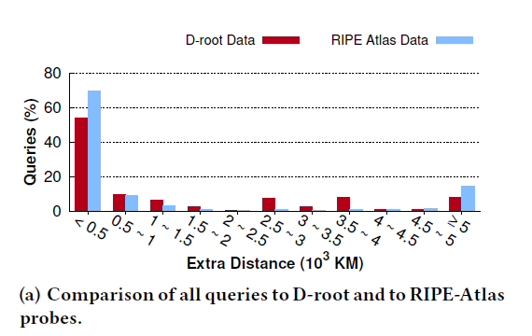
Result
Use geographical distance to evaluate the performance
Over 1/3 D-root queries travels 1000 km further

Slide 21
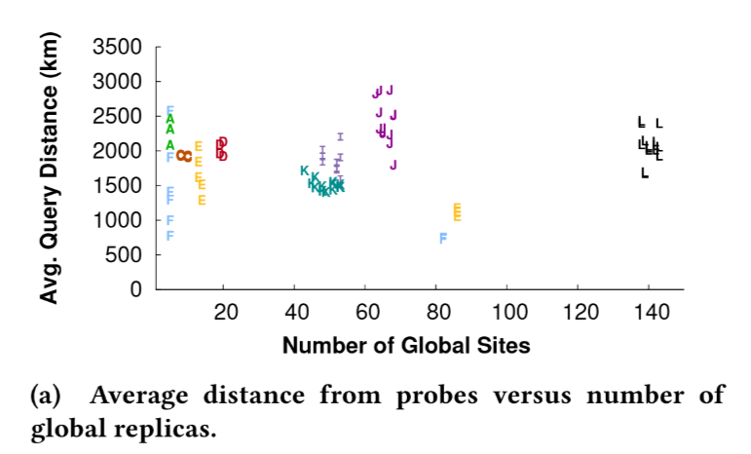
More replicas do not guarantee the improvement of performance
Each point represents one week of data.

Slide 22
Proposed Solution: Add Geographical Hints to BGP
Use Community Number (Key:Value like)
  16bit:16bit
  First 16bit usually is the AS number
  Last 16bit 7bit(Latitude) + 9bit(Longitude)
Each router chooses the nearest path based on:
  BGP’s geographical hits and
  Router’s geographical location

Slide 23
MPLS-based Anycast Optimization
A Practical Architecture for an Anycast CDN
Alzoubi et al. [ToW’11][WWW’08]
A practical and proactive way to optimize performance for a “single-homed” anycast network

Slide 24
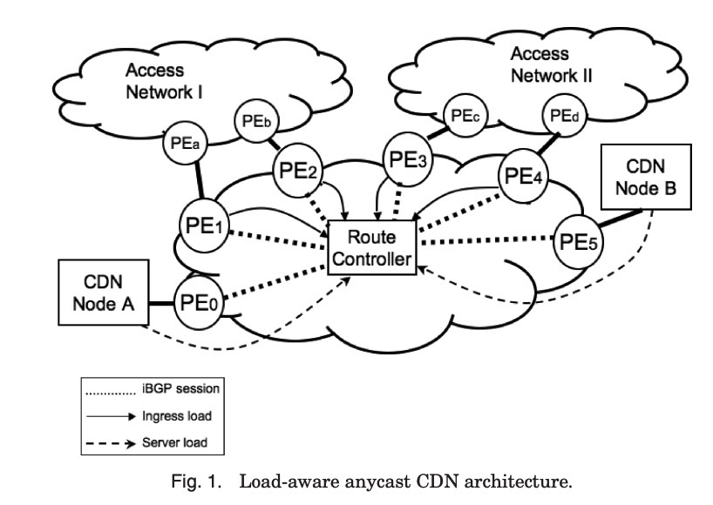
MPLS-based Anycast Optimization
For load-balancing purposes, redirect traffic from different PEs to different CDN nodes with MPLS tunnels
Notes:
PE provider’s edge router

Slide 25
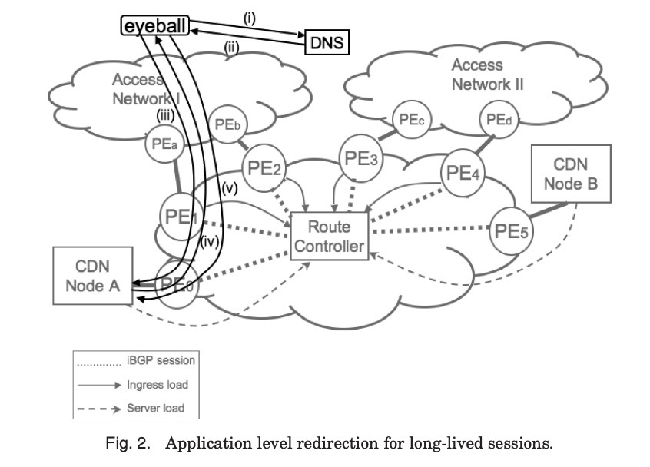
For large objects, redirect connection to unicast address

