Slide 1
P4
Programming Protocol-Independent Packet Processors
Slides based on materials from Laurent Vanbever and Jennifer Rexford, as modified by Anja Feldmann and Bala Chandrasekaran, and now Bruce Maggs.

Slide 2
SDN Recap
Key Idea: physically separate control plane from data plane
  Switches and controller communicate via standardized API (e.g., OpenFlow)
  Switches report events to controller
  Controller installs match-action rules in switch forwarding tables
Logically-centralized controller
(Slow but smart)
OpenFlow
(API)
Switches

Slide 3
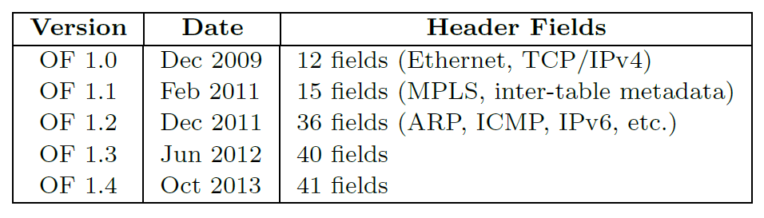
OpenFlow Recognized Header Fields
OpenFlow API recognizes header fields for specific protocols
The standard started growing more and more complex
Custom protocols and actions are not supported
P4: Programming Protocol-Independent Packet Processors, P. Bosshart, D. Daly, G. Gibb, M. Izzard, N. McKeown, J. Rexford, C. Schlesinger, D. Talayco, A. Vahdat, G. Varghese, D. Walker. ACM SIGCOMM Computer Communication Review, Volume 44, Issue 3, July 2014, pp. 87–95

Slide 4
Protocol-Independent Switch Architecture
Make switches protocol independent!
  How? An architectural change is needed.

Slide 5
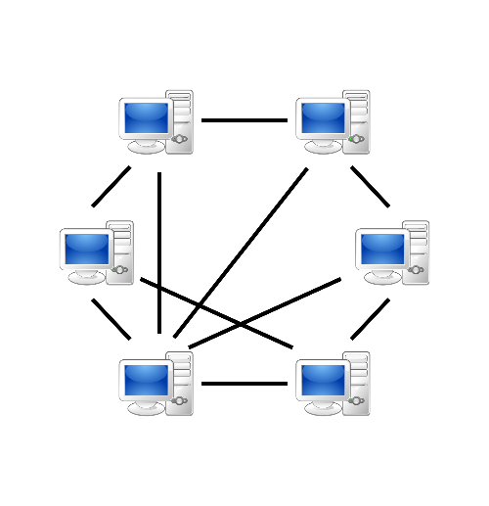

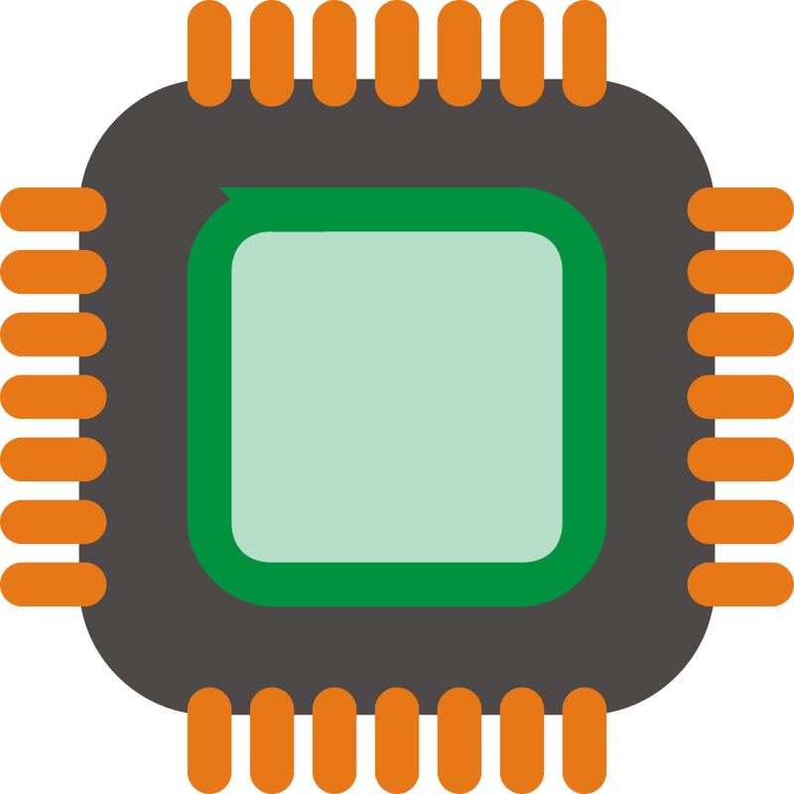
Status Quo: Bottom-up design
Legacy Switch
Switch OS
Custom requirements
network
Run-time API
Driver
The ASIC (application-specific integrated circuit)
datasheet dictates the rules!
Fixed data-plane function ASIC

Slide 6

A better approach: Top-down design
P4 switch
Switch OS
Custom requirements
Feedback
network
Run-time API
Driver
P4
User/controller dictates the rules
P4 Programmable Device

Slide 7
Protocol-Independent Switch Architecture
Programmable
Parser
Programmable Match-Action Pipeline
Programmable
Deparser
Packets
…
…
…
…
…
…
Match-Action Stage
(Unit)
P4 describes PISA’s behavior

Slide 8
P4: Goals
Protocol independence
  Programmer defines packet formats (parsing) and processing algorithms (actions).
Target independence
  Low-level hardware organization is not fixed
  Compiler compiles the program for the target device
Consistent control plane interface
  Control plane APIs are automatically generated by the compiler
Reconfigurability
  Data plane program can be changed in the field

Slide 9
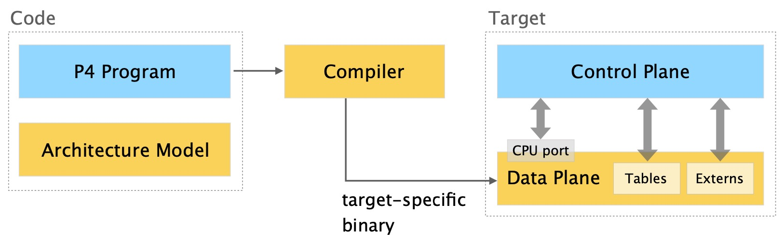
P4: Big picture

Slide 10
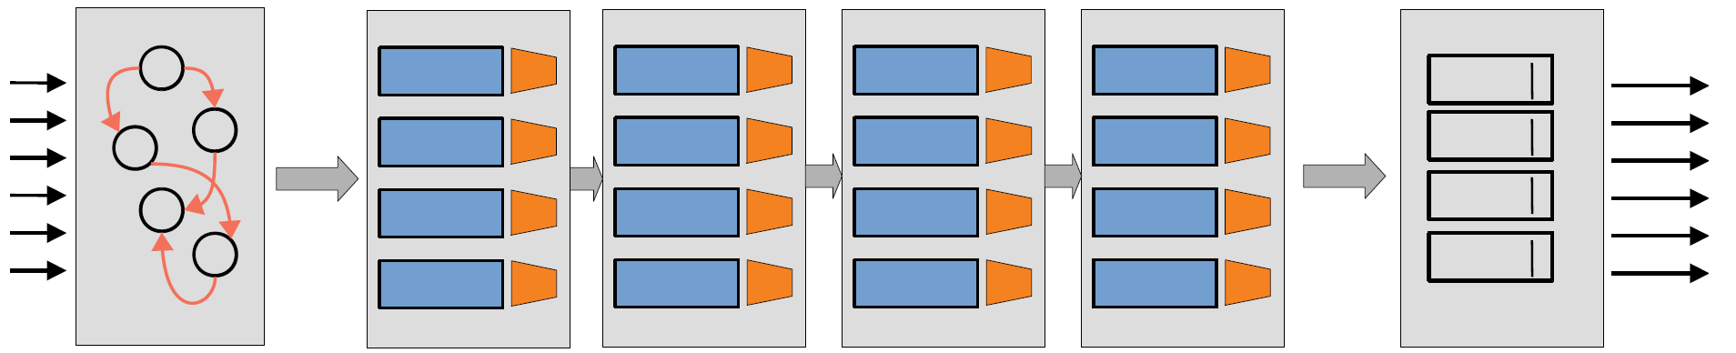
L3 Data Plane Program
IPv4
L2
ACL
(access control list)
IPv6
Programmable
Parser
Programmable Match-Action Pipeline
Programmable
Deparser
Ethernet
MAC
Address
Table
IPv4
Address
Table
IPv6
Address
Table
ACL
Rules
Match-Action
Stage (Unit)

Slide 11
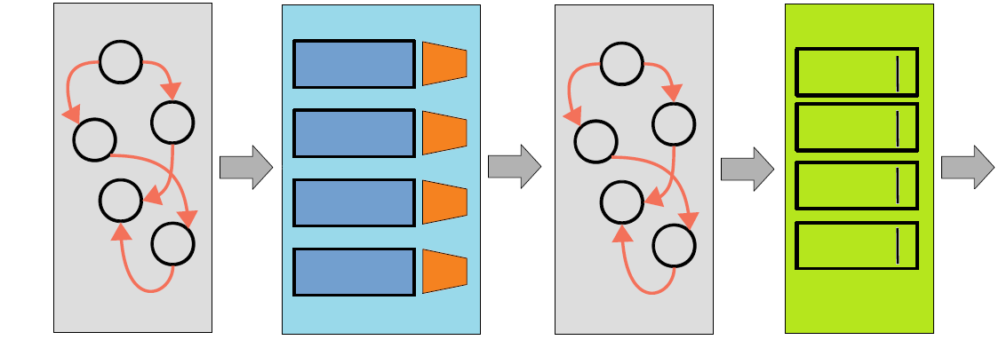
P4: Language elements
Parsers
State machine, bitfield extraction
Controls
Tables, Actions, control flow statement
Expressions
Basic operations and operators
Data Types
Bitstrings, headers, structures, arrays
Architecture
Description
Programmable blocks and their interfaces
Extern
Libraries
Support for specialized
components

Slide 12
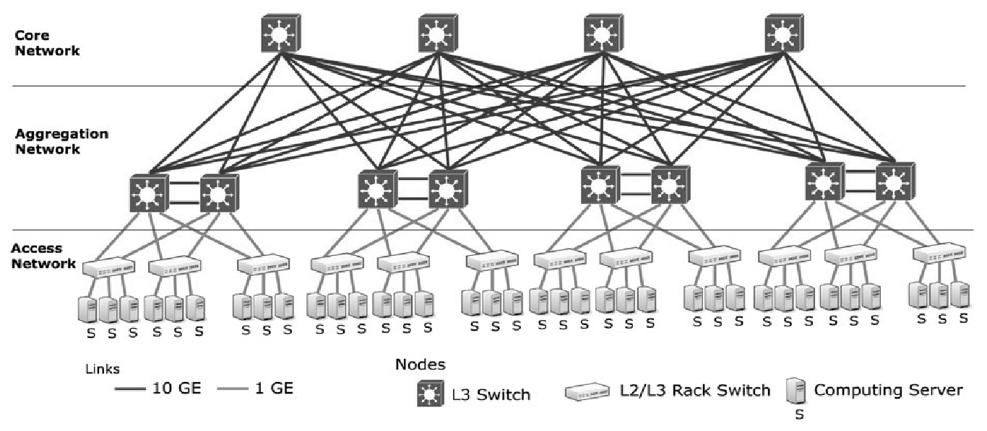
Example Program from P4 Paper
Add MPLS like tags to route packets in two-level data center “fat-tree” network
up2
down1
up1
down2
Figure from “A Comparative study of data center network architectures,” K. Bilal, S. U. Khan, J. Kolodziej, L. Zhang, S. Madani, N. M. Allah, L. Wang, and D. Chen. In Proceedings of the 26th European Conference on Modeling and Simulation, 2012.

Slide 13
P4 Program Components
Headers
  specify sequence and structures of fields
Parsers
  specify how to identify headers and header sequences
Tables
  define match fields and which actions to take
Actions
  manipulate data, allowing control plane to influence data plane
Control programs
  Determine the order in which match-action tables are applied to a packet

Slide 14
P4 Specification
Version 1.0.0 released May 22, 2017
Latest specification (Version 1.2.5, October 11, 2024):
  https://p4.org/wp-content/uploads/2024/10/P4-16-spec-v1.2.5.html
  Cheat sheet:
    https://opennetworking.org/wp-content/uploads/2020/12/p4-cheat-sheet.pdf
  Tutorial:
    https://opennetworking.org/wp-content/uploads/2020/12/P4_D2_East_2018_01_basics.pdf
P4 paper from 2014 uses different syntax
See Version 1.0.5 specification for another implementation of mTag example:
  https://p4.org/p4-spec/p4-14/v1.0.5/tex/p4.pdf

Slide 15
P4 Types
Basic Types
bit<n>: Unsigned integer (bitstring) of size n
bit is the same as bit<1> <-> bool
int<n>: Signed integer of size n (>=2)
varbit<n>: Variable-length bitstring
bit<48> macAddr;
bit<32> ip4Addr;
int<32> x;
int<32> y;
varbit<320> options

Slide 16
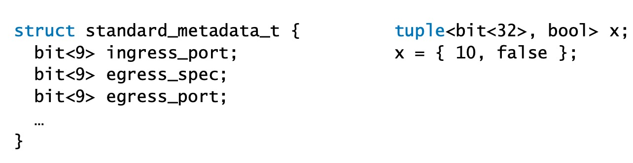
P4 Composite types
Struct
Collection of named members
Tuple
Ordered collection of unnamed members

Slide 17
P4 Headers (translated from paper)
header ethernet {
bit<48> dst_addr;
bit<48> src_addr;
bit<16> ethertype;
}
header vlan {
bit<3> pcp;
bit<1> cfi;
bit<12> vid;
bit<16> ethertype;
}
header mTag {
bit<8> up1;
bit<8> up2;
bit<8> down1;
bit<8> down2;
bit<16> ethertype;
}
Similar to a struct in C
Bonus: Hidden “validity” field
extract()
fills the header fields from the packet
If extract() is successful
validity ← true
ethernet ethertype 0x8100 or 0x9100, indicates vlan field present
vlan ethertype 0xaaaa indicates tag present

Slide 18
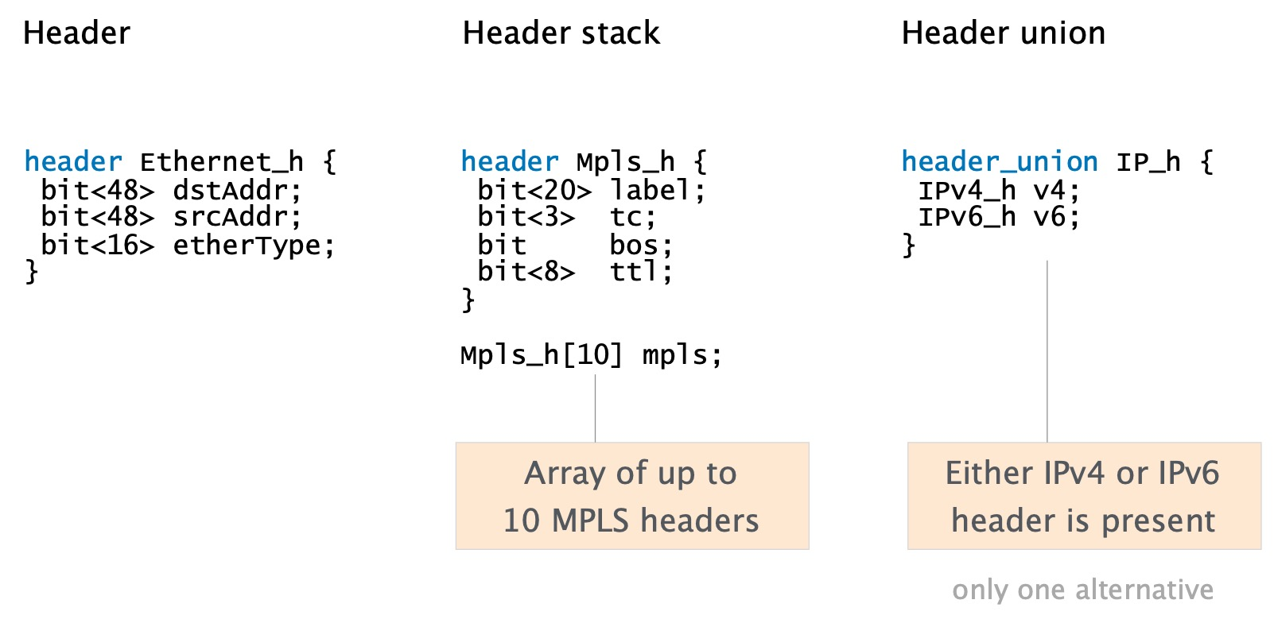
P4 Headers

Slide 19
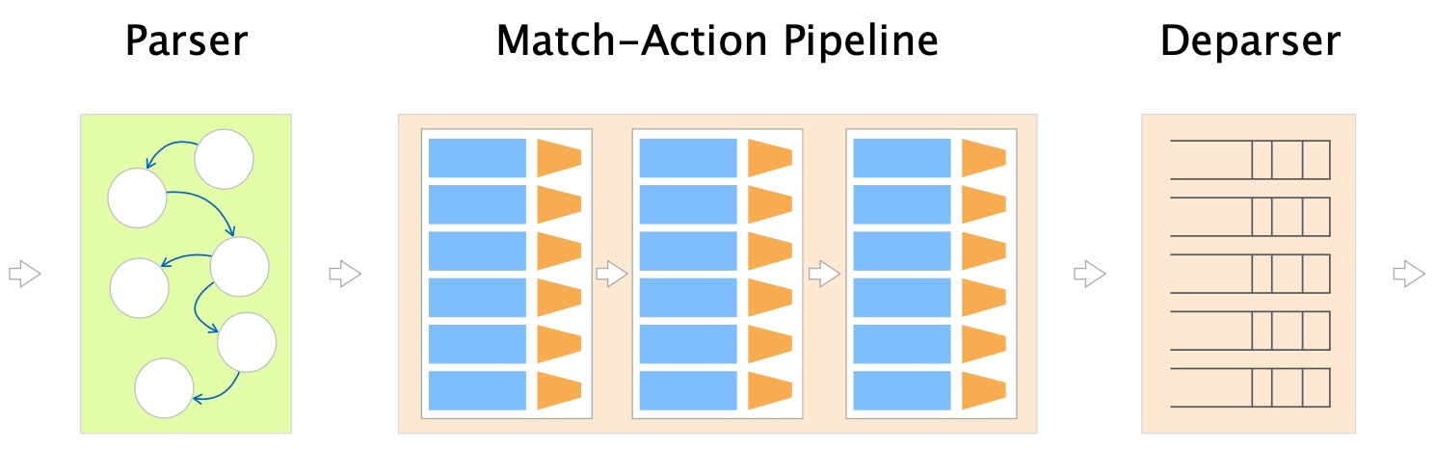
P4 Programs

Slide 20
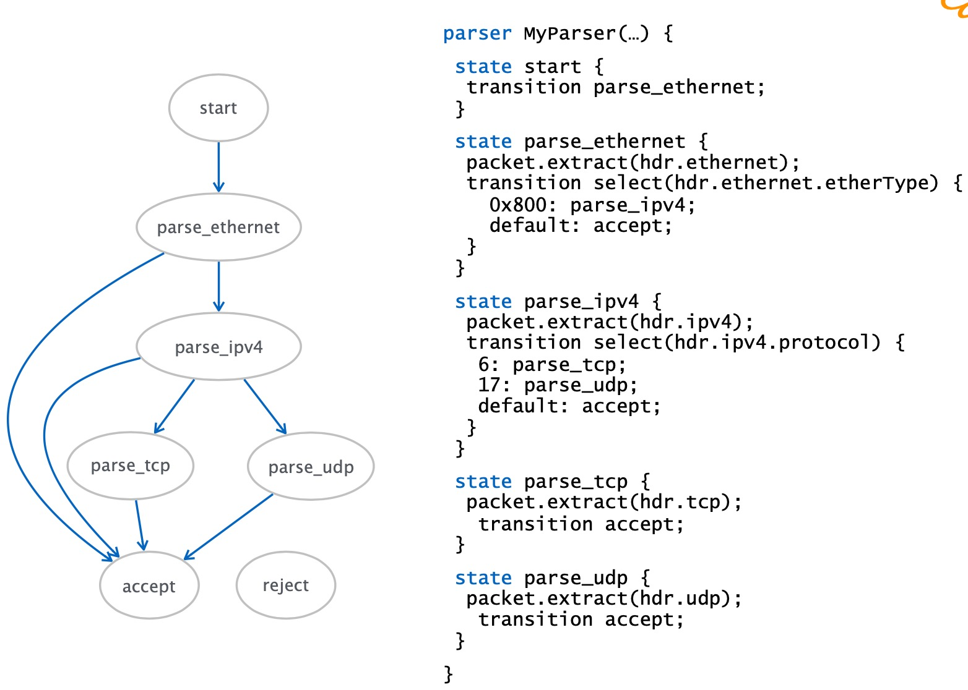
Parser uses a state machine

Slide 21
P4 Parser (translated from paper)
parser tag_parser ethernet {
state start {
transition parse_ethernet;
}
state parse_ethernet {
packet.extract(hdr.ethernet);
transition select(hdr.ethernet.ethertype) {
0x8100: parse_vlan;
0x9100: parse_vlan;
0x800: parse_ipv4;
}
}
state parse_vlan {
packet.extract(hdr.vlan);
transition select(hrd.vlan.ethertype) {
0xaaaa: parse_mTag;
0x800: parse_ipv4;
}
}
state parse_mTag {
packet_extract(hdr.mTag);
transition select(hdr.mTag.ethertype) {
0x800: parse_ipv4;
}
}
}

Slide 22
P4 Programs

Slide 23


P4 Tables
10.0.1.1
10.0.1.2
Key | Action | Action Data
10.0.1.1/32 | Ipv4_forward | dstAddr= 00:00:00:00:AB:01 port=1
10.0.1.2/32 | drop
* | NoAction

Slide 24
Match-Action Table Operation
Control Plane
Metadata
Header and
Metatdata Fields
Lookup Key
Key | Action | Action Data
Hit
Action
Code
Action
Action
Data
Hit/Miss
Selector
Data
Default
Action
Default Action
Data
Headers
&
Metadata (e.g., ingress port)
Action
Execution
Headers
&
Metadata (output)

Slide 25
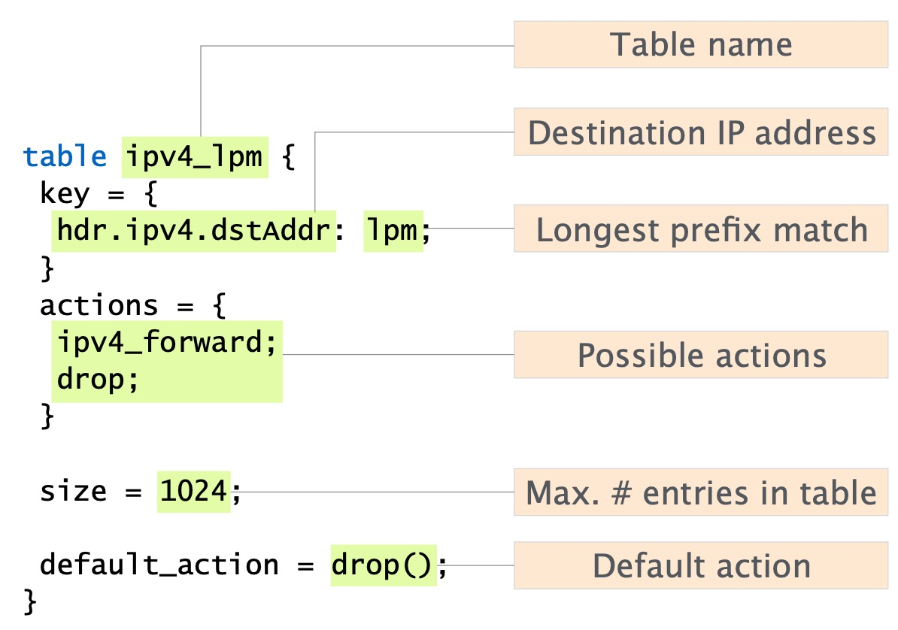
P4 Tables
exact, ternary, lpm, …

Slide 26
P4 Table (translated from paper)
table mTag_table {
key = {
ethernet.dst_addr: exact;
vlan.vid: exact;
}
actions {
// At runtime, entries are programmed with params
// for the add_mTag action.
add_mTag(params);
}
size = 20000;
}
Table established in each edge switch to add appropriate mTag to each packet (including the up1 tag that the switch itself uses).
Each table entry specifies an exact match on a specific ethernet destination and VLAN ID.
On match, the appropriate tags for reaching the destination are added to the packet.

Slide 27
P4 Action (translated from paper)
Action add_mTag(up1, up2, down1, down2) {
add_header(mTag);
// Copy VLAN ethertype to mTag
mTag.ethertype = vlan.ethertype
// Set VLAN’s ethertype to signal mTag
vlan.ethertype = 0xaaaa;
mTag.up1 = up1;
mTag.up2 = up2;
mTag.down1 = down1;
mTag.down2 = down2;
// Set the destination egress port as well
metadata.egress_spec = up1;
}

Slide 28
P4 Statements
return
exit
Control flow
  if … else …
  switch (…) { action1: { ... } action2: { …} }

Slide 29
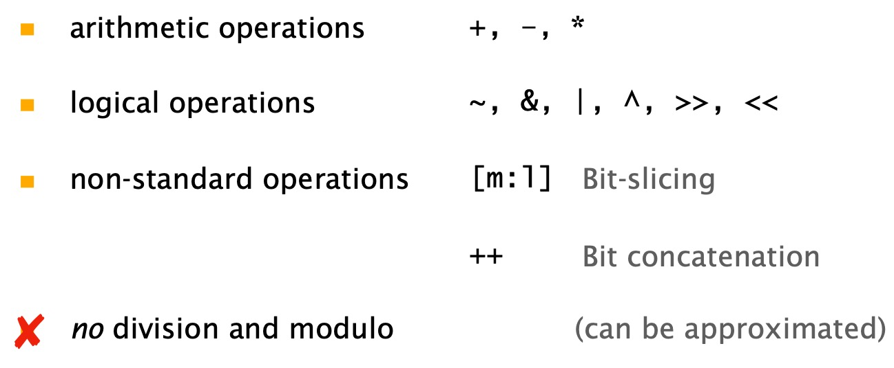
P4 Operators

Slide 30
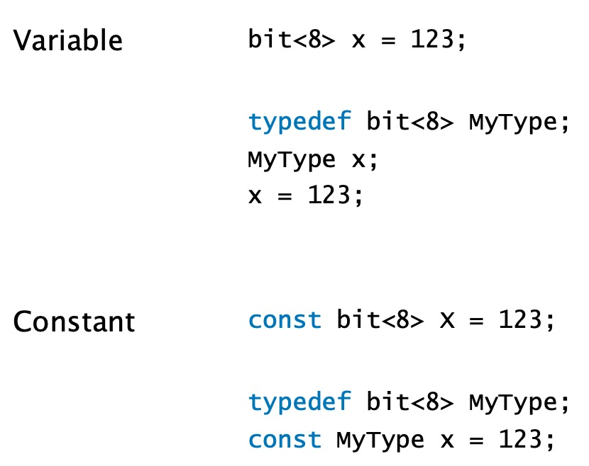
P4 Variables & Constants

Slide 31
P4 Variables
Variables cannot be used to maintain state between different network packets!
Stateful constructs?
  Tables
  Externs – architecture-dependent external objects and functions

Slide 32
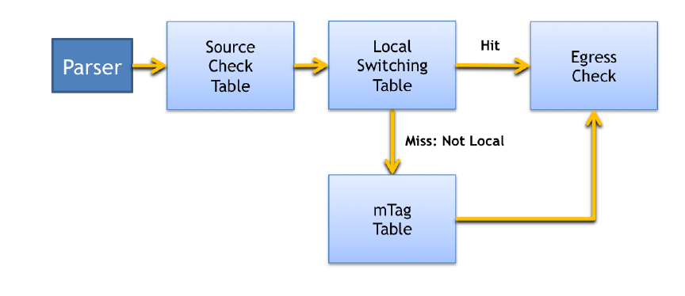
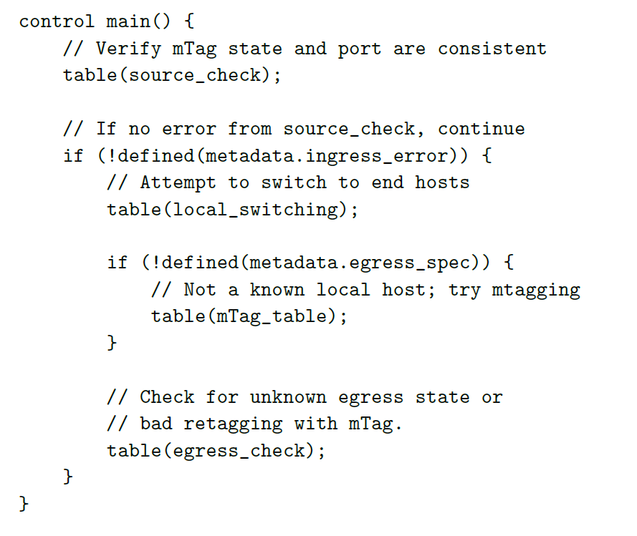
P4 Control (notation from paper)
source_check verifies that tags are only seen on ports of switches in core and aggregation levels and strips off mTag.
local_switching checks if destination is a locally connected host.
Matches in table trigger actions.

Slide 33
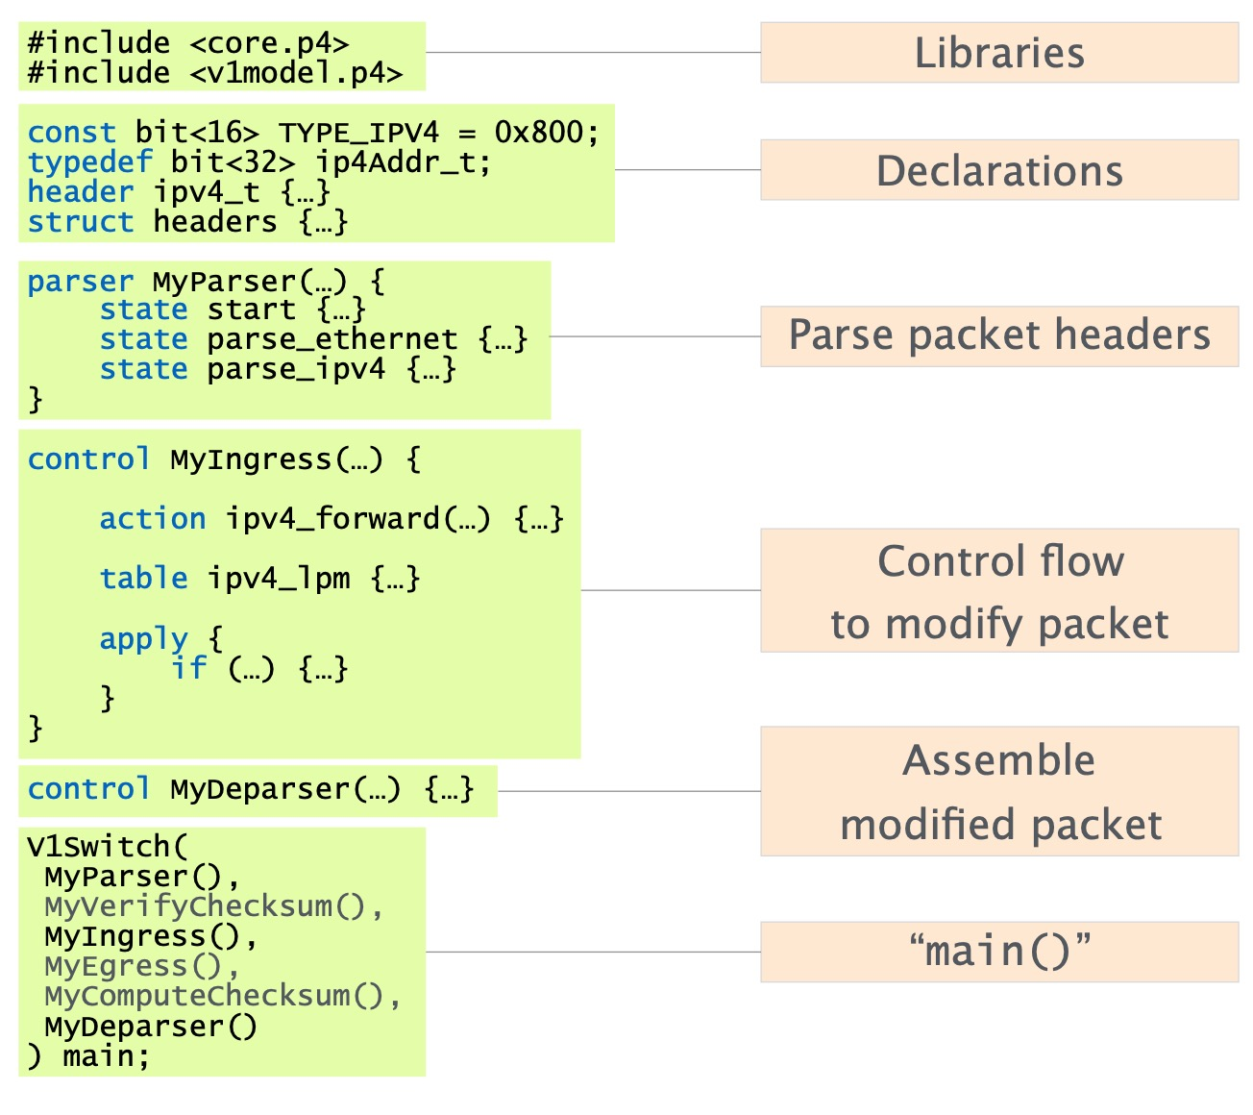
Complete P4 Program

Slide 34
P4 Programs

Slide 35
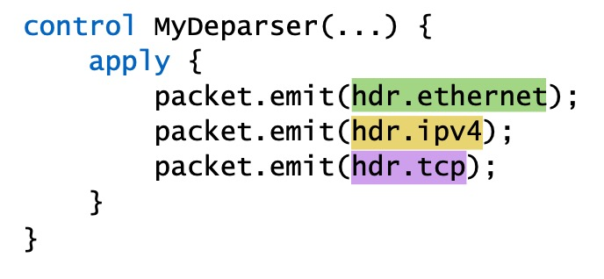
Deparser

Slide 36
Tale of a start-up
Barefoot Networks founded by Martin Izzard, Nick McKeown, Pat Bosshart, Stefanos Sidiropoulos, and Dan Lenoski
Developed “Tofino” series of P4 programmable Ethernet switch ASICS
Acquired by Intel in 2019 for an undisclosed price
In 2023 Intel announced that it was halting production of networking chips

