Slide 1
Data Center Networking
COMPSCI / ECE 356
Topology, congestion control, routing

Slide 2
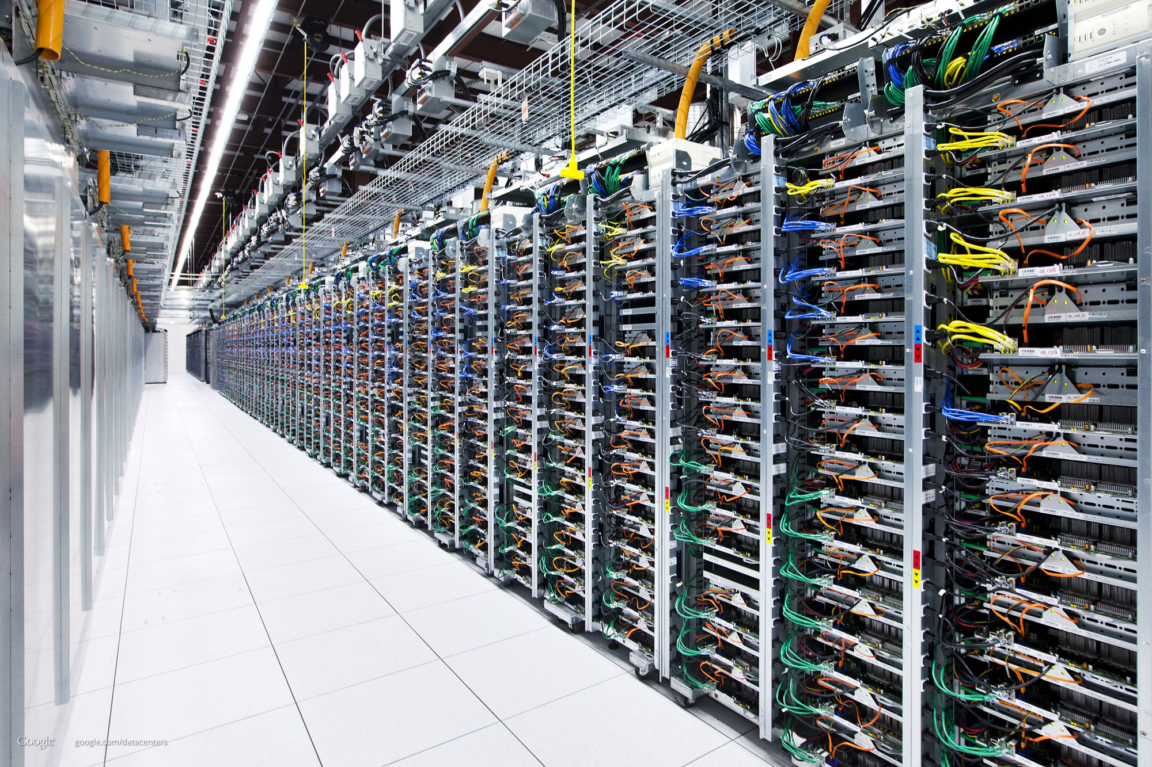
http://www.infotechlead.com/2013/03/28/gartner-data-center-spending-to-grow-3-7-to-146-billion-in-2013-8707

Slide 3
What to build?
This question has spawned a cottage industry in the computer networking research community.
“Fat-tree” [SIGCOMM 2008]
VL2 [SIGCOMM 2009, CoNEXT 2013]
DCell [SIGCOMM 2008]
BCube [SIGCOMM 2009]
Jellyfish [NSDI 2012]

Slide 4
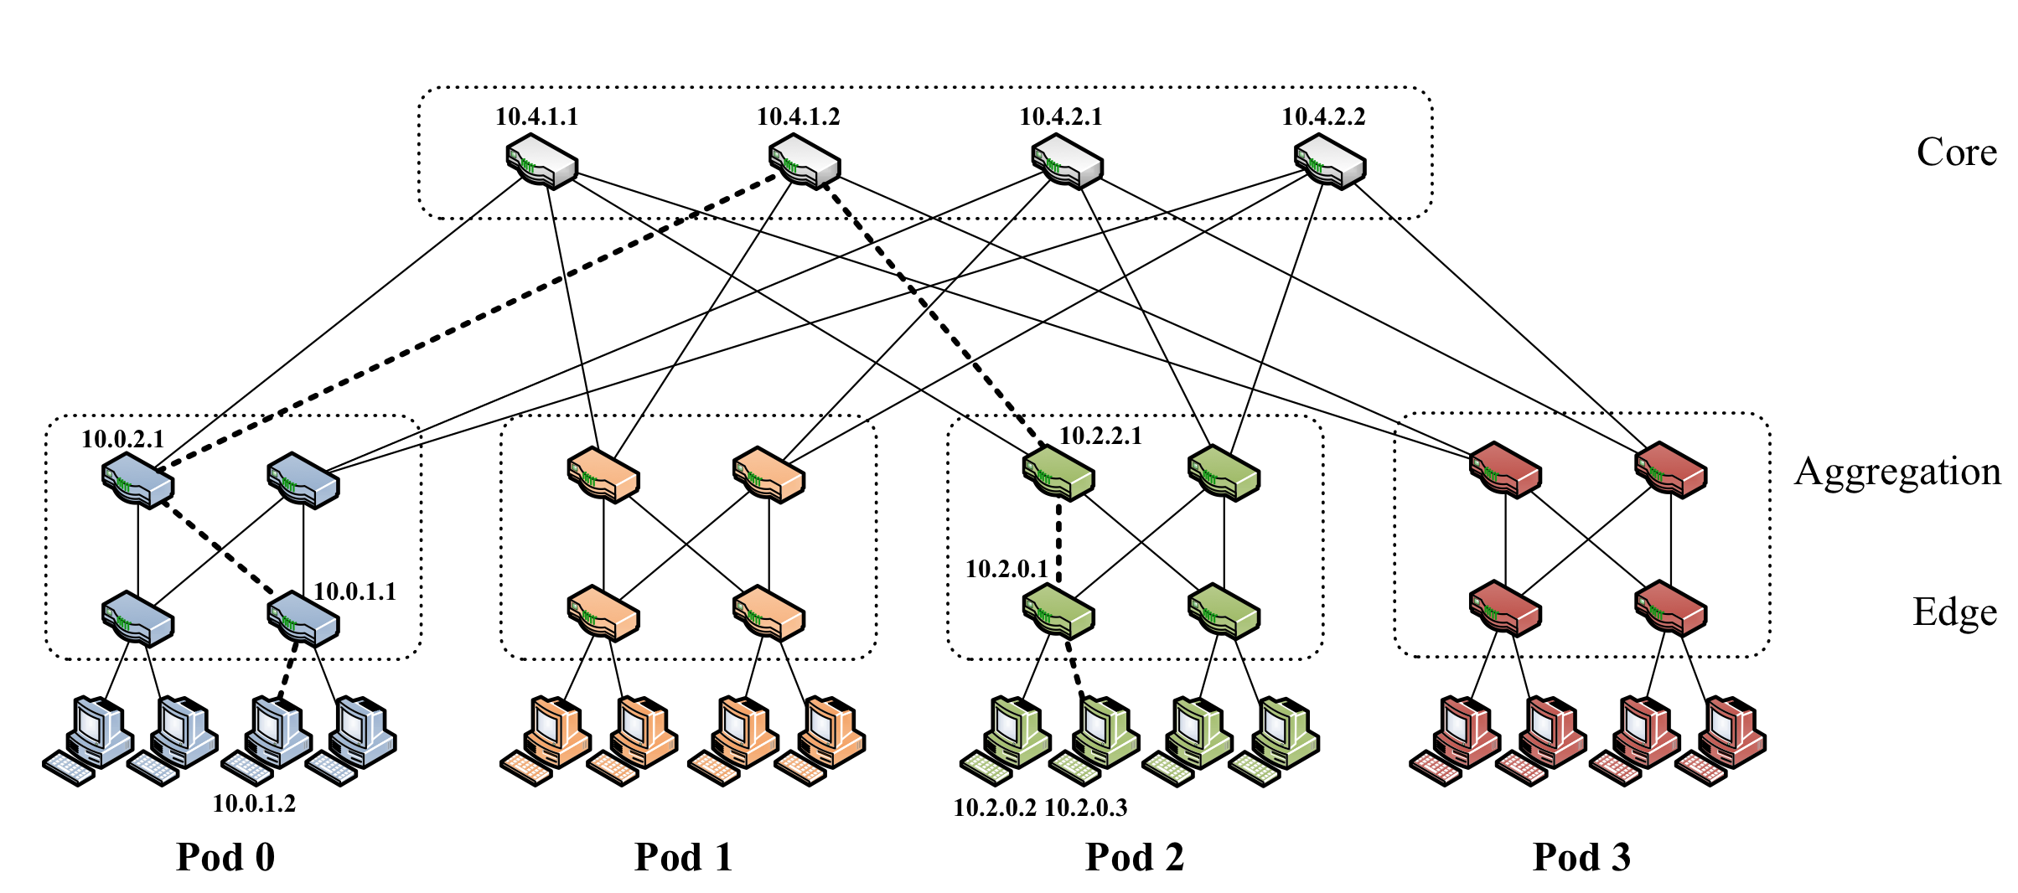
“Fat-tree” SIGCOMM 2008

Slide 5
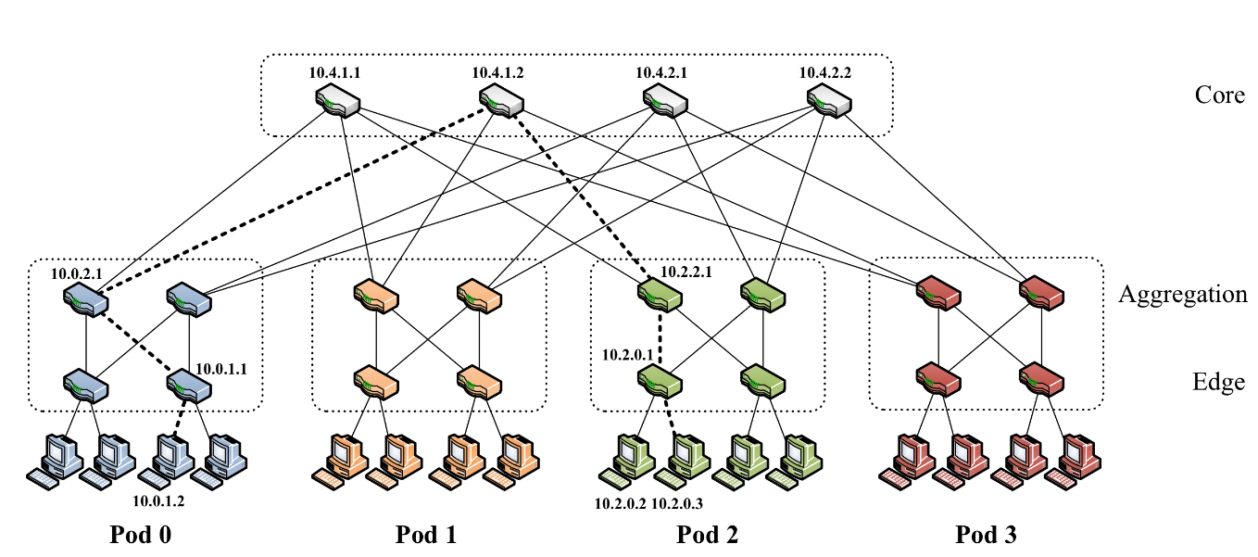
Bisection bandwidth
Minimum number of links (or link bandwidth) whose removal partitions nodes (servers) into two equal sized sets
bisection bandwidth n/2 links
; oversubscription ratio 1
Oversubscription ratio
Ratio of number of links (or link bandwidth) connecting servers to number of links at top level

Slide 6
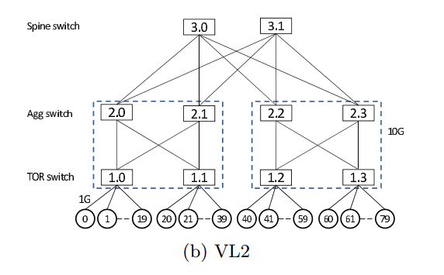
VL2 (SIGCOMM 2009, CoNEXT 2013)
called a Clos network
oversubscription ratio 1
(but 1Gbps links at leaves, 10Gbps elsewhere)

Slide 7
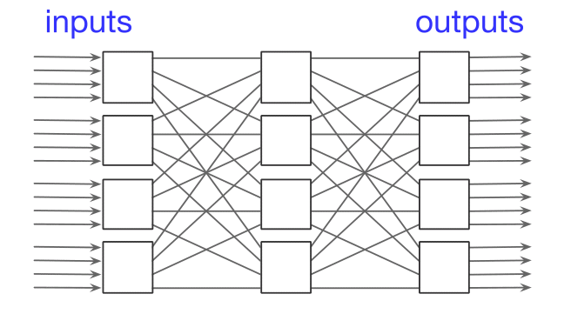
Clos Network
Source of confusion? In 2006 Bill Dally equated fat-trees with “folded-Clos” networks and cited to the 1953 paper of Clos. The Cray Black Widow was therefore a folded-Clos network.

Slide 8
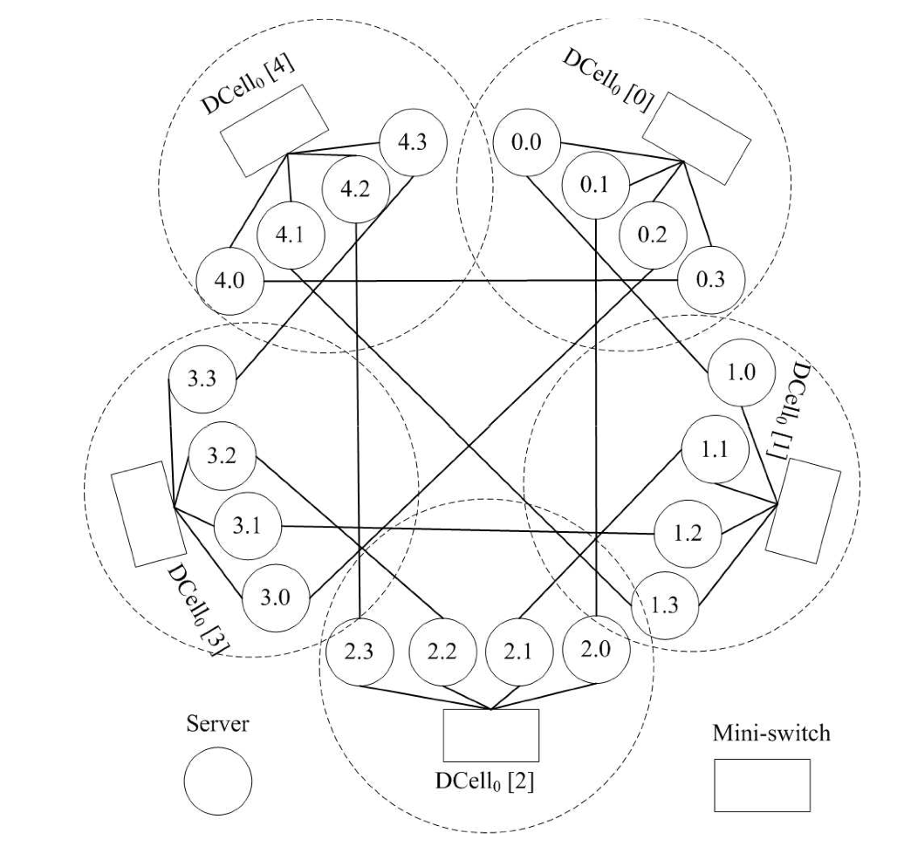
DCell (SIGCOMM 2008)
A “clique of cliques”
Servers forward packets
n servers in DCell₀
(n+1)n servers in DCell₁
(((n+1)n)+1)(n+1)n in DCell₂
oversubscription ratio 1
DCell₁ n=4

Slide 9
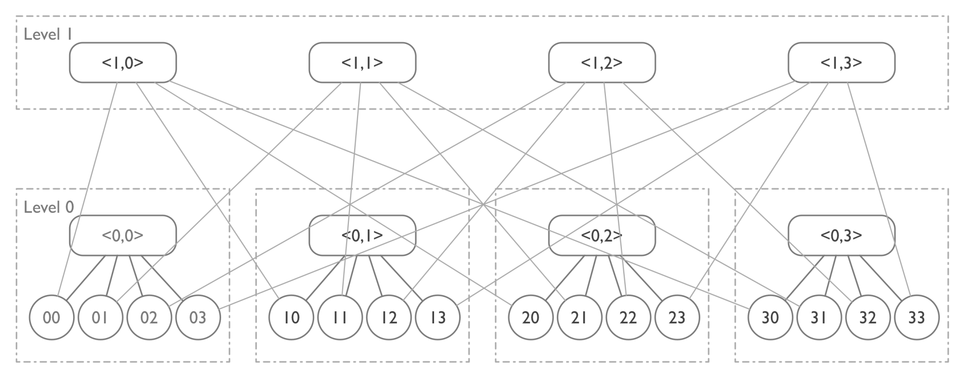
Bcube (SIGCOMM 2009)
Mesh of stars (analogous to a mesh of trees)
Bisection width between .25n and .35n

Slide 10
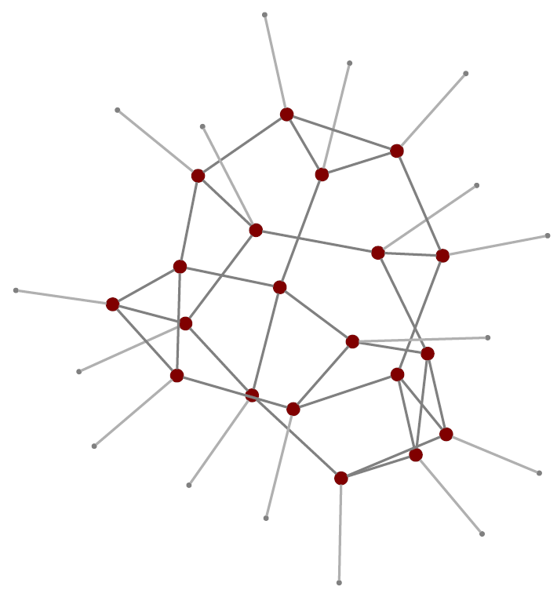
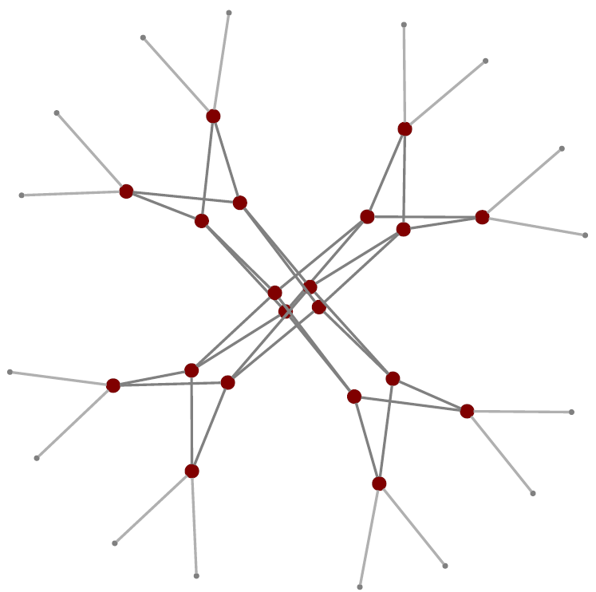
Jellyfish (NSDI 2012)
vs.
Random connections
Bisection width Θ(n)
“fat-tree” butterfly

Slide 11
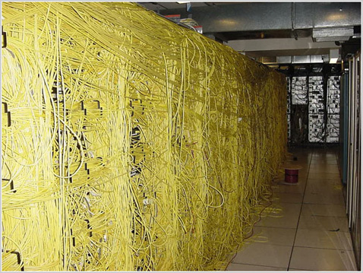
http://www.itdisasters.com/category/networking-rack/

Slide 12
How to compare networks?
Bisection width
Diameter
Maximum degree
Degree sequence
Area or volume
Fault tolerance
Cost

Slide 13
A Universal Approach
Build a single network that is competitive, for any application, with any other network that can be built at the same cost.

Slide 14
Area-Universality
Theorem [Leiserson, 1985]: There is a fat-tree network of area n that can emulate any other network that can be laid out in area n with slowdown O(log³ n).
Later improved to O(log n) slowdown
“area” can be replaced by “volume”

Slide 15
Coarse Structure of Fat-Tree Network

Slide 16
Full Butterfly Fat-Tree
Not the only fat-tree!

Slide 17
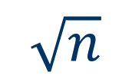
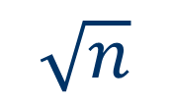
Recursive Decomposition of VLSI Layout
Idea: match fat-tree channel capacity with maximum number of wires cut in layout.
$$\sqrt{n}$$
$$\sqrt{n}$$

Slide 18
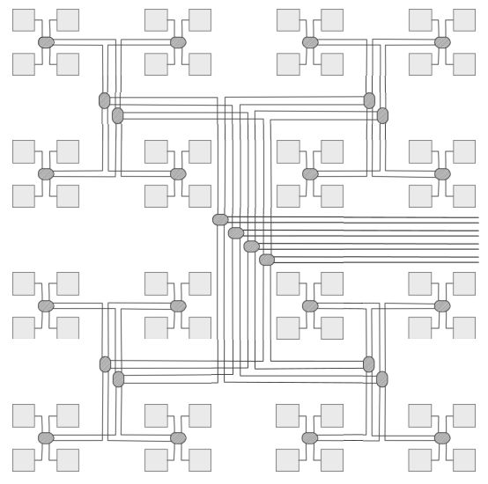
Layout of Area-Universal Fat-Tree

Slide 19
Channel with Redundant Links
“multi-fat-tree”

Slide 20
No Magic Formula
[Leiserson 1989] In practice, of course, no mathematical rule governs interconnect technology. Most networks that have been proposed for parallel processing … are inflexible when it comes to adapting their topologies to the arbitrary bandwidths provided by packaging technology… The channels of a fat-tree can be adapted to effectively utilize whatever bandwidths the technology can provide and which make engineering sense in terms of cost and performance.

Slide 21
The Universal Approach for Data Center Design
Allocate the same amount of money to each level in a three- or four-level fat-tree network.
Levels: within a rack, between racks in a row, between rows, etc.
No special-purpose network can allocate more than a factor of three or four more at any level.

Slide 22
Caveats
Assumes that performance is proportional to cost (e.g., for one-third the cost, can buy one-third the capacity)
Assumes that it is physically possible to spend the same amount at each level (Ethernet cable has diameter 0.54cm)
Assumes that bandwidth bottlenecks, not latency, limit performance.

Slide 23
Hidden Programming Costs
“Writing programs that economize on communications is difficult and expensive.’’
Therefore the oversubscription ratio should be one.
Therefore investment in bandwidth at the root should be large.

Slide 24
Costs (2015)
A switch costs approximately $125 per 10Gbps port
10Gbps Direct Attached Copper (DAC) line (5m) is $50-$100
10Gbps fiber with optical modules (20m) is around $200

Slide 25
Trends
Looked at large-scale network deployed by a major provider of on-line services.
In 2010, money spent on layers (bottom up) was 6:2:1.
In 2014, the ratio was 2:2:1.

Slide 26
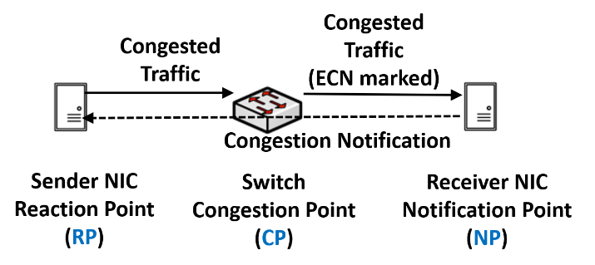
Explicit Congestion Notification (ECN)
Router or switch at congestion point (CP) probabilistically sets ECN bit in IP header to indicate congestion.
Receiver (NP) sets ECN bit in TCP header to notify sender.
Sender (RP) treats ECN bit as a packet loss
https://mentor.ieee.org/802.1/dcn/19/1-19-0081-00-ICne-roce-network-proposal.pptx

Slide 27
Data Center TCP (DCTCP)
Goal is to keep buffers as small as possible to reduce latency.
Modify ECN to mark packets whenever queue exceeds a small threshold.
Sender keeps exponential weighted average α of fraction of marked packets.
  α ← (1 − g) × α + g × F
  where g is a fixed constant, and F is fraction of recent packets that are marked
On receipt of marked packet, congestion window adjusted according to fraction
  cwnd ← cwnd × (1 − α/2)
M. Alizadeh, A. Greenberg, D. A. Maltz, J. Padhya, P. Patel, B. Prabhakar, S. Sengupta, M. Sridhara, “Data Center TCP (DCTCP)”, Proceedings of the ACM SIGCOMM 2010 Conference, August 2010.
H. Wu, J. Ju, G. Lu, C. Guo, Y. Xiong, Y. Zhang, “Tuning ECN for Data Center Networks,” Proceedings of the ACM SIGCOMM 2012 Conference, August 2012 - suggests DCTCP’s changes to ECN may not be necessary.

Slide 28
Remote Direct Memory Access (RDMA)
Server - Initiator
Server - Target
Server - Initiator
Server - Target
Buffer
Application
Application
Buffer
Buffer
Application
Application
Buffer
Buffer
Sockets
Sockets
Buffer
Buffer
Sockets
Sockets
Buffer
Buffer
Transport Protocol Driver
Transport Protocol Driver
Buffer
Buffer
Transport Protocol Driver
Transport Protocol Driver
Buffer
Buffer
NIC Driver
NIC Driver
Buffer
Buffer
NIC Driver
NIC Driver
Buffer
NIC
NIC
RNIC
RNIC
Buffer
Buffer
Buffer
Buffer
TCP/IP
RDMA
Reduces latency by bypassing TCP
Some other mechanism must provide reliable delivery!
https://mentor.ieee.org/802.1/dcn/19/1-19-0081-00-ICne-roce-network-proposal.pptx

Slide 29
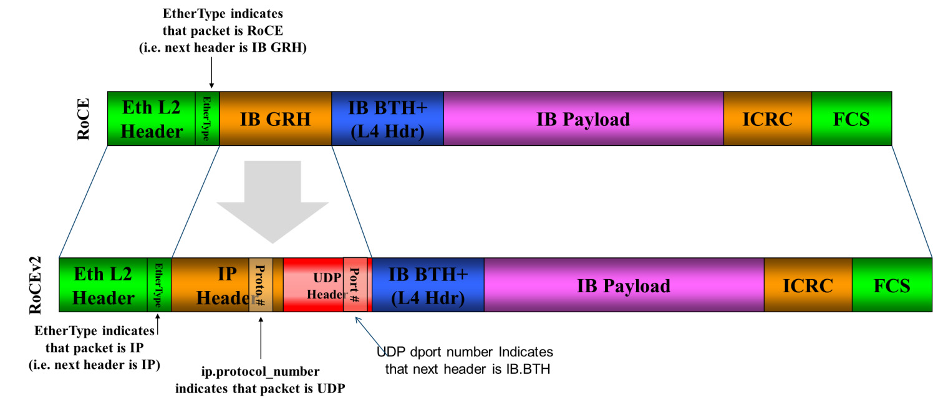
RoCE – RDMA Over Converged Ethernet
https://docs.mellanox.com/display/WINOFv550/RoCEv2?preview=/12005151/12005152/image2019-3-10_16-58-37.png

Slide 30
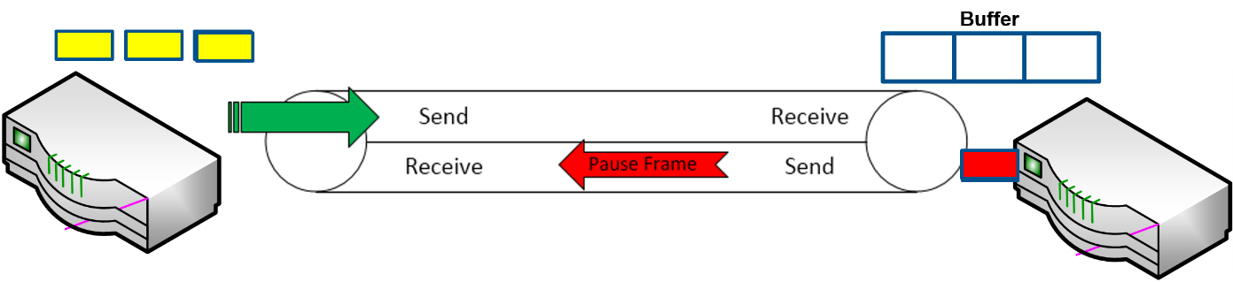
Lossless Ethernet - Priority Flow Control (PFC)
Switch with nearly full buffer sends “pause frame” to predecessor
Predecessor’s buffer may also fill up, generating a cascade of pause frames
End hosts must also implement PFC
Suitable in data center where all components are under one administration
https://docs.mellanox.com/display/WINOFv550/RoCEv2?preview=/12005151/12005152/image2019-3-10_16-58-37.png

Slide 31
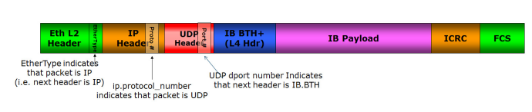
Mellanox Proposal to Employ ECN to Avoid PFC
RoCEv2 Packet Format
ECN field in IP header is used to mark congestion (same as used for TCP)
PFC + ECN
PFC + ECN
switch
NIC
Mellanox competitor Chelsio doesn’t approve of RoCE, which requires lossless networks: “it continues the science experiment”
https://www.chelsio.com/wp-content/uploads/resources/Resilient_RoCE.pdf
https://docs.mellanox.com/display/WINOFv550/RoCEv2?preview=/12005151/12005152/image2019-3-10_16-58-37.png

Slide 32
Microsoft uses BGP to Route in a Data Center
64512
64513
64514
64515
64516
64517
64518
64519
64520
64521
64522
64523
Each router has a distinct (private) AS number
Up-Down paths have shortest AS Path attribute
In the event of failure, BGP selects alternate paths

Slide 33
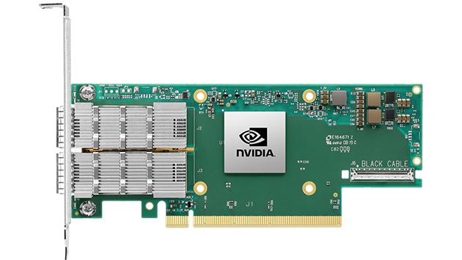
SmartNICs
https://www.nvidia.com/en-sg/networking/ethernet/connectx-6/
Idea: offload network functionality to the network interface card (NIC)
TCP/IP stack
Encryption / decryption (e.g., TLS)
Data compression / decompression
Firewall
Telemetry (collect traffic statistics)
Provide direct access to storage/memory
Etc.

